Slide 1
Master Thesis (Software Technology)
Concepts and Implementation of the AllJoyn Bridge for the EnOcean Protocol
Presenter:
Baloch Zahoor Ahmed
Matriculation Nr: 753437

Slide 2
Goals
The participants should be able to …
Understand the Idea behind Thesis topic
Understand the technologies used in Thesis topic
Understand the Design and implementation of Prototype
Understand the Result
1

Slide 3
Outline
Introduction
Digital Concepts
EnOcean Technology
Internet of Things
Motivation for the Thesis
Technologies
AllJoyn Framework
Smart EnOcean Gateway
AllJoyn Device System Bridge
Tools
Design and Implementation
EnOcean DSB Design
EnOcean DSB Implementation
Conclusion
Demo
2

Slide 4



Introduction
Digital Concepts
EnOcean Technology
Battery-less
Wireless
3

Slide 5

Introduction
Internet of Things
4.9 billion IoT devices by 2015
30 percentage more by 2016
20 billion IoT devices expected by 2020
IoT Standards
http://www.gartner.com/newsroom/id/3165317
4

Slide 6
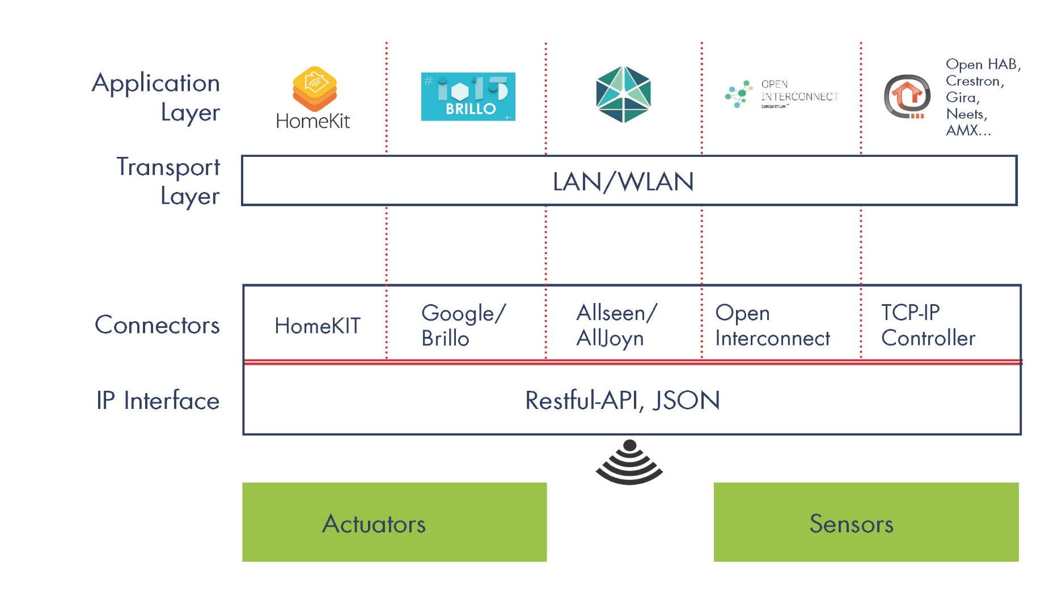
Introduction
Motivation:
http://enocean-gateway.eu/images/documents/Documentation/index.html?funcionality_purpose-of-the-ga.html
5

Slide 7
AllJoyn
Introduction
Open source Framework
Developed in 2011 by Qualcomm
Now led by the Linux Foundation
Allseen Alliance has more then 200 members
Features
Easy Devices Discover and Communication
Enables Proximity P2P Networking
Publish API
6

Slide 8
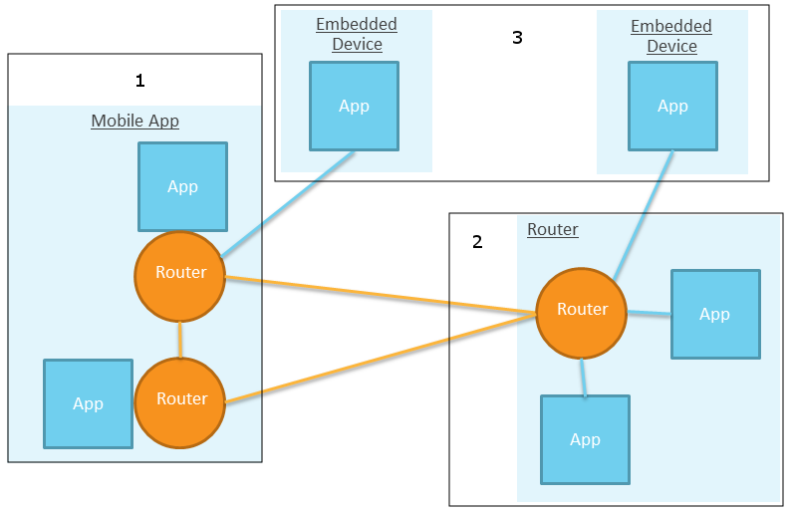
AllJoyn
AllJoyn Network Architecture
AllJoyn Router
AllJoyn App
https://allseenalliance.org/framework/documentation/learn/architecture
7

Slide 9
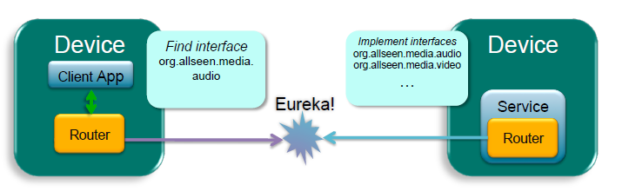
AllJoyn
AllJoyn Communication
Advertisement
About Announcement
Brian Spencer. “AllJoyn Framework System Overview". 2014. Presentation.
8

Slide 10
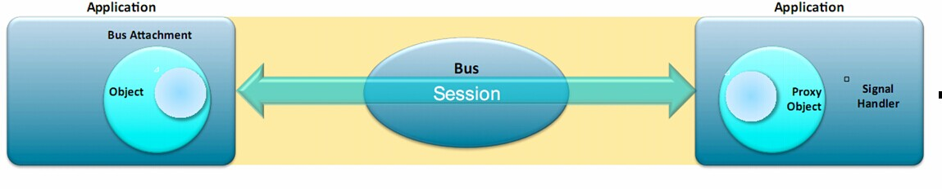
AllJoyn
AllJoyn Bus
Distributed Software Bus
Bus Attachment
Bus Object
http://images.cnitblog.com/i/603253/201408/161616027339802.jpg
9

Slide 11
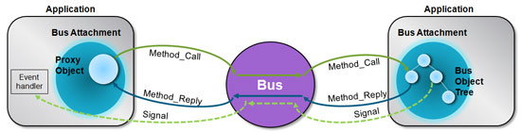
AllJoyn
AllJoyn Interface Members
Actions
Events
Properties
https://developer.qualcomm.com/sites/default/files/alljoyn-blog-pic1.jpg
10

Slide 12
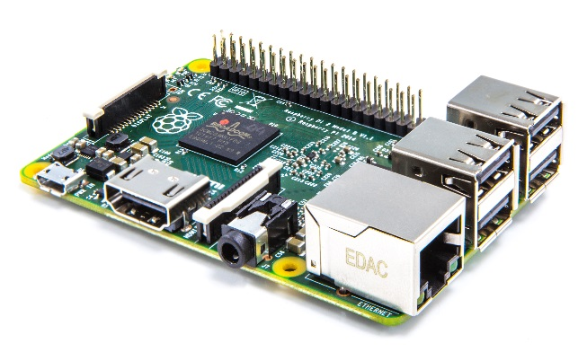
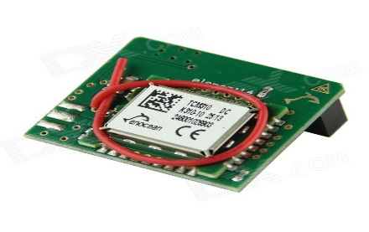
Smart EnOcean Gateway
Hardware
Raspberry Pi 2 model b
EnOcean Pi
https://www.raspberrypi.org/wp-content/uploads/2015/01/Pi2ModB1GB_-comp.jpeg
http://img.dxcdn.com/productimages/sku_351832_1.jpg
11

Slide 13
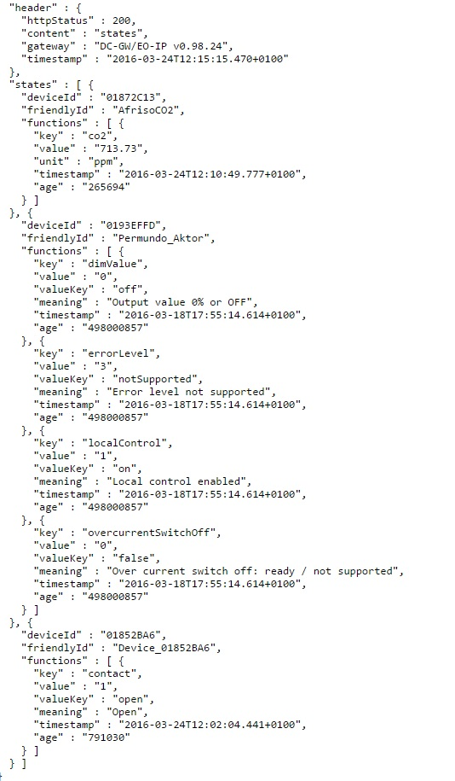
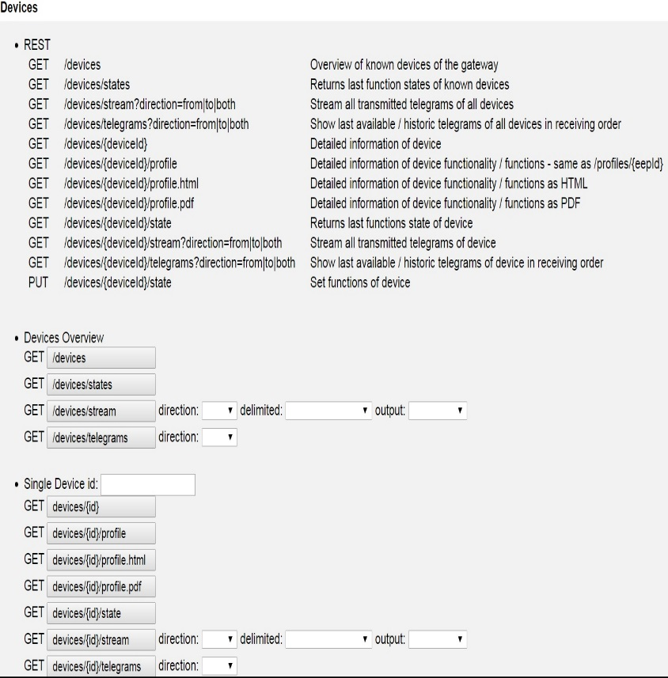

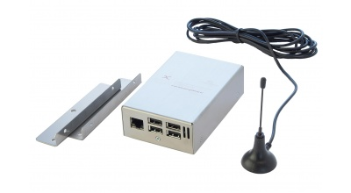
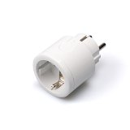
Smart EnOcean Gateway
Software
REST API
Streaming API
12

Slide 14
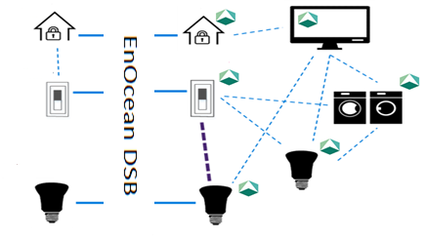
AllJoyn Device System Bridge
Purpose
13

Slide 15
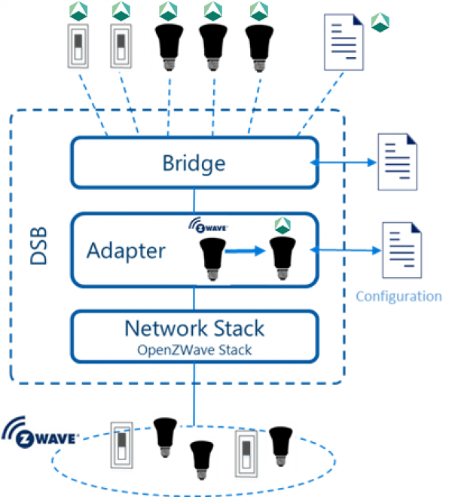
AllJoyn DSB
Architecture
14

Slide 16
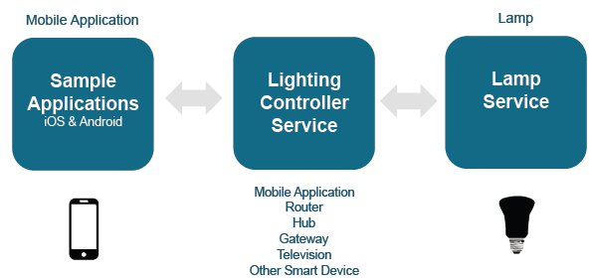
AllJoyn DSB
Lighting Service Framework
Brian Vogelsang and Marc Alexander. "Connect Lighting Working Group". 2014. Presentation.
15

Slide 17
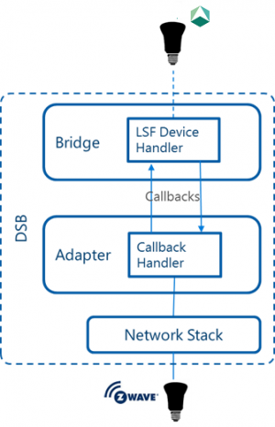
AllJoyn DSB
Service Framework Handler
16

Slide 18
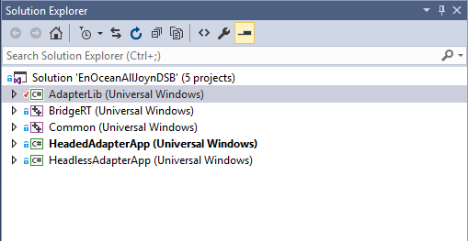
Tools
Windows 10
Visual Studio 2015
AllJoyn DSB Template
17

Slide 19
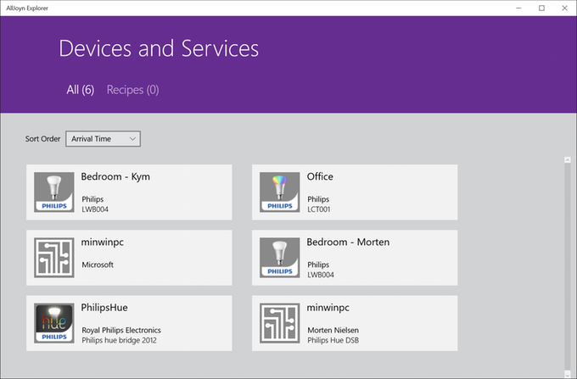
Tools
AllJoyn Explorer
https://hackster.imgix.net/uploads/image/file/93214/7.PNG?w=680&h=510&fit=max
18

Slide 20
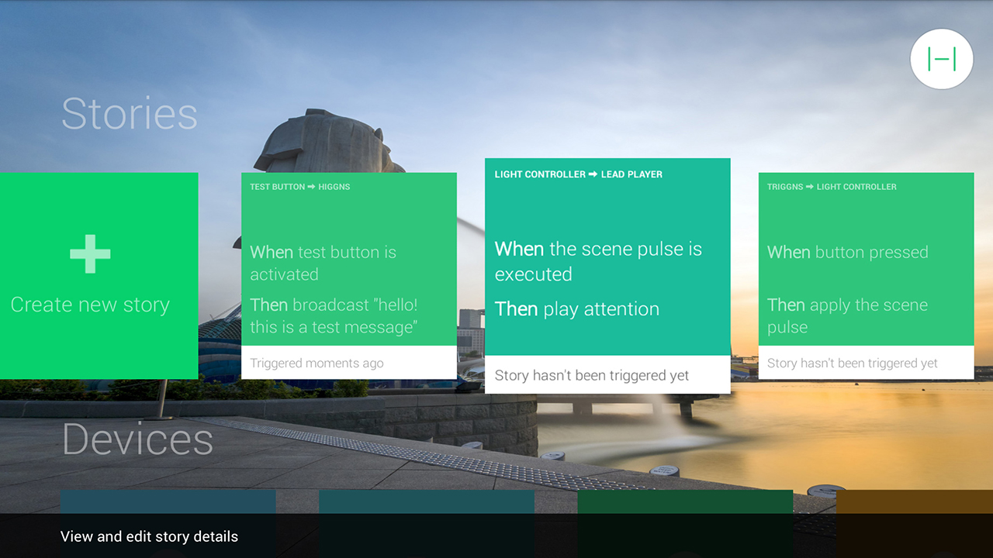
Tools
Higgns
http://ecx.images-amazon.com/images/I/8194KAhGD7L.jpg
19

Slide 21
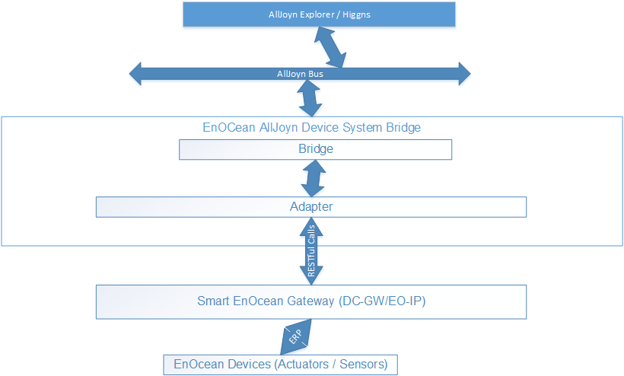
EnOcean DSB Design
Overall System Communication
20

Slide 22
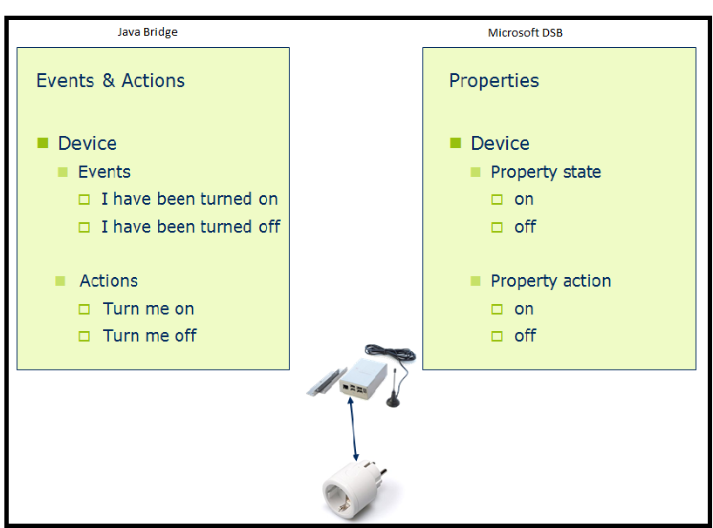
EnOcean DSB Design
Possible Architectures
21

Slide 23
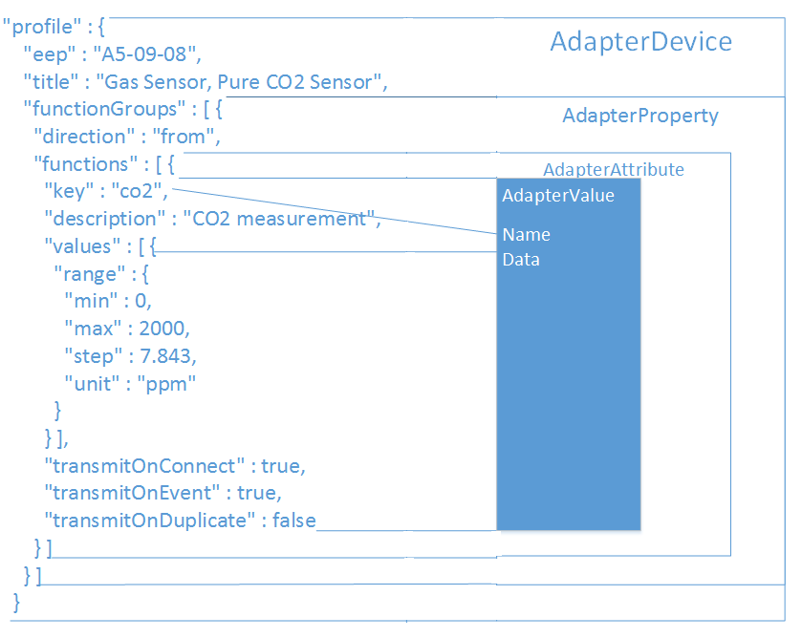
EnOcean DSB Design
EnOcean Profile Mapping
22

Slide 24
EnOcean DSB Design
Use cases
23

Slide 25
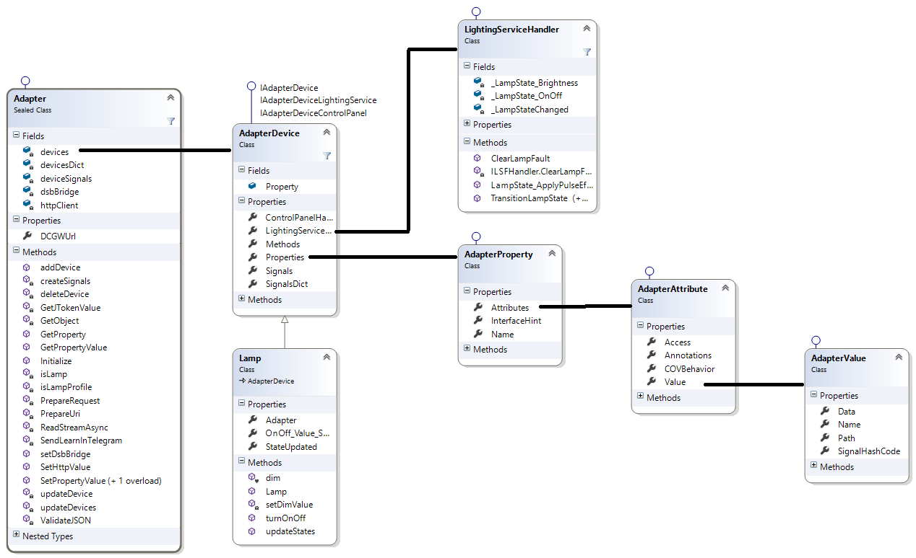
EO DSB Implementation
EnOcean DSB Classes
24

Slide 26
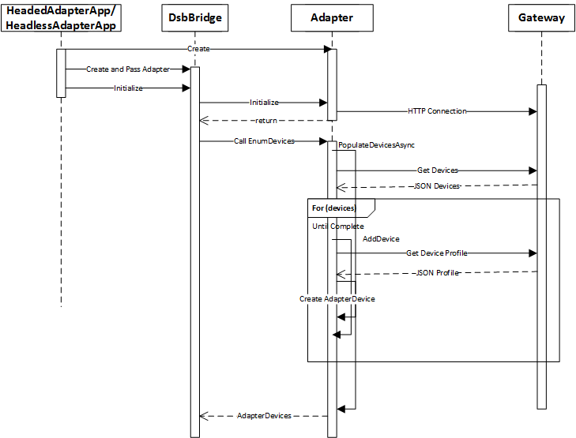
EO DSB Implementation
EO Device Discovery and Virtual AllJoyn Representation
25

Slide 27
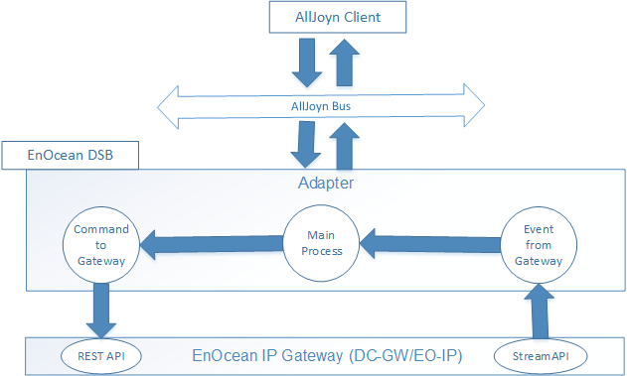
EO DSB Implementation
Handling Communication between AllJoyn Client and Gateway
26

Slide 28
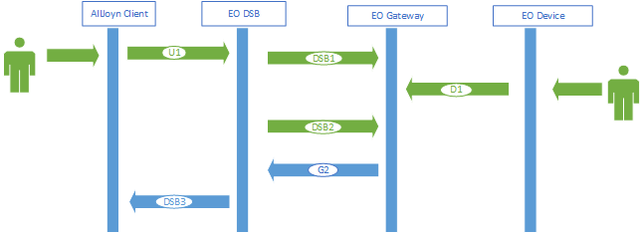
EO DSB Implementation
Learn-in Process
27

Slide 29
Conclusion
EnOcean DSB
Limitations
Future Work
AllJoyn Home DSB
Common Interfaces
Update
28

Slide 30
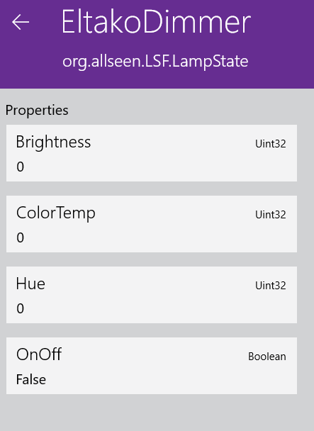
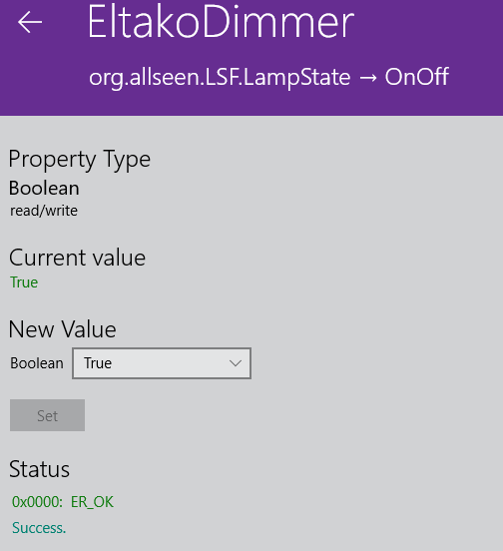
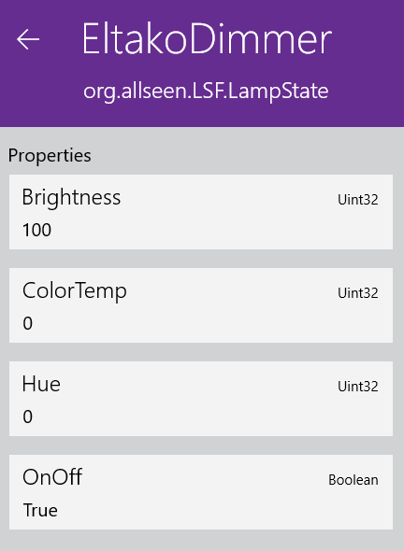
Demo
29

Slide 31
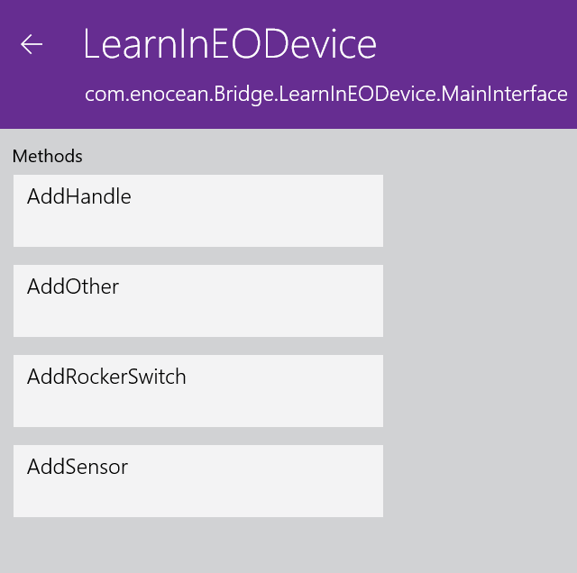
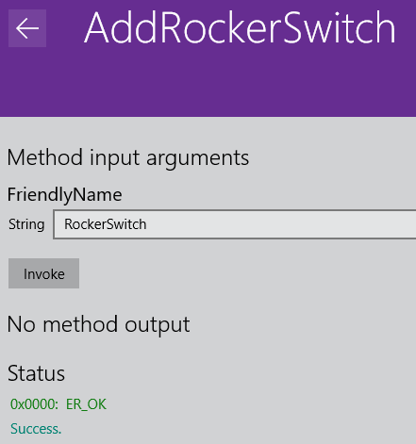
Demo
30

Slide 32
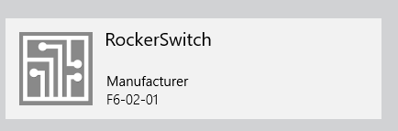
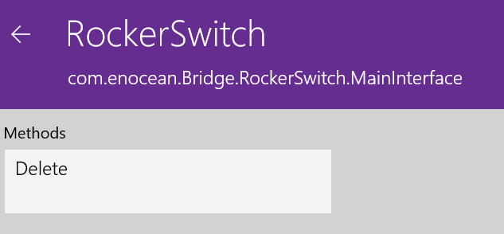
Demo
31

Slide 33
References
https://wiki.allseenalliance.org/gateway/dsb
32

Slide 34
QUESTIONS ??

