Slide 1
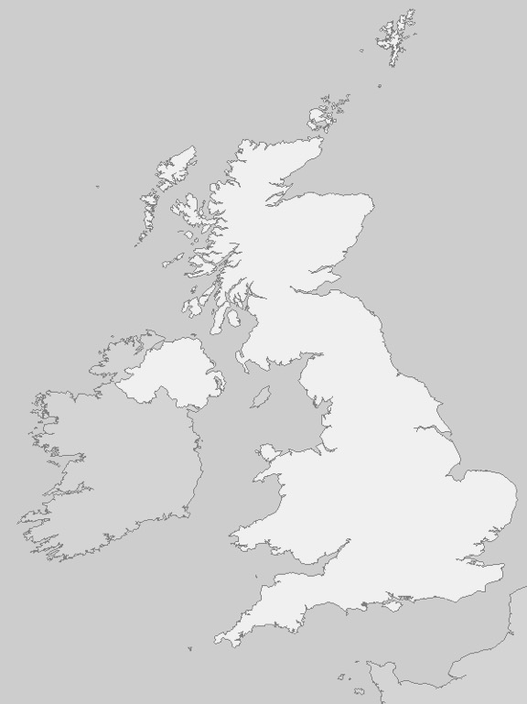

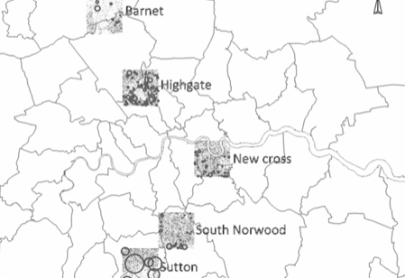
84% of addresses are in England and Wales
14% in London
~113km2 area (2%)
3,982 “named roads”
35m addresses

Slide 2
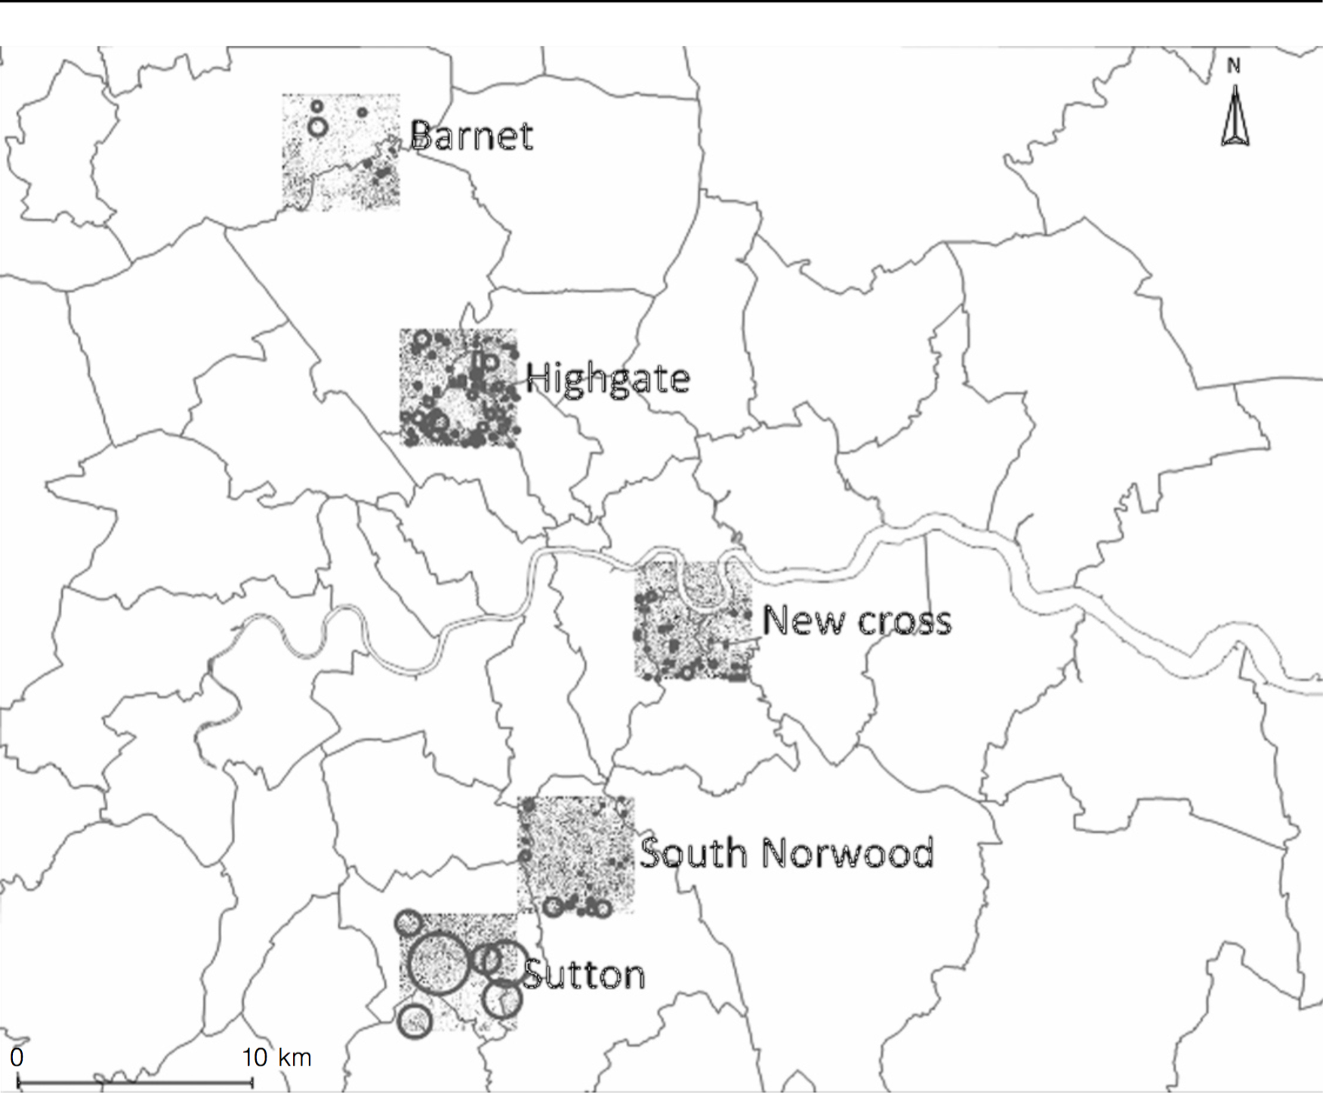

Slide 3
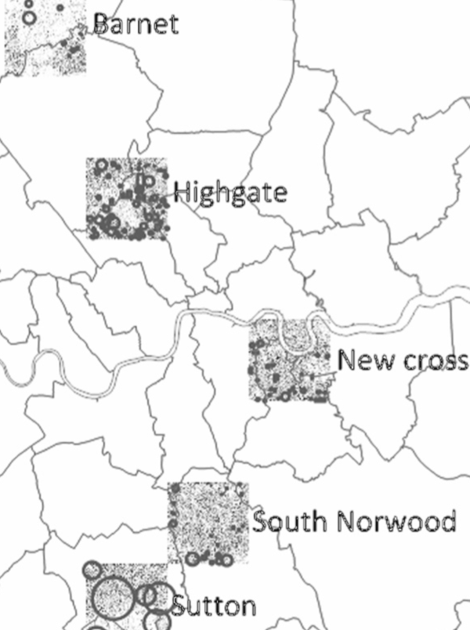
98% of addresses include a house number
82% of streets are referenced in LRPP
74% of the streets qualify for house number inference
111k house numbers are in LRPP
113k house numbers can be inferred
Not known and not suitable for inference

Slide 4
p1: Create a list of all existing house numbers for each road listed in OSON
OLAF
p2: Create a list of all existing house names for each road listed in OSON
p3: Create a list of the associations between each of the house numbers and names above and the list of postcodes in OSON

Slide 5
p1.1: Identify the list of house numbers in each OSON road through references in other open data
p1: Create a list of all existing house numbers for each road listed in OSON
OLAF
p2: Create a list of all existing house names for each road listed in OSON
p1.2: Statistically infer the existence of house numbers from the house numbers collected at p1.1
p3: Create a list of the associations between each of the house numbers and names above and the list of postcodes in OSON
p1.3: Correct the output of p1.2
p1.4: Enable the further application of p1.2 by creating the necessary data through crowdsourcing
Greyed-out boxes indicate processes that are not developed in this document

Slide 6
Other OLAF creation processes
Reference data
OSON
Known house numbers
Inference data
Inference
LRPP
Streets for which data is missing
Prioritisation / filtering
Augmentation with elements to support crowdsourcing
Fail
Crowdflower
Results collection and aggregation
OSOR
Success

Slide 7
Computation of additional data (e.g. inference)
Ingestion of primary data sources
[data is missing that cannot be produced but through human contribution]
[collection was not successful]
[no stop condition
is verified]
Preparation and augmentation for crowdsourcing
Crowd sourcing
Assessment of collected data
[collection was successful]
[any stop condition
is verified]
[no data
is missing]

Slide 8
p1.2: Statistically infer the existence of house numbers from the house numbers collected at p1.1
Inference
Ingestion of primary data sources
[collection was not successful]
[no stop condition
is verified]
[roads lack house number data]
p1.1: Identify the list of house numbers in each OSON road through references in other open data
Preparation and augmentation for crowdsourcing
Data collection in CrowdFlower
Assessment of collected data
[collection was successful]
[any stop condition
is verified]
[no road lacks house number data]
p1.4: Enable the further application of p1.2 by creating the necessary data through crowdsourcing

