Slide 1
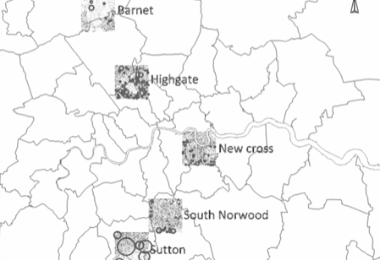

Geographic scope
~113km2 area (2%)
4,401 “named roads”
14,088 postcodes
84% of addresses are in England and Wales
14% in London
35m addresses

Slide 2
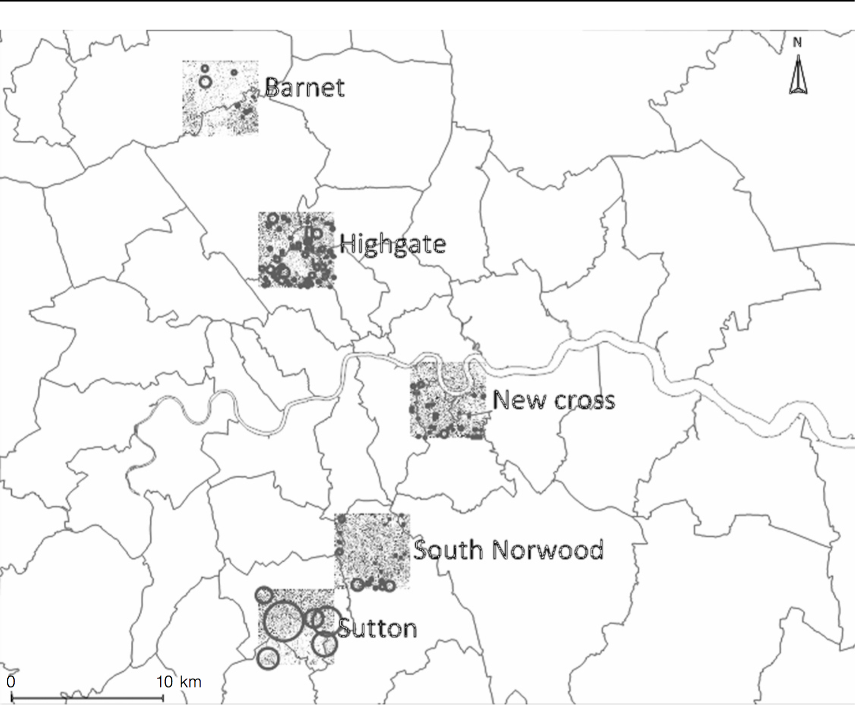

Slide 3
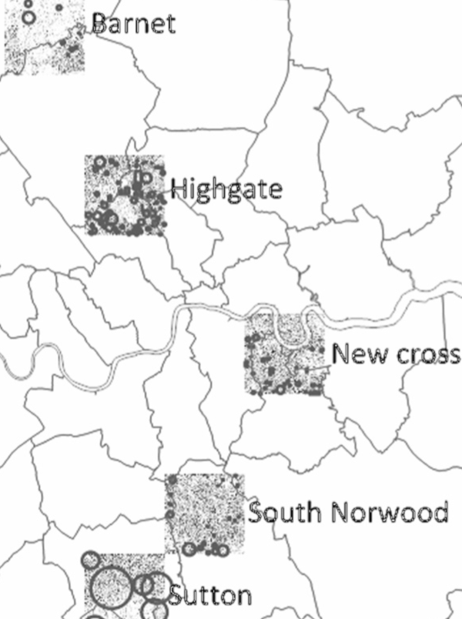
98% of addresses include a house number
82% of streets are referenced in Land Registry’s “Price Paid Data” (LRPP)
74% of the streets qualify for house number inference
111k house numbers are in LRPP
113k house numbers can be inferred
?
Not known and not suitable for inference

Slide 4
p1: Create a list of all existing house numbers for each road listed in OSON
OLAF
p2: Create a list of all existing house names for each road listed in OSON
p3: Create a list of the associations between each of the house numbers and names above and the list of postcodes in OSON

Slide 5
p1.1: Identify the list of house numbers in each OSON road through references in other open data
p1: Create a list of all existing house numbers for each road listed in OSON
OLAF
p1.2: Statistically infer the existence of house numbers from the house numbers collected at p1.1
p2: Create a list of all existing house names for each road listed in OSON
p3: Create a list of the associations between each of the house numbers and names above and the list of postcodes in OSON
p1.3: Correct the output of p1.2
p1.4: Enable the further application of p1.2 by creating the necessary data through crowdsourcing

Slide 6
Other OLAF creation processes
Reference data
OSON
Known house numbers
Inference data
Inference
LRPP
Streets for which data is missing
Fail
Augmentation with elements to support crowdsourcing
Crowdflower
Results collection and aggregation
Success
OSOR

