Slide 1
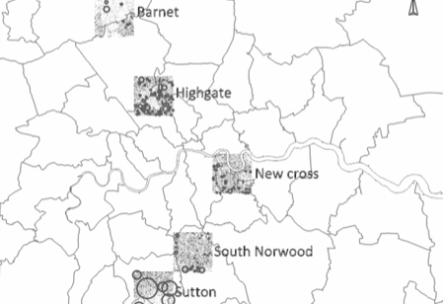

Geographic scope
~113km2 area (2%)
4,401 “named roads”
14,088 postcodes
84% of addresses are in England and Wales
14% in London
35m addresses

Slide 2
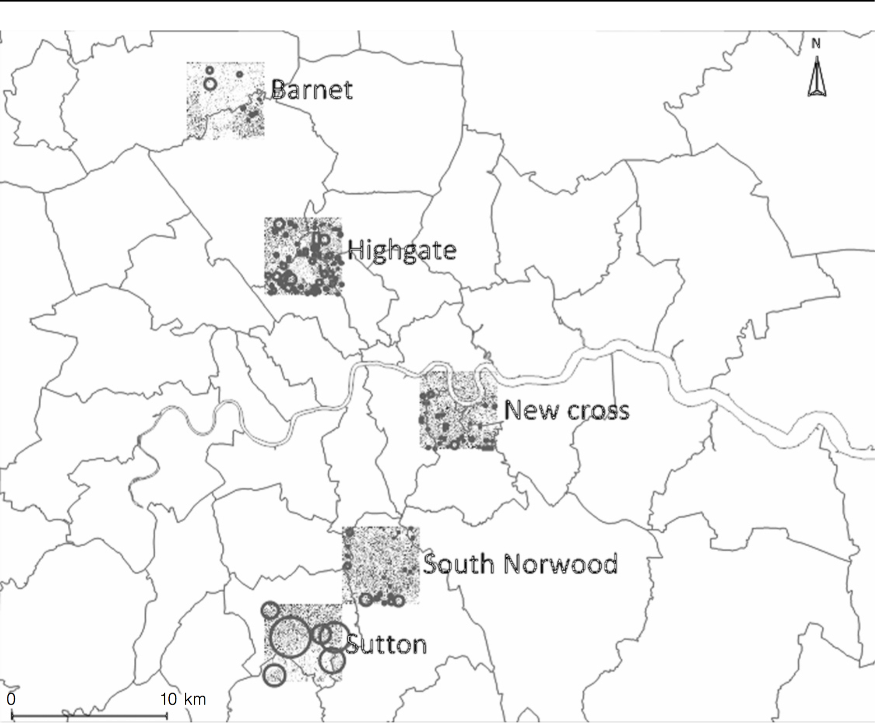

Slide 3
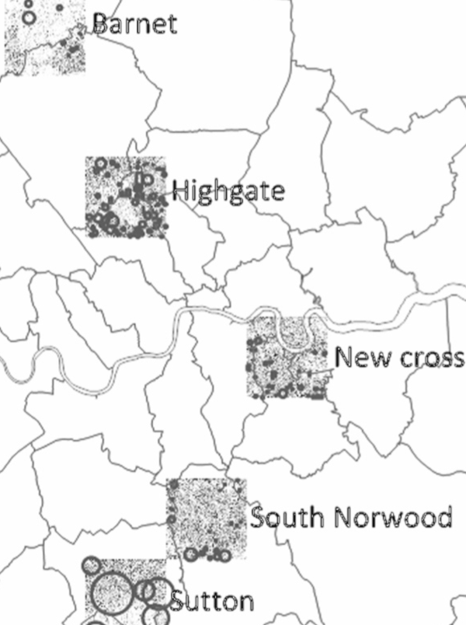
98% of addresses include a house number
82% of streets are referenced in Land Registry’s “Price Paid Data” (LRPP)
74% of the streets qualify for house number inference
111k house numbers are in LRPP
113k house numbers can be inferred
?
Not known and not suitable for inference

