Slide 1
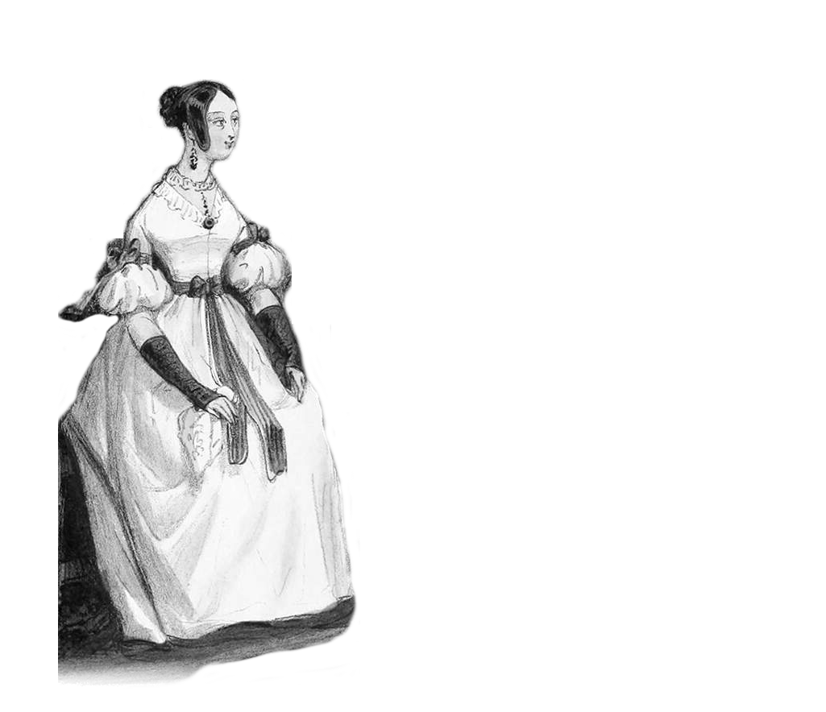
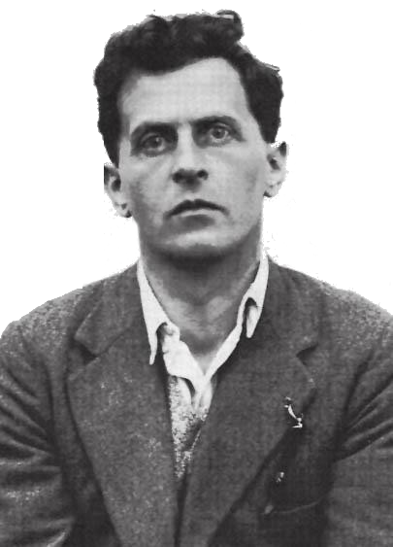
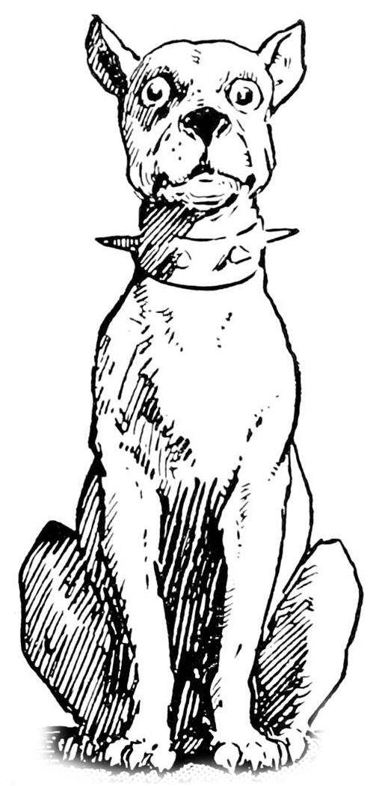


Slide 2
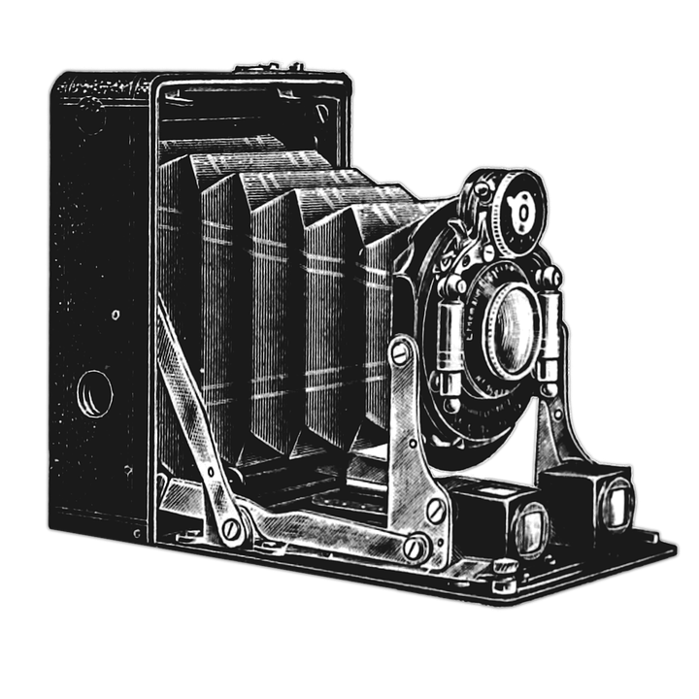
Your camera
?
Me

Slide 3
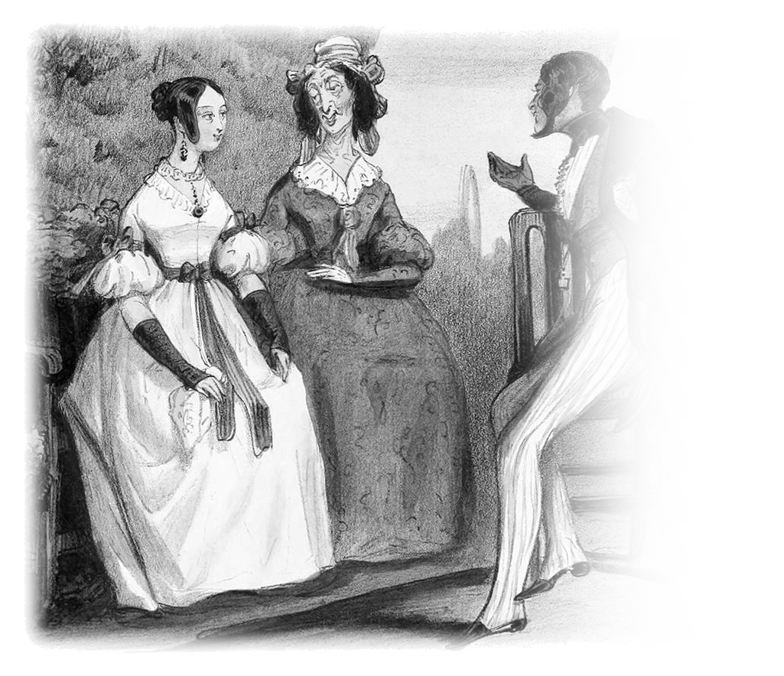
Your camera
?
My friends and I, in the park

Slide 4
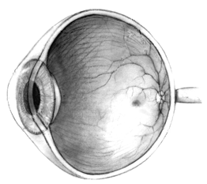
Your eye
?
Me

Slide 5
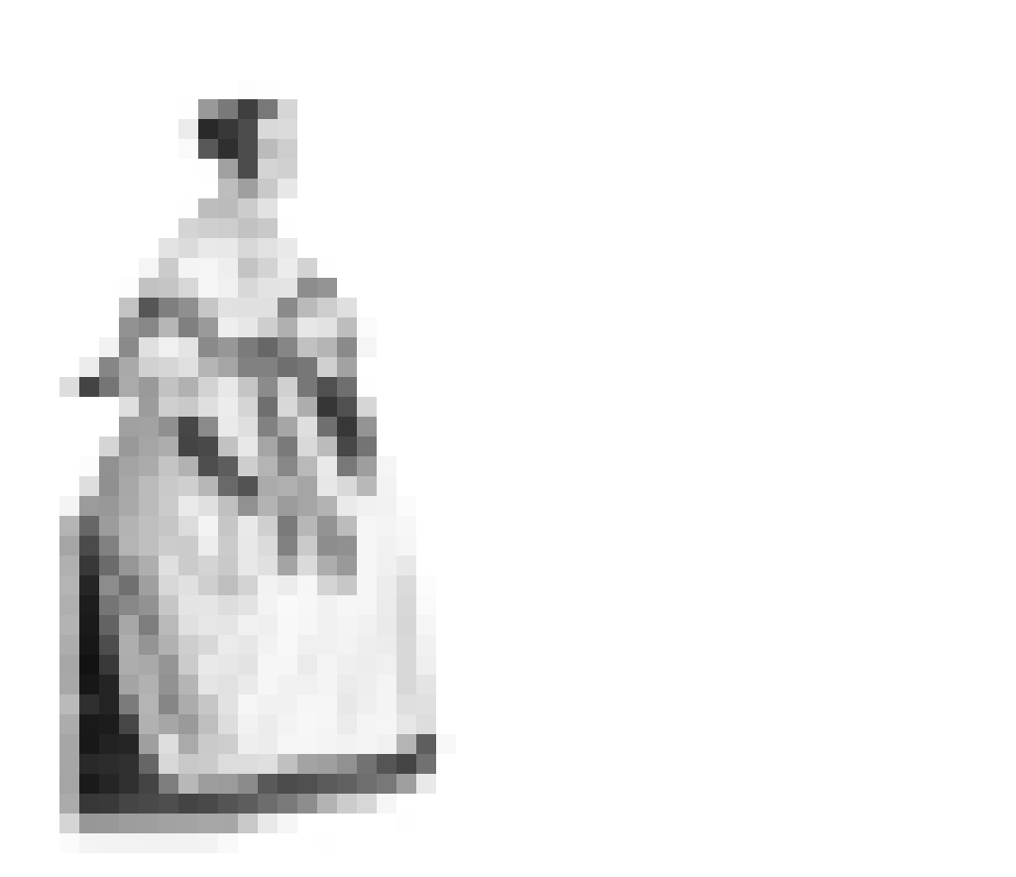
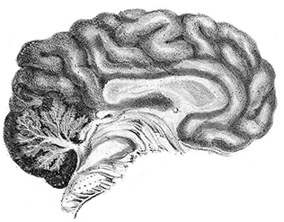
Your eye
Your brain (*)
?
?
Me
(*) Probably your actual brain is bigger than your eye

Slide 6
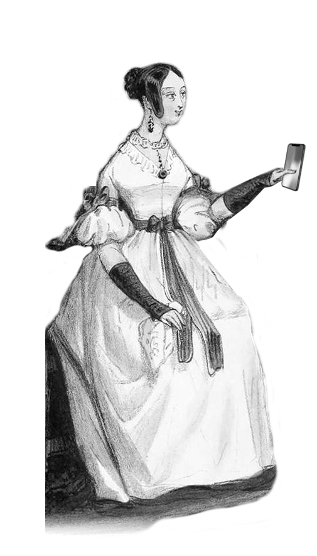

Your brain
?
?
Me

Slide 7
Your brain
?
?
?
Someone else’s dog
Me

Slide 8
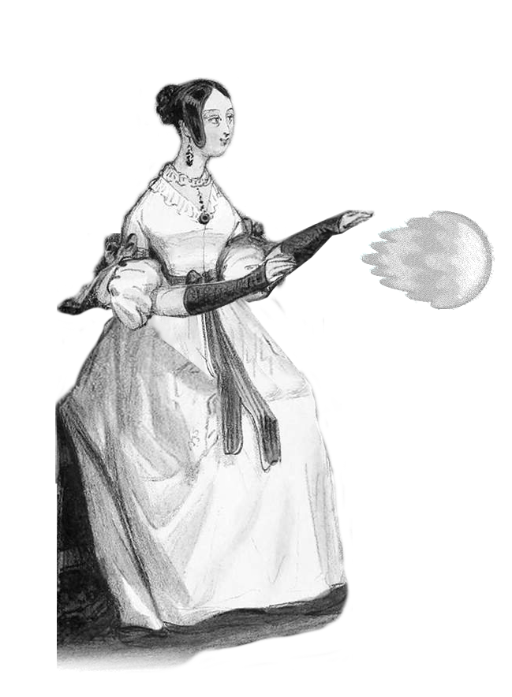
Control
Me

Slide 9
