Slide 1
SSH REPORT
Presenter: Hồ Thị Khưa

Slide 2

Agenda
1
Introduction to SSH
Concept, mechanism of action, uses and conditions
2
Setting up SSH with GitHub
About the commands used
3
Demo
Demo about setting up SSH with GitHub
4
Lesson learned
Share what I've learned and references

Slide 3
Introduction to SSH
1.1 Concept
SSH (Secure Shell Protocol) is a secure encrypted network protocol that creates a secure connection (creates a tunnel separate from other services to maintain a private connection between a client and a server) over a network unsecured grid. SSH is also understood as an application used to connect and log into a computer system by a user.

Slide 4
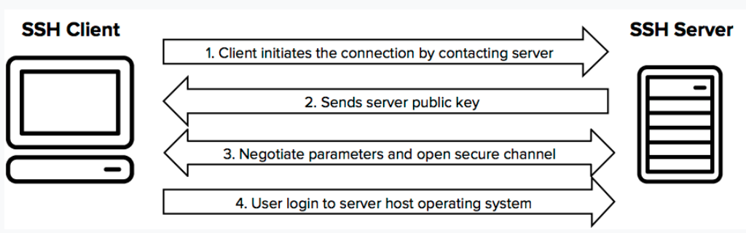
1.2 Mechanism of action

Slide 5
1.3 Uses
Login to the shell of the remote computer (server)
Executing the command on the connected machine
Set up automatic login to the server
Safe file transfer

Slide 6




1.4 Condition
An SSH service from a Remote machine (remote, server) – Ex: Google Cloud Platform, AWS Management Console, GitHub …
Client machine (local) using SSH Client programs

Slide 7
Setting up SSH with GitHub

Slide 8
Open SSH Client
Open Git Bash Here
2.1 Generate SSH Key
$ mkdir folder_name
$ cd folder_name
$ ssh-keygen –t rsa –f id_rsa
$ cat id_rsa.pub

Slide 9
Open GitHub → Setting
Below the screen, select the item named SSH and GPG key
2.2 Setting up SSH public key for GitHub
Select the item New SSH Key
Enter an SSH title in the Title section, and the key part, copy and paste the entire content of the id_rsa.pub file into
Finally click Add SSH Key to complete

Slide 10
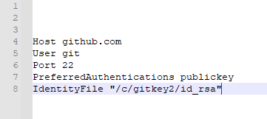
$ code ~/.ssh/config
$ pwd (get path public key)
2.3 Setting up private SSH for SSH/Git on the computer

Slide 11
3. Demo

Slide 12

SSH Document
4. Lesson learned
Website:
https://xuanthulab.net/ssh-secure-shell/
YouTube:
https://www.youtube.com/watch?v=x20NiW2BM3Y&list=PLwJr0JSP7i8BF0muBxB3aLPhycTmognX2

Slide 13
Thank you
Insert the title of your subtitle Here

