Slide 1
Redux store

Slide 2
1. What is Redux?
2. How Redux works?
3. How does the principle work?
4. When to use Redux?
5. Note
6. Demo code

Slide 3
1. What is Redux?
Redux is a predictable state container for JavaScript apps.

Slide 4
2. How Redux works
It has a store that stores the entire state of the app.
Each component can directly access the stored state instead of having to send drop down props from component to component.

Slide 5
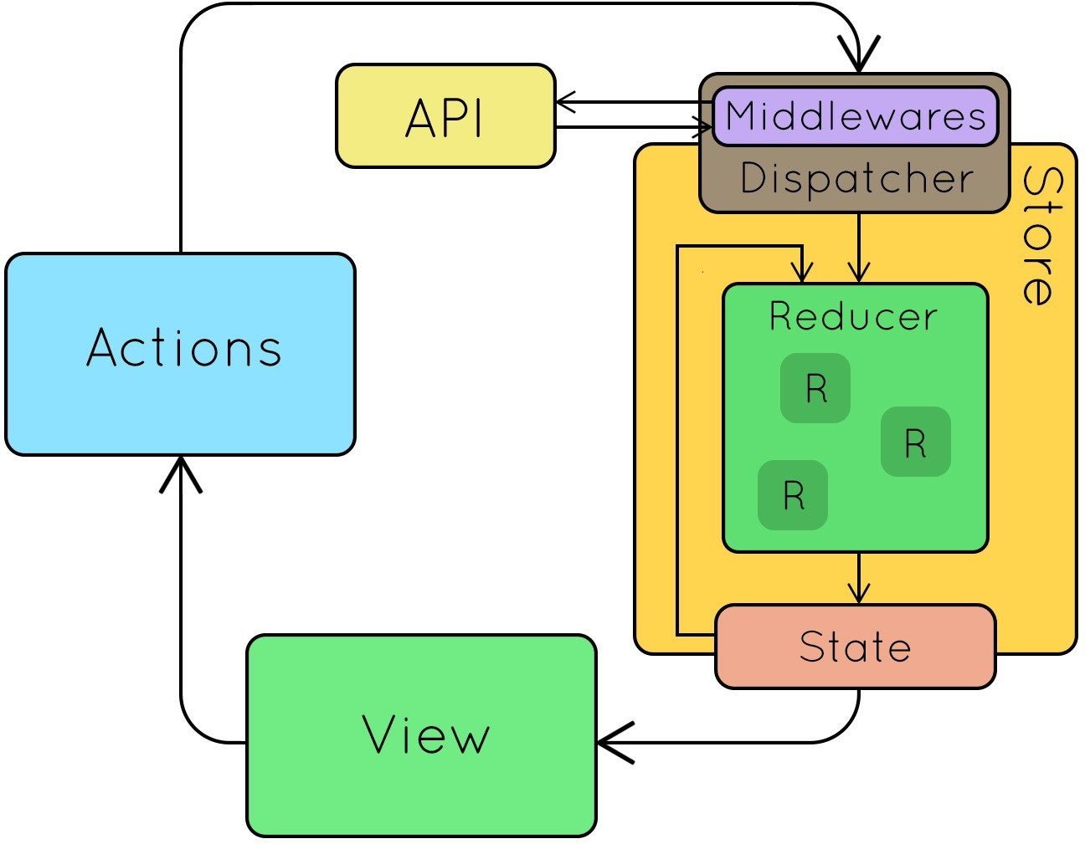
3. How does the principle work?
Uses a uni -directional data flow architecture.
Store includes:
State: is the current data stored on the state.
Reducer: is a function that transforms the old state into the new state.
Dispatcher: manages middlewares and passes data down to the reducer.
Action = plain javascript object describing the action.

Slide 6
Store includes:
getState(): Help get the current state
dispatch(action): Make an action call
subscribe(listener): Always listen to see if there are any changes and then immediately update to View

Slide 7
4. When to use Redux?
Data is used in many places
Undo/redo function is supported
Need to cache data for reuse in the future.

Slide 8
5. Note
Redux uses a one-way architecture: uni-directional data flow
Redux uses only a single store as a Single Source of Truth
Redux state is READ-ONLY. To update must dispatch an action (js object)
Redux state changes made by Pure functions (reducer)
Redux can be used for javascript applications (Angular, VueJS
,Pure javascript), not just ReactJS.

Slide 9
6. Demo code

Slide 10
