Slide 1
Fast Bilateral Space Stereo for Synthetic Defocus
Paper by:
Jonathan T. Barron Andrew Adams
YiChang Shih Carlos Hernández
Reference : Fast Bilateral Space Stereo for Synthetic Defocus : Paper

Slide 2
A General Taxonomy of Stereo Algorithms
Ref: A Taxonomy and Evaluation of Dense Two-Frame Stereo Correspondence Algorithms
A vast majority of stereo algorithms use a subset of following approaches:
Stereo Matching
Cost Aggregation
Disparity Computation / Optimization
Local Methods: Stereo Matching + Cost Aggregation + Disparity Computation
Global Methods: Stereo Matching + Disparity Optimization
This Paper: Stereo Matching + Disparity Optimization in Bilateral Space

Slide 3
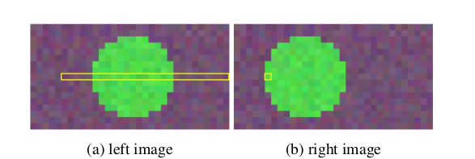
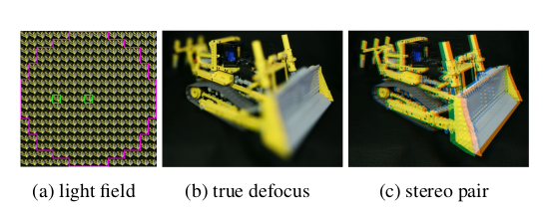
High Level Project Idea
Stereo Matching
Bilateral Solver

Slide 4
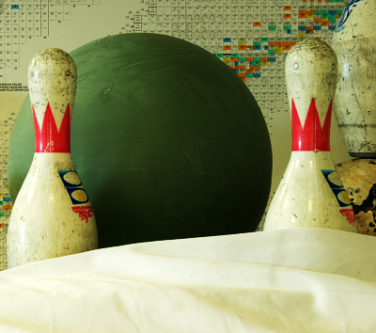
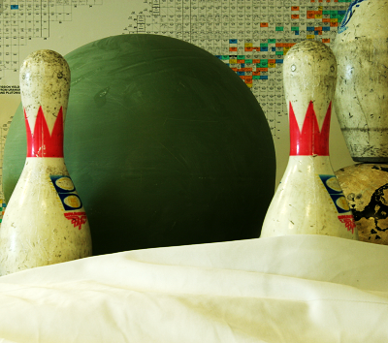
Stereo Matching
Also known as Matching Cost Computation
Stereo Matching is comparing information about a scene from two vantage points.
We basically compute the cost of assigning any pixel (x, y) a disparity value ‘d’.

Slide 5
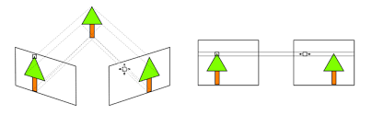
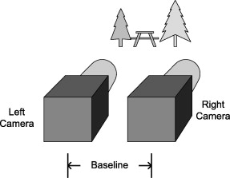
Assumption
For the implementation of this paper, it is assumed that the stereo images are rectified.

Slide 6
Different Methods To Perform Stereo Matching
Sum of Absolute Differences
Sum of Squared Differences
Birchfield Tomasi Measures

Slide 7
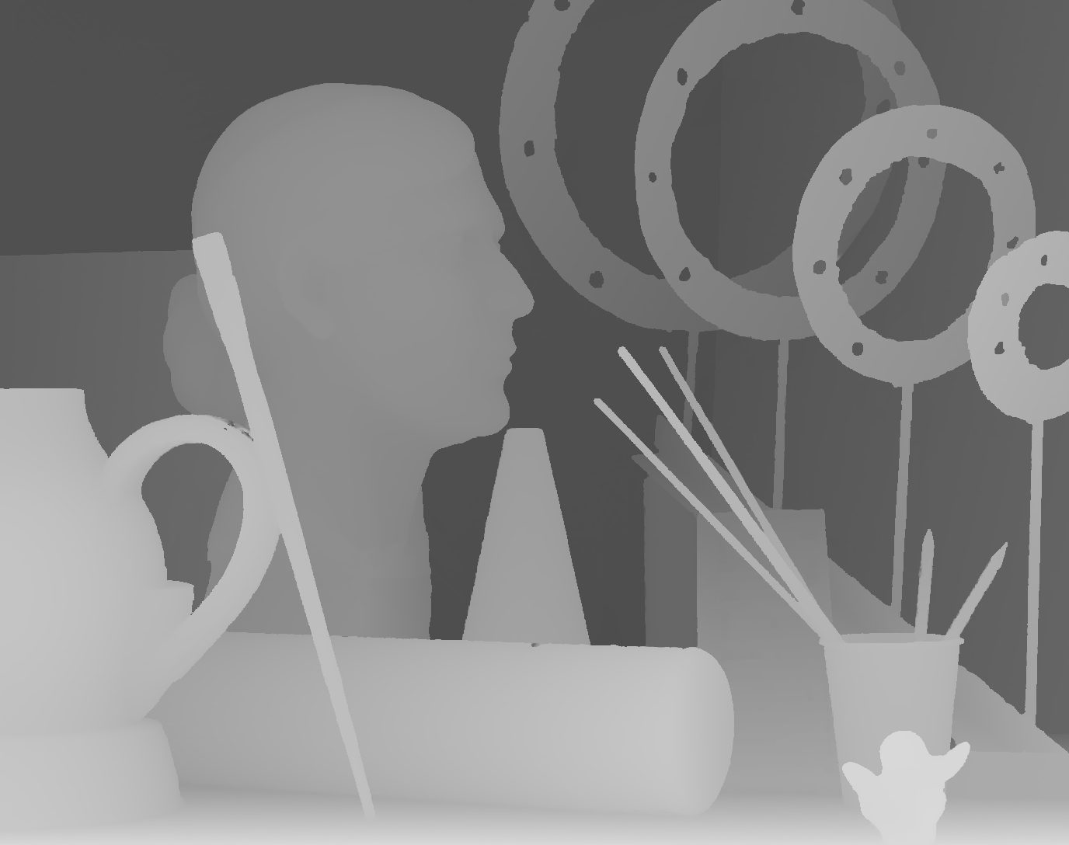

Bilateral Filtering
Approximating bilateral filtering to a product of sparse matrices
Instead of naive implementation of bilateral filter, a bilateral grid or permutohedral lattice can be used
The filter is obtained by representing approximating to a product of splat, blur, and slice matrices

Slide 8
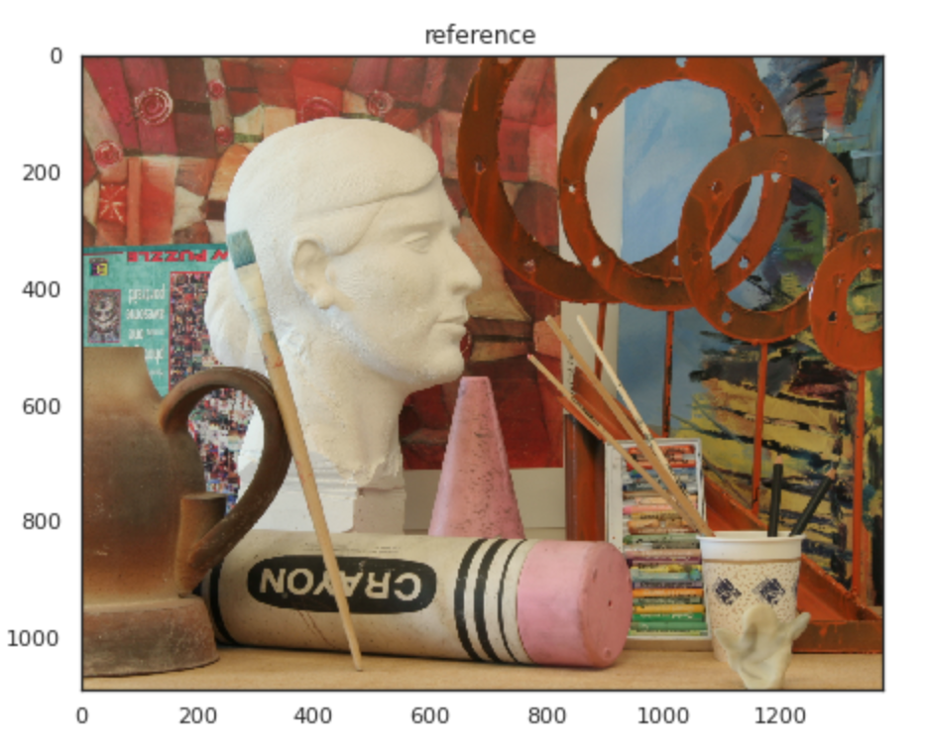
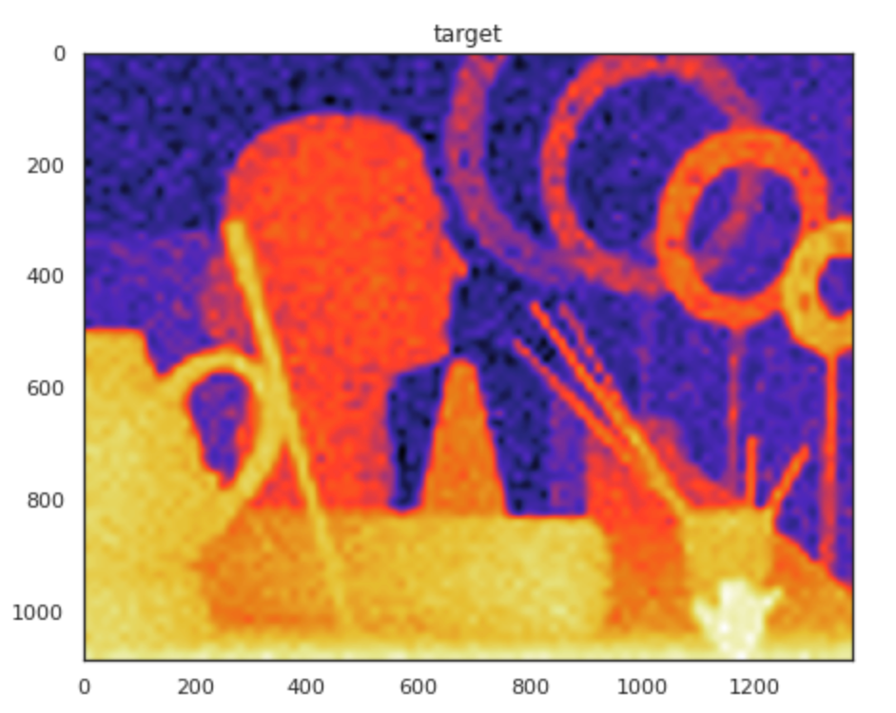
Bilateral Filtering

Slide 9
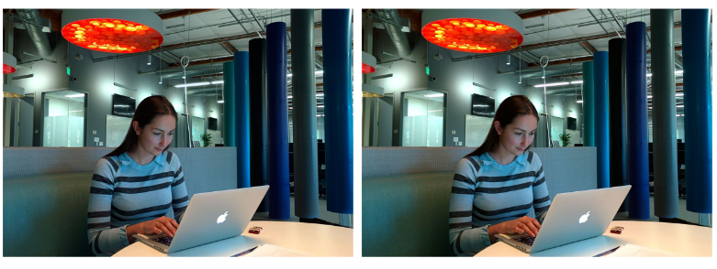
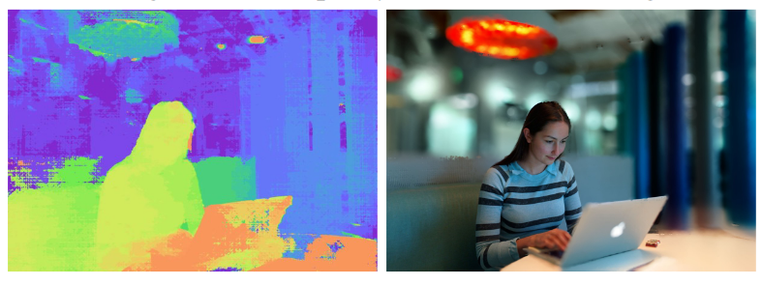
Result comparison:

Slide 10
Thanks!
Pix It

