Slide 1
TOPIC 02
Metrics, and the four-component design
Confirm the metrics the improvement is measured by, then design the four resource tiers
Kangan Institute

Slide 2
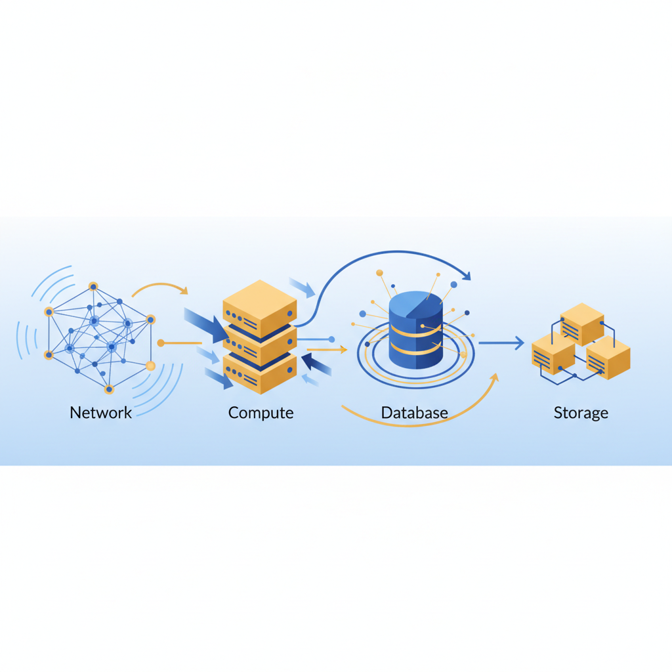
The design starts with a yardstick
■ The analysis is done and the decisions are confirmed; now the design work starts.
■ First the metrics — the numbers the improved system will be measured against — then the four resource tiers.
■ Scalability here means elastic capacity-on-demand, demonstrable by test — not a forecast, and not over-provisioning.
■ Design only, to the business needs — the build is AT3.
Kangan Institute
1
Notes:
Workbook tasks 8 and 9 today, then the object-storage question. Metrics before design — you can't design to a target you haven't set.
Misconception: scalable = big enough for the busiest day. That's over-provisioning; scalable means capacity moves with load.

Slide 3
01
SECTION
Confirm the performance metrics
a number with a target, for every goal
Kangan Institute

Slide 4
From goals to metrics
■ A goal is directional; a metric makes it measurable — a number with a target the improved system can be tested against.
■ Evaluate and confirm the metrics for each goal: availability, recovery times, response time, cost per period.
■ Write them so a later test can pass or fail against them — these numbers come back in the build.
Kangan Institute
2
Notes:
Workbook task 8. The goals came from Topic 1; today each one gets its number.
"Be reliable" is the goal restated — push to availability percentages, recovery-time targets, response times, cost per period.
These exact metrics are what AT3's monitoring and testing measure against — say so; it motivates the care.

Slide 5
ACTIVITY
Confirm the metrics
■ Workbook — task 8.
■ Evaluate and confirm the performance metrics for the practice engagement — a named metric and a target value for each goal.
⏱ ~25 min
Kangan Institute
3
Notes:
Activity = practice workbook task 8.
The sanity check: could a later test pass or fail against each metric? If not, tighten it.

Slide 6
Key takeaways
Section 1 · The yardstick
Every goal gets a metric; every metric gets a target.
Written to be tested against, later, by the build.
Kangan Institute
4

Slide 7
02
SECTION
Design the four resource tiers
select and improve each tier to the business needs
Kangan Institute

Slide 8
Scalability is elastic capacity-on-demand
■ Elastic capacity: add resources as load rises, release them as load falls — pay for what you use.
■ The test of a scalable design is a demonstration — it scales on demand, proven later by test — not a load forecast on paper.
■ Over-provisioning fixed spare capacity is not scalability; right-size instead.
Kangan Institute
5
Notes:
The definition that governs the Topic. Both directions of elasticity matter — releasing capacity is where the saving lives.

Slide 9
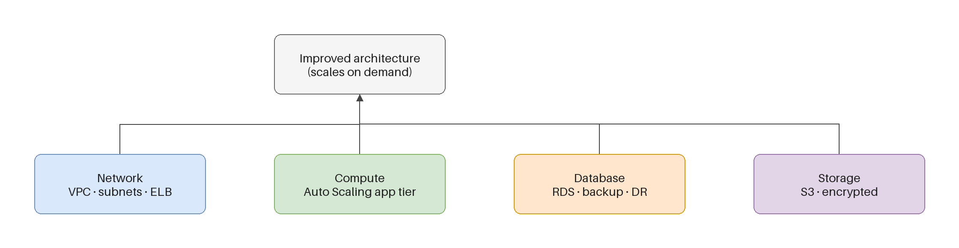
The four resource components
■ Split the design across four tiers: network, compute, database, storage.
■ Compute and storage scale elastically on demand; network and database are selected and configured to support that scale.
■ These are the same four units the build team later divides the IaC work by — a clean seam from design to build.
Kangan Institute
6
Notes:
The frame the whole design (and the AT2 work-split) is organised by. Not all four tiers scale the same way — that distinction is the teaching.

Slide 10
Selecting and improving each tier
■ Network: right-size the path and load-spreading so the tier below can scale out behind it.
■ Compute: move from fixed capacity to a pool that grows and shrinks on demand.
■ Database: select a managed service that scales reads without a rebuild, keeping the accounting data consistent.
■ Storage: select storage that grows on demand rather than a fixed-size volume.
Kangan Institute
7
Notes:
The how-to per tier. The database consistency constraint matters — it's an accounting system; you scale reads, you don't shard the ledger.

Slide 11
Justify against the business needs
■ Tie every resource choice to a stated business need — why this tier, why this size.
■ Choose the simplest option that meets the need; note where capacity scales elastically and how a test would demonstrate it.
■ No tier scaled beyond what a need justifies.
Kangan Institute
8
Notes:
The discipline that turns selections into a defensible design. "To be safe" is not a justification.

Slide 12
ACTIVITY
Design the four tiers
■ Workbook — task 9.
■ Select and improve the network, compute, database and storage tiers for the practice engagement, each choice justified against a named need.
⏱ ~35 min
Kangan Institute
9
Notes:
Activity = practice workbook task 9 — the biggest design task in AT1.
Watch for over-provisioning, and for network/database marked elastic when they support scale rather than scale themselves.

Slide 13
Key takeaways
Section 2 · The four tiers
Network, compute, database, storage — the design's frame and the build's work-split.
Compute and storage scale; network and database support.
Simplest option that meets the need, elasticity demonstrable by test.
Kangan Institute
10

Slide 14
03
SECTION
Object storage in context
the contrast that sharpens the storage choice
Kangan Institute

Slide 15
Object storage, and what it is for
■ Object storage holds whole objects addressed by key — it scales on demand and serves static content directly, no server involved.
■ The natural home for a static website's content: pages, images, downloads.
■ A stateful, transactional, database-backed system is the opposite workload — object storage is not its primary store.
Kangan Institute
11
Notes:
Contextual knowledge for the assessment's Q2 — the contrast is the answer: static content suits object storage; a transactional ledger does not.
Be ready to explain provisioning object storage for a static-site workload — that's the examinable half.

Slide 16
ACTIVITY
Answer the object-storage question
■ The assessment's question Q2, rehearsed in writing.
■ Contrast a stateful accounting workload's storage needs with an object-storage-dependent website workload, and explain how you would provision the latter.
⏱ ~15 min
Kangan Institute
12
Notes:
Activity = assessment Q2 rehearsed. The practice workbook carries no questions — use the assessment's.
Check both halves are present: the contrast, and the provisioning explanation.

Slide 17
Key takeaways
Topic 2 · Key takeaways
Metrics first: a number with a target for every goal, written to be tested against.
Four tiers, each selected and improved to a named need — simplest that fits.
Object storage suits static content; a transactional system is the contrast to know.
Kangan Institute
13

Slide 18
Next: Topic 3 — security, reliability and cost
The metrics are set and the four tiers are designed.
Next the improvement designs: security, reliability and scalability, cost and monitoring — and the cost-benefit case that justifies them.

