Slide 1
TOPIC 03
Designing the improvements: security, reliability, cost
Design the security, reliability, scalability and cost improvements — and argue the cost-benefit case
Kangan Institute

Slide 2
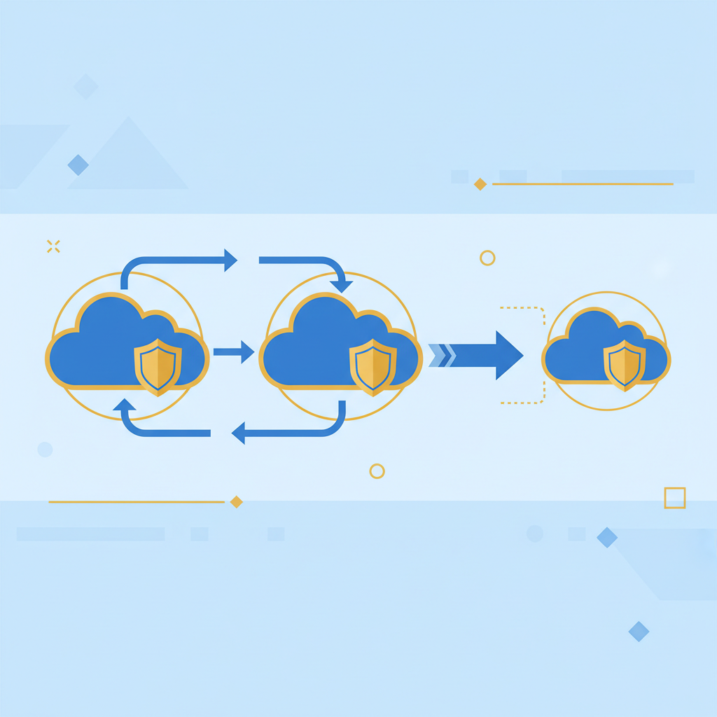
The improvement passes
■ The tiers are designed; now you improve them — security, then reliability and scalability, then cost and monitoring.
■ Each pass reviews the same architecture through a different lens, to the goals and metrics you set.
■ It ends with the argument: every improvement justified on cost versus benefit.
■ Design only — the build is AT3.
Kangan Institute
1
Notes:
Workbook tasks 10 to 13, in order — three improvement passes then the cost-benefit case.
The centrepiece lands in this Topic: rejecting an improvement can be the strongest design move in the cluster.

Slide 3
01
SECTION
The security improvements
the improvement stays secure
Kangan Institute

Slide 4
Security layers, and improving them
■ The layers: network isolation, security groups, least-privilege access, and encryption at rest and in transit as the baseline.
■ Review each layer against the goals and design the improvements — tightening what exists before adding anything new.
■ Every later change must inherit these layers, not bypass them — a DR copy of financial data carries the same protections as the primary.
Kangan Institute
2
Notes:
Workbook task 10 — the security pass. Encryption is assumed on by default, including any cross-region copy.
Misconception: a DR copy is "just a backup" and can be looser. A weaker copy is the breach.

Slide 5
ACTIVITY
Design the security improvements
■ Workbook — task 10.
■ Review the practice engagement's security layers and design the improvements, each tied to a goal.
⏱ ~25 min
Kangan Institute
3
Notes:
Activity = practice workbook task 10.
Push tightening-first: an improvement that adds a service before fixing a loose group has the order wrong.

Slide 6
Key takeaways
Section 1 · Security
Isolation, groups, least privilege, encryption — the baseline layers.
Improvements inherit the layers; copies carry the same protections.
Kangan Institute
4

Slide 7
02
SECTION
The reliability and scalability improvements
improve reliability to the goal, not beyond it
Kangan Institute

Slide 8
What makes a cloud system reliable
■ Reliability: the system keeps serving through component and zone failures, and recovers from loss.
■ Three building blocks: redundancy across zones, backup and restore, and cross-region disaster recovery.
■ Backup recovers data in place; DR survives losing a whole region — different failures, different tools.
Kangan Institute
5
Notes:
The frame before the design. Map each building block to the failure it answers.

Slide 9
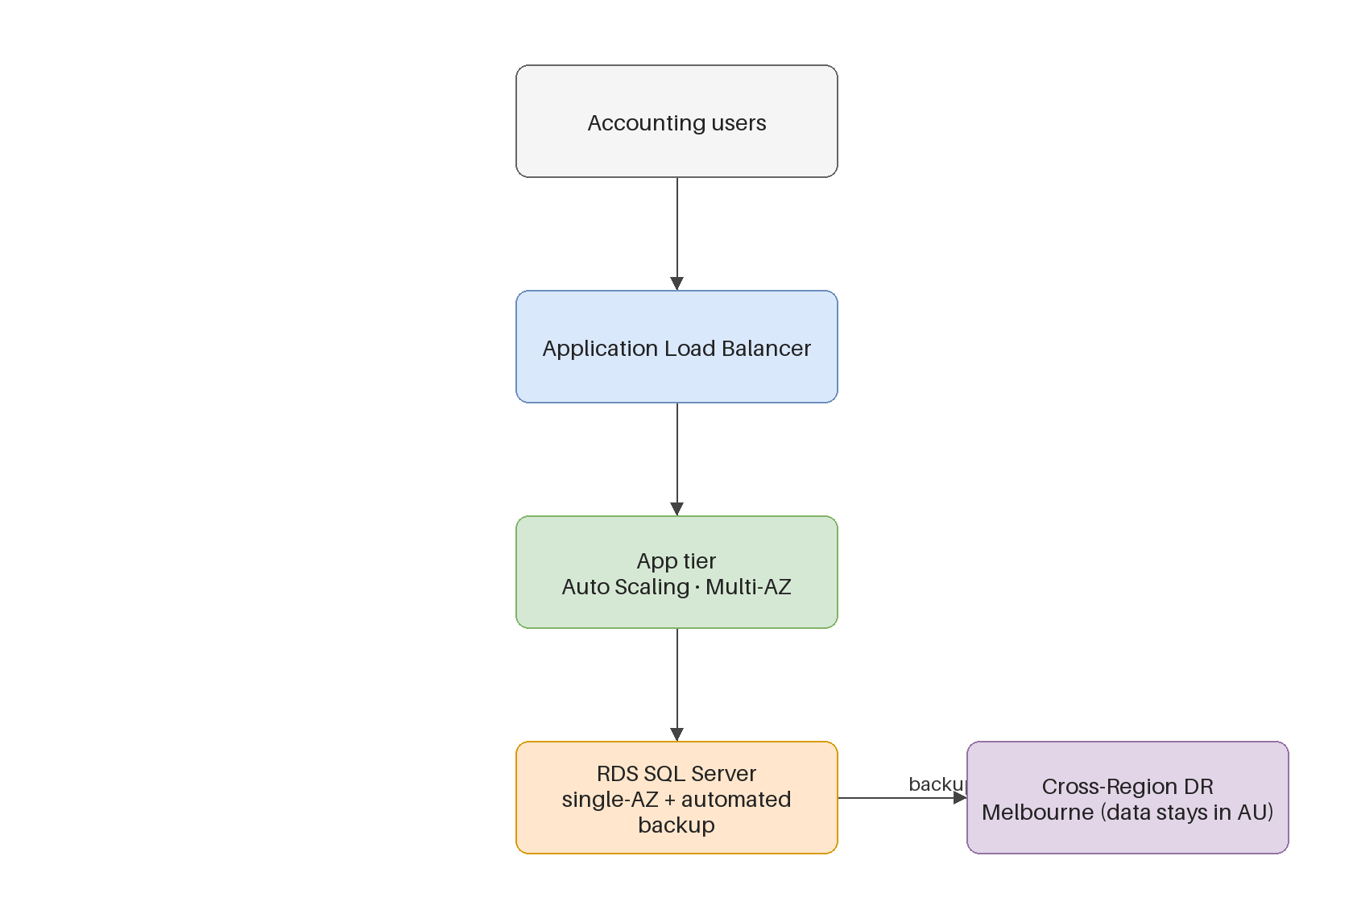
The reliability target
■ Review the single-zone baseline against the reliability goals; name where a single failure takes the system down.
■ The shape of the target: the application tier redundant across zones behind a load balancer; the database covered by backup and restore; a cross-region DR copy, onshore.
■ One tier is deliberately not made redundant — the next slide argues why.
Kangan Institute
6
Notes:
Walk the diagram tier by tier. Leave the database tension unresolved for one slide on purpose.
Redundancy is applied tier by tier, to the goal — not painted across everything.

Slide 10
The centrepiece: rejecting an improvement
■ The accounting product is vendor-certified single-instance only — a failover database is simply not available for it.
■ The only route to one is replacing the product: new licence, data migration, change management, migration risk.
■ That cost is disproportionate to the reliability gained, so the design rejects it — single-instance database, covered by backup, restore and DR.
■ "Reliable database = failover database" is the reflex to resist; justify against the goal and the cost, not a checklist.
Kangan Institute
7
Notes:
The single most assessed piece of reasoning in AT1 — slow down here.
The assessed skill is arguing the trade-off, not naming the feature. A rejection argued well outscores a feature added by reflex.

Slide 11
Database reliability — the options weighed
Option | Reliability gain | Cost / risk | Verdict
Single-instance + backup/restore + cross-region DR | recover from loss; DR onshore | low — no product change | CHOSEN
Failover (Multi-AZ) database | zero-downtime zone failover | not available — vendor single-instance only | infeasible
Replace the accounting product | enables failover | licence + migration + change management + risk | disproportionate — rejected
The chosen row must be argued, not just stated — the reasoning is the mark.
Kangan Institute
8

Slide 12
The residency slice
■ A scoped constraint: specific regulated data must reside in a named region; the main system stays where it is.
■ The design keeps the regulated data in-region — a slice of the reliability and DR design, not a second architecture.
■ Constraints like this were read precisely in the compliance task; here they get built into the design.
Kangan Institute
9
Notes:
Keep it light — one constraint shaping where specific data sits, nothing more.
Ties back to workbook task 3; the compliance reading becomes a design input here.

Slide 13
ACTIVITY
Design the reliability and scalability improvements
■ Workbook — task 11.
■ Design the reliability and scalability improvements for the practice engagement to your goals, and argue one cost-benefit trade-off explicitly.
⏱ ~35 min
Kangan Institute
10
Notes:
Activity = practice workbook task 11.
The practice vehicle runs MySQL with no single-instance constraint — the data-tier call is theirs to make, potentially the opposite of Ledgerline's, by the same reasoning. That's the learning, not a mistake.
Watch for the copied verdict; the constraint differs by design.

Slide 14
Key takeaways
Section 2 · Reliability
Redundancy tier by tier, to the goal.
The rejection, argued on cost versus benefit, is the centrepiece.
Regulated data placed by the compliance reading.
Kangan Institute
11

Slide 15
03
SECTION
Cost optimisation and monitoring
pay for what the goals need, and watch it
Kangan Institute

Slide 16
The cost pass
■ Review the design for cost: right-size every tier, release what elasticity makes releasable, and price the improvements.
■ The techniques that deliver the improvements — redundant deployment, health checks, automated backups and snapshots, cross-region copies — each has a running cost; know it.
■ A design that meets its goals at lower cost beats the same design at higher cost, every time.
Kangan Institute
12
Notes:
Workbook task 12, first half. Elasticity's cost payoff is releasing capacity — connect back to Topic 2's definition.

Slide 17
Design the monitoring in
■ Decide now what the improved system reports: the metrics from task 8, watched by alarms with owners.
■ Monitoring designed in is cheap; monitoring bolted on later is a retrofit.
■ This design is what the build's monitoring task implements — the numbers are already set.
Kangan Institute
13
Notes:
Task 12, second half. The metrics from Topic 2 come back as the things monitored — the thread is deliberate.

Slide 18
ACTIVITY
Cost and monitoring
■ Workbook — task 12.
■ Design the cost optimisation and the monitoring for the practice engagement — what is right-sized, what is released, what is watched.
⏱ ~25 min
Kangan Institute
14
Notes:
Activity = practice workbook task 12.
Every monitored metric should trace to task 8; every cost claim to a tier.

Slide 19
Key takeaways
Section 3 · Cost and monitoring
Right-size, release, price the improvements.
Monitor the metrics you set, by design not retrofit.
Kangan Institute
15

Slide 20
04
SECTION
The cost-benefit justification
every improvement earns its place
Kangan Institute

Slide 21
Justify on cost versus benefit
■ Every improvement is justified on cost versus benefit, against the current run cost as the baseline.
■ The shape: what it costs, what it buys, and why that trade is worth it for this business.
■ The rejected options belong in the argument too — what you didn't build, and why, is half the case.
Kangan Institute
16
Notes:
Workbook task 13 — the written case. The operational costing document is the baseline; every claim cites it.
The centrepiece rejection from C2 is the worked example of the form.

Slide 22
ACTIVITY
Write the cost-benefit justification
■ Workbook — task 13.
■ Justify each improvement for the practice engagement on cost versus benefit, citing the current run cost as the baseline.
⏱ ~30 min
Kangan Institute
17
Notes:
Activity = practice workbook task 13.
Push for numbers from the costing document, and for at least one argued rejection.

Slide 23
Key takeaways
Topic 3 · Key takeaways
Three passes over one architecture: security, reliability, cost.
The strongest design move can be a rejection, argued on cost versus benefit.
Monitoring designed in against the metrics you set.
Every improvement earns its place against the run-cost baseline.
Kangan Institute
18

Slide 24
Next: Topic 4 — draw it, document it, present it
The design is complete: analysed, targeted, improved and justified.
Next you draw the improved architecture, document the proposal, and present it for sign-off.

