Slide 1
TOPIC 05
Establishing the build team
Agree the objective, set expectations, plan for trouble, allocate the work
Kangan Institute

Slide 2

Leading the build team
■ AT2 begins: the approved design is written as CloudFormation by a team of four, one component each — network, compute, database, storage.
■ Dividing the write is the leadership vehicle: what is marked is how you plan, allocate and lead — not the code.
■ This Topic stands the team up; leading it through the build is Topic 6.
Kangan Institute
1
Notes:
Workbook tasks 1 to 6 today — the whole team set-up, in order.
Misconception: this is a CloudFormation topic. The code is the vehicle; the leadership evidence is what's assessed.

Slide 3
01
SECTION
The objective, the expectations, the accountability
know the goal, set expectations, hold the line
Kangan Institute

Slide 4
Agree what the team is here to do
■ Name the common objective out loud — everyone should be able to recite it the same way.
■ Break it into responsibilities and required outcomes: what the team must produce, to what standard.
■ Shared, explicit objectives are what let four separate component-writers pull in one direction.
Kangan Institute
2
Notes:
Workbook task 1. Unstated objectives drift — making it explicit and shared is the assessable act.
Test: could every member say the objective the same way?

Slide 5
Set what is expected of each member
■ A performance plan per member: expected outcomes, goals and behaviours for their component — measurable, not a pep talk.
■ Align each plan to the team objective and to the organisation's policies.
■ The shape: an outcome, a standard, a deadline, and a collaboration behaviour.
Kangan Institute
3
Notes:
Workbook task 2. If you can't measure whether it was met, it isn't a performance plan.
Draft one live for the database owner — outcome, standard, deadline, behaviour.

Slide 6
Agree how you hold each other accountable
■ Concrete mechanisms: clear ownership per component, review checkpoints, a shared definition of done.
■ Grounded in organisational requirements — policies, codes of conduct, the organisation's culture — and inside the legislative ones: health and safety, privacy, anti-discrimination.
■ Accountability is preventive structure, not blame after the fact.
Kangan Institute
4
Notes:
Workbook task 3. Mechanisms, not slogans — and the grounding in policy and law is examinable.
Question to pose: one policy and one law that shape how this team holds the line.

Slide 7
ACTIVITY
Stand the team up
■ Workbook — tasks 1, 2 and 3.
■ As the practice team: agree the objective, set what is expected of each member, and agree the accountability mechanisms.
⏱ ~35 min
Kangan Institute
5
Notes:
Activity = practice workbook tasks 1–3, done as a team, recorded individually.
Watch for pep-talk performance plans and slogan accountability — push mechanisms and measures.

Slide 8
Key takeaways
Section 1 · The set-up
One objective, recitable by all.
Measurable expectations per member.
Accountability grounded in policy and law.
Kangan Institute
6

Slide 9
02
SECTION
Plan for what could go wrong
decide the response while calm
Kangan Institute

Slide 10
The typical contingencies
■ The workplace classics: unplanned absence of a component owner, re-allocation when load shifts, succession for important roles.
■ A contingency is a named trigger plus a pre-agreed response — written into the team plan, decided before it's needed.
■ For this build: the database owner is out the day before the milestone — who picks it up, and how is the handover recorded?
Kangan Institute
7
Notes:
Workbook task 4. A risk without a pre-agreed response isn't a contingency; the response is the deliverable.
The three named classics are the examinable list.

Slide 11
ACTIVITY
Plan the contingencies
■ Workbook — task 4.
■ Write the team's contingencies: the triggers that could hurt the build, and the response agreed for each.
⏱ ~20 min
Kangan Institute
8
Notes:
Activity = practice workbook task 4.
Every row is trigger plus response — challenge any that are just risks listed.

Slide 12
Key takeaways
Section 2 · Contingencies
Absence, re-allocation, succession — planned before they happen.
Trigger plus pre-agreed response, in writing.
Kangan Institute
9

Slide 13
03
SECTION
Allocate the work, and agree the outside connections
hand out the boxes, and the seams
Kangan Institute

Slide 14
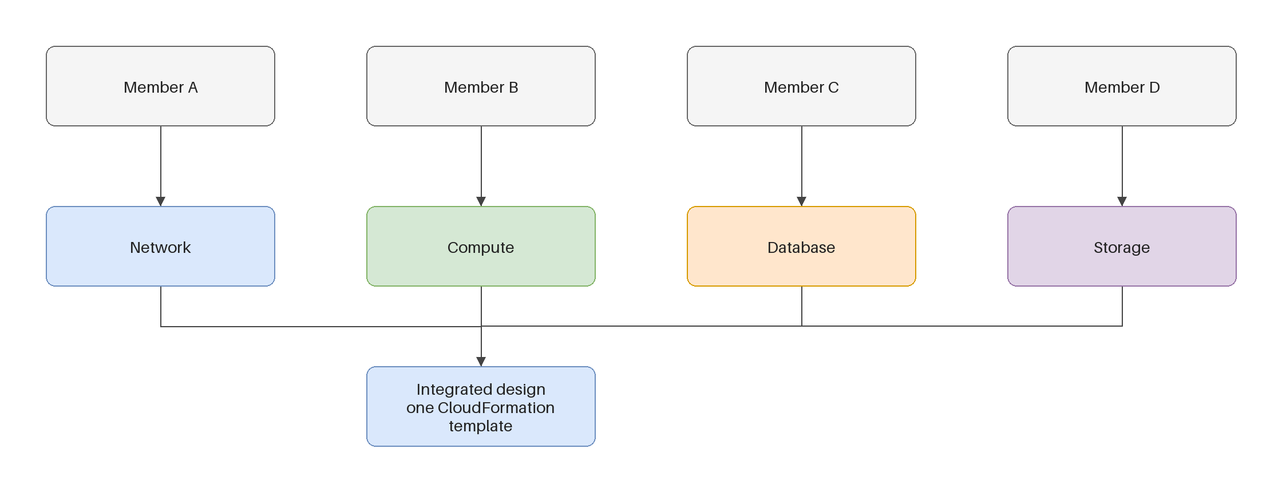
Allocate the four components
■ One component per member — network, compute, database, storage — by expertise or by development potential.
■ Each allocation carries instruction: the component's scope, the interfaces it must expose, and any contingencies that attach to it.
■ Allocate the seams, not just the boxes — shared parameters and dependencies are where four components become one build.
Kangan Institute
10
Notes:
Workbook task 5. "Development potential" matters — you can allocate to stretch someone, with the extra instruction that implies.
The unmanaged interface is where the build breaks; the diagram shows the seams.

Slide 15
Communicate it, and connect beyond the team
■ Communicate the objectives and responsibilities so everyone shares the same picture of done — confirmed by play-back, not just sent.
■ Agree how the team works with people outside it: the internal teams and external specialists worth pulling in, and for what.
■ Facilitation that works for everyone: match the channel to the message, and communicate across cultures and needs.
Kangan Institute
11
Notes:
Workbook task 6 — the outside-team agreement is its own task.
Communication isn't done until it's played back; a decision needs a conversation, a record needs writing.

Slide 16
ACTIVITY
Allocate and agree
■ Workbook — tasks 5 and 6.
■ Allocate the four components with instruction and seams, then agree how the team will work with people outside it.
⏱ ~30 min
Kangan Institute
12
Notes:
Activity = practice workbook tasks 5–6, as the practice team.
Press the seams: what must the network owner expose to the compute owner? And press a concrete outside connection, named, with a reason.

Slide 17
Key takeaways
Topic 5 · Key takeaways
Objective, expectations, accountability, contingencies — the team plan.
Four components allocated with instruction; the seams allocated too.
Outside connections agreed before they're needed.
Kangan Institute
13

Slide 18
Next: Topic 6 — leading the build
The team is stood up: objective agreed, work allocated, trouble planned for.
Next the build runs — and you lead it: the meeting, the coaching, the measuring, the reflecting.

