Slide 1
TOPIC 06
Leading the build
Build and integrate as a team, lead the observed meeting, reflect, measure and develop
Kangan Institute

Slide 2

Leading the build
■ The team is stood up; now the build runs — and the evidence is how you lead it.
■ Today: build and integrate, lead the observed meeting, then the written accounts — conflict, coaching, issues, measurement, feedback, development, reflection.
■ Leadership, not code: nobody is marked on their template here.
Kangan Institute
1
Notes:
Workbook tasks 7 to 17 today, plus the written questions. The reflective accounts (11–17) are written from real episodes in the build — that's why the build comes first.
Misconception: to lead the build you must be the best coder. You run the process and develop the people.

Slide 3
01
SECTION
Do the work, and integrate the build
four components, one template
Kangan Institute

Slide 4
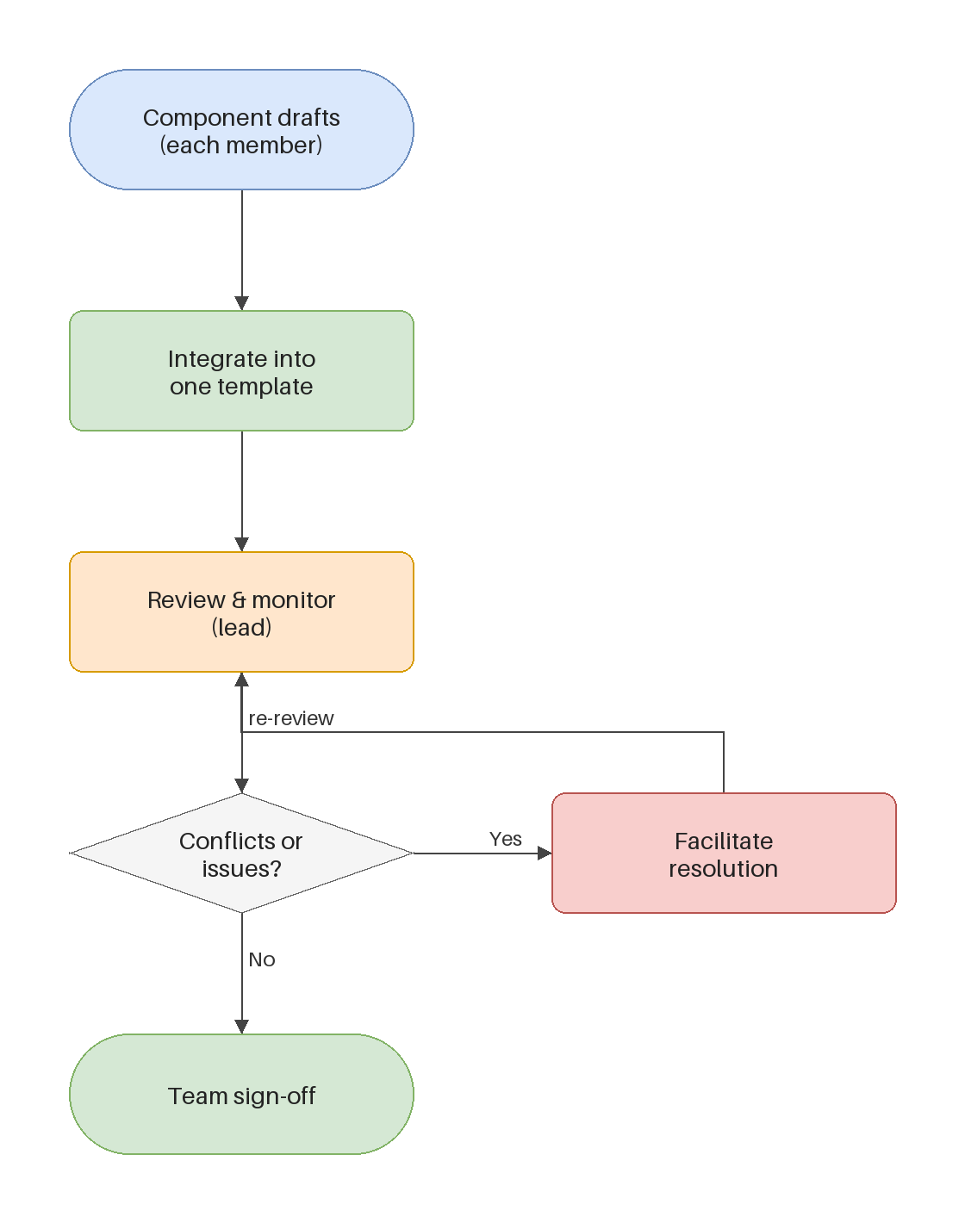
The build, and where leadership acts
■ The team writes four components, one each; they integrate into one deployable template the team confirms together.
■ Your code is submitted as itself — kept where the team can see it, not copied into worksheets.
■ The leader's work sits on the flow — coaching, unblocking, integrating — not inside a component.
Kangan Institute
2
Notes:
Workbook tasks 7 and 8. Walk the flow on the diagram: drafts, integrate, review, team sign-off.
Integration is facilitated, not typed — the seams agreed in Topic 5 come due here.

Slide 5
ACTIVITY
Build and integrate
■ Workbook — tasks 7 and 8.
■ Build your allocated component and record where it lives, then integrate the four components into one deployable template and confirm it as a team.
⏱ ~60 min
Kangan Institute
3
Notes:
Activity = practice workbook tasks 7–8 — the working session of the Topic; budget real time.
Record what integration actually took — that record feeds the issue reflection later.

Slide 6
Key takeaways
Section 1 · The build
Work visible to the team, integrated together, confirmed together.
What integration took is worth writing down — it becomes evidence.
Kangan Institute
4

Slide 7
02
SECTION
Lead the meeting, observed
run it so someone watching sees leadership
Kangan Institute

Slide 8
Leading a team meeting
■ A led meeting has a shape: purpose stated, everyone heard, blockers surfaced, decisions made and recorded.
■ Facilitate open and respectful communication — draw out the quiet member, park the derail, keep the thread.
■ An observer completes notes at the end — what someone outside the team saw is part of the record.
Kangan Institute
5
Notes:
Workbook tasks 9 and 10 — the meeting is observed by the assessor in AT2; here a classmate or the teacher observes.
The observable behaviours are the teaching: stating purpose, inviting contributions, resolving on the spot, recording decisions.

Slide 9
ACTIVITY
Run the meeting
■ Workbook — tasks 9 and 10.
■ Lead a team meeting with an observer watching, then have the observer complete the observation notes while it's fresh.
⏱ ~30 min
Kangan Institute
6
Notes:
Activity = practice workbook tasks 9–10, roles rotated so everyone leads once.
The observer writes what they saw, not what they'd have done — that's the note's value.

Slide 10
Key takeaways
Section 2 · The meeting
Purpose, voices, blockers, decisions, record.
The observer's view is evidence — hear it while it's fresh.
Kangan Institute
7

Slide 11
03
SECTION
The reflective accounts
real episodes, told honestly
Kangan Institute

Slide 12
Handling conflict and challenge
■ The strategies: separate the person from the problem, find the shared interest, agree a way forward — not a winner.
■ The challenges worth recognising: difficulty performing tasks, conflict with clients or teammates, risks and hazards, unethical behaviour.
■ Surfaced and managed conflict improves the build; suppressed conflict resurfaces at integration.
Kangan Institute
8
Notes:
The techniques behind workbook task 11's reflection. Conflict is normal; managing it is the skill.
The named challenge list is examinable — it also shapes what counts as a reportable episode.

Slide 13
Coaching, and supporting individuals
■ Coaching develops capability in the moment: ask before telling, model then hand over, give room to try, check understanding.
■ Support individuals toward the common goal — sometimes that's a stretch, not a rescue.
■ If you just supply the fix, you've solved the task and developed no one.
Kangan Institute
9
Notes:
The techniques behind task 12's reflection. Ask-before-telling is the move to rehearse.
Coaching in the flow of the build, not a separate training session.

Slide 14
Writing a reflective account
■ A reflection is a real episode, told honestly: what happened, what you did, what came of it, what you'd do differently.
■ Name the technique you used — the account shows the skill by showing it in use.
■ Three accounts: a conflict or challenge, a coaching moment, an issue the team hit and your part in resolving it.
Kangan Institute
10
Notes:
Workbook tasks 11, 12 and 13. The episodes come from the build they just ran — that's why the order matters.
An invented episode reads as one; the honest small story beats the polished fiction.

Slide 15
ACTIVITY
Write the three accounts
■ Workbook — tasks 11, 12 and 13.
■ Write the conflict account, the coaching account, and the issue account — real episodes from your build, with the technique named in each.
⏱ ~35 min
Kangan Institute
11
Notes:
Activity = practice workbook tasks 11–13, individually.
Press for the technique named in every account, and the what-would-you-do-differently line.

Slide 16
Key takeaways
Section 3 · The accounts
Person from problem; shared interest; a way forward.
Ask before telling; stretch, don't rescue.
Real episode, named technique, honest lesson.
Kangan Institute
12

Slide 17
04
SECTION
Measure, feed back, develop
the plan is the yardstick
Kangan Institute

Slide 18
Measure the team against the plan
■ The performance plans from the set-up are the yardstick: what was due, what was delivered, at what quality.
■ Measure the work, not the person — objective, evidence-based, collated so the picture is evidence rather than impression.
■ Measurement is the input to feedback; without it feedback is opinion.
Kangan Institute
13
Notes:
Workbook task 14. This is why the Topic 5 performance plans had to be measurable.
Collating scattered notes into one picture is what makes the judgement defensible.

Slide 19
Feedback, and development
■ The feedback shape: close to the event, specific, actionable — behaviour, effect, next step.
■ A measured gap becomes a development opportunity: specific, tied to a person and the team's goal.
■ An opportunity without an action plan is a note — who, what, by when.
Kangan Institute
14
Notes:
Workbook tasks 15 and 16. Feedback that never names the gap develops no one; a gap without help closing it is half a job.
"Do more training" is not a development opportunity; a named skill for a named person is.

Slide 20
ACTIVITY
Measure, feed back, develop
■ Workbook — tasks 14, 15 and 16.
■ Measure the team against the plan, record the feedback you gave, and record the development opportunities and what you did about them.
⏱ ~30 min
Kangan Institute
15
Notes:
Activity = practice workbook tasks 14–16.
Every judgement cites the plan; every opportunity carries an action.

Slide 21
Key takeaways
Section 4 · Measure and grow
Measured against the plan, collated as evidence.
Behaviour, effect, next step.
Gaps become opportunities become action plans.
Kangan Institute
16

Slide 22
05
SECTION
Reflect, and answer
how you led, in your own words
Kangan Institute

Slide 23
Reflect on how you led
■ The professional behaviours to reflect against: reliability, fairness, openness, following through.
■ A reflection reviews, it doesn't summarise: what your leading changed, what it cost, what you'd carry forward.
■ The questions that follow ask for your techniques — facilitation, coaching, conflict — cited from your own build.
Kangan Institute
17
Notes:
Workbook task 17 plus the assessment's Q1–Q3, rehearsed from the practice build.
The team copies what a leader does, not what they say — the reflection should notice what was copied.

Slide 24
ACTIVITY
Reflect and answer the questions
■ Workbook — task 17, then the assessment's questions Q1 to Q3 from your own build.
■ Reflect on how you led, then answer: the requirements that applied, the techniques you used, and how you resolve conflict.
⏱ ~30 min
Kangan Institute
18
Notes:
Activity = practice workbook task 17 + assessment Q1–Q3.
Every answer cites an episode from their own build — the accounts from C3 are the source material.

Slide 25
Key takeaways
Topic 6 · Key takeaways
The build is the vehicle; the leading is the evidence.
Real episodes, techniques named, measured against the plan.
Reflection reviews; answers cite your own build.
Kangan Institute
19

Slide 26
Next: Topic 7 — the individual deploy
The team delivered, and you led it — planned, run, measured, developed, reflected.
Next is AT3: each member individually deploys, tests and proves the improvement.

