Slide 1
TOPIC 07
Deploying and proving the improvement
Deploy the baseline, apply your approved improvement, then monitor, test and refine
Kangan Institute

Slide 2
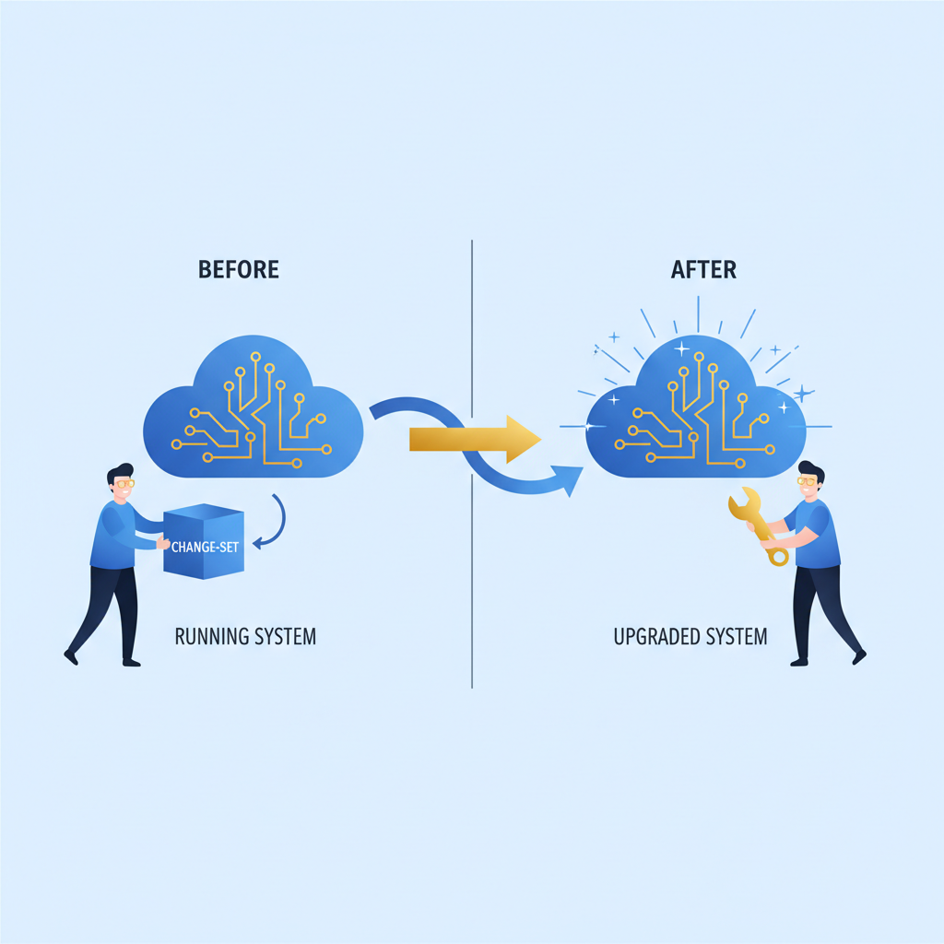
From approved design to running system
■ The design is approved and the team's IaC is written; now you individually deploy it, prove it, and refine it.
■ Today's arc: baseline up, scope recorded, improvement applied, measured, tested four ways, refined.
■ Region substitution applies to every deploy: the design names its real regions; you build in us-east-1.
■ teach, demo, practice — watch the deploy and change-set, then run your own.
Kangan Institute
1
Notes:
Workbook tasks 1 to 9 today, in order. Not a fresh build — the baseline first, the improvement over it.
Say the substitution out loud at every deploy.

Slide 3
01
SECTION
The baseline up, the scope recorded
a known start, an honest boundary
Kangan Institute

Slide 4
Apply-as-update: the change-set discipline
■ Deploy the approved baseline first, then apply the improvement as a change-set over it — not a fresh, replacing stack.
■ A change-set is a reviewable diff: what will be added or modified, seen before it runs.
■ In-place and additive: no resource replacement, no data migration.
Kangan Institute
2
Notes:
The conceptual core of AT3. Review-before-execute is the discipline the whole Topic runs on.
Question to pose: why baseline-then-change-set instead of deploying the improved stack directly?

Slide 5
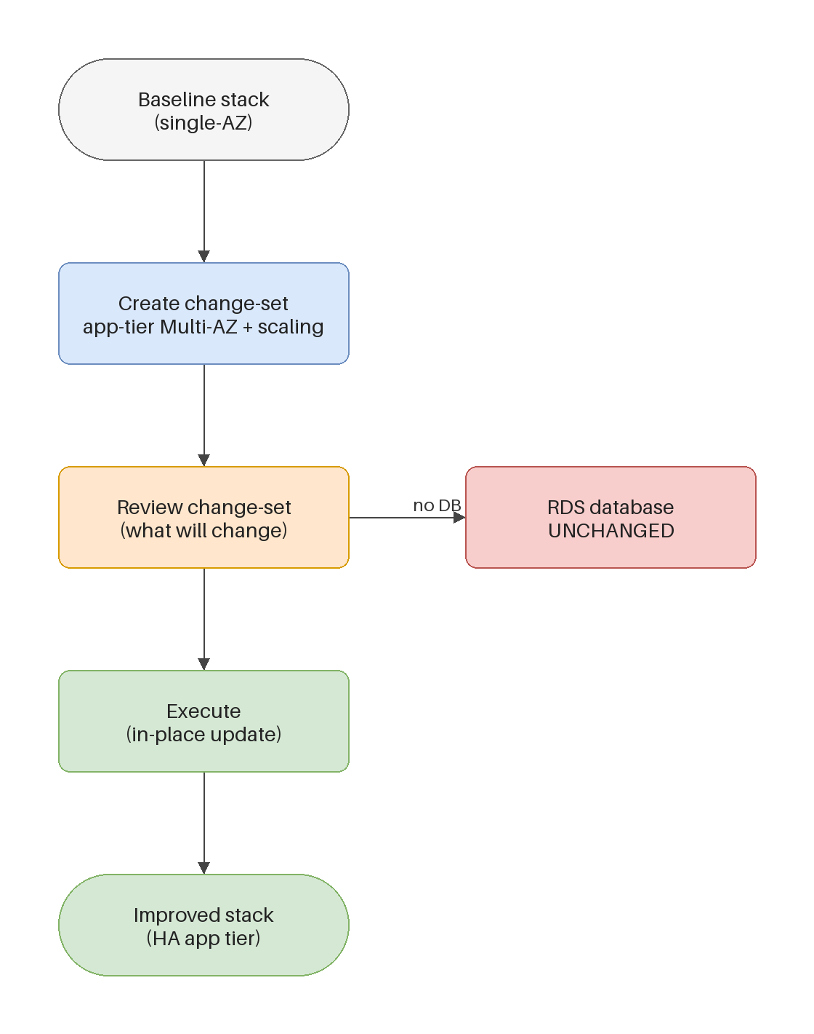
The lab constraint: the database is create-only
■ The change-set must not modify the database — the lab role denies rds:ModifyDBInstance.
■ Database-tier DR therefore stays design-level, as designed; the live demonstration lands on the app tier.
■ Nothing is dropped, only relocated — the constraint is honest and it is documented.
Kangan Institute
3
Notes:
The lab reality, on the diagram: baseline, change-set adds app-tier redundancy and scaling, database untouched.
Misconception: create-only means DB DR isn't assessed. It's evidenced at design level; the built proof moves tiers.

Slide 6
Record what you are authorised to build
■ Before deploying anything else, write down the approved scope — copied from your design sign-off, not remembered.
■ The scope is the boundary for everything that follows: improvements inside it land; ideas outside it wait.
■ An implementer who can show their authorisation is demonstrating governance, not bureaucracy.
Kangan Institute
4
Notes:
Workbook task 2 — new discipline, taught with its task. The sign-off from the design exercise is the source.
If a test later suggests something outside the scope, it goes to the long-term strategy, not the change-set.

Slide 7
RECORDED DEMO
Deploy the baseline
■ Deploy the approved baseline stack in the lab to CREATE_COMPLETE — region set first, substitution said aloud.
■ Confirm the resources, and capture the evidence as you go.
▶ Play the AWS recorded demo (recorded/live demo) — you do this next
Kangan Institute
5
Notes:
Live demonstration, educator-led. Narrate the evidence capture — the screenshots taken now are the record later.
A pre-deployed spare stack saves the session if the live deploy is slow. ~8–10 min.

Slide 8
ACTIVITY
Baseline and scope
■ Workbook — tasks 1 and 2.
■ Deploy the baseline environment and confirm it serves, then record the scope you are authorised to build from your design sign-off.
⏱ ~30 min
Kangan Institute
6
Notes:
Activity = practice workbook tasks 1–2.
The deploy takes time — have them record the scope while the stack builds.

Slide 9
Key takeaways
Section 1 · The start
Baseline first; the improvement rides over it.
The database tier is create-only; its DR is evidenced in the design.
Scope copied from the sign-off, before anything else deploys.
Kangan Institute
7

Slide 10
02
SECTION
Apply the approved improvement
your design, applied as a reviewable diff
Kangan Institute

Slide 11
The improvement as a change-set
■ Create the change-set for your approved improvement; read the diff before executing — every line is an add or a modify you intended.
■ The database shows no changes in the diff; anything that would replace a resource is a flag to stop and think.
■ Execute, watch to completion, confirm the improved resources are live.
Kangan Institute
8
Notes:
Workbook task 3 — their own approved improvement, applied. The diff review is the assessed habit.
A REPLACE in the diff means data questions — make them notice before executing, not after.

Slide 12
RECORDED DEMO
Apply a change-set
■ Create a change-set over the deployed baseline, read the diff with the class, execute it, confirm the improvement is live.
▶ Play the AWS recorded demo (recorded/live demo) — you do this next
Kangan Institute
9
Notes:
Live demonstration, educator-led. Pause on the diff and read it aloud — additions, modifies, and the untouched database.
Screenshot the diff and the completed update as the evidence pattern students mirror. ~8 min.

Slide 13
ACTIVITY
Apply your improvement
■ Workbook — task 3.
■ Apply your own approved improvement as a change-set: review the diff, execute, and confirm the improvement is live.
⏱ ~30 min
Kangan Institute
10
Notes:
Activity = practice workbook task 3, each student applying their own design.
Stop anyone executing without reading the diff — the review is the point.

Slide 14
Key takeaways
Section 2 · The apply
Read the diff; know every line.
The database stays untouched; replacements are a stop sign.
Confirmed live, with the evidence captured.
Kangan Institute
11

Slide 15
03
SECTION
Monitor and measure
measured against the metrics you set
Kangan Institute

Slide 16
Monitoring against the metrics and goals
■ Point the monitoring at the deployed resources and measure against the metrics and goals from your design — the deploy has to prove the improvement, not just exist.
■ Industry-standard tooling: metrics, alarms, dashboards — chosen because each maps to a goal, not to collect everything.
■ Record the baseline reading and the post-improvement reading; the before-and-after pair is the proof.
Kangan Institute
12
Notes:
Workbook task 4. The metrics were set back in the design — this is where they come due.
One reading proves nothing; the comparison does.

Slide 17
ACTIVITY
Monitor and measure
■ Workbook — task 4.
■ Set up the monitoring and measure the deployed architecture against your own metrics and business goals, before and after.
⏱ ~25 min
Kangan Institute
13
Notes:
Activity = practice workbook task 4.
Every metric watched should trace to a goal from their design; challenge orphans.

Slide 18
Key takeaways
Section 3 · The measure
Metrics mapped to goals, alarms on the thresholds.
Before and after — the pair is the evidence.
Kangan Institute
14

Slide 19
04
SECTION
Test and demonstrate, four ways
prove it, don't assert it
Kangan Institute

Slide 20
Demonstrating each concern
■ Reliability: fail an app-tier instance and show the service stays available — the single-point-of-failure test is the headline.
■ Security: show the layers hold — the isolation that should block, blocks. Scalability: drive load and show capacity move.
■ Cost: show the improvement's running cost against the goal. Four concerns, four demonstrations — a claim is not a demonstration.
Kangan Institute
15
Notes:
Workbook tasks 5 to 8, one concern per task. The SPOF test is the marquee — killing an instance and watching the service hold.
Because the DB tier is create-only, the reliability demonstration lands on the app tier — restate the constraint where it bites.

Slide 21
Testing and debugging technique
■ The loop: reproduce, isolate, read the logs and metrics, confirm the fix.
■ Every test produces a result you can act on — the findings feed the refinements next.
■ Capture as you test: the screenshot taken during the failure is the one you can't take afterwards.
Kangan Institute
16
Notes:
The repeatable method — a debugging loop you can evidence, against random poking.
The capture-during habit matters most in the SPOF test; the recovering state is the evidence.

Slide 22
ACTIVITY
Test and demonstrate
■ Workbook — tasks 5, 6, 7 and 8.
■ Test and demonstrate reliability, security, scalability and cost optimisation on your deployed system, capturing the evidence as each test runs.
⏱ ~45 min
Kangan Institute
17
Notes:
Activity = practice workbook tasks 5–8 — the proving session; budget real time.
Each test states what was done, what was observed, and what it proves — push all three parts.

Slide 23
Key takeaways
Section 4 · The proof
Four concerns, four demonstrations.
The SPOF test is the reliability headline.
Reproduce, isolate, read, confirm — and capture during, not after.
Kangan Institute
18

Slide 24
05
SECTION
Short-term refinements
act on the results, now
Kangan Institute

Slide 25
Apply what the tests found
■ Your tests will have found something — a threshold too tight, a missing alarm, a slow health check, capacity set wrong.
■ Short-term means applied now, on the running system, as a small follow-up change; the long-term strategy is next Topic.
■ Re-measure after each refinement — a refinement you don't re-measure isn't finished.
Kangan Institute
19
Notes:
Workbook task 9 — the workbook says plainly the tests will have found something; finding nothing means look harder.
Keep the short/long distinction crisp: applied now versus described for later.

Slide 26
ACTIVITY
Refine and re-measure
■ Workbook — task 9.
■ Apply the short-term refinements your test results call for, and re-measure to confirm each one moved the metric the right way.
⏱ ~25 min
Kangan Institute
20
Notes:
Activity = practice workbook task 9.
Every refinement cites the test result that caused it and the re-measurement that confirmed it.

Slide 27
Key takeaways
Topic 7 · Key takeaways
Baseline, scope, improvement — in that order, as reviewable diffs.
Measured before and after against your own metrics.
Four demonstrations, evidence captured during.
Refined from the results, and re-measured.
Kangan Institute
21

Slide 28
Next: Topic 8 — document, strategise, close
Deployed, proven, refined — the improvement runs and the evidence exists.
Next: the as-deployed record, the long-term strategy, the handover, and taking it all down.

