Slide 1
TOPIC 01
Web-scale architecture design
Design the changes that scale the platform for a global audience
Kangan Institute

Slide 2

From design to web-scale
■ Topic 1 opens AT1: you design the changes that ready a platform for serving a large, distant audience.
■ Design for scale, reach, availability and a public surface — to the supplied requirements, with a source for every number.
■ This Topic is the web-scale half of the design; the microservice half is Topic 2.
■ Design only — the build is AT2.
Kangan Institute
1
Notes:
First slide of AT1 and the cluster's design work — set the job and the boundary, don't teach yet.
The workbook walks them through this design task by task; today runs tasks 1 to 14 in order.
Hold the line: design only, to the supplied requirements — gold-plating is a defect, not a bonus.
Question to pose: name one thing that has to change about how a site is delivered when its audience goes global.

Slide 3
01
SECTION
The needs, and the current position
what to scale, and the gaps to close
Kangan Institute

Slide 4
What web-scale means
■ Web-scale means serving large, variable, global demand without manual intervention.
■ Scale elastically: add capacity as load rises, release it as load falls — pay for what you use.
■ The three things that scale: network, compute, storage.
Kangan Institute
2
Notes:
Vocabulary slide — vendor-neutral, tight. Stress "without manual intervention"; that separates web-scale from buying a bigger server.
The network/compute/storage triple is the spine of the whole design — every change scales one of the three.
Misconception: scaling up (one big server) vs scaling out (many small units, added and removed automatically).

Slide 5
Establish what the design is held to
■ Before designing anything, read the requirements and the application specification and record the needs.
■ Who uses it, from where, how much, how variable — plus the non-functionals: availability, latency, cost.
■ Name the document each need came from. A target you cannot attribute is one you have assumed.
Kangan Institute
3
Notes:
This is workbook task 1's discipline: needs with sources. A consultant reads the brief; they don't invent numbers.
Press the attribution line — "where would 99.9% availability actually be written down?"
The load-bearing requirements are non-functional; a feature list doesn't size an architecture.

Slide 6
Review the current architecture against those needs
■ Go through the current architecture layer by layer and ask: does it meet the needs just recorded?
■ Where it does not, say why not — that gap is what the design must close.
■ Some layers already meet their needs. Finding those matters as much as finding the gaps — a review that rebuilds what already works has misread the job.
Kangan Institute
4
Notes:
A review is a comparison against requirements, not a description. Every gap ties to the need it fails.
The already-adequate layers are the trap worth naming — the workbook's worked example row deliberately answers "yes".

Slide 7
ACTIVITY
Record the needs and review the architecture
■ Workbook — tasks 1 and 2.
■ Record the scaling and performance needs with the document each came from, then review the current architecture layer by layer against them.
⏱ ~25 min
Kangan Institute
5
Notes:
Activity = practice workbook tasks 1–2. Both are table tasks with a given example row.
Where they get stuck: vague needs with no source — point them back to the named intranet documents.
Share-back: one gap and the exact requirement it breaks.

Slide 8
Key takeaways
Section 1 · Needs and gaps
Web-scale is elastic scaling of network, compute and storage to variable global demand.
Every need carries a source; every gap ties to a need.
A layer that already meets its needs stays as it is.
Kangan Institute
6

Slide 9
02
SECTION
The design inputs: residency and services
constraints and building blocks first
Kangan Institute

Slide 10
The residency obligation is a design input
■ Some data is legally obliged to stay in, or be copied to, a particular country — read what the obligation actually requires before designing around it.
■ Record what it obliges, and just as importantly what it does not — an obligation read too broadly costs as much as one ignored.
■ It is a constraint you carry through the design, not a feature you add at the end.
Kangan Institute
7
Notes:
Workbook task 3 — read the residency requirements document and record what it does and does not oblige.
The over-read is the common failure: assuming everything must live onshore when only certain data must.
This constraint recurs through the whole cluster; establish the careful-reading habit now.

Slide 11
Choose the services before you place them
■ List the cloud services the design needs, layer by layer, and what job each does.
■ Managed services first: they scale, replicate and patch without you operating them.
■ This list is the palette; the next section arranges it into an architecture.
Kangan Institute
8
Notes:
Workbook task 4 — identify the services before designing with them. Keeps the design honest: every box on the later diagram comes from this list.
Press "what job does it do" over brand names — the service category is the decision, the product follows.

Slide 12
ACTIVITY
Record the obligation and pick the services
■ Workbook — tasks 3 and 4.
■ Record what the residency requirements oblige and do not oblige, then list the cloud services the design needs and the job each does.
⏱ ~20 min
Kangan Institute
9
Notes:
Activity = practice workbook tasks 3–4.
Watch for the residency over-read; the document says precisely what is in scope.

Slide 13
Key takeaways
Section 2 · Inputs
Read the obligation; record what it requires and what it does not.
Pick the services and the job each does before arranging them.
Kangan Institute
10

Slide 14
03
SECTION
Designing the tiers
scale by layer, reach the globe
Kangan Institute

Slide 15
Scaling by layer
■ Network: load balancing spreads traffic; edge delivery shortens the path to the user.
■ Compute: a pool that grows and shrinks on demand, not one fixed server.
■ Storage: managed, replicated data services that scale reads.
Kangan Institute
11
Notes:
Turns the triple into three concrete moves, one layer per line — still vendor-neutral.
The read-heavy audience is why scaling reads is the storage job; connect it back to the recorded needs.

Slide 16
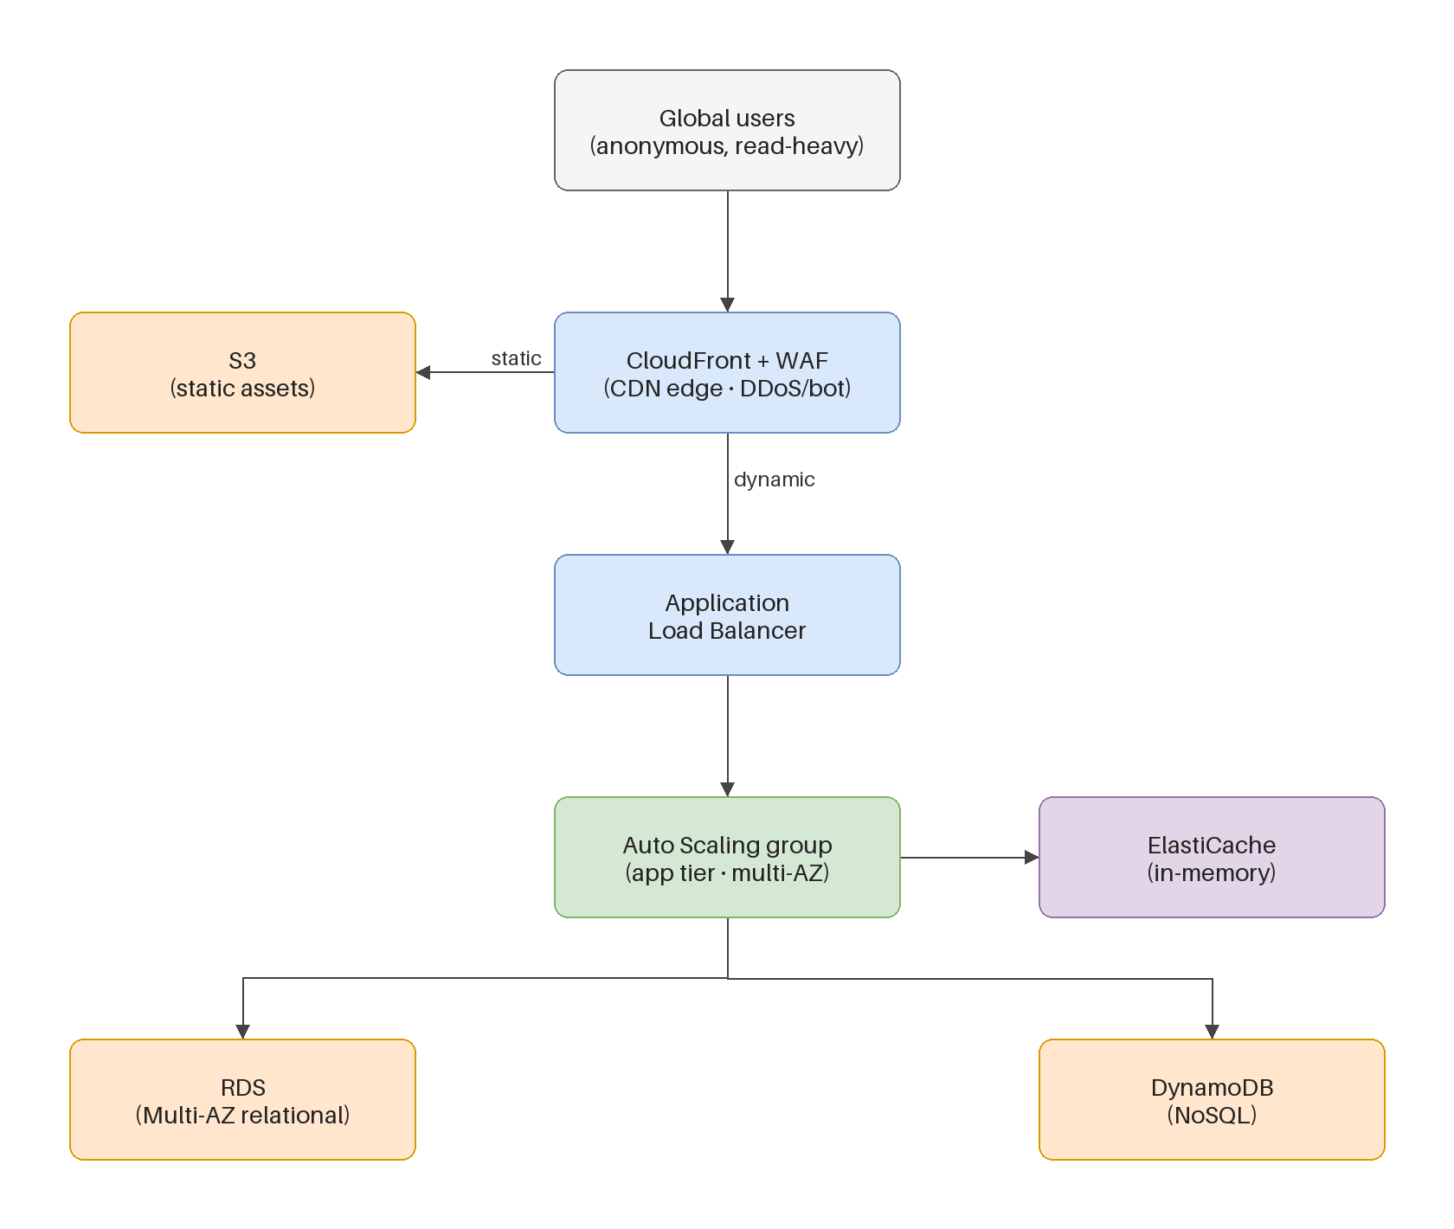
The target web-scale architecture
■ The edge absorbs read-heavy global traffic and the public attack surface.
■ A load balancer fronts an auto-scaling application tier spread across locations.
■ Managed data tiers and an in-memory cache scale the reads.
Kangan Institute
12
Notes:
The keystone slide — assemble the diagram live, tier by tier, mapping each tier to a gap from C1.
Every box answers a named gap; a component that closes no requirement doesn't belong.
This is a worked example to adapt, not a template to copy — their workbook design is their own.

Slide 17
Designing for a distant audience
■ Serve static and cacheable content from the edge, close to the users.
■ DNS and a global entry point route each user to the nearest healthy edge.
■ The web-scaling principles at work: statelessness, caching, horizontal scale, loose coupling.
Kangan Institute
13
Notes:
The global-reach slice — task 8's subject. "Healthy" matters: routing is an availability mechanism too.
The four principles are examinable and underpin every box; students cite them in the knowledge questions later.

Slide 18
The caching decision
■ Two different caches solve two different problems: the edge caches static content near users; an in-memory cache holds hot data near compute.
■ Cache what is read often and changes rarely; every cache carries a staleness trade-off.
■ Choose the simplest option that meets the requirement, and be ready to say why.
Kangan Institute
14
Notes:
Workbook task 9 makes caching its own decision — treat it as one, not a checkbox.
The staleness trade-off is the discussion: what happens when the cached copy is wrong, and how long can that last?

Slide 19
The four web-scale choices
Choice | Use when | Trade-off
SQL vs NoSQL | relational + transactional vs flexible, high-scale reads | consistency vs scale/flexibility
Monolith vs microservice | simple and small vs independent scale and deploy | simplicity vs operational complexity
VM / container / serverless | control vs portability vs no-ops scale | management overhead vs flexibility
CDN vs in-memory cache | cache static at the edge vs cache hot data near compute | global static reads vs dynamic hot data
Choose the simplest option that meets the requirement — you will justify each choice in writing.
Kangan Institute
15

Slide 20
ACTIVITY
Design the tiers
■ Workbook — tasks 5 to 9.
■ Design the network and entry point, the compute tier, the database and storage tier, the global serving approach, and make the caching decision.
⏱ ~45 min
Kangan Institute
16
Notes:
Activity = practice workbook tasks 5–9, one design table per tier. The biggest block of the Topic.
Circulate against orphan components — every choice traces to a recorded need from tasks 1–3.
They design their own; the teaching diagram is a model, not an answer.

Slide 21
Key takeaways
Section 3 · The design
Scale each layer with its own mechanism; deliver at the edge.
Statelessness, caching, horizontal scale, loose coupling.
Two caches, two problems; every cache trades staleness for speed.
Kangan Institute
17

Slide 22
04
SECTION
Checking the design
prove it scales, keep it up, keep it safe
Kangan Institute

Slide 23
Check it scales as utilisation increases
■ Walk the design up: double the load, then ten times it — which layer moves first, and does anything sit fixed?
■ A fixed component in a scaling path is the next bottleneck; find it on paper before it finds you in production.
Kangan Institute
18
Notes:
Workbook task 10 — a thought experiment against their own design, layer by layer.
Push for the mechanism: "what exactly adds capacity at this layer, and what triggers it?"

Slide 24

Protecting the public surface
■ A public site faces the open internet: web exploits, bots and volumetric attacks.
■ Defend at the edge: a firewall for malicious requests, the delivery network absorbing volume.
■ Deployment across locations plus health checks keeps the service available through failures.
Kangan Institute
19
Notes:
Task 11's subject — availability and security are one check, not two: a volumetric attack is an availability attack.
The three threat classes map one-to-one to the defences; have students make the pairing.

Slide 25
Review your design and revise it
■ Read the whole design back against every requirement: scale, reach, availability, security, residency.
■ Where a requirement is not met, make the simplest change that satisfies it, and record what you changed.
■ A review that changes nothing and finds nothing has usually not been done.
Kangan Institute
20
Notes:
Task 12 — the review discipline. It is an engineering step that can send you back, not a proofread.
A recorded revision is good evidence, not an admission of error — say so explicitly.

Slide 26
ACTIVITY
Check, harden and revise
■ Workbook — tasks 10, 11 and 12.
■ Check the design scales with utilisation, confirm availability and security are maintained, then review the whole design and record any revision.
⏱ ~30 min
Kangan Institute
21
Notes:
Activity = practice workbook tasks 10–12, all against their own tasks 5–9 answers.
The common miss is skipping the revise step — press for at least an honest "checked, nothing changed, because…".

Slide 27
Key takeaways
Section 4 · The checks
Walk the load up and find the fixed component.
Availability and security are one check on a public surface.
Review against every requirement; record what changed.
Kangan Institute
22

Slide 28
05
SECTION
Draw it, and justify it
one picture, one argument
Kangan Institute

Slide 29
Draw the architecture
■ One diagram of the whole design: every tier, every service you chose, and where the users come in.
■ Label what each component is, not just what product it uses — a reader should see the job of every box.
■ The diagram must agree with the tables that produced it; a box with no design decision behind it is a decoration.
Kangan Institute
23
Notes:
Workbook task 13. The drawing is evidence the design hangs together — mismatches with tasks 5–9 surface here.
Any drawing tool is fine; legibility and agreement with the design beat prettiness.

Slide 30
Justify the design in writing
■ For each major choice: the requirement it serves, the option you took, and why that option over the alternative.
■ Write to be checked: someone holding the requirements should be able to tick your justification off against them.
■ The simplest design that meets the requirements is the strongest claim you can make.
Kangan Institute
24
Notes:
Workbook task 14 closes the web-scale half — the written argument for the design.
Push requirement-option-why as the sentence shape; "because it is best practice" is not a justification.

Slide 31
ACTIVITY
Draw and justify the web-scale design
■ Workbook — tasks 13 and 14.
■ Draw the full architecture, then justify the design choice by choice against the requirements.
⏱ ~30 min
Kangan Institute
25
Notes:
Activity = practice workbook tasks 13–14.
Have pairs swap diagrams and try to read each other's — the questions they ask are the missing labels.

Slide 32
Key takeaways
Topic 1 · Key takeaways
Needs with sources; gaps tied to needs; constraints read precisely.
Scale each layer with its own mechanism; check it scales, stays up and stays safe.
Draw the whole design; justify every choice against a requirement.
Kangan Institute
26

Slide 33
Next: Topic 2 — the microservice
The web-scale half of the design is done: designed, checked, drawn and justified.
Next you design the second half — a small service with its own architecture and contract — and it plugs into this one.

