Slide 1
TOPIC 02
Microservice & serverless design
Design the serverless microservice, its contract, and answer for the whole design
Kangan Institute

Slide 2
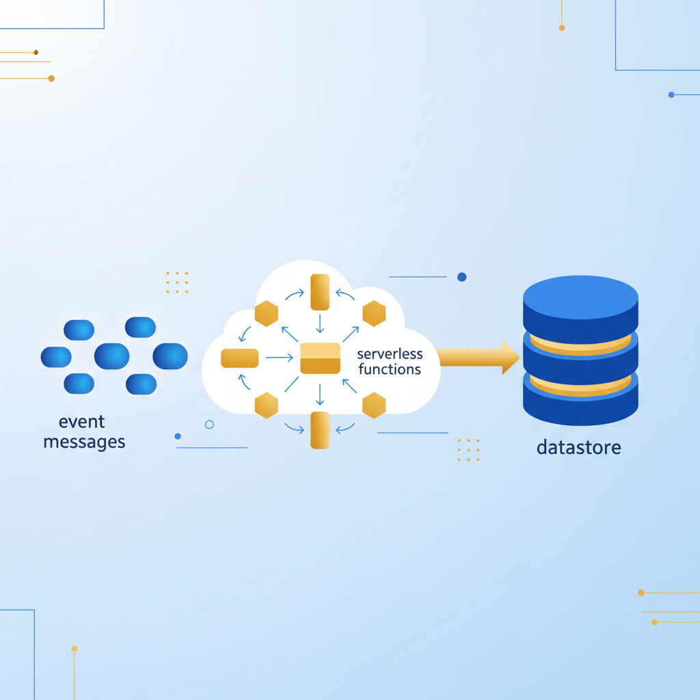
From web-scale to the microservice
■ Topic 1 designed the web-scale platform; Topic 2 designs the small service that plugs into it.
■ The service records access events to a residency-compliant store — the localisation hook straight from the requirements.
■ Serverless: no servers to manage, event-driven, scales with demand, pay per request.
■ Design only — the build is AT2.
Kangan Institute
1
Notes:
Second design half — today runs workbook tasks 15 to 19, then rehearses the Part A knowledge questions.
Stress event-driven: the platform emits events, the service reacts.
Misconception: serverless doesn't mean no servers — it means the operational responsibility isn't yours.

Slide 3
01
SECTION
The microservice and its data
one service, one job, one record
Kangan Institute

Slide 4
What a microservice is
■ A microservice does one thing well — a small, independently deployable unit with a single responsibility.
■ It owns its data and exposes a narrow interface; other systems talk to it only through that contract.
■ Right-sized: big enough to be useful, small enough to reason about and scale on its own.
Kangan Institute
2
Notes:
The definition the whole Topic builds on — single responsibility is the test for whether something is its own service.
If another system needs this service's data, it goes through the interface — never into the store directly.

Slide 5
The audit-log microservice
■ The one job: capture each access event the platform emits and record it durably.
■ The platform is the event producer; it knows only the webhook contract, not the store behind it.
■ The residency obligation is why this service exists on its own — the log lands in a store the platform needn't host.
Kangan Institute
3
Notes:
Workbook task 15's subject made concrete. The service's reason to exist is the residency need.
Question to pose: why build a separate service just to record events? (single job, independent scale, resident store).

Slide 6
Its data transactions
■ One transaction: append an access event — who, what, when — written once and never updated.
■ Append-only buys idempotent writes and simple, high-scale reads.
■ A transaction exists because a business need demands it, not because it is technically possible.
Kangan Institute
4
Notes:
The data pattern defines the store's shape later. An audit log is immutable by nature — mutability would break its evidentiary value.
Press transaction-to-need traceability; the workbook table asks for it.

Slide 7
ACTIVITY
Identify the microservice and its transactions
■ Workbook — task 15.
■ Identify the microservice and the data it handles, and state the business need behind each transaction.
⏱ ~20 min
Kangan Institute
5
Notes:
Activity = practice workbook task 15.
Watch for one big service that does everything — push single responsibility.

Slide 8
Key takeaways
Section 1 · The service
One job, its own data, a narrow contract.
Append-only: written once, read at scale.
Every transaction traces to a business need.
Kangan Institute
6

Slide 9
02
SECTION
The supporting services
pick the serverless building blocks
Kangan Institute

Slide 10
The serverless building blocks
■ Compute: a function service runs your code on demand, no servers to manage.
■ Front door: an API gateway receives requests and routes them to the function.
■ Messaging: a queue buffers events and decouples producer from consumer.
■ Persistence: a managed datastore keeps the data without you running a database server.
Kangan Institute
7
Notes:
The four building-block types, one per line — vendor-neutral, AWS named only as the example.
Question to pose: which block lets the platform fire a thousand events a second when the logger writes two hundred? (the queue).

Slide 11
Choosing services for the audit log
■ Ingress: an API gateway receives the webhook over HTTPS.
■ Buffer: a queue absorbs bursts and decouples the platform from the logger.
■ Compute: a function validates and writes each event — the only custom code in the service.
■ Store: a managed NoSQL datastore holds the append-only log, placed to honour residency.
Kangan Institute
8
Notes:
The selection decision made concrete — each block mapped to a job and a requirement.
Misconception: relational by default. The access pattern (append-only, simple high-scale reads) and residency drive the choice.

Slide 12
ACTIVITY
Determine the supporting services
■ Workbook — task 16.
■ Determine the cloud services that support your microservice, and justify each against a requirement.
⏱ ~20 min
Kangan Institute
9
Notes:
Activity = practice workbook task 16.
Product names with no reason attached is the common miss — every choice names its requirement.

Slide 13
Key takeaways
Section 2 · The services
Gateway, queue, function, managed store — each chosen for a named job.
The queue is the decoupling seam, not an optional extra.
Kangan Institute
10

Slide 14
03
SECTION
The architecture, drawn, and its contract
cohesive, loosely coupled, contract-first
Kangan Institute

Slide 15
Cohesion, coupling and the datastore
■ High cohesion: everything in the service serves its one job.
■ Loose coupling: the queue between producer and consumer means neither breaks the other.
■ Persistent datastore: the record survives independently of the compute that wrote it.
Kangan Institute
11
Notes:
Three examinable principles — cohesion is within a service, coupling is between services; you want high cohesion and loose coupling.
The function runs for milliseconds then disappears; the datastore is why the record outlives it.

Slide 16
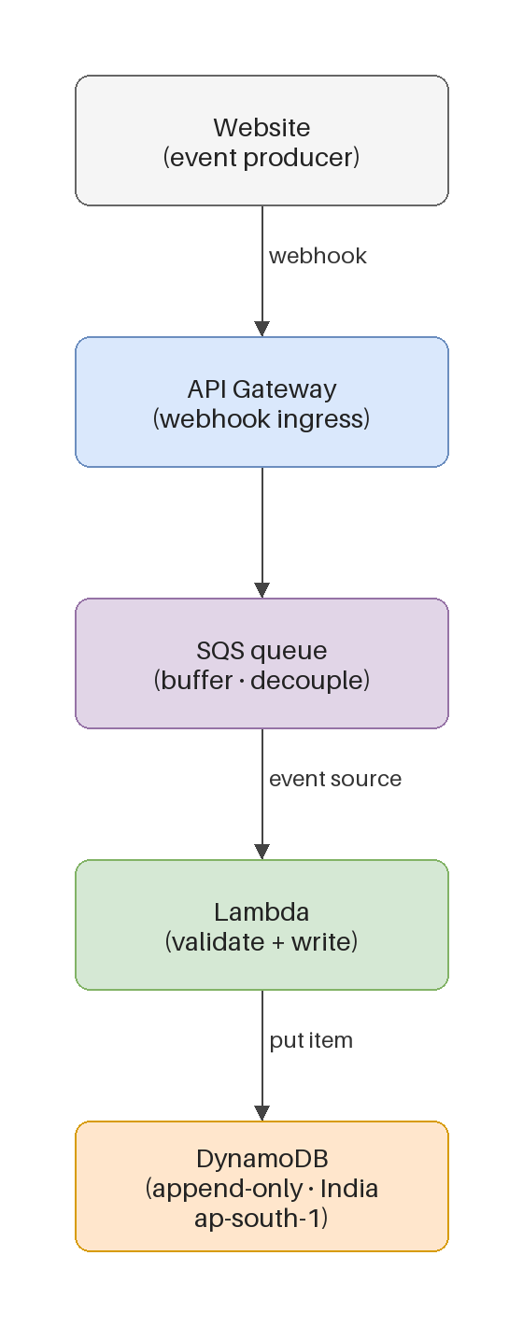
The target architecture
■ The flow: webhook, then gateway, then queue, then function, then datastore.
■ The platform knows only the webhook; each stage is independently scalable and replaceable.
■ The store sits in the region the obligation names — resident by construction, not by policy.
Kangan Institute
12
Notes:
Trace the flow stage by stage; each stage delivers a principle from the previous slide.
A worked example to adapt, not copy — workbook task 17 asks for their own drawing.

Slide 17
The integration contract
■ Define the webhook payload: the fields the platform sends and what each means.
■ Version it and validate it — producer and consumer agree on this and nothing else.
■ A clear contract is what lets the two sides evolve independently.
Kangan Institute
13
Notes:
Workbook task 18's subject. Contract-first: it is defined before either side builds, not documented after.
Question to pose: the platform team adds a field — how does versioning stop that breaking the logger?

Slide 18
ACTIVITY
Draw the architecture and define the contract
■ Workbook — tasks 17 and 18.
■ Draw your microservice architecture, then define the webhook integration contract it hinges on.
⏱ ~30 min
Kangan Institute
14
Notes:
Activity = practice workbook tasks 17–18.
The two common misses: redrawing the teaching diagram verbatim, and forgetting the queue seam.

Slide 19
Key takeaways
Section 3 · Architecture and contract
Every stage independently scalable; the platform knows only the webhook.
Residency is where you put the box, not a policy you add later.
Contract-first keeps the two sides independent.
Kangan Institute
15

Slide 20
04
SECTION
Justify it, and answer for it
your design, your argument
Kangan Institute

Slide 21
Justify the microservice design
■ For each choice: the requirement it serves, the option you took, and why that option over the alternative.
■ The strongest justification names what you did not choose and why the simpler option wins.
■ Someone holding the requirements should be able to tick your justification off line by line.
Kangan Institute
16
Notes:
Workbook task 19 — the written argument, same shape as the web-scale justification in Topic 1.
"Because it is best practice" is not a justification; requirement, option, why.

Slide 22
The knowledge questions ask about your own design
■ The Part A questions ask you to explain your component choices, your cohesion and coupling, the web-scaling principles you applied, and how the design keeps the residency option open.
■ Every answer cites your own design — the tables you filled in and the diagrams you drew are the material.
■ A definition with no reference to your design answers nothing.
Kangan Institute
17
Notes:
The assessment workbook carries Q1–Q4 at the end of Part A; the practice workbook carries none, so rehearse with the assessment's questions against the practice design.
The failure mode is textbook definitions — push every answer back to their own tables and drawings.

Slide 23
ACTIVITY
Justify the design and rehearse the questions
■ Workbook — task 19, then the assessment's Part A questions Q1 to Q4, answered from your practice design.
■ Justify the microservice design in writing, then answer the four knowledge questions citing your own choices.
⏱ ~30 min
Kangan Institute
18
Notes:
Activity = practice workbook task 19 + assessment Q1–Q4 rehearsed on the practice design.
Listen for answers that quote their own design decisions rather than recite definitions.

Slide 24
Key takeaways
Topic 2 · Key takeaways
One job, its own data, a narrow versioned contract.
High cohesion within, loose coupling between; the queue is the seam.
Justify choice by choice against requirements; answer questions from your own design.
Kangan Institute
19

Slide 25
Next: Topic 3 — disaster recovery
Part A's design work is done: the web-scale platform and the microservice, drawn, justified and defensible.
Next you plan for the day it all fails — DR requirements and impact analysis.

