Slide 1
TOPIC 04
DR: strategy & plan
Choose a recovery strategy to the objectives and assemble the documented DR plan
Kangan Institute

Slide 2

From analysis to a plan
■ Topic 3 set the objectives and ranked the risks; Topic 4 turns them into a recovery plan.
■ You evaluate the strategies, recommend one, add everything else a plan carries, and assemble it.
■ The plan must map to the prioritised risks and provably meet the objectives you set.
■ Planning only — recovery is not executed here.
Kangan Institute
1
Notes:
Today consumes Topic 3's output — the register and objectives stay on the desk; workbook tasks 28 to 37 in order.
Misconception: the plan is just picking a strategy. The strategy is one row; the plan is everything from detection to sign-off.

Slide 3
01
SECTION
Evaluate the options, recommend an approach
four strategies, one recommendation
Kangan Institute

Slide 4
The four cloud DR strategies
■ Backup and restore: cheapest, slowest — restore from backups after an event.
■ Pilot light: core data live in a second region, minimal standby; scale up on failover.
■ Warm standby: a scaled-down running copy, ready to take load quickly.
■ Multi-region active-active: full running copies, near-zero recovery targets, highest cost.
Kangan Institute
2
Notes:
A spectrum of cost against speed, walked cheapest to priciest — the core examinable content of the Topic.
Misconception: active-active is "best". The best strategy is the simplest that meets the objectives.

Slide 5
Strategy trade-offs
Strategy | RTO | RPO | Cost
Backup & restore | Hours | Hours | Low
Pilot light | ~10s of min | Minutes | Medium
Warm standby | Minutes | Seconds–min | Higher
Active-active | Near-zero | Near-zero | Highest
The right choice is the simplest that meets the objectives.
Kangan Institute
3

Slide 6
Evaluate the options, then recommend
■ Evaluate each strategy against the objectives and budget from your own analysis — a range considered is part of the evidence.
■ Recommend the simplest option that meets the requirements, and say what ruled out the cheaper ones.
■ Cheaper is right until it fails an objective.
Kangan Institute
4
Notes:
Workbook tasks 28 and 29 — the evaluation then the recommendation, as separate written steps.
The step-up reasoning is what markers look for: start cheap, move up only when a target forces it.

Slide 7
ACTIVITY
Evaluate and recommend
■ Workbook — tasks 28 and 29.
■ Evaluate the recovery options against your objectives, then record the recommended approach and what ruled the others out.
⏱ ~25 min
Kangan Institute
5
Notes:
Activity = practice workbook tasks 28–29.
Watch for jumping straight to active-active "to be safe", and choices made with no numbers cited.

Slide 8
Key takeaways
Section 1 · The choice
Four strategies trade recovery speed against standing cost.
Show the range considered; recommend the simplest that fits.
Every elimination cites an objective.
Kangan Institute
6

Slide 9
02
SECTION
The rest of the plan
native protections, priorities, and the parts everyone forgets
Kangan Institute

Slide 10
Lean on native protections and prioritise
■ Use the vendor's native protections: automated backups, cross-region copy, durable storage.
■ Prioritise recovery against the ranked risks — the highest-severity, business-critical parts come back first.
■ Native durability does the heavy lifting; your plan sequences and governs it.
Kangan Institute
7
Notes:
Workbook task 30. Recovery order is set by the Topic 3 ranking, not by convenience.
Question to pose: you can't bring everything back at once — what decides the order?

Slide 11
Insurance, and the other components
■ Insurance transfers residual loss — it covers money, it does not restore service.
■ The other components: the runbook, declaration and escalation, communications, failover of the entry point.
■ A plan is who does what, in what order, and how people are told — not just a strategy name.
Kangan Institute
8
Notes:
Workbook tasks 31 and 32. Insurance sits alongside recovery, never instead of it — a refund buys back none of your recovery time.
The human components are the ones students forget; prompt "who declares the disaster?"

Slide 12
ACTIVITY
Priorities, insurance and components
■ Workbook — tasks 30, 31 and 32.
■ Record the vendor protections leaned on and the recovery priorities, the role insurance plays, and the other components your plan carries.
⏱ ~25 min
Kangan Institute
9
Notes:
Activity = practice workbook tasks 30–32.
Push past the technical parts — escalation, communications and ownership are assessed components too.

Slide 13
Key takeaways
Section 2 · The components
Build on native protections; sequence by severity.
Insurance covers residual loss only.
Runbook, escalation, communications, failover — the plan's working parts.
Kangan Institute
10

Slide 14
03
SECTION
Detection, steps, and proving the targets
detect it, recover it, prove the clock fits
Kangan Institute

Slide 15
Detection and alerting
■ A plan that starts with "when someone notices" has already spent its recovery time.
■ State what detects each event class — monitoring, alarms, health checks — and who gets told, how.
■ Detection time is inside the recovery clock; the objective includes it.
Kangan Institute
11
Notes:
Workbook task 33 — detection as part of the plan, not an assumption. The RTO clock starts at the event, not at the discovery.
Tie back to the alarm work they'll do in AT2 — same machinery, planning-side view.

Slide 16
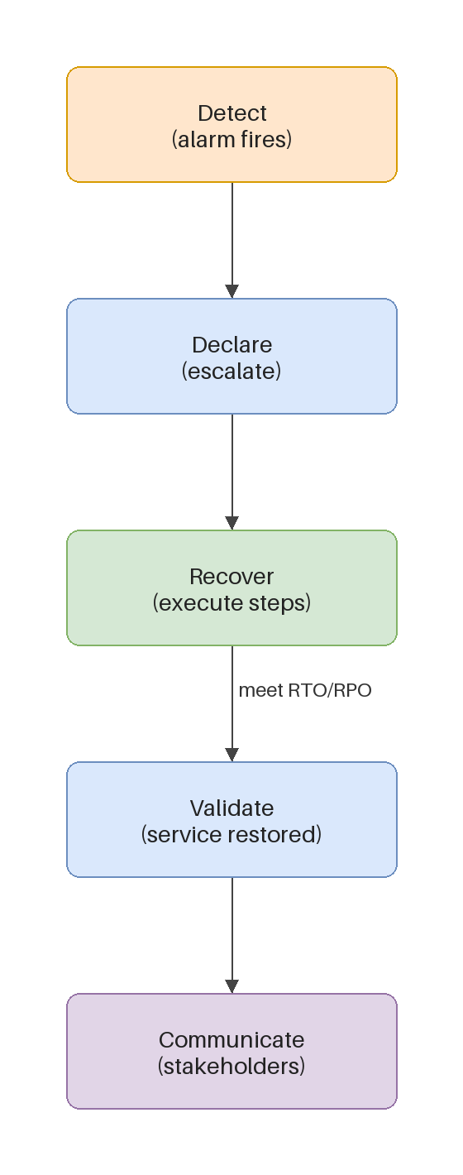
The recovery steps
■ Ordered steps with timelines, key features, and the service providers involved.
■ Name who executes each step and what recovered looks like — an owner and a definition of done per step.
■ Recover in priority order; the sequence comes from your ranking, not from habit.
Kangan Institute
12
Notes:
Workbook task 34 — the runbook. Walk the diagram: detect, declare, recover in priority order, verify.
No anonymous actions; every step carries a who and a done.

Slide 17
Show the plan meets the objectives
■ Add the step timings up and set the total against the recovery time objective — the arithmetic is the proof.
■ Do the same for data: what the plan can lose against what the objective allows.
■ If the numbers don't fit, the plan changes — re-sequence, parallelise, or step the strategy up.
Kangan Institute
13
Notes:
Workbook task 35 — the explicit objectives argument. Listing the right steps is not proof; the addition is.
This is where a cheap strategy honestly fails and gets stepped up — that revision is good evidence.

Slide 18
ACTIVITY
Detection, steps and the proof
■ Workbook — tasks 33, 34 and 35.
■ State the detection and alerting, write the recovery steps with owners and timings, then show the plan meets the recovery objectives.
⏱ ~35 min
Kangan Institute
14
Notes:
Activity = practice workbook tasks 33–35.
Make them add the timings up — the missing arithmetic is the most common gap in the whole Part B.

Slide 19
Key takeaways
Section 3 · The proof
Detection time is inside the recovery clock.
Every step has an owner, a timing, and a definition of done.
The arithmetic against the objectives is the proof.
Kangan Institute
15

Slide 20
04
SECTION
Standards, and the assembled plan
to a standard, in one document
Kangan Institute

Slide 21
Continuity standards
■ ISO/IEC 27031 — ICT readiness for business continuity; 27001/27002 — the security management context around it.
■ Standards give the plan a recognised structure and assurance language.
■ Reference them so the plan is auditable, not ad hoc.
Kangan Institute
16
Notes:
Workbook task 36 — which standards the plan reflects, and why referencing them matters.
Misconception: you must implement the standard. At this level you reference it to structure and justify the plan.

Slide 22
Assemble the Disaster Recovery Plan
■ Bring the parts into one document: requirements, objectives, risks, strategy, components, steps, proof.
■ Complete, internally consistent, and traceable — any action leads back to the risk and requirement that drove it.
■ Written for the business in plain professional English; this is the deliverable of the whole Part B.
Kangan Institute
17
Notes:
Workbook task 37 — assembly. The reader test: someone cold can follow any recovery action back to its risk.
Everything from Topics 3 and 4 exists to produce this one artefact.

Slide 23
ACTIVITY
The standards, and the assembled plan
■ Workbook — tasks 36 and 37, then the assessment's Part B question Q7 from your own plan.
■ Record the standards the plan reflects, assemble the full Disaster Recovery Plan, then explain the recovery techniques available and why yours fits.
⏱ ~35 min
Kangan Institute
18
Notes:
Activity = practice workbook tasks 36–37 + assessment Q7 rehearsed from the assembled plan.
The practice workbook carries no questions — use the assessment's, answered from the plan just written.

Slide 24
Key takeaways
Topic 4 · Key takeaways
Recommend the simplest strategy the objectives allow, and show your working.
A plan is detection, steps, owners, timings, components — with the arithmetic proving the targets.
Reference the continuity standards; assemble one traceable document.
Kangan Institute
19

Slide 25
Next: Topic 5 — present for approval
The Solution Design and the Disaster Recovery Plan are both complete.
Next you take them to the client: the walkthrough, the feedback, the lodgement and the sign-off.

