Slide 1
TOPIC 06
IaC: fundamentals & operating provided templates
Infrastructure as Code from first principles, then operating a template you were given
Kangan Institute

Slide 2

From design to build
■ AT1 is signed off; AT2 begins — you build in the lab, to the approved design.
■ This Topic: what IaC is, then operating a template someone else wrote — including when it fails.
■ Region substitution starts here: the design names its real region, but you deploy to us-east-1 in the lab. Same build, only the console region differs.
■ teach, demo, practice: watch the demo, then do it on the practice workbook.
Kangan Institute
1
Notes:
Start of the AT2 build arc — workbook tasks 1 to 10 today, in order.
Say the region substitution out loud: the design still mandates the real region for legal reasons; the lab just can't host it.
Misconception: us-east-1 means residency doesn't matter. No — substitute and label it.

Slide 3
01
SECTION
Why IaC, and choosing the service
describe infrastructure, don't click it
Kangan Institute

Slide 4
What Infrastructure as Code is
■ IaC describes infrastructure in a text template the platform provisions for you.
■ Benefits over manual console work: repeatable, versioned, reviewable, fast to rebuild.
■ The same template gives the same result every time — no click-to-click drift.
Kangan Institute
2
Notes:
Workbook task 1's subject — the benefits are the examinable list; say them as the reasons a professional uses IaC.
Question to pose: you built it perfectly in the console last week and need it again today — what does the console give you?

Slide 5
What automation gives, and what can go wrong
■ One template stands up many related resources consistently, in the right order, without manual steps.
■ The failure modes are real: drift from manual edits, a bad change rolling a stack back, permission and quota errors.
■ Knowing what can go wrong is part of the competence — it's a workbook task, not a footnote.
Kangan Institute
3
Notes:
Workbook tasks 2 and 3 — the upside and the downside, as separate written answers.
Drift is the one to make concrete: someone hand-edits a deployed resource and the template no longer tells the truth.

Slide 6
Select the infrastructure-as-code service
■ Choose an IaC service compatible with the platform — on AWS, CloudFormation is native.
■ Compatibility is the criterion: the service must speak the platform's resources directly.
■ Record the choice and the reason — it's a decision, and decisions get justified.
Kangan Institute
4
Notes:
Workbook task 4. Native versus third-party is worth naming, but the workbook asks for a justified selection, not a survey.

Slide 7
ACTIVITY
The IaC groundwork
■ Workbook — tasks 1, 2, 3 and 4.
■ Record why IaC fits this job, what the automation gives, what can go wrong, and the service you select.
⏱ ~25 min
Kangan Institute
5
Notes:
Activity = practice workbook tasks 1–4, all written answers.
Push past generic answers — each one is about this job and this platform.

Slide 8
Key takeaways
Section 1 · The groundwork
Repeatable, versioned, reviewable, rebuildable.
The failure modes are part of the knowledge.
Select the service for compatibility, and justify it.
Kangan Institute
6

Slide 9
02
SECTION
Reading a template you were given
read it before you run it
Kangan Institute

Slide 10
Template syntax
■ The parts: Parameters take inputs, Resources declare what to create, Outputs share results, intrinsic functions wire them together.
■ Resources declare desired state; the platform works out how to reach it.
■ Read top-down: inputs, then resources, then outputs.
Kangan Institute
7
Notes:
The anatomy, so students can read one. Declarative is the mindset shift — file order is not execution order.
Question to pose: the template says a database and a server should exist — who decides the creation order? (the references).

Slide 11
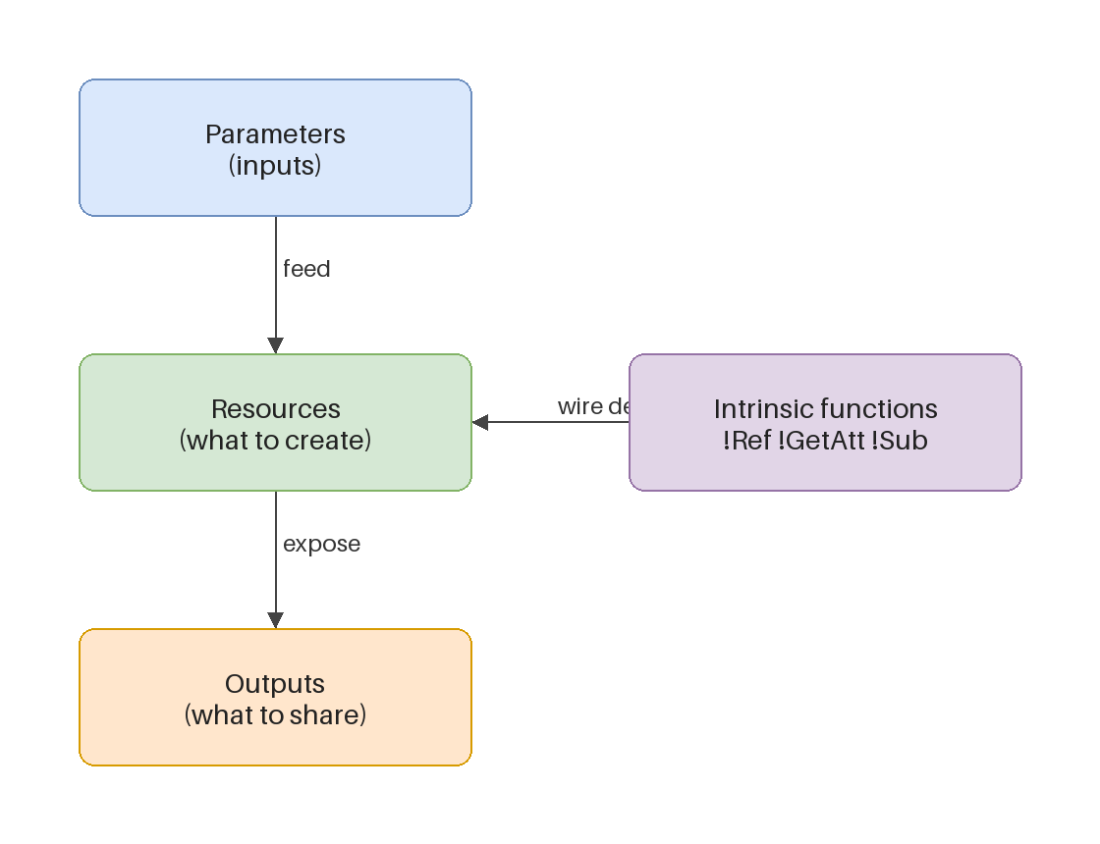
Review the provided template
■ Determine what resources it creates and what depends on what — the build order falls out of the references.
■ Know what a template does before you deploy it; deploying blind is how surprises get expensive.
■ The provided data-store template is the case: read it, list its resources, trace its references.
Kangan Institute
8
Notes:
Workbook task 5 — the assessed reading skill. Trace one reference live on the diagram.
A professional reviews before running; the workbook's table asks for exactly that review.

Slide 12
ACTIVITY
Review the data-store template
■ Workbook — task 5.
■ Review the provided template: the resources it creates, their dependencies, and what the parameters control.
⏱ ~20 min
Kangan Institute
9
Notes:
Activity = practice workbook task 5, on the practice template.
The dependency question is the one to press: how do you know, from the file alone, what must exist first?

Slide 13
Key takeaways
Section 2 · Reading
Parameters, resources, outputs — read top-down.
Desired state, not steps; references make the order.
Never deploy what you haven't read.
Kangan Institute
10

Slide 14
03
SECTION
Deploy it, fix it, confirm it
the first failure is the cause
Kangan Institute

Slide 15
The tooling, and what failure looks like
■ The console or the CLI executes the template — either tool, same operations.
■ When a deployment fails it rolls back, and the rollback fills the log with consequences, not causes.
■ Find the first failure event and read its reason — that one is the cause.
Kangan Institute
11
Notes:
Sets up the deploy-fail-fix run the workbook stages: the practice template fails first time by design.
The first-CREATE_FAILED discipline is the whole method; the later failures are downstream.

Slide 16
RECORDED DEMO
Deploy, hit the failure, fix it
■ Deploy the provided template in the lab and let it fail.
■ Find the first failure event, read its reason aloud, make the one-line fix, redeploy to success.
■ Confirm the resource exists using the console or CLI — deploy then confirm, every time.
▶ Play the AWS recorded demo (recorded/live demo) — you do this next
Kangan Institute
12
Notes:
Live demonstration, educator-led (screen it live or your own capture — no recorded-demos catalogue in CL2).
Set the region first and say the substitution out loud.
Narrate the diagnosis before touching anything — model reading over guessing.
Common errors worth naming as you go: a bad reference, a missing permission, an invalid property, a name clash.
Prep: clean lab, the practice data-store template to hand. ~8–10 min.

Slide 17
Confirming a deployment
■ A green status is the platform's claim; confirmation is you checking the resource itself.
■ Use the console or the CLI: does the resource exist, with the properties the template declared?
■ Deploy, then confirm — the habit that catches the gap between claimed and real.
Kangan Institute
13
Notes:
Workbook task 8 makes confirmation its own task — treat it as one, not as glancing at the status colour.

Slide 18
ACTIVITY
Deploy, diagnose, fix, confirm
■ Workbook — tasks 6, 7 and 8.
■ Deploy the provided template, diagnose and fix the failure it hits, redeploy, and confirm the deployment properly.
⏱ ~30 min
Kangan Institute
14
Notes:
Activity = practice workbook tasks 6–8. The failure is planted; hitting it is the exercise, not a mistake.
Watch for reading the last failure instead of the first, and for random property-poking instead of diagnosis.

Slide 19
Key takeaways
Section 3 · Deploy and fix
Read the first failure event; the rest is rollback noise.
One deliberate fix, then redeploy — diagnosis over trial and error.
Confirm the resource, not the status colour.
Kangan Institute
15

Slide 20
04
SECTION
Update it, and put it back
every change is a reviewable diff
Kangan Institute

Slide 21
Updating through the template
■ To change a deployed stack, change the template — never the live resources by hand.
■ A change set shows the diff before it runs: what will be added, modified, replaced.
■ Review the diff, execute, confirm — the same confirm habit as the deploy.
Kangan Institute
16
Notes:
Workbook task 9. Hand-editing a templated resource is drift — connect back to C1's failure modes.
Pause on the change set in any demo; the review-before-run moment is the teaching.

Slide 22
Return it to a known state
■ A practice environment ends where it began: return the store to its known state.
■ Known state means provable — the template and the deployed reality agree again, and you can say how you know.
■ Stacks you manage through templates go up and come back down the same way.
Kangan Institute
17
Notes:
Workbook task 10 — the reset, done through the tooling, confirmed like everything else.
Full removal is a later closeout task; today is about returning to baseline.

Slide 23
ACTIVITY
Update and reset
■ Workbook — tasks 9 and 10.
■ Update the provided template and redeploy through a change set, then return the store to its known state and show how you know.
⏱ ~25 min
Kangan Institute
18
Notes:
Activity = practice workbook tasks 9–10.
Ask each student what their change set listed before they executed it.

Slide 24
Key takeaways
Section 4 · Change and reset
Change the template, not the resources.
Review the diff before it runs.
Known state is provable state.
Kangan Institute
19

Slide 25
05
SECTION
Shared cloud foundations
the standards under the build
Kangan Institute

Slide 26
Standards and standard products
■ Industry technology standards underpin the build: interoperability, security and management baselines.
■ Standard products are what the platform assembles from: compute families, managed databases, object and block storage.
■ This foundation sits under both halves of the build — the templates and the microservice — and it comes back in the written questions.
Kangan Institute
20
Notes:
Shared KE across both units, taught once here, assessed in the AT2 written questions at closeout.
Make it concrete: name one standard product in this build and a baseline it implements.

Slide 27
Next: Topic 7 — author your own
You can read, deploy, fix, update and reset a template someone else wrote.
Next you write your own — and what it deploys is the microservice you designed in Topic 2.

