Slide 1
TOPIC 07
Building the microservice with your own IaC
Author your own template, deploy the microservice from it, prove it works, then make it reusable
Kangan Institute

Slide 2
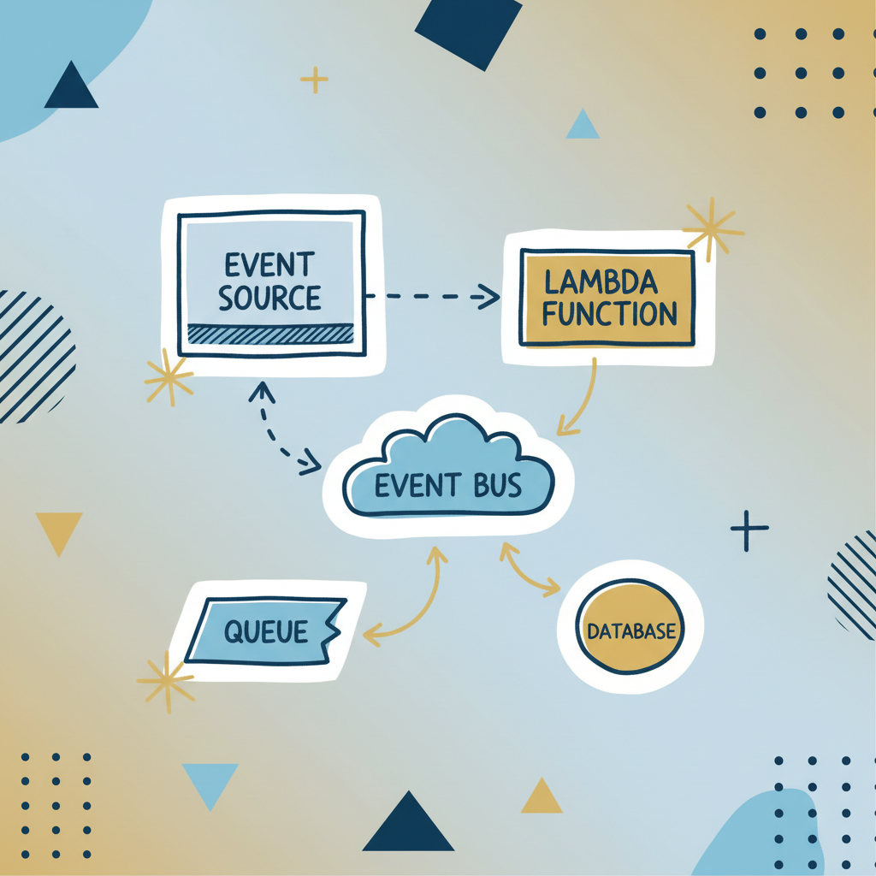
Build what you designed
■ This is the centre of AT2: the microservice you designed in Topic 2, built by a template you author yourself.
■ The code is supplied; the infrastructure is yours to declare — review, author, deploy, confirm, test, troubleshoot, reuse.
■ The design names its real region; in the lab you deploy to us-east-1 — same build, different console label.
■ The lab's LabRole serves as every execution role and credential — you never create IAM here.
Kangan Institute
1
Notes:
The biggest Topic of AT2 — workbook tasks 11 to 18, one continuous build in workbook order.
Point back to the Topic 2 design: the paper design is today's build spec.
Flag LabRole now so nobody goes hunting for IAM to build.

Slide 3
01
SECTION
Review before you build
read the code, hold the contract
Kangan Institute

Slide 4
Review the supplied code and the contract
■ Read the provided handler and the webhook contract: what the code expects, what it writes, what it needs from config.
■ Your design from Topic 2 is the build spec — re-read it beside the code and note where they meet.
■ Deployment is assembling parts you understand; skipping the review means wiring blind.
Kangan Institute
2
Notes:
Workbook task 11 — the read-first discipline before any console work.
The config question is the hook: the code needs a table name — where does it come from? (deployment config, which their template supplies).

Slide 5
ACTIVITY
Review the code and contract
■ Workbook — task 11.
■ Work out what the supplied code does, what the contract promises, and what the infrastructure must provide for both.
⏱ ~20 min
Kangan Institute
3
Notes:
Activity = practice workbook task 11.
The output that matters: a list of what the template must create — it becomes the plan for task 12.

Slide 6
Key takeaways
Section 1 · The review
Know what the code expects before you provision anything.
The Topic 2 design plus the contract is the build spec.
Kangan Institute
4

Slide 7
02
SECTION
Author your template
declare the microservice's infrastructure
Kangan Institute

Slide 8
Authoring from syntax
■ Apply the template syntax to declare a set of related resources — the reading skill from last Topic, reversed.
■ Start from the outcome: what resources, what depends on what, what inputs and outputs.
■ Build incrementally — a few resources, deploy, confirm, add more. Don't write it all then drown in errors.
Kangan Institute
5
Notes:
The step up from reading to producing. Design the template before typing it.
Incremental authoring is the habit that saves the session — a big-bang deploy buries the first failure under many.

Slide 9
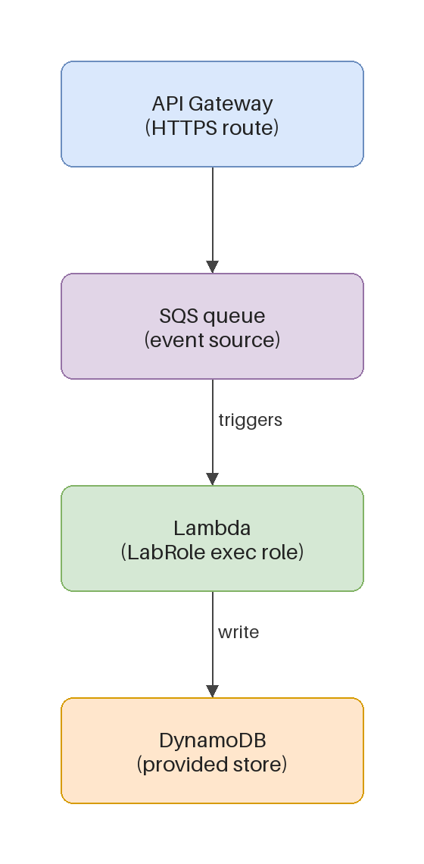
The wiring your template declares
■ The gateway receives the webhook and hands it on; the queue is the function's event source; the function writes to the store.
■ The event-source mapping is the make-or-break declaration — a deployed function that nothing triggers just sits there.
■ The store's table name reaches the function as configuration, not hard-coded.
Kangan Institute
6
Notes:
The event-driven wiring pattern, on the diagram — this is what their template has to say.
Students expect a direct API-to-function call; the queue in between is the design point worth pressing.

Slide 10
Industry IaC practice
■ Parameters over hard-coded values; least privilege on any role; tag every resource.
■ Outputs expose what other stacks and services need — the integration seam.
■ Standard practice is what makes a template safe to reuse and hand over.
Kangan Institute
7
Notes:
The professional checklist their authored template is judged against.
In the lab, least privilege means passing LabRole — the practice point still stands outside the lab.

Slide 11
RECORDED DEMO
Author a template from scratch
■ Author a small template live: state the outcome, declare a couple of resources with a dependency, apply the practices as you go.
■ Deploy it and watch it reach CREATE_COMPLETE.
▶ Play the AWS recorded demo (recorded/live demo) — you do this next
Kangan Institute
8
Notes:
Live demonstration, educator-led (screen it live or your own capture — no recorded-demos catalogue in CL2).
Design before typing — say the resources and dependencies out loud first.
Point at each practice as you write it: a parameter, a tag, the role passed not created.
Prep: clean lab in us-east-1, a small related resource set in mind, editor ready. ~8–10 min.

Slide 12
ACTIVITY
Author your template
■ Workbook — task 12.
■ Write the template that deploys the microservice: the resources the review said you need, wired the way the design says.
⏱ ~40 min
Kangan Institute
9
Notes:
Activity = practice workbook task 12 — the biggest single task in AT2. Authoring is slow; budget for it.
Push incremental: a tiny deployable version first, grown resource by resource.
The task 11 list is their checklist — every item on it becomes a declaration.

Slide 13
Key takeaways
Section 2 · Authoring
Design the template before typing it; build it incrementally.
The event-source mapping is the wiring that makes it a pipeline.
Parameters, least privilege, tags, outputs — the professional checklist.
Kangan Institute
10

Slide 14
03
SECTION
Deploy it, and confirm it
expect more than one attempt
Kangan Institute

Slide 15
Deploying your own template
■ Expect it to take more than one attempt — that is normal, and the workbook says so.
■ Same discipline as last Topic: first failure event, read the reason, one deliberate fix, redeploy.
■ Each failure you fix is evidence — record what broke and what fixed it as you go.
Kangan Institute
11
Notes:
Workbook task 13. Normalise the fail-fix loop before they start; the record-as-you-go habit feeds task 16.
Blind redeploys burn the lab clock; hold them at the log until they can name the cause.

Slide 16
RECORDED DEMO
Deploy the microservice from your template
■ Deploy the authored template in the lab; pass LabRole; watch the events through to CREATE_COMPLETE.
■ Confirm each resource exists and the event-source mapping is enabled.
▶ Play the AWS recorded demo (recorded/live demo) — you do this next
Kangan Institute
12
Notes:
Live demonstration, educator-led. Say the region substitution out loud as you set it.
The event-source mapping check is the one students skip — show where it lives and that it's on.
Prep: the C2 demo template ready to deploy, lab open. ~6–8 min.

Slide 17
Confirm the deployment properly
■ Confirmation is checking the resources, not the status colour — console or CLI, either counts.
■ Does each resource exist, with the properties your template declared? Is the wiring live?
■ Deploy, then confirm — every time, and record what you checked.
Kangan Institute
13
Notes:
Workbook task 14 makes confirmation its own task. The green stack status is the platform's claim; the check is theirs.

Slide 18
ACTIVITY
Deploy and confirm
■ Workbook — tasks 13 and 14.
■ Deploy your template — expect and work through failures — then confirm every resource and the wiring.
⏱ ~35 min
Kangan Institute
14
Notes:
Activity = practice workbook tasks 13–14.
Failures here are the workbook working as designed; the record of them feeds the troubleshooting task.

Slide 19
Key takeaways
Section 3 · Deploy and confirm
More than one attempt is normal; read the first failure.
Record each break and fix as you go.
Confirm resources and wiring, not the status colour.
Kangan Institute
15

Slide 20
04
SECTION
Test it end to end, and troubleshoot
the record is the proof, the logs are the map
Kangan Institute

Slide 21
Test by the observable outcome
■ Send a real event through the contract and find the record in the store — that is the test.
■ A success response only says the front door accepted it; the pipeline behind is asynchronous.
■ Test the unhappy path too: an invalid event should be turned away, and no bad record written.
Kangan Institute
16
Notes:
Workbook task 15. The 200-is-not-proof point is the heart of it — walk from response to stored record every time.
Exactly-once matters: one post, one item — not zero, not two.

Slide 22
RECORDED DEMO
Post events and confirm records
■ Post a valid event and find the item in the store; post an invalid one and confirm it is rejected.
▶ Play the AWS recorded demo (recorded/live demo) — you do this next
Kangan Institute
17
Notes:
Live demonstration, educator-led, against the deployed demo pipeline.
Show where you look — the store item, not the API response. Both paths, side by side.
Prep: valid and invalid sample events ready, store open in another tab. ~6–8 min.

Slide 23
Troubleshoot from the logs
■ The failure is recorded somewhere — function logs, queue behaviour, dead letters. Find it before touching anything.
■ The usual suspects: a permission error, a payload-validation bug, a mis-wired event source.
■ Fix, redeploy, re-test — the loop ends when the record writes, not when the error stops.
Kangan Institute
18
Notes:
Workbook task 16 asks for the record of what actually broke across tasks 12–15 and what was done — the fail-fix notes pay off here.
Read-diagnose-fix-redeploy-retest, narrated from the log; guessing is the anti-pattern.

Slide 24
ACTIVITY
Test and troubleshoot
■ Workbook — tasks 15 and 16.
■ Test the microservice end to end through the contract, then record what actually broke along the way and how you fixed it.
⏱ ~30 min
Kangan Institute
19
Notes:
Activity = practice workbook tasks 15–16.
Task 16 is honest history, not hypotheticals — what broke for them, found in their own notes and logs.

Slide 25
Key takeaways
Section 4 · Prove and fix
The stored record is the proof; the response code is not.
Invalid events turned away is half the test.
The logs name the cause; the notes become the troubleshooting record.
Kangan Institute
20

Slide 26
05
SECTION
Make it reusable, then grow it
one template, many environments
Kangan Institute

Slide 27
Parameterisation and reuse
■ Parameterise so the same template body deploys different configurations — values in, nothing edited.
■ Names, sizes, environments, regions: anything that varies between deployments is a parameter.
■ Write once, deploy many — this is the code-reuse payoff of IaC.
Kangan Institute
21
Notes:
Workbook task 17's idea. Copying the template and editing it is the anti-pattern — two templates drift apart.
Region as a parameter is the neat tie back to the scenario/deploy substitution.

Slide 28
Add a resource through an update
■ Grow the template, not the console: add the new resource to the file and update the stack.
■ The change set shows the diff — the existing resources stay, the new one arrives.
■ Update, confirm, and the template still tells the whole truth about the stack.
Kangan Institute
22
Notes:
Workbook task 18. Tearing down and rebuilding loses state; the update-in-place is the skill.
The template-tells-the-truth framing connects back to drift from Topic 6.

Slide 29
RECORDED DEMO
Parameterise, redeploy, extend
■ Turn a hard-coded value into a parameter and deploy a second environment beside the first.
■ Then add a resource to the template and update the running stack — watch the diff apply.
▶ Play the AWS recorded demo (recorded/live demo) — you do this next
Kangan Institute
23
Notes:
Live demonstration, educator-led. The template body not changing between the two environments is the point made visible.
Pause on the change set before the update — review before run, one more time.
Prep: the deployed demo stack, one obvious value to parameterise, one small resource to add. ~8 min.

Slide 30
ACTIVITY
Parameterise and extend
■ Workbook — tasks 17 and 18.
■ Redeploy your template as a second environment by changing only parameter values, then add a resource and update the existing stack in place.
⏱ ~30 min
Kangan Institute
24
Notes:
Activity = practice workbook tasks 17–18.
Insist the body stays fixed between the two environments — editing it defeats the exercise.

Slide 31
Key takeaways
Topic 7 · Key takeaways
Review the code, author to the design, build incrementally.
Expect failures; read the first one; record the history honestly.
The stored record is the proof of a working pipeline.
One parameterised template: many environments, grown by updates, never drifting.
Kangan Institute
25

Slide 32
Next: Topic 8 — monitoring
The microservice is built, tested and reusable — by a template you wrote yourself.
Next you make it observable: the metric and alarm that tell you it's alive without you looking.

