Slide 1
TOPIC 08
Monitoring & alarms
Make the running microservice observable — a metric and a scaling-relevant alarm
Kangan Institute

Slide 2
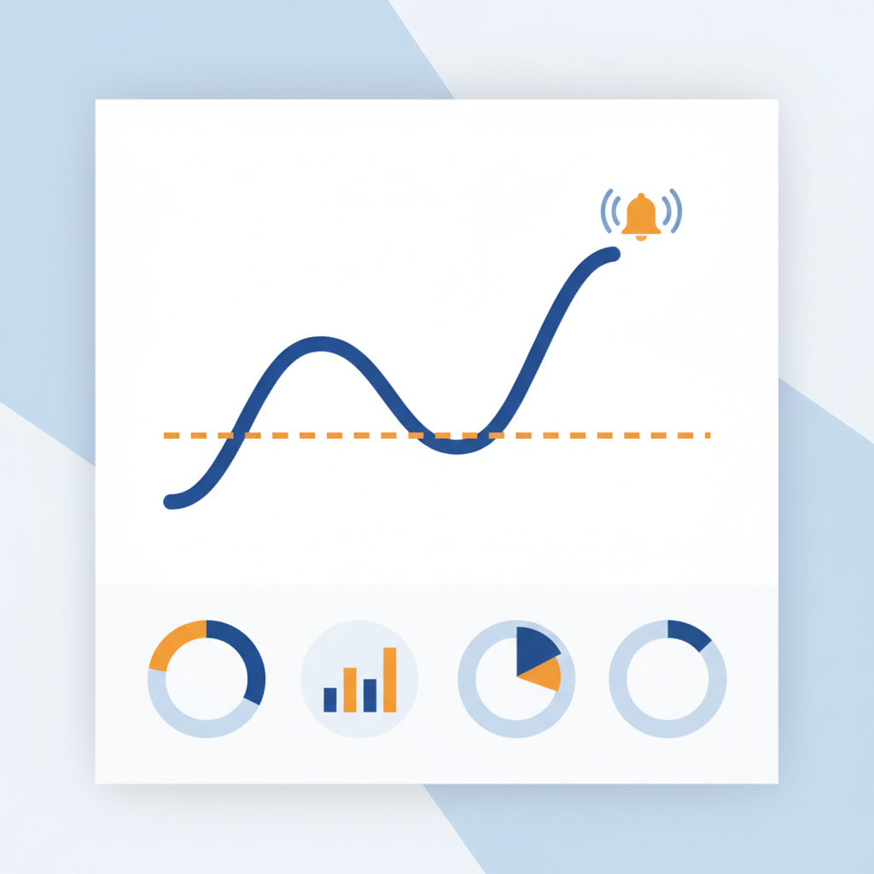
Make it observable
■ The microservice runs; now you make it observable so you can see trouble coming.
■ This is the practical form of the DR plan's detection step from Topic 4 — the paper promise becomes real configuration.
■ One workbook task today, done properly: a metric that means something, and an alarm that provably fires.
Kangan Institute
1
Notes:
The pivot from "it runs" to "you can see it running" — workbook task 19.
Tie back to Topic 4's detection step: a system you can't observe can't meet its own recovery objectives.

Slide 3
01
SECTION
Metrics, and what to watch
watch the right signals
Kangan Institute

Slide 4
Cloud metrics
■ A metric is a time-series number the platform emits about a resource.
■ Monitoring watches the metrics that predict trouble, before users feel it.
■ You cannot manage what you do not measure.
Kangan Institute
2
Notes:
Foundation slide. The art is choosing the few leading signals, not building a dashboard wall.
A useful metric moves before the failure — a rising queue, not a user complaint.

Slide 5
What to watch on the microservice
■ Queue depth: the scaling signal for a queue-driven function — a rising backlog means the consumer can't keep up.
■ Function errors and throttles: the code failing, or the platform limiting concurrency.
■ Store throttles: the datastore pushing back under load.
Kangan Institute
3
Notes:
The primer made concrete for their pipeline. No server CPU to watch — the serverless signals differ from a VM's.
Queue depth is the headline: it predicts overload, which makes it the natural alarm candidate.

Slide 6
Key takeaways
Section 1 · The signals
Metrics are time-series signals; pick the leading ones.
Queue depth, function errors and throttles, store throttles.
Kangan Institute
4

Slide 7
02
SECTION
The alarm, set and proven
a threshold that tells someone
Kangan Institute

Slide 8
Set an alarm to the design spec
■ A scaling-relevant alarm: a threshold on a meaningful metric, with a notification attached.
■ The threshold traces to a design target — "why that number?" has an answer from the spec, not a shrug.
■ An alarm nobody is told about is a light in an empty room; the notification is half the point.
Kangan Institute
5
Notes:
Workbook task 19's discipline: metric, threshold, notification — and the threshold defensible from the design.
Round numbers plucked from the air are the thing to challenge.

Slide 9
RECORDED DEMO
Configure and fire an alarm
■ Configure a queue-depth alarm with a notification, then drive the metric past the threshold.
■ Watch it go to alarm, see the notification arrive, and watch it recover.
▶ Play the AWS recorded demo (recorded/live demo) — you do this next
Kangan Institute
6
Notes:
Live demonstration, educator-led (screen it live — no recorded-demos catalogue in CL2).
Say where the threshold number comes from as you type it.
Show the full lifecycle: OK, alarm, notification, back to OK — a configured-but-never-fired alarm is untested.
Prep: the microservice running, a way to flood the queue, the notification target visible. ~8–10 min.

Slide 10
ACTIVITY
Set up the metric and the alarm
■ Workbook — task 19.
■ Set up the metric and the scaling-relevant alarm with a notification, drive it to alarm, and confirm the notification fired.
⏱ ~25 min
Kangan Institute
7
Notes:
Activity = practice workbook task 19.
The two misses: an alarm configured but never fired, and a threshold they can't justify.

Slide 11
Key takeaways
Topic 8 · Key takeaways
Monitor the signals that predict trouble on a serverless service.
Threshold from the spec, notification attached.
An untested alarm is not an alarm — fire it and prove it.
Kangan Institute
8

Slide 12
Next: Topic 9 — close out the build
The build is complete and observable.
Next you document it for the people who inherit it, take it down cleanly, and get it signed off.

