Slide 1
TOPIC 09
Documenting, teardown & sign-off
User documentation, a clean teardown, the sign-off, and the written questions
Kangan Institute

Slide 2
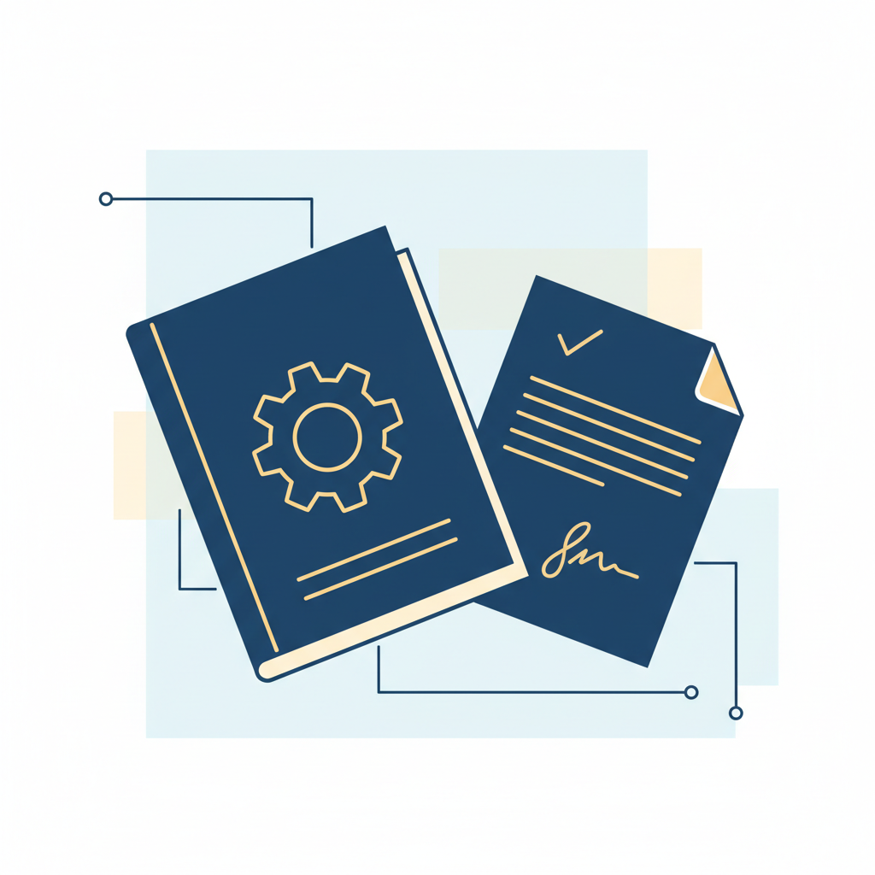
Closing out the build
■ The system is built, tested and observable; now it gets documented, taken down, and signed off.
■ Three tasks and three questions today — the professional wrap on the whole build.
■ Everything you captured during the build is the material — a closeout can't be reconstructed from memory.
Kangan Institute
1
Notes:
Workbook tasks 20 to 22, then the written questions Q1 to Q3.
The capture-as-you-go habit from Topic 7 pays off here; thin evidence now is a habit gap surfacing.

Slide 3
01
SECTION
User documentation
someone else can run your stacks
Kangan Institute

Slide 4
What IaC user documentation is for
■ User docs let someone who didn't write the template deploy, update and delete it safely.
■ Include the templates and their parameters — what each does and its allowed values.
■ Clear, logical structure — a reader follows it without you in the room.
Kangan Institute
2
Notes:
The audience is a future operator, not the author. Undocumented parameters are traps.
Readable code is not a runbook — the operations need spelling out.

Slide 5
Document operating the stacks
■ How to deploy, update through a change set, and delete each stack, with its parameters.
■ Note where the region is a parameter and what the lab substitution meant.
■ Procedures, not descriptions — numbered steps a stranger can follow under pressure.
Kangan Institute
3
Notes:
Workbook task 20. The common miss is describing what the template contains instead of how to operate it.
Update-via-change-set is the procedure students forget to document.

Slide 6
ACTIVITY
Write the user documentation
■ Workbook — task 20.
■ Write the user documentation for what you built: deploy, update and delete for each stack, parameters included.
⏱ ~30 min
Kangan Institute
4
Notes:
Activity = practice workbook task 20.
The swap test works: could a neighbour deploy the stack from the doc alone?

Slide 7
Key takeaways
Section 1 · The docs
Written for the operator who inherits it.
Deploy, update, delete — as procedures, with the parameters.
Kangan Institute
5

Slide 8
02
SECTION
Taking it down cleanly
nothing left behind, nothing still billing
Kangan Institute

Slide 9
Remove what you deployed
■ Tear down through the tooling, not by hand — the stack goes down the way it came up.
■ Confirm the removal: a delete that leaves orphans keeps costing and blocks a rebuild.
■ Multiple stacks come down in reverse dependency order — the one nothing depends on goes first.
Kangan Institute
6
Notes:
Workbook task 21. Hand-deleting resources a template owns is the closing form of drift.
Confirming the teardown is the half students skip — check the console after, not just the delete status.

Slide 10
ACTIVITY
Tear it down
■ Workbook — task 21.
■ Remove everything you deployed using the tooling, in the right order, and confirm nothing is left behind.
⏱ ~20 min
Kangan Institute
7
Notes:
Activity = practice workbook task 21.
Ask what order they chose and why — the dependency reasoning is the teaching.

Slide 11
Key takeaways
Section 2 · The teardown
Through the tooling, in reverse dependency order.
Confirmed gone, not assumed gone.
Kangan Institute
8

Slide 12
03
SECTION
Confirming the build, and sign-off
walk them through it, get it accepted
Kangan Institute

Slide 13
Walk the client through the build
■ Walk the client through what you built, how you know it works, and what you're handing over.
■ Plain language for the audience — the person signing may not be technical.
■ Seek feedback and respond: adjust, or defend with reasons. Both are professional.
Kangan Institute
9
Notes:
Workbook task 22, first half. The evidence from the build is the material — the tests, the alarm firing, the docs.
Rehearse saying "the alarm fires on queue depth" without the jargon.

Slide 14
Obtain the sign-off
■ Ask for the decision and record it — the build accepted against the approved design.
■ Sign-off closes the loop that opened in AT1: designed, approved, built, accepted.
■ The recorded decision is the evidence, conditions and all.
Kangan Institute
10
Notes:
Task 22, second half — same discipline as the AT1 sign-off in Topic 5; call back to it.
Approval with conditions is a normal outcome here too.

Slide 15
ACTIVITY
Confirm the build and get sign-off
■ Workbook — task 22.
■ Walk your client through the build in pairs, respond to their feedback, and record the sign-off decision.
⏱ ~25 min
Kangan Institute
11
Notes:
Activity = practice workbook task 22, in pairs, both roles.
The client asks at least one question and gives at least one piece of feedback — the response is the skill.

Slide 16
Key takeaways
Section 3 · The close
Plain language, evidence in hand.
Feedback answered with reasons; the decision recorded.
Kangan Institute
12

Slide 17
04
SECTION
The written questions
your build, in your words
Kangan Institute

Slide 18
The questions ask about your own build
■ Three questions: the standards and standard products your build relies on, how you tested and debugged, and how you'd manage the templates over time.
■ Every answer cites your own work — your template, your tests, your fixes, your change sets.
■ A definition with nothing of your build in it answers nothing.
Kangan Institute
13
Notes:
The assessment workbook carries Q1–Q3; the practice workbook carries none — rehearse with the assessment's questions against the practice build.
"How you tested" is answered from their task 15–16 record; "manage over time" from their parameterisation and updates.

Slide 19
ACTIVITY
Answer the questions
■ The assessment's questions Q1 to Q3, rehearsed from your practice build.
■ Answer each from what you actually did — the standards you relied on, the testing you ran, the way your templates would be managed.
⏱ ~25 min
Kangan Institute
14
Notes:
Activity = assessment Q1–Q3 rehearsed on the practice build.
Push every generic answer back to a concrete artefact of their own.

Slide 20
Key takeaways
Topic 9 · Key takeaways
Docs for the inheritor; teardown confirmed; sign-off recorded.
The written answers cite your own build, every time.
Kangan Institute
15

Slide 21
Cluster complete
Designed, planned, presented and approved; then built, proven, documented and signed off.
The whole engagement, both sides of the table — that is the cluster.

