Slide 1
TOPIC 01
Analysing the baseline architecture
Review the baseline, check compliance, weigh the options, set the goals
Kangan Institute

Slide 2

From analysis to improvement
■ Topic 1 opens AT1: before you improve a cloud system you first understand the one you have.
■ Today runs the analysis half of the design: review the baseline, check compliance, weigh the options, set the goals.
■ We work the YAT public website engagement — a real single-AZ system with a real improvement to argue for.
■ Your assessment runs the same method on a different YAT system. Same reasoning, different answers.
■ Stay at analysis: diagnose and justify, don't design the changes yet.
Kangan Institute
1
Notes:
Workbook tasks 1 to 7 today, in order. Diagnosis precedes design — hold that line all Topic.
Misconception: "we already know the fix, let's design it." A fix proposed before the goals exist has nothing to be measured against.

Slide 3
01
SECTION
Review the baseline, and evaluate it
understand what you have before you change it
Kangan Institute

Slide 4
How to review a cloud architecture
■ A structured review reads an architecture against pillars: security, reliability, performance, cost.
■ Frame it with the industry standards used in cloud solutions and the standard products the platform is built on.
■ The method is vendor-neutral; you apply it to a real baseline next.
Kangan Institute
2
Notes:
The four pillars recur all cluster. A review evaluates against them — an inventory with no judgement isn't a review.
Question to pose: which pillar does a single-AZ design most obviously fail?

Slide 5
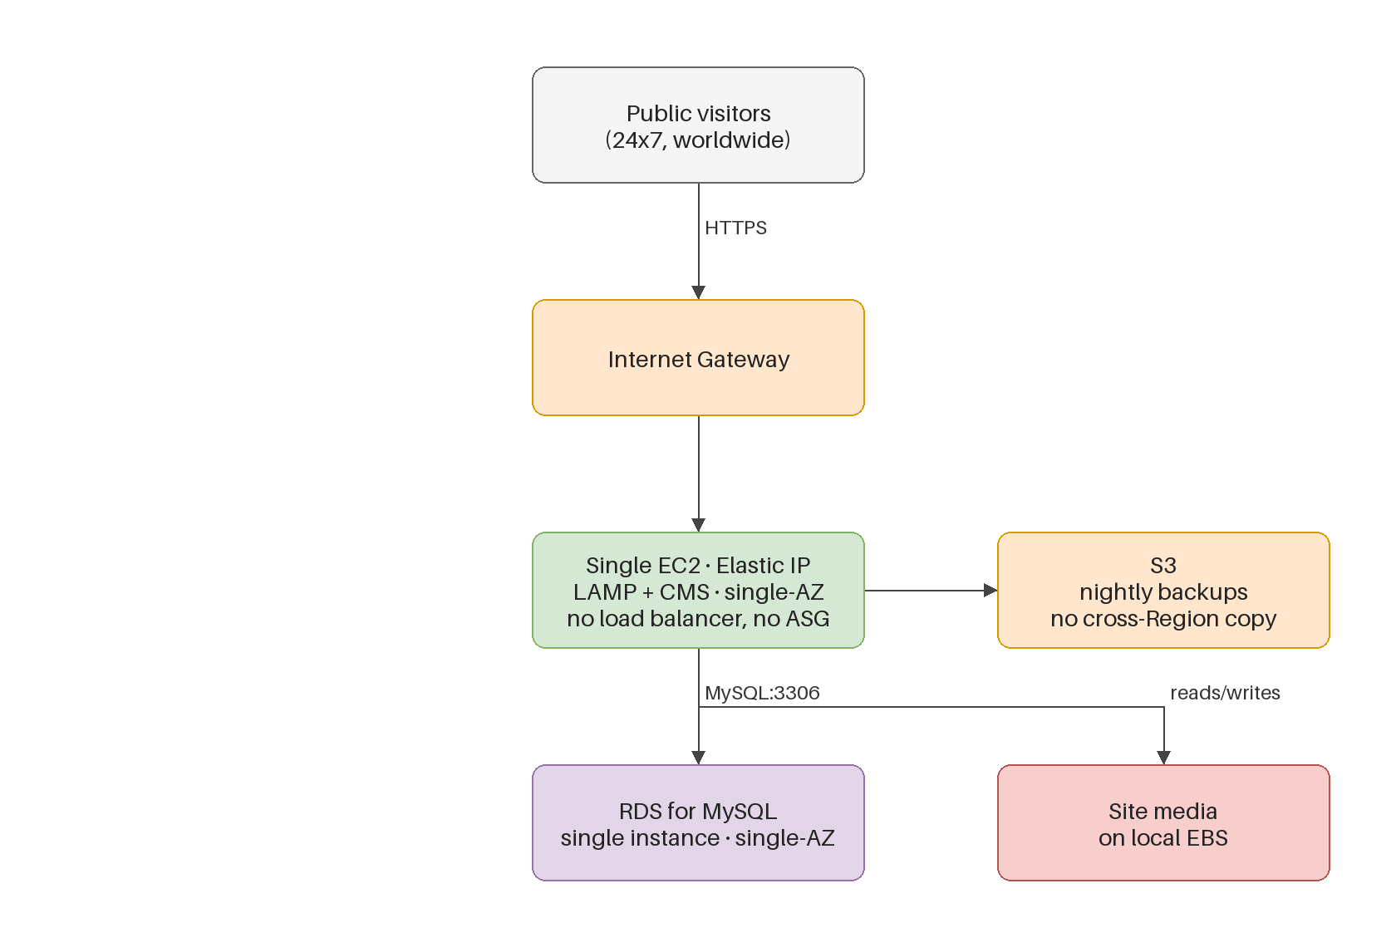
Review the website baseline
■ The current architecture: a VPC, one Availability Zone, a single web instance and a single database.
■ Read the topology top-down — network, compute, database, storage — noting how each resource is deployed today.
■ Single-AZ means every tier shares one failure domain; one zone outage takes it all down.
■ There is no load balancer and no Auto Scaling group — one instance is the entire website.
Kangan Institute
3
Notes:
Walk the diagram; trace the request path and have them find the shared failure domain.
Note what is ABSENT as well as what is present — a missing tier is a finding, not a blank.
The workbook's task 1 runs the same reading, on this same engagement.

Slide 6
Evaluate the design decisions and their business impact
■ Evaluate the baseline and state the business impact of its design decisions — downtime, lost enquiries, reputational exposure.
■ The website is public and 24x7, so an outage is visible to prospective students the moment it happens.
■ Impact is a business statement, not a technical one; the goals you set later answer this language.
Kangan Institute
4
Notes:
Push from event to cost: "the server goes down" is technical; "the course catalogue is offline during an advertising campaign" is impact.
Ask what a public audience changes about impact compared with a staff-only system — that contrast is the reasoning their assessment needs.

Slide 7
ACTIVITY
Review and evaluate the practice baseline
■ Workbook — tasks 1 and 2.
■ Review the practice engagement's current architecture top-down, then evaluate it and state the business impact of its design decisions.
⏱ ~30 min
Kangan Institute
5
Notes:
Activity = practice workbook tasks 1–2, on the website engagement.
Watch for resource lists with no judgement, and technical-only impacts.

Slide 8
Key takeaways
Section 1 · The review
Four pillars: security, reliability, performance, cost.
Impact in business language, tied to each design decision.
Record the constraints you find — they shape everything after.
Kangan Institute
6

Slide 9
02
SECTION
The compliance obligation
read what it obliges, record where you stand
Kangan Institute

Slide 10
Assess compliance against the regulatory requirements
■ Read the applicable regulatory instruments and record what each actually obliges — no more, no less.
■ Assess the current architecture against each obligation: compliant, non-compliant, or not applicable — with the evidence.
■ An obligation read too broadly costs as much as one ignored; the precise reading is the skill.
Kangan Institute
7
Notes:
Workbook task 3 — the regulatory requirements document is on the intranet; the task is careful reading plus an honest assessment.
The over-read is the common failure; the instruments say precisely what is in scope.

Slide 11
ACTIVITY
Assess compliance
■ Workbook — task 3.
■ Assess the practice engagement's compliance against the applicable regulatory requirements, obligation by obligation.
⏱ ~20 min
Kangan Institute
8
Notes:
Activity = practice workbook task 3.
Press for evidence on every row — "compliant" with nothing behind it is a guess.

Slide 12
Key takeaways
Section 2 · Compliance
Record what each instrument obliges, precisely.
Assess against each obligation with evidence.
Kangan Institute
9

Slide 13
03
SECTION
The options, and their fit
what could change, and what fits the business
Kangan Institute

Slide 14
Design patterns and architectural options
■ The option space: multi-zone redundancy, horizontal scaling and load balancing, managed versus self-run data tiers, caching, decoupling.
■ Each option is a pattern with a cost and a benefit — there is no single right answer, only a fit.
■ Cloud adoption itself changed the option space: managed services, elasticity and shared responsibility reshape what an improvement can be.
Kangan Institute
10
Notes:
A menu, not a decision — the next slide narrows it. Give each option a one-line "what it buys".
Misconception: more redundancy is always better. Every option costs; the skill is fit.

Slide 15
Assess the options against the business model
■ Determine and assess the benefits of each option against the current business model and needs — not in the abstract.
■ Constraints sharpen the choice: an option a constraint rules out narrows the argument to the ones that remain.
■ End with a judgement per option, not a balanced-sounding list.
Kangan Institute
11
Notes:
Workbook tasks 4 and 5 — the option list, then the assessment against the business.
The single-instance-DB constraint from C1 is the worked example of a constraint doing analytical work.

Slide 16
Reaching an improvement is a migration
■ Any option you pick has to be reached from the running baseline: move incrementally, keep the system serving, evidence each step, be able to roll back.
■ The cost of the path is part of the option's cost — a benefit you can only reach through a risky cutover is worth less than it looks.
■ Weigh the journey with the destination when you assess each option.
Kangan Institute
12
Notes:
The migration principles, placed where the options are weighed — the path's cost and risk belong in the assessment.
Question to pose: two options with the same end state, one reachable incrementally and one only by big-bang — which wins, and why?

Slide 17
ACTIVITY
Options and fit
■ Workbook — tasks 4 and 5.
■ Identify the design patterns and options open to the practice engagement, then assess their benefits against its business model and needs.
⏱ ~30 min
Kangan Institute
13
Notes:
Activity = practice workbook tasks 4–5.
Push them to judge each option, and to record what they rule out and why — the rejection reasoning is marked skill.

Slide 18
Key takeaways
Section 3 · The options
Patterns with costs and benefits; fit over maximum.
Assess against this business, not in the abstract.
A ruled-out option with a reason is analysis, not failure.
Kangan Institute
14

Slide 19
04
SECTION
Goals set, decisions confirmed
the target the improvement is measured against
Kangan Institute

Slide 20
Goals across the four concerns
■ Set business goals across security, reliability, high performance and cost efficiency.
■ A goal is directional and business-owned — "survive a zone failure without data loss" — and it comes from the business requirements, not from the technology you like.
■ "Use Multi-AZ" is a solution masquerading as a goal; the goal is the outcome underneath it.
Kangan Institute
15
Notes:
Workbook task 6. The goal-versus-solution confusion is the one to press — have them find the outcome under a technology statement.

Slide 21
Confirm the design decisions
■ Confirm the decisions to carry forward, each one traced to a business need and consistent with the goals just set.
■ This shortlist is what Topics 2 and 3 design in detail — nothing enters the design that wasn't confirmed here.
■ Record what you confirmed and what you deferred; both are decisions.
Kangan Institute
16
Notes:
Workbook task 7 closes the analysis. The workbook order is deliberate: goals first, then decisions confirmed against them.

Slide 22
ACTIVITY
Goals and decisions
■ Workbook — tasks 6 and 7.
■ Set the business goals across the four concerns, then confirm the design decisions you will carry into the design work.
⏱ ~25 min
Kangan Institute
17
Notes:
Activity = practice workbook tasks 6–7.
Watch for goals that are really solutions, and confirmations with no trace to a need.

Slide 23
Key takeaways
Topic 1 · Key takeaways
Review against the pillars; state impact in business language.
Read the obligations precisely; assess with evidence.
Options judged for fit; goals owned by the business; decisions confirmed against them.
Kangan Institute
18

Slide 24
Next: Topic 2 — metrics, and the four-component design
The analysis is done: baseline understood, compliance assessed, options weighed, goals set, decisions confirmed.
Next the design starts — the metrics that prove it, and the four resource components.

