Slide 1
TOPIC 06
Getting to work — the account and the network fabric
Kangan Institute

Slide 2
Building what someone else designed
advice becomes a build
■ AT1 was advice on paper. From here you build, in the console, and evidence it.
■ Your run sheet tells you what to build and the settings to build it to. Finding your way around the console is your job.
■ Today: the account and its region, then the private network and the paths in and out of it.
■ Every block of teaching today ends with the next task on your run sheet.
Kangan Institute
1

Slide 3
01
SECTION
Working to a run sheet
the implementer's seat
Kangan Institute

Slide 4
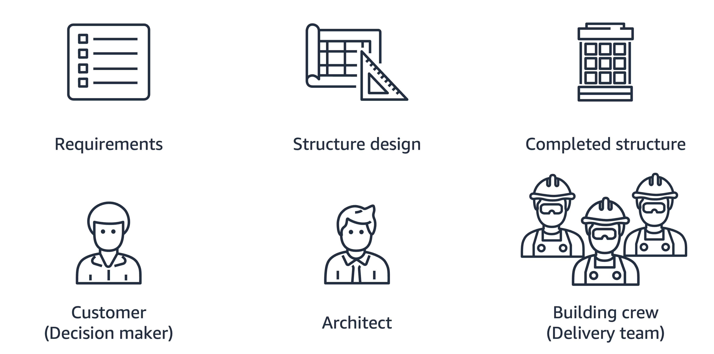
Requirements → design → build
three roles, one hand-off each
■ Cloud architecture turns requirements into a structure:
– the customer sets the requirements · an architect produces the design · a delivery crew builds it
■ Three roles, a hand-off between each. From here you sit in the third one.
Kangan Institute
2

Slide 5
What a run sheet gives you, and what it doesn't
the settings are given; the route is not
■ It gives you the task, the settings to build it to, and what your screenshot must show.
■ It does not give you the clicks. Working out where a setting lives is part of the job.
■ Build what it specifies. Where it asks you to choose, the choice — and your reasoning — is yours.
■ Work the tasks in order. Each one is built on the one before it.
Kangan Institute
3

Slide 6
Region is the first decision
set it before you create anything
■ Everything you create belongs to one region, so it is set before you create anything.
■ The driver is compliance, not preference — where the data is allowed to live.
■ Your run sheet names a production region and a build region. They differ, and only the location label changes; the build is identical.
■ Make the region visible in your evidence.
Kangan Institute
4

Slide 7
Capture as you build
build → capture → move on
■ Take each screenshot as you finish that task, not at the end of the session.
■ Console state moves on. A screen you have navigated away from often cannot be recreated.
■ The bar for a screenshot is simple: clear enough for the assessor to read. If they cannot make out the setting you are claiming, it is not evidence.
Kangan Institute
5

Slide 8
ACTIVITY
Set your region and confirm it
■ Run sheet — task 1.
■ Sign in, set the region your run sheet names for building, and capture the console with the region selector visible.
⏱ ~10 min
Kangan Institute
6
Notes:
Activity = practice run sheet task 1. They should finish with the region set and one capture.
Circulate for the lab launch/console hand-off; check the region indicator on each screen.

Slide 9
Key takeaways
Section 1 · Working to a run sheet
You are the builder. The settings are given; finding them is yours.
Region first — it is compliance, and everything is region-scoped.
Capture each task as you finish it.
Kangan Institute
7

Slide 10
02
SECTION
The private network and its subnets
the fabric everything sits in
Kangan Institute

Slide 11
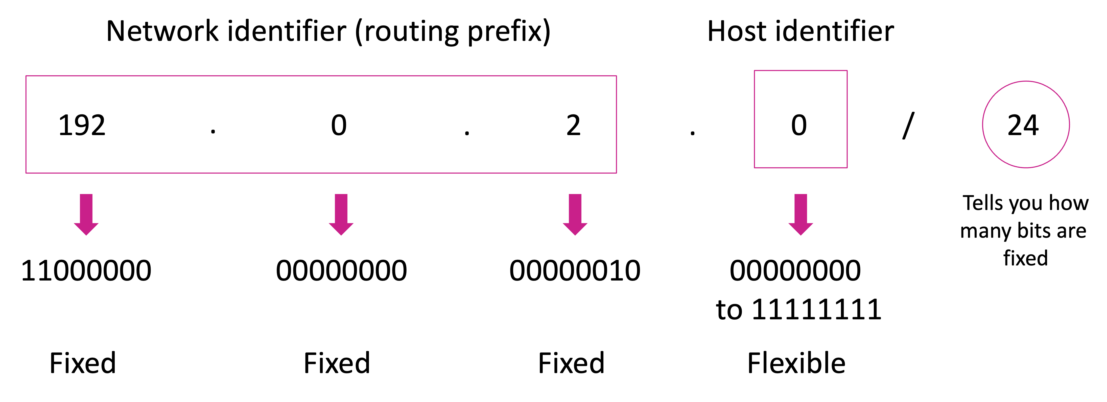
Networks, addresses and ranges
the vocabulary the build assumes
■ A network connects machines so they can reach each other; it can be divided into subnets.
■ Every machine has an IP address — a unique numeric label.
■ A CIDR block describes a range of addresses. The number after the slash says how many bits are fixed, so a smaller number means a bigger range.
■ Traffic moves between networks through routers and gateways.
Kangan Institute
8

Slide 12
Your own private network in the cloud
region-scoped, spans zones
■ A virtual private network is a logically isolated slice of the provider's cloud that you define.
■ It belongs to one region and spans the availability zones inside it.
■ You size it with a CIDR block when you create it, and you cannot change that later — so it is given room to grow.
Kangan Institute
9

Slide 13
Names — the two settings you are about to turn on
two tick boxes, and why they matter later
■ DNS turns a name into an address. Machines connect to addresses; people and configuration use names.
■ Creating the network asks you to enable two things, and they are not the same:
– DNS resolution — things inside the network can look names up at all
– DNS hostnames — things inside the network get a name of their own, not just an address
■ You are not building a DNS service here. You are switching on the one the platform already runs.
■ It pays off at the end: the load balancer is given a name, and that name is what you open in a browser to prove the build works. Its addresses change over time; the name does not — which is the whole reason anything uses names.
■ Get this wrong and every server can be running perfectly and still be unreachable by name.
Kangan Institute
10

Slide 14
Subnets
one zone each; public or private
■ You divide the network into subnets. Each subnet lives in exactly one availability zone.
■ A subnet is public or private according to whether it has a route to the internet — not according to what it is called.
■ Set the zone yourself on every subnet. Left alone the console picks one for you, and a subnet in the wrong zone causes failures much later that never mention subnets.
Kangan Institute
11

Slide 15
Why there are more subnets than tiers
a service requirement, not a tier
■ Your run sheet asks for more subnets than you have tiers to put in them.
■ Some managed services refuse to be created unless you hand them subnets in two zones — even when everything you are running sits in one.
■ So a couple of subnets exist to satisfy a service requirement, and stay empty.
■ Worth remembering. It becomes the starting point of the availability work later.
Kangan Institute
12

Slide 16
ACTIVITY
Create the network and its subnets
■ Run sheet — tasks 2 and 3.
■ Create the private network at the range your run sheet gives, then every subnet it lists, setting the zone on each one yourself.
⏱ ~20 min
Kangan Institute
13
Notes:
Activity = practice run sheet tasks 2–3. Circulate for the zone dropdown left on "No preference" —
it is the failure that shows up three tasks later. Check the Availability Zone column on share-back.

Slide 17
Key takeaways
Section 2 · The network
A virtual private network is yours, region-scoped, and sized once.
Subnets each sit in one zone; public or private is decided by routing.
Some subnets exist only because a service demands two zones.
Kangan Institute
14

Slide 18
03
SECTION
Paths in and out
what can reach what
Kangan Institute

Slide 19
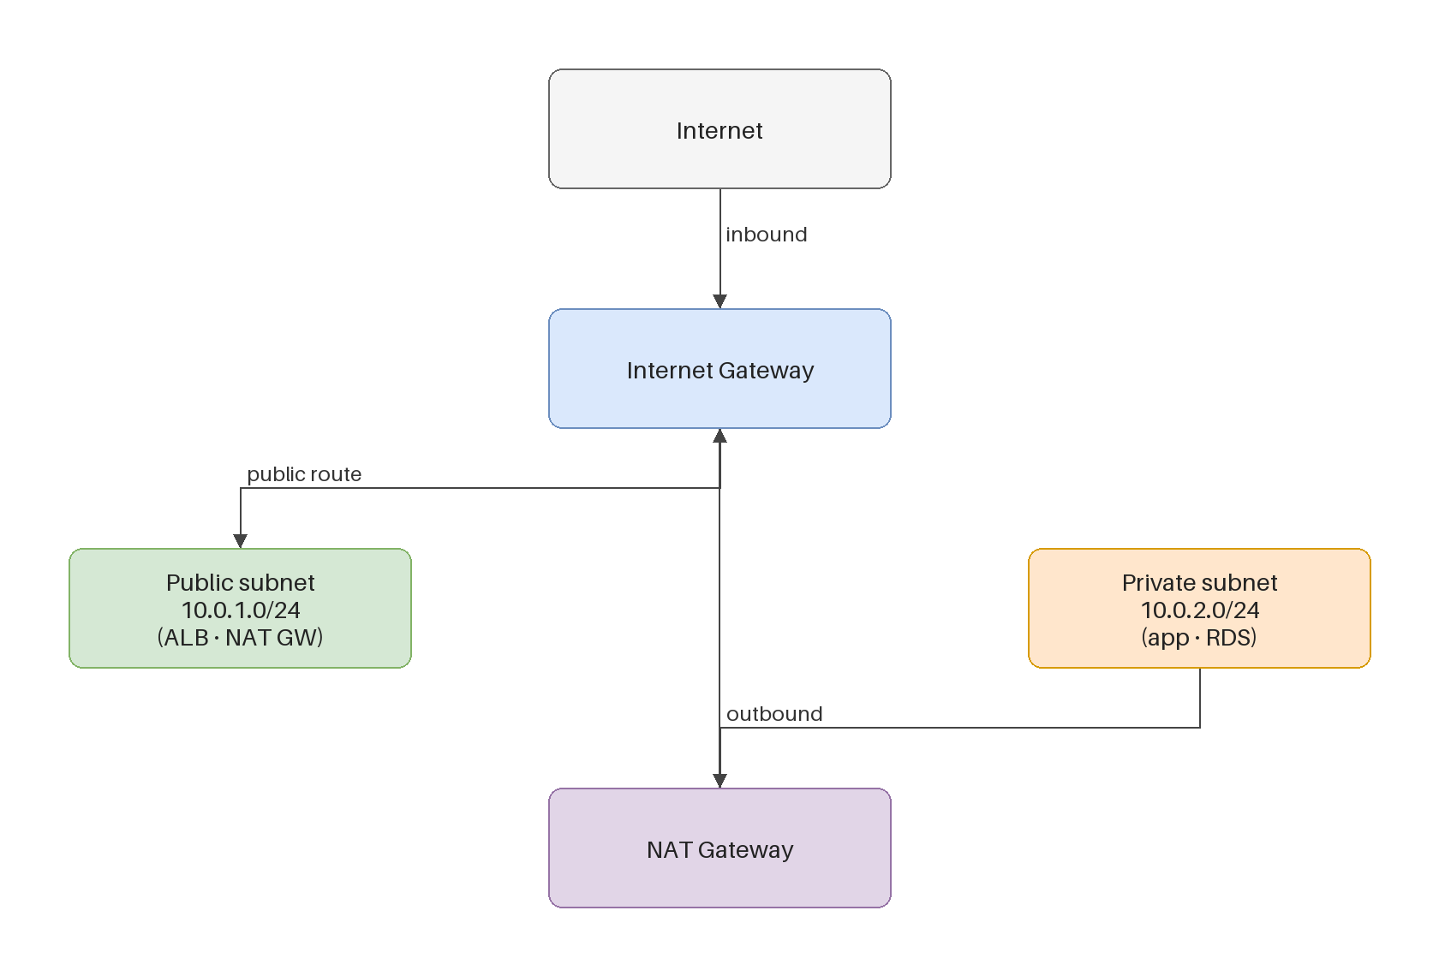
Two gateways, two jobs
one way in, one way out
■ An internet gateway gives a subnet a two-way path to the internet.
■ A NAT gateway lets private resources reach out — for updates and external calls — while nothing on the internet can reach in.
■ A NAT gateway is placed in a public subnet, and serves the private ones.
Kangan Institute
15

Slide 20
Route tables decide what is public
public or private is a routing decision
■ A route table holds the rules that direct a subnet's traffic, and every table has a built-in local route so anything inside the network can talk.
■ Add a 0.0.0.0/0 route to an internet gateway and the subnet is public. Point it at a NAT gateway instead and the subnet reaches out but cannot be reached.
■ A subnet with no route table of its own falls back to the network's default, which has no path out at all.
Kangan Institute
16

Slide 21
A tier that should have no way out
deliberately unreachable
■ Your data subnets get no route table and no path to the internet. That is not an omission.
■ A database has no business making outbound connections, so it is given no means to.
■ Least privilege applies to routing, not just to permissions.
Kangan Institute
17

Slide 22
ACTIVITY
Build the gateways and the routing
■ Run sheet — tasks 4, 5 and 6.
■ Create and attach the internet gateway, create the NAT gateway, then build the route tables and associate them with the right subnets.
⏱ ~25 min
Kangan Institute
18
Notes:
Activity = practice run sheet tasks 4–6. The NAT gateway takes several minutes to become available
and cannot be routed to before it does — warn them so they do not assume it has failed.
Common miss: associating the subnets after adding the route.

Slide 23
Key takeaways
Section 3 · Paths in and out
An internet gateway is two-way; a NAT gateway is outbound only.
The route table is what makes a subnet public or private.
The data tier is given no route out, deliberately.
Kangan Institute
19

Slide 24
Next — who may talk to what
The network exists. Nothing yet controls which tier may reach which.
Next: the firewall rules that chain the tiers, and the identities that operate the platform.

