Slide 1
TOPIC 07
Controlling access
Kangan Institute

Slide 2
Nothing is allowed yet
from plumbing to permission
■ The network is built, and by default nothing in it may talk to anything else.
■ Today you write the rules that let each tier reach exactly the tier next to it — and no further.
■ Then the identities: who operates this platform after you hand it over, and how a server gets permission to do its job without holding a password.
Kangan Institute
1

Slide 3
01
SECTION
Rules between tiers
who may talk to what
Kangan Institute

Slide 4
What a firewall does
address plus port
■ A firewall filters traffic by rule and decides what is allowed through.
■ Traffic is identified by address and by port — the number that says which service is being asked for.
■ Least privilege: open only the ports the job needs, and only to whoever needs them.
Kangan Institute
2

Slide 5
Security groups
stateful, allow-only, deny by default
■ A security group is a virtual firewall attached to a resource, not to a subnet.
■ It is stateful — allow traffic in and the reply is automatically allowed back out. You do not write a matching outbound rule.
■ It holds allow-rules only. There is no deny rule, because a new group already denies everything inbound until you add one.
Kangan Institute
3

Slide 6
Chaining the tiers
source = a group, not an address
■ You can name another security group as the source of a rule, instead of an address range.
■ The rule then follows membership: however many servers the platform launches, and whatever addresses they get, the rule still fits.
■ That is what makes a chain — the entry point accepts the public, the application tier accepts only the entry point, the database accepts only the application tier.
■ Create the groups empty first. Each names another as a source, which you cannot do until it exists.
Kangan Institute
4

Slide 7
Naming things the platform will accept
read the constraint first
■ Providers reserve some prefixes for the identifiers they generate themselves.
■ A name that collides with a reserved prefix is rejected outright, with an error that reads as though your rule is wrong when only the name is.
■ Read the constraint in your run sheet before you type the names.
Kangan Institute
5

Slide 8
ACTIVITY
Build the security-group chain
■ Run sheet — task 7.
■ Create the three groups as empty shells, then add each inbound rule, naming the upstream group as the source rather than an address range.
⏱ ~20 min
Kangan Institute
6
Notes:
Activity = practice run sheet task 7. Two predictable stumbles: trying to add rules before all
three groups exist, and typing an address range where the run sheet says a group.
Share-back: show the database group's inbound rule and confirm its source is the application group.

Slide 9
Key takeaways
Section 1 · Rules between tiers
A security group protects one resource, is stateful, and denies by default.
Naming another group as the source makes the rule follow the servers.
Create the shells first; the chain cannot be written in one pass.
Kangan Institute
7

Slide 10
02
SECTION
Who operates the platform
identity, and its boundary
Kangan Institute

Slide 11
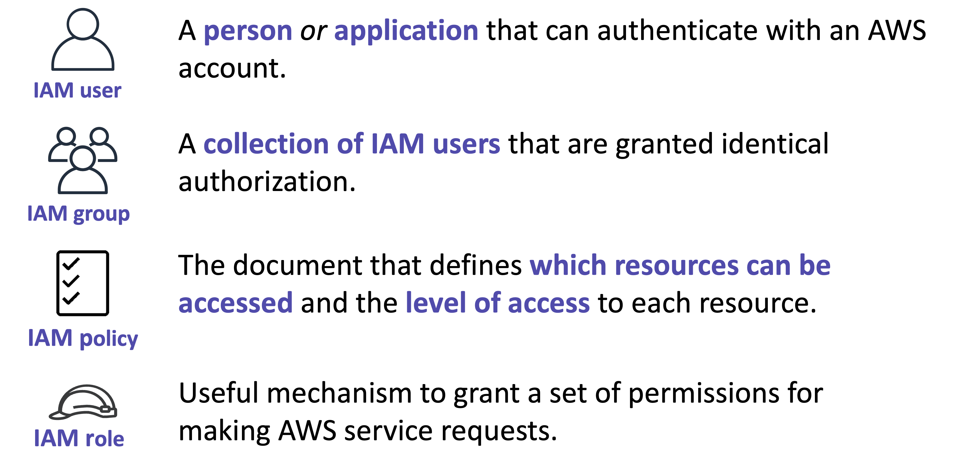
The four identity components
people, and permissions
■ User — one identity per person or application that signs in.
■ Group — a collection of users who need the same permissions, so you set them once.
■ Role — permissions with no permanent credentials, assumed temporarily by a person or a service.
■ Policy — the document that says what is allowed. Everything is denied until a policy grants it.
Kangan Institute
8

Slide 12
Securing access
set once, granted narrowly
■ Attach policies to groups and put users in them, rather than attaching policies to individuals.
■ Grant only what the job needs — you widen a permission when a task proves it necessary, not in advance.
■ Protect the account's founding identity and use it only when nothing else will do.
■ Use roles for services, never long-lived keys.
Kangan Institute
9

Slide 13
Why the operators cannot change identity
the boundary is the point
■ The group that runs the platform gets read access to everything and no ability to change permissions — including its own.
■ A group that can rewrite its own permissions has no boundary at all; it can grant itself anything.
■ So operations sit with the team that runs the system, and identity stays with whoever governs the account. That separation is the control.
Kangan Institute
10

Slide 14
When the environment refuses you
the refusal is the capture
■ Some environments will not permit identities to be created at all. Yours is one of them.
■ You will complete the form correctly and be refused. That refusal is the evidence.
■ Filling the form correctly is the part worth practising — and a constraint you name and evidence is a professional result, not a failure.
Kangan Institute
11

Slide 15
ACTIVITY
Configure the access model
■ Run sheet — task 8.
■ Complete the group form and the user form with the values your run sheet gives, submit each, and capture the completed form together with the error it returns.
⏱ ~20 min
Kangan Institute
12
Notes:
Activity = practice run sheet task 8. Tell them up front they will be refused, so nobody spends
the session hunting a fault. Both captures must show the completed form *and* the error.

Slide 16
Key takeaways
Section 2 · Identity
Users and groups are people; roles and policies are permissions.
Policies go on groups; grant narrowly; protect the founding identity.
Whoever operates a platform should not be able to widen their own access.
Kangan Institute
13

Slide 17
03
SECTION
Identity for a server
permission without a password
Kangan Institute

Slide 18
How a server gets permission
nothing stored on the box
■ A server needs to reach other services — storage, logging — and it needs permission to do it.
■ It assumes a role: temporary credentials, issued automatically, rotated for you.
■ Nothing is stored on the server. There is no key on disk to find, copy or leak.
■ You attach the role when you define the server, not afterwards by hand.
Kangan Institute
14

Slide 19
Reading a role you did not write
inherit it, then read it
■ Open a role and read its attached policies to see what it actually permits.
■ This is a routine professional move: you inherit roles far more often than you author them, and you are accountable for what they allow.
■ Your environment supplies the role your servers will use. Read it, and write its name down — the next task asks for it.
Kangan Institute
15

Slide 20
ACTIVITY
Review the role your servers will use
■ Run sheet — task 9.
■ Open the role your run sheet names, read which services its policies grant access to, capture it, and note the name exactly as shown.
⏱ ~10 min
Kangan Institute
16
Notes:
Activity = practice run sheet task 9. A read, not a build — say so, or they will hunt for a create
button they do not have. The name matters: the launch template task asks for it verbatim.

Slide 21
Key takeaways
Section 3 · Identity for a server
A server assumes a role; no credentials are stored on it.
Roles are attached when the server is defined.
Reading an inherited role's permissions is part of the job.
Kangan Institute
17

Slide 22
Next — the application tier
The network is built and the rules are written. Nothing is running in it yet.
Next: defining a server once, putting a load balancer in front, and letting the platform manage how many there are.

