Slide 1
TOPIC 08
The application tier
Kangan Institute

Slide 2
Something to run
the workload moves in
■ The network is built and the rules are written. Today the workload moves in.
■ Three moves: define what a server is, put something in front of it, and hand over how many there are.
■ You will also make the first of the run sheet's two real decisions — and have to defend it.
Kangan Institute
1

Slide 3
01
SECTION
Defining a server, once
a definition, not a machine
Kangan Institute

Slide 4
What a server is
four dimensions
■ A server is a computer that runs your application for other people to use.
■ Its size is four things at once: processing, memory, disk, and network throughput.
■ A virtual machine is a software-defined server — you rent one and size it to the workload rather than buying a box.
Kangan Institute
2

Slide 5
Launching a server — the choices
image · size · disk · permission
■ Machine image — the template the server starts from: an operating system, and anything pre-installed on it.
■ Instance type — the named size that sets processing, memory and network together.
■ Storage — the disk attached to the server: durable block storage that survives a stop and start.
■ Role, security group, first-boot script — permission, firewall, and what it configures itself with when it starts.
Kangan Institute
3

Slide 6
Two kinds of storage, and which one this is
a drive, or a file store
■ Disk storage — a volume attached to one server, which the operating system treats as a drive. It is what an operating system boots from and what a database writes to.
■ Object storage — whole files kept by name and fetched over the network. Effectively unlimited, cheaper at scale, and able to age old files off to a cheap archive tier.
■ Nothing mounts object storage like a drive, and nothing runs an operating system from it.
■ You are attaching disk storage here, in two places — the server's own volumes, and later the storage behind the database. Both are disks.
■ Object storage would be the right answer for something else: uploads, attachments, backups kept off the machine that made them.
Kangan Institute
4

Slide 7
Configuring at boot, not by hand
identical every time
■ A first-boot script runs once, the first time a server starts, and installs and configures what it needs.
■ It means every server comes up identical, whether the platform builds one or ten.
■ The alternative — logging in and setting each one up — cannot survive a platform that creates servers on its own.
Kangan Institute
5

Slide 8
Why you build a template and not a server
the definition is the artefact
■ You are not launching a server today. You are writing the definition one is built from.
■ Something else will create the servers from it, on demand, without anyone touching the console.
■ So the template carries no subnet — whatever creates the servers decides where they go.
■ Nothing gets configured on a running server by hand. If it did, the next server would not have it.
Kangan Institute
6

Slide 9
Making a choice you can defend
name what you rejected
■ "I chose this one" is not a justification. Neither is "it is best practice".
■ A justification has four parts:
– state what you chose · the facts about this workload that bear on it · weigh the trade-off · name the option you rejected and why
■ The rejected option is what most people leave out, and it is what proves the choice was a judgement rather than a default.
■ Both of the run sheet's decisions ask for it explicitly. This is the first one.
Kangan Institute
7

Slide 10
ACTIVITY
Create the launch template
■ Run sheet — task 10.
■ Build the template to the settings your run sheet gives, including the role you noted last topic and the first-boot script exactly as written.
■ Then make the sizing decision: choose, name the option you did not choose, and justify it against what this workload actually has to do.
⏱ ~30 min
Kangan Institute
8
Notes:
Activity = practice run sheet task 10, including its decision box. Two reliable stumbles: the
security group left unset (the servers come up unreachable much later), and the first-boot script
pasted without its first line. Push the justification past "it's cheaper" to the workload facts.

Slide 11
Key takeaways
Section 1 · The server definition
A server is sized in four dimensions; the instance type sets them together.
A first-boot script makes every server identical.
You wrote a definition, not a machine — nothing is configured by hand.
A defensible choice names the option you rejected.
Kangan Institute
9

Slide 12
02
SECTION
Putting something in front
one address, many servers
Kangan Institute

Slide 13
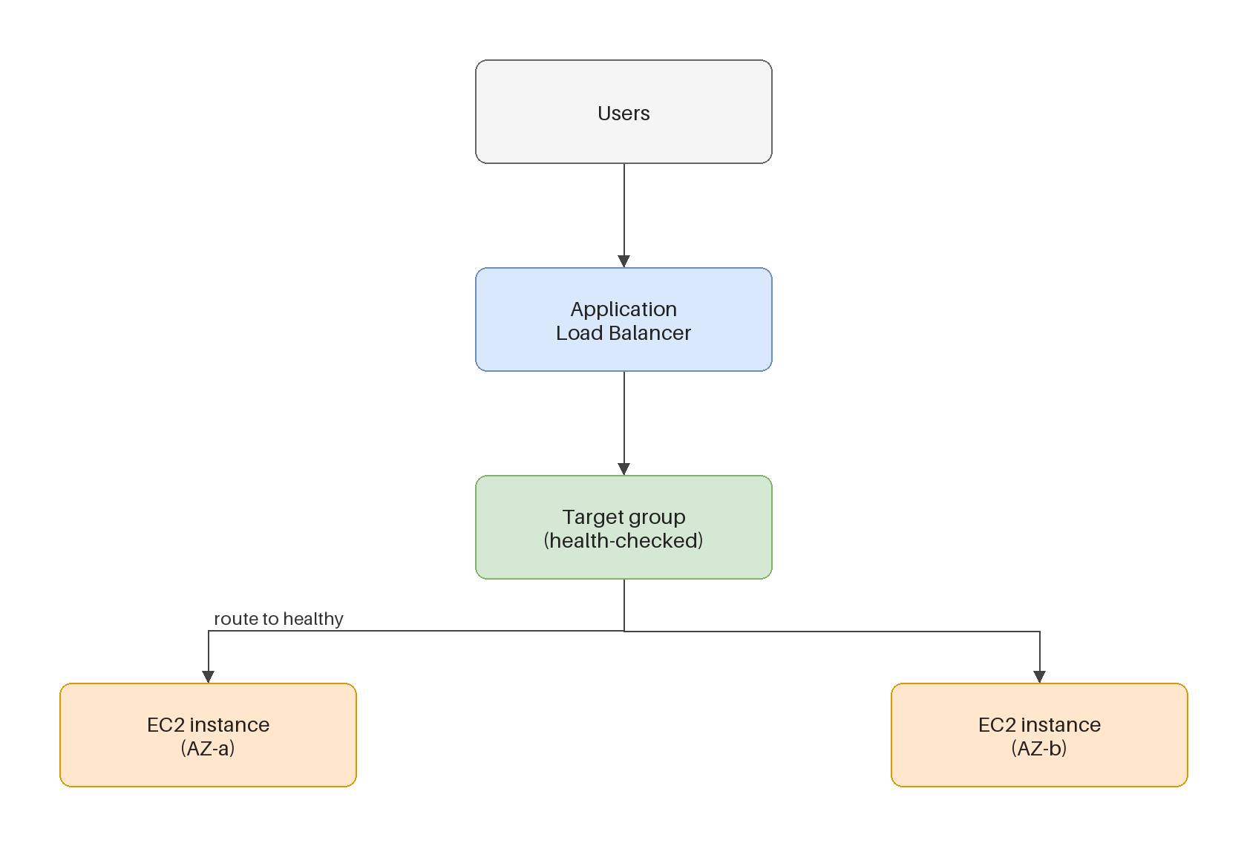
What a load balancer does
the front door
■ It takes traffic on one address and spreads it across however many servers are running.
■ It health-checks each one and sends traffic only to those passing.
■ So servers can come and go without anyone re-pointing anything.
Kangan Institute
10

Slide 14
Listeners and target groups
answer here, forward there
■ A listener is the port the balancer answers on, and what it forwards to.
■ A target group is the list of servers it forwards to, plus the health check that decides which of them are fit to receive traffic.
■ You create the target group empty. You do not register servers by hand — whatever creates them will register them for you.
Kangan Institute
11

Slide 15
Internet-facing or internal
who is meant to reach it
■ A balancer is either reachable from the internet or only from inside the network.
■ Which one is a design decision about who the users are and how they arrive.
■ Your run sheet states which. Build that.
Kangan Institute
12

Slide 16
Why it needs two zones
the balancer spans; the workload may not
■ A load balancer will not create unless you give it subnets in two availability zones.
■ This is the requirement that put the extra subnets in your network back in Topic 6.
■ It does not mean your workload is spread across two zones. It means the balancer is.
■ Hold that distinction. It is exactly the trap the availability work opens with.
Kangan Institute
13

Slide 17
ACTIVITY
Create the target group and the load balancer
■ Run sheet — tasks 11 and 12.
■ Create the target group, registering nothing. Then create the balancer across the subnets your run sheet names, with its listener forwarding to that target group.
⏱ ~20 min
Kangan Institute
14
Notes:
Activity = practice run sheet tasks 11–12. The console will add a default security group to the
balancer — it has to be removed and replaced with the one they built. Nothing is healthy yet;
there are no servers. Say so, or they will think it is broken.

Slide 18
Key takeaways
Section 2 · The load balancer
One address in front, health-checked servers behind.
The listener answers; the target group receives.
It requires two zones — which is not the same as the workload having two.
Kangan Institute
15

Slide 19
03
SECTION
Letting the platform manage capacity
how many, decided for you
Kangan Institute

Slide 20
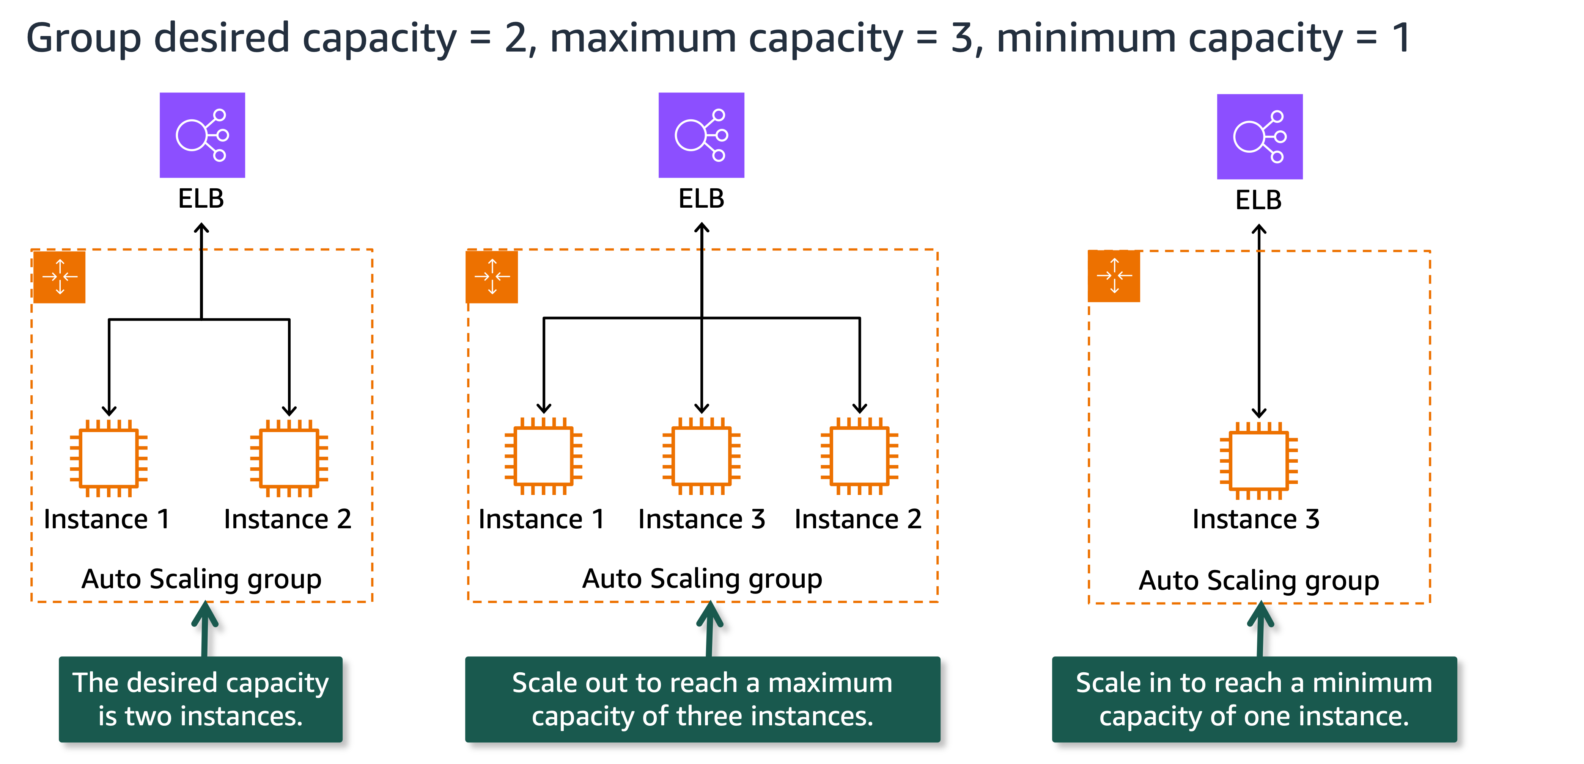
Scaling in two directions
bigger, or more
■ Vertical — replace what you have with something bigger. There is a ceiling, and usually a restart.
■ Horizontal — add more of the same alongside what is already running. No outage, and no ceiling worth worrying about.
■ Horizontal is the cloud pattern, and it is the foundation everything in AT3 is built on.
Kangan Institute
16

Slide 21
The scaling group
it builds them, it replaces them
■ It creates and removes servers from your launch template, and registers them with the target group.
■ Minimum, desired, maximum: minimum and maximum are the guard-rails, desired is where it sits now.
■ It replaces a server that fails its health check without anyone being paged. It is self-healing as much as it is scaling.
Kangan Institute
17

Slide 22
The policy that moves capacity
hold this number
■ A target-tracking policy names a metric and a value to hold it near, and the group adds or removes servers to keep it there.
■ Set the guard-rails from what the workload needs; set the target value from what you want the servers doing.
■ Health-check type matters: checking with the load balancer means "is it serving?", not merely "is it running?".
Kangan Institute
18

Slide 23
ACTIVITY
Create the scaling group
■ Run sheet — task 13.
■ Create the group from your template, into the subnet your run sheet names, attached to your target group with load-balancer health checks on, then set the capacity numbers and the scaling policy.
⏱ ~20 min
Kangan Institute
19
Notes:
Activity = practice run sheet task 13. The load-balancer step defaults to "no load balancer" and is
the single most-skipped page in the whole run sheet — call it out before they start.
A server should appear within a couple of minutes; have them watch the Activity tab.

Slide 24
Key takeaways
Section 3 · Capacity
Horizontal scaling adds servers without an outage; vertical replaces with a bigger one.
The group builds from the template, registers with the target group, and replaces failures.
A policy holds a metric near a value between the guard-rails.
Kangan Institute
20

Slide 25
Next — the data tier
The application tier is running and scaling. It has nowhere to keep anything.
Next: a managed database, and the alarms that tell you when any of this stops working.

