Slide 1
TOPIC 09
The data tier and knowing when it breaks
Kangan Institute

Slide 2
Somewhere to keep it
data, and knowing about it
■ The application tier runs and scales, and stores nothing that survives a server being replaced.
■ Today: a managed database in the private tier, and the alarms that tell you when something has stopped working.
■ The run sheet's second decision is here, and it is asked the same way as the first.
Kangan Institute
1

Slide 3
01
SECTION
A managed relational database
someone has to run it
Kangan Institute

Slide 4
Relational databases, and who operates them
the work does not go away
■ A relational database stores structured data in tables and is queried with SQL.
■ Somebody has to install and patch it, take and test backups, secure it and scale it. That work never disappears — the only question is who does it.
Kangan Institute
2

Slide 5
Self-hosted or managed
control, or effort
■ Self-hosted — you run the engine on your own server. Complete control of the engine and the operating system, and all of the operational work is yours.
■ Managed — the provider installs, patches, backs up and scales it. You keep the schema, the data and the query performance.
■ Control against effort. Choose managed unless you genuinely need engine-level control.
Kangan Institute
3

Slide 6
The managed database service
class · storage · private · backed up
■ Two dials size it: an instance class for processing and memory, and storage.
■ It runs inside your own private network, in the subnets you allow it, reachable only from where your rules permit — not on the public internet.
■ Automated backups let you restore to a point in time; encryption at rest is a setting you turn on at creation.
■ A standby in a second zone is available and deliberately off here. That is the AT3 work.
Kangan Institute
4

Slide 7
Telling the service where it may live
the second two-zone requirement
■ Before you can create the database you have to give the service a subnet group — the set of subnets it is permitted to use.
■ Like the load balancer, it will not accept subnets in a single zone.
■ This is the second time that constraint has shaped your network. It is why the empty subnets exist.
Kangan Institute
5

Slide 8
You deliver an empty database
the container, not the contents
■ You provision the container, correctly configured. You do not load the schema or the data.
■ That is the customer's data and the customer's responsibility, and moving it is a separate piece of work with its own risks.
■ An empty, correctly configured, private, encrypted, backed-up instance is the finished deliverable.
Kangan Institute
6

Slide 9
ACTIVITY
Create the subnet group and the database
■ Run sheet — tasks 14 and 15.
■ Create the subnet group, then create the database to the settings your run sheet gives — private, encrypted, with its backups configured and no standby.
■ Make the sizing decision the same way as last topic: choose, name what you rejected, justify it against this workload.
⏱ ~30 min
Kangan Institute
7
Notes:
Activity = practice run sheet tasks 14–15, including the decision box. The subnet group lives in
the database console, not the network console — most people go looking in the wrong place.
Push them off the simplified creation path; it silently makes four of the specified choices for them.
The database takes several minutes to become available — start the alarms task while it builds.

Slide 10
Key takeaways
Section 1 · The data tier
Managed shifts the operational work; the schema and data stay yours.
It lives in your private network, and the subnet group is what puts it there.
Encryption and backups are set at creation; the standby is deferred.
You hand over an empty instance.
Kangan Institute
8

Slide 11
02
SECTION
Knowing when it breaks
find out before your users do
Kangan Institute

Slide 12
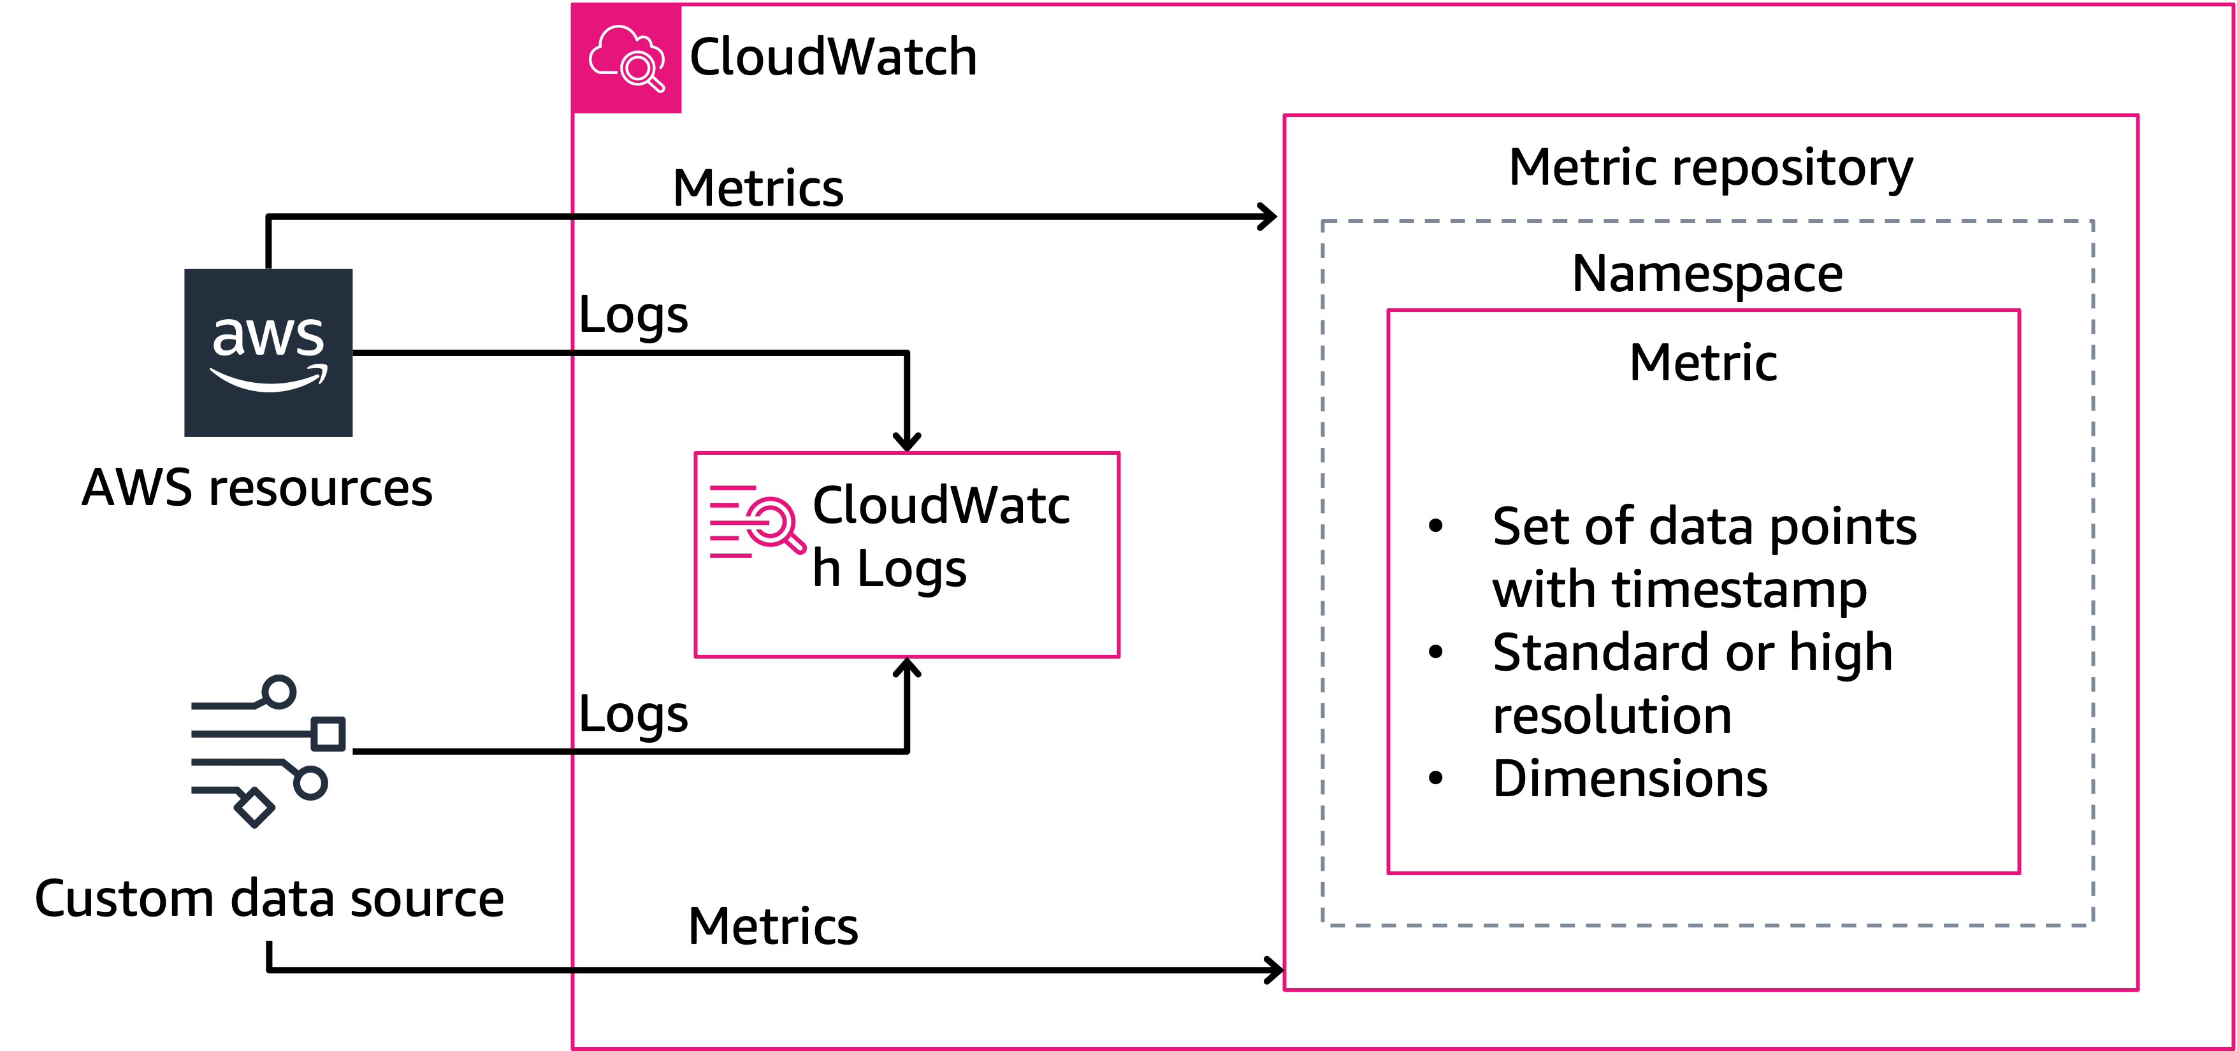
Metric, alarm, log
the number, the rule, the diary
■ A metric is a measurement taken over time.
■ An alarm is a rule watching a metric, which fires when a threshold is crossed.
■ A log is a record of events — what happened, and when.
■ You monitor so that you find out before your users do.
Kangan Institute
9

Slide 13
What an alarm is actually made of
five parts, not one
■ A threshold on its own is not an alarm. It takes five things:
– the metric · the statistic (maximum, minimum, average) · the period · the threshold · how many periods must breach before it fires
■ Choose the statistic to match the question. "Is anything unhealthy?" wants a maximum; "are we running out of room?" wants a minimum.
■ The count of breaching periods is what stops a single momentary spike waking someone up.
Kangan Institute
10

Slide 14
Finding the right metric
a wrong grouping never fires
■ Metrics are grouped by dimension, and services often publish several similar-looking groupings.
■ Picking the wrong grouping gives you an alarm that never fires, and looks correct while it does not.
■ Read what the run sheet names carefully, and confirm the row you tick is the resource you built.
Kangan Institute
11

Slide 15
Units are not what the graph shows
do the arithmetic on purpose
■ Some thresholds are entered in raw units — bytes, seconds — while the graph above the field is drawn in something friendlier.
■ It is very easy to type a number a thousand times too small and see nothing wrong.
■ Work the arithmetic out deliberately, write it down, and sanity-check it against the graph.
Kangan Institute
12

Slide 16
ACTIVITY
Create the baseline alarms
■ Run sheet — task 16.
■ Create the alarms your run sheet specifies, each with its metric, statistic, period, threshold and breach count, and a notification destination.
⏱ ~25 min
Kangan Institute
13
Notes:
Activity = practice run sheet task 16. The storage threshold is the one that goes wrong — it is
entered in bytes while the graph is drawn in gigabytes. Have them show their working.
A new alarm sits in an insufficient-data state for a few minutes; that is normal, not a fault.

Slide 17
Key takeaways
Section 2 · Monitoring
Metric, alarm and log are three different things.
An alarm is metric + statistic + period + threshold + breach count.
The wrong metric grouping produces an alarm that never fires.
Check the units against the field, not the graph.
Kangan Institute
14

Slide 18
03
SECTION
Who secures what
the line through your own build
Kangan Institute

Slide 19
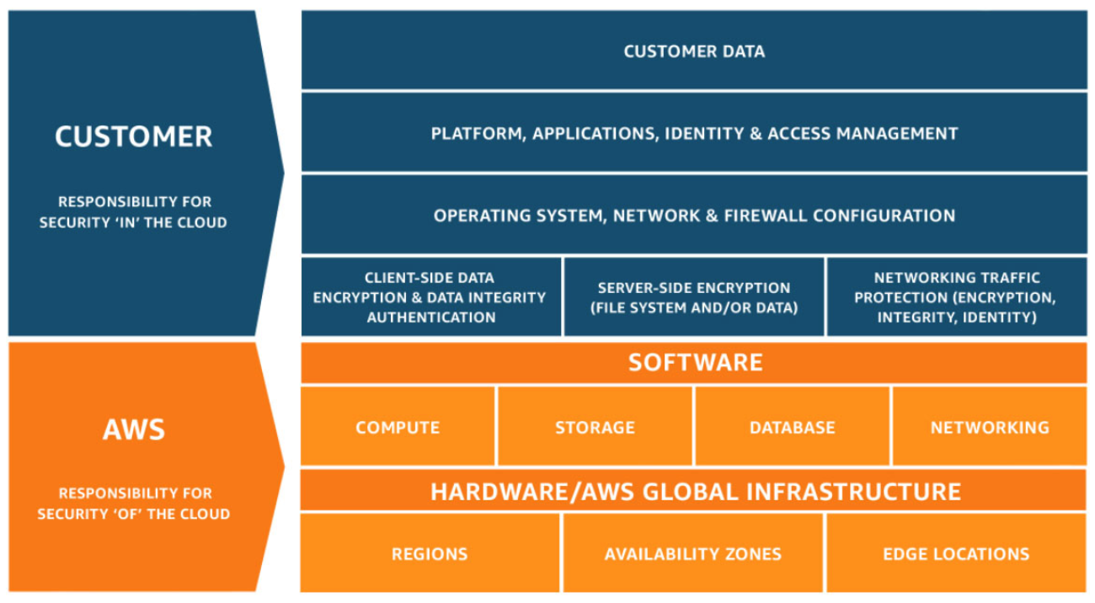
The shared responsibility model
security of the cloud, security in it
■ The provider secures the cloud: the facilities, the hardware, the network underneath it all.
■ You secure what you put in it: the operating system, the configuration, the access rules, and your data.
■ Knowing exactly where the line falls tells you what you must configure and what you can rely on. That is the whole practical value of it.
Kangan Institute
15

Slide 20
The line moves with the service
more managed, more on the provider
■ Run software yourself on a server and you own more of it — the operating system, the patching, the configuration.
■ Use a managed service and the provider takes the engine, the host and the maintenance. You keep the data and who may reach it.
■ So the same piece of software has a different owner depending on how you chose to run it. That choice is the one you made in this topic.
Kangan Institute
16

Slide 21
What never moves
the data is always yours
■ Responsibility for the data itself never transfers, under any service model, to any provider.
■ Neither does deciding who may reach it. A managed database still leaves the access rules and the connection permissions entirely yours.
■ This is where the model is most often got wrong: "it's managed" gets read as "it's theirs".
Kangan Institute
17

Slide 22
ACTIVITY
Assign the security responsibilities
■ Run sheet — task 17.
■ Work through your build component by component and record who secures each part and what that actually involves — then say which responsibilities the managed database moved, and which it did not.
⏱ ~25 min
Kangan Institute
18
Notes:
Activity = practice run sheet task 17. The two rows that decide the result are the database (a split,
not a handover) and the data (never the provider's). Press anyone who writes the database off as
"AWS's responsibility".
Answers must name their own resources — this is about the thing they built, not the model in general.

Slide 23
Key takeaways
Section 3 · Who secures what
The provider secures the cloud; you secure what you put in it.
The line moves with how managed the service is.
The data, and who may reach it, never move.
Kangan Institute
19

Slide 24
Next — proving it works
Everything on the run sheet is now built, and you have said who is responsible for securing it.
Next: test every path, prove the isolation, make it scale in front of you, and hand it over.

