Slide 1
TOPIC 11
HA concepts
What high availability is — and how the cloud achieves it
Kangan Institute

Slide 2
Making the baseline highly available
the AT3 arc
■ AT2 built a working single-AZ baseline. AT3 makes it highly available — resilient to losing an Availability Zone.
■ Topic 11 is the concepts; Topic 12 you design the upgrade; Topic 13 you implement + simulate; Topic 14 you close out.
■ This Topic builds the vocabulary — availability, fault tolerance, SPOFs, recovery objectives — and the cloud toolkit.
Kangan Institute
1

Slide 3
01
SECTION
Availability, reliability & service levels
what 'highly available' means
Kangan Institute

Slide 4
What is high availability?
■ High availability = a system stays operational and accessible with minimal downtime, even if parts fail.
■ Availability is a percentage, and it maps to downtime: 99% ≈ 7 hours/month offline; 99.999% ≈ 26 seconds/month.
■ More nines costs a lot more — often 2–5× — and isn't always achievable.
Kangan Institute
2

Slide 5
Reliability & service levels
■ Reliability = how consistently a service works correctly (availability only means it's online).
■ A service level is a performance target (availability, response time).
■ Recoverability - how quickly and completely services and data can be restored after a failure. Often measured by:
Recovery Time Objective (RTO) – the maximum downtime a business will tolerate (e.g. 4 hours)
Recovery Point Objective (RPO) – the maximum acceptable data loss they will tolerate (e.g. 2 hours)
■ A Service Level Agreement (SLA) sets the minimum service level — miss it and credits/penalties apply.
Kangan Institute
3

Slide 6
Business impact analysis (BIA)
■ Most businesses cannot afford to build 100% available systems.
■ So: how do they determine how much loss/downtime is tolerable?
Business Impact Analysis (BIA) – Formal assessment of how downtime or data loss affects operations, revenue, etc.
Regulatory and Compliance Requirements – Legal or industry standards may state uptime/data protection obligations.
Existing Commitments – customer contracts, SLAs, or brand promises may set reliability and recovery targets.
e.g. ASX Tier 1 Participants legally must meet a 4-hour RTO
Kangan Institute
3

Slide 7
YAT's availability target
the design
■ Ledgerline needs ≥ 99.5% availability in business hours (Mon–Fri ~07:30–18:00) — there's no 24/7 requirement.
■ The HA goal is to survive the loss of an Availability Zone — not to chase 99.999%.
■ Five-nines would multiply the cost for resilience this business-hours workload doesn't need.
Kangan Institute
4

Slide 8
ACTIVITY
Match the target to the business
■ Quick discussion:
– why does 99.5% business-hours fit Ledgerline, and what downtime does it allow?
– when would chasing five-nines be the wrong call — and why?
⏱ ~5 min
Kangan Institute
5

Slide 9
Key takeaways
Section 1 · Availability
HA = stay operational with minimal downtime despite failures.
Availability % maps to real downtime; more nines costs 2–5× more.
Reliability (works correctly) is more than availability (online); SLAs set the minimum.
YAT's target is 99.5% business-hours and AZ resilience — not five-nines.
Kangan Institute
6

Slide 10
02
SECTION
Single points of failure & recovery objectives
where it breaks, and how fast you recover
Kangan Institute

Slide 11
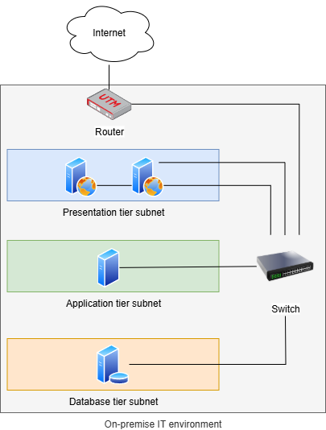
What is a single point of failure?
■ A single point of failure (SPOF) is any component whose failure stops the whole service.
■ Like a car's engine — one failure and nothing moves.
■ In IT: many app servers all on one database; a whole office on one internet link; one server, one Availability Zone.
■ This is an example of an on-premise, multi-tier system
■ If a single presentation-tier webserver goes offline, another server may be able to take over the workload
What would happen if the router fails?
If the database server needs to be updated and restarted, would the system still work?
Kangan Institute
7

Slide 12
Recovery objectives — RTO & RPO
■ RTO (Recovery Time Objective) = the maximum downtime the business will tolerate.
■ RPO (Recovery Point Objective) = the maximum data loss it will tolerate.
■ Worked example: backups every 15 min → RPO 15 min; recover 3 layers at 30 min each + 1 h testing → RTO 2.5 h.
■ Why not set both to zero? Cost — zero loss / zero downtime is extremely expensive.
Kangan Institute
8

Slide 13
Vertical scaling and its availability cost
■ Vertical scaling = a bigger server (more CPU/RAM)
■ Horizontal scaling = more servers.
■ Vertical scaling usually needs a shutdown/restart and hits a ceiling — so it's an availability cost.
■ Horizontal scaling is preferred for availability; mitigate vertical changes via an overnight window, a standby switch, or hot-swap.
■ Some tasks (e.g. judging a trial) can’t be done faster by adding more people.
■ Other tasks can be done faster by adding resources
Shipping 1000 boxes in 1 car = 10 months. Use 5 cars? Only 2 months.
Kangan Institute
9

Slide 14
ACTIVITY
Spot the SPOFs in the baseline
■ Look at the single-AZ Accounting baseline you'd be hardening:
– list its single points of failure (think: AZ, database, the running instance, egress)
– estimate the baseline's recovery objectives (RPO / RTO) and where they fall short
■ Keep your list — Topic 12 designs these out.
⏱ ~10 min
Kangan Institute
10

Slide 15
Key takeaways
Section 2 · SPOFs & recovery
A SPOF is any component whose failure stops the whole service.
RTO = tolerable downtime; RPO = tolerable data loss; zero costs the most.
Vertical scaling carries downtime + a ceiling — horizontal scaling aids availability.
The baseline's single AZ and single database are its key SPOFs.
Kangan Institute
11

Slide 16
03
SECTION
Achieving availability in the cloud
the HA toolkit
Kangan Institute

Slide 17
Principle of cloud HA design
Reliability: Preventing/quickly recovering from failures. Most HA principles documented here.
Operational Excellence: Running/managing systems to deliver business value
Security: Protecting information and systems
Performance Efficiency: Using IT resources efficiently
Cost Optimization: Avoiding un-needed costs
Sustainability: Minimising environmental impact
Kangan Institute
12

Slide 18
Reliability
Automate
Design systems that automatically detect and recover from failures.
Test
Regularly test your recovery procedures to ensure they work as expected.
Scale
Add more instances (scale horizontally) rather than upgrading instances to efficiently improve performance.
Stop Guessing
Instead of adding many servers “just in case”, use a smaller capacity and scale up as needed based on performance needs.
Manage Change
Use automation for changes to reduce the risk of misconfigurations and human error.
Kangan Institute
12

Slide 19
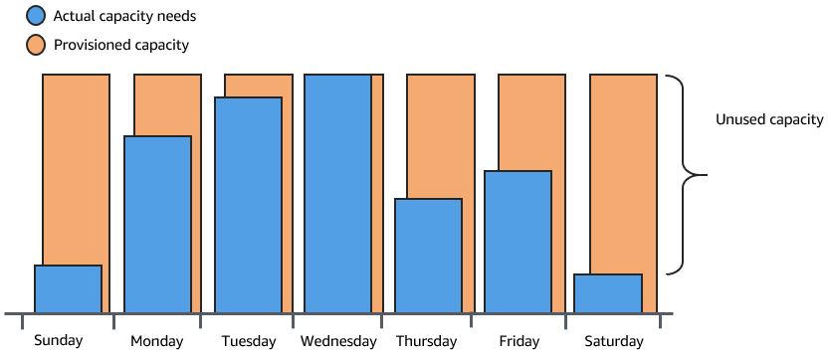
Stop Guessing Capacity
Traditional multi-tier architecture required servers three layers: Presentation, Logic, Data
Need 3x performance for a Wednesday sale? Buy 3x servers – costly.
Kangan Institute
12

Slide 20
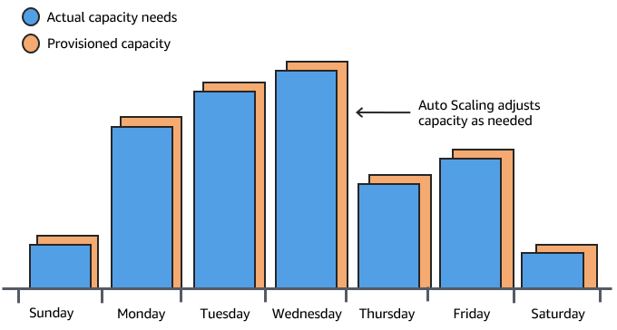
Stop Guessing Capacity
Reliability tier tells us to stop guessing capacity:
Servers running slow? Add more servers.
Workload dropped 80% after 11pm? Remove servers to save money.
Kangan Institute
12

Slide 21
Built-in vs designed fault tolerance
502 Topic 3
■ Using the cloud does not make you highly available by itself.
■ You design redundancy — across compute, storage and network — so no single failure takes the service down.
■ A single-AZ cloud design has a SPOF just like an on-prem one.
Kangan Institute
12

Slide 22
The cloud HA toolkit
502 Topic 1 · ACA M10
■ Multi-AZ — run resources across Availability Zones so the loss of one AZ doesn't stop the service.
■ Load balancing — spread traffic across servers; route only to healthy ones.
■ Auto Scaling across AZs — keep healthy capacity in each AZ (availability, not just load).
■ Managed Multi-AZ databases — a synchronous standby with automatic failover. (Multi-Region / full DR is out of scope — CL2.)
Kangan Institute
13

Slide 23
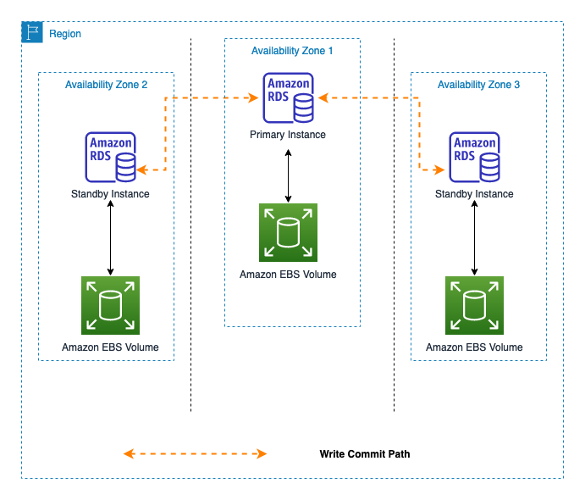
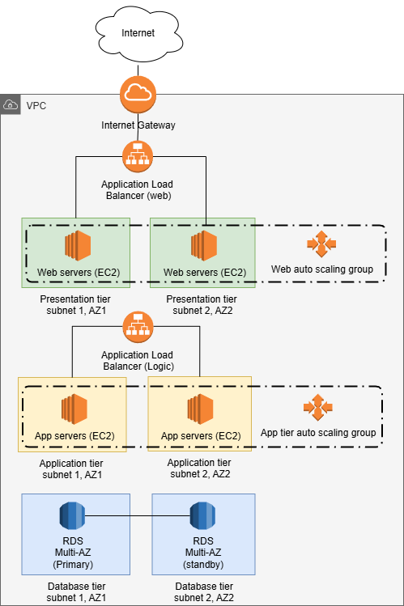
Multi-AZ in action
502 Topic 1 S13 · ACA M10
■ A Multi-AZ database keeps a primary in one AZ and a synchronous standby in another.
■ If the primary (or its AZ) fails, the standby is promoted automatically — service continues with seconds of downtime.
■ We can illustrate auto scaling across AZs in our network diagrams
■ The application reaches the database by name, so nothing needs reconfiguring.
Kangan Institute
14

Slide 24
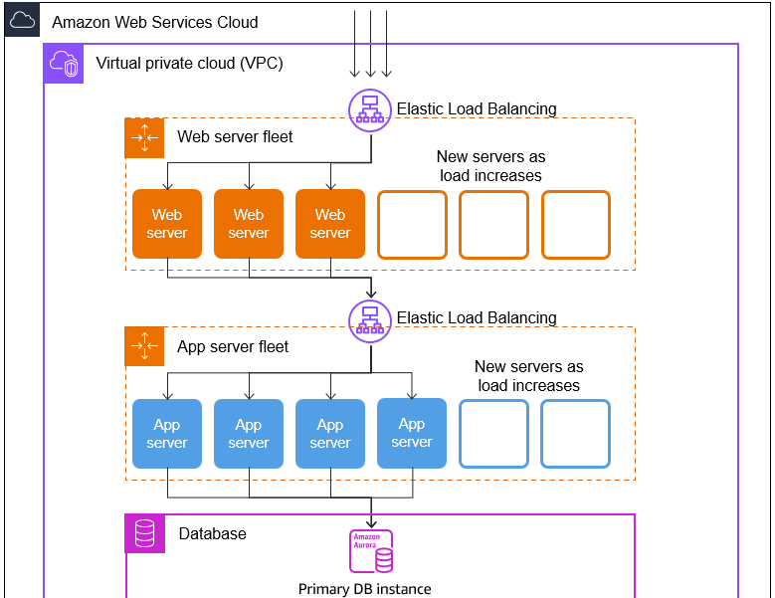
Load Balancers
■ Load balancers distribute traffic across each tier (web/app/data)
■ Each tier scales up/down servers as needed
Database service (Aurora is a managed service that auto-scales)
Kangan Institute
14

Slide 25
Auto Scaling Across AZ’s
Manages a logical collection of Amazon Elastic Compute Cloud (Amazon EC2) instances called an Amazon EC2 Auto Scaling group across Availability Zones
Launches or retires EC2 instances configured by launch templates
Resizes based on events from scaling policies, load balancer health check notifications, or schedule actions
Integrates with Elastic Load Balancing (ELB) to send new instances registrations and receive health notifications
Balances the number of instances across Availability Zones
Is available free of charge
Amazon EC2 Auto Scaling
Kangan Institute
14
Notes:
In the cloud, scaling can be handled automatically. Amazon EC2 Auto Scaling does this by grouping EC2 instances in a management group called an Amazon EC2 Auto Scaling group. The group can span across Availability Zones. An Amazon EC2 Auto Scaling group can automatically add or remove EC2 instances according to user-defined scaling policies, schedule actions, and Elastic Load Balancing (ELB) health checks. When a new EC2 instance is added to the group, a launch template or launch configuration that specifies the instance configuration is used.
Amazon EC2 Auto Scaling integrates with ELB. It automatically registers new instances with load balancers to distribute incoming traffic across the instances in the group. Amazon EC2 Auto Scaling can receive notifications of an unhealthy instance to remove from the group. The group can also balance the number of instances across Availability Zones so that the number of instances is similar for each Availability Zone.
With Amazon EC2 Auto Scaling, your applications gain the following benefits:
Better fault tolerance: Amazon EC2 Auto Scaling can detect when an instance is unhealthy, terminate it, and launch an instance to replace it. You can also configure Amazon EC2 Auto Scaling to use multiple Availability Zones. If one Availability Zone becomes unavailable, Amazon EC2 Auto Scaling can launch instances in another one to compensate.
Better availability: Amazon EC2 Auto Scaling helps ensure that your application always has the right amount of capacity to handle the current traffic demand.
Better cost management: Amazon EC2 Auto Scaling can dynamically increase and decrease capacity as needed. Because you pay for the EC2 instances you use, you save money by launching instances when they are needed and terminating them when they aren’t.
For more information, see the AWS Well-Architected Framework on the content resources page of your online course.

Slide 26
ACTIVITY
Match the mechanism to the SPOF
■ For each SPOF you found in the Accounting system cloud architecture baseline, name the cloud mechanism that removes it:
– single AZ → ? · single database → ? · single running instance → ? · single NAT gateway → ?
■ (Answers: a second AZ · Multi-AZ database · an ASG across AZs · a NAT gateway per AZ.)
■ This is the shape of the design you'll produce in Topic 12.
⏱ ~10 min
Kangan Institute
15

Slide 27
Key takeaways
Section 3 · Cloud HA
The cloud doesn't give you HA — you design redundancy across the tiers.
The toolkit: Multi-AZ, load balancing, auto-scaling across AZs, Multi-AZ databases.
Multi-AZ databases fail over automatically — seconds of downtime, no app change.
Each baseline SPOF maps to a mechanism — that's your HA design.
Kangan Institute
16

Slide 28
Key takeaways
Topic 11 · Key takeaways
High availability = stay up despite failure; availability % ↔ downtime and cost.
SPOFs and RTO/RPO are how you reason about availability.
Vertical scaling costs availability; horizontal scaling and redundancy buy it.
The cloud HA toolkit (Multi-AZ, LB, autoscaling, Multi-AZ DB) removes SPOFs.
Next you'll use this to DESIGN the HA upgrade yourself.
Kangan Institute
17

Slide 29
Next: Topic 12 — HA design
You design the HA upgrade for the Accounting baseline — review it, remove its SPOFs, set recovery objectives, and document the design.
You produce the design; the requirements and the baseline are your inputs.

