Slide 1
TOPIC 12
HA design
Design the upgrade — review the baseline, design out its single points of failure, and document it
Kangan Institute

Slide 2
Now you design it
AT3 Part A skills
■ Topic 11 gave you the concepts; Topic 12 is where you produce an HA design.
■ You design the upgrade yourself — the baseline and the HA requirements are your inputs, not a finished answer.
■ Three moves: review the baseline + find its SPOFs → design them out → document the design and plan the work.
■ Topic 13 then implements and simulates what you design here.
Kangan Institute
1

Slide 3
01
SECTION
Review the baseline & find its SPOFs
evaluate before you change
Kangan Institute

Slide 4
Review the architecture
■ Start by understanding what's there: the multi-tier shape — presentation / logic / data (web / app / database).
■ Each tier can be built, scaled and diagnosed separately.
■ Review the deployed single-AZ baseline before you change anything.
Kangan Institute
2

Slide 5
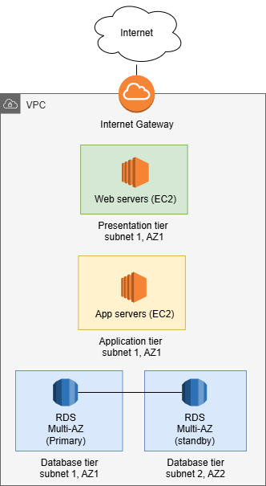
Identify the single points of failure
■ Walk the architecture and mark every component whose failure stops the whole service.
■ In a single-AZ cloud build that's the AZ itself, the one database, the one running instance, the one NAT.
■ A network diagram makes the SPOFs visible — find them before you design the fix.
Kangan Institute
3

Slide 6
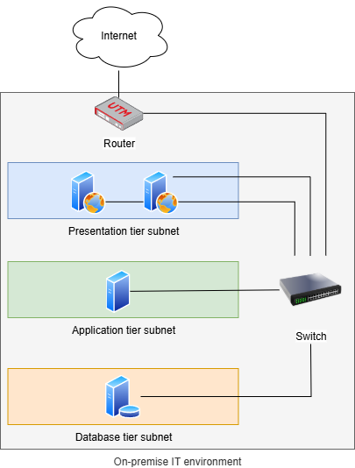
Estimate the recovery objectives
■ Recall RPO and RTO:
Recovery Time Objective – How much downtime an organisation can tolerate.
Recovery Point Objective – How much data loss it tolerable.
■ Estimate the baseline's RPO from the backup interval, and its RTO from recovery-per-tier + testing.
■ If backups run every 15 minutes and it takes 30 minutes each to recover each layer:
Max data loss: up to 15 minutes
Max outage: 30 min x 3 layers = 1.5 hours
Integration and testing = 1 hour
■ This system has an RPO of 15 min, RTO of 2.5 hours
■ Flag components that scale vertically (they carry downtime) and the availability impact.
Kangan Institute
4

Slide 7
ACTIVITY
Review the Accounting baseline
■ Take the supplied single-AZ Accounting baseline and evaluate its availability:
– list its single points of failure (AZ · database · running instance · NAT)
– estimate its RPO and RTO, and where they fall short of the HA requirement
– note the components that scale vertically and the downtime that implies
■ Document your findings — they drive the design.
⏱ ~20 min
Kangan Institute
5

Slide 8
Key takeaways
Section 1 · Review & SPOFs
Understand the multi-tier baseline before you change it.
Identify every single point of failure — a diagram makes them visible.
Estimate the baseline's RPO/RTO and flag vertical-scaling components.
Your findings are the input to the design.
Kangan Institute
6

Slide 9
02
SECTION
Design the HA-equivalent
remove every SPOF
Kangan Institute

Slide 10
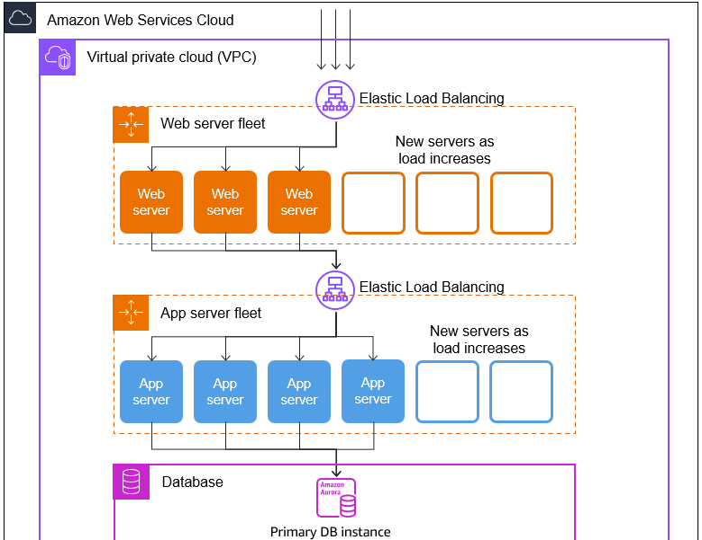
Design redundancy — remove the SPoFs
■ Using the cloud doesn't make you highly available — you design redundancy.
■ For each SPOF, add redundancy across compute, storage and network so no single failure stops the service.
■ The goal: an equivalent architecture that keeps running when one component — or one AZ — fails.
Kangan Institute
7

Slide 11
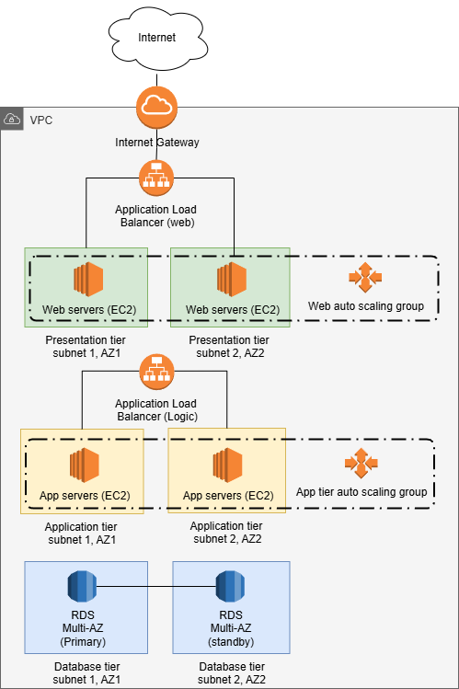
The cross-AZ HA architecture
ACA M10 S41
■ Spread the workload across two Availability Zones: load balancing across AZs → instances (ASG) across AZs → a Multi-AZ database.
■ The load balancer routes only to healthy targets; the ASG keeps capacity in each AZ; the database fails over automatically.
■ Redundant egress (a NAT per AZ) keeps outbound working if an AZ is lost.
Kangan Institute
8

Slide 12
Remove each SPOF — the mapping
design method
■ Single Availability Zone → a second AZ with mirrored subnets.
■ Single running instance → an Auto Scaling group spread across both AZs.
■ Single database → a Multi-AZ database with a synchronous standby + automatic failover.
■ Single NAT gateway → a NAT gateway per AZ.
Kangan Institute
9

Slide 13
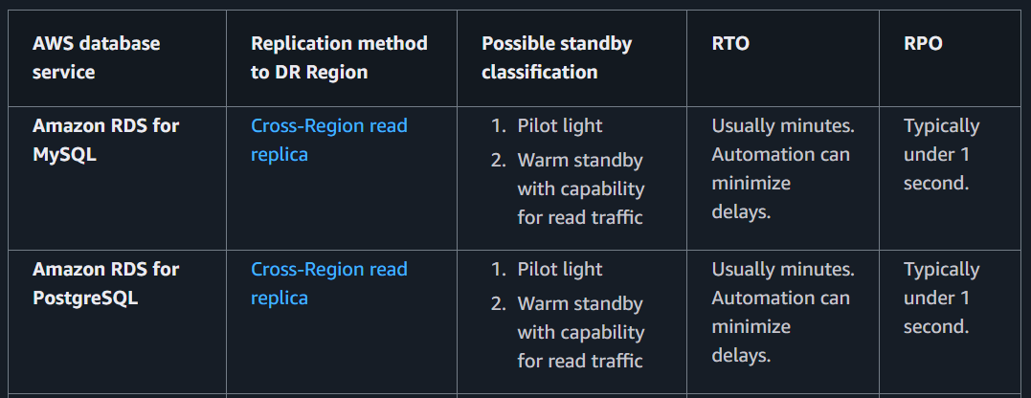
Re-estimate the recovery objectives
ICTCLD502 · Design HA S11
■ Re-estimate RPO/RTO for the HA design — per component and overall.
■ RPO is unchanged (backups); RTO drops to minutes for an AZ or instance failure via automatic failover.
■ Check the numbers now meet the HA requirement — and note what remains (the single Region).
Kangan Institute
10

Slide 14
ACTIVITY
Design the HA-equivalent for Accounting
■ Design the upgrade for the baseline you reviewed:
– design out each SPOF using the mapping (2 AZs · cross-AZ ASG · Multi-AZ DB · NAT per AZ)
– sketch the cross-AZ topology
– re-estimate the recovery objectives and confirm they meet the requirement
⏱ ~25 min
Kangan Institute
11

Slide 15
Key takeaways
Section 2 · Design
HA isn't automatic — you design redundancy across the tiers.
Spread across two AZs: LB + ASG across AZs, Multi-AZ database, redundant NAT.
Map each SPOF to its fix — that's the HA design.
Re-estimate recovery objectives and check they meet the requirement.
Kangan Institute
12

Slide 16
03
SECTION
Document the design & plan the work
the deliverable
Kangan Institute

Slide 17
What an HA design documents
■ Architecture diagram — the components, the redundancy, the connections between tiers.
■ Service list — the AWS services used and each one's purpose.
■ SPoF analysis — the SPOFs identified, and the solution implemented for each.
■ RTO/RPO table — recovery objectives per component and overall; scaling plans — what scales, how, and the trigger.
Kangan Institute
13

Slide 18
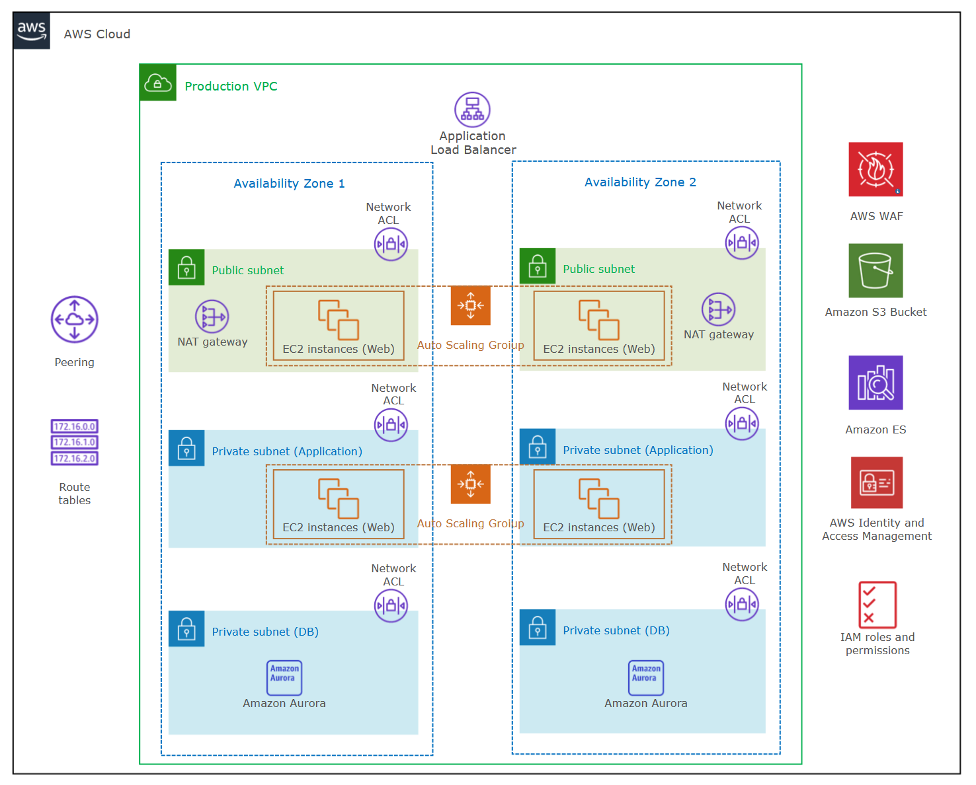
Draw the HA topology
■ A logical diagram showing the two AZs, the redundancy, the tiers and their connections.
■ Focus on the key details — boundaries, resource types, connectivity — not every setting.
■ Use the scenario's network-diagram conventions (the same draw.io style as the baseline diagram).
Lesson: https://drawio-app.com/network-diagrams/
Kangan Institute
14

Slide 19
Plan the implementation & simulation
■ Sequencing — the order to harden the running baseline in place, without an outage (add the AZ, extend ASG/ALB, convert the DB to Multi-AZ).
■ Simulation plan — the failures and resizes you'll run to prove fault tolerance (AZ/instance failure, database failover, resize under load).
■ This plan is what Topic 13 executes.
Kangan Institute
15

Slide 20
ACTIVITY
Produce your HA design document
■ Assemble the HA design for the Accounting upgrade:
– architecture diagram · service list · SPoF analysis + solutions · RTO/RPO table · scaling plans
– the implementation sequencing + the simulation plan
■ This is the deliverable — the design you'll implement next.
⏱ ~30 min
Kangan Institute
16

Slide 21
Key takeaways
Section 3 · Document & plan
An HA design = diagram · service list · SPoF analysis · RTO/RPO table · scaling plans.
Draw the topology clearly — two AZs, redundancy, tiers, connections.
Plan the sequencing (harden in place, no outage) and the simulations.
The documented design is the Part-A deliverable.
Kangan Institute
17

Slide 22
Key takeaways
Topic 12 · Key takeaways
Review the baseline and find its single points of failure.
Design them out across two AZs (LB + ASG + Multi-AZ DB + redundant NAT).
Re-estimate recovery objectives against the requirement.
Document the design (five parts) and plan the implementation + simulations.
You produce the design — next you build it.
Kangan Institute
18

Slide 23
Next: Topic 13 — HA implementation & simulation
Implement your HA design on the running baseline, then simulate failures and resizes to prove it's fault tolerant.
Bring your design document and your simulation plan.

