Slide 1
TOPIC 13
HA implementation & simulation
Build your HA design — then break it on purpose to prove it works
Kangan Institute

Slide 2
Build it, then break it
AT3 Part B skills
■ In Topic 12 you designed the HA upgrade; now you implement it on the running baseline.
■ Then you simulate failures and resizes — to prove the design is actually fault tolerant.
■ Build → demonstrate connectivity → simulate → compare to your design → improve → document.
■ For the build: watch the recorded demo, then do it. The simulations you drive yourself.
Kangan Institute
1

Slide 3
01
SECTION
Implement the design
harden in place
Kangan Institute

Slide 4
Implementation approaches
■ Big-bang / cutover — switch over all at once: fastest, but high risk.
■ Incremental — adopt in phases: easier to adapt and troubleshoot; slower.
■ Parallel — run old and new together: safest fall-back, but highest cost.
■ In-place HA hardening is incremental — add redundancy without taking the service down.
Kangan Institute
2

Slide 5
Build it well
■ Deploy with scripts (infrastructure as code) — repeatable, documented, fewer errors.
■ Right-size with the Auto Scaling group instead of guessing capacity.
■ Automate security and monitoring (IAM, CloudWatch, alarms).
Kangan Institute
3

Slide 6
Demonstrate connectivity at all tiers
■ After implementing, confirm each tier works — and only talks to what it should:
– client → application; application → database; database reachable only from the app tier
■ Confirm failover works — and that you can fail back to the primary.
■ This is the evidence that the build is correct, not just present.
Kangan Institute
4

Slide 7
RECORDED DEMO
Build a highly available application
■ Create an Auto Scaling group spread across two Availability Zones, behind a load balancer.
■ Add a Multi-AZ database with an automatic-failover standby.
■ Confirm the load balancer routes only to healthy targets across both AZs.
▶ Play the AWS recorded demo (ACA M10 · Creating a Highly Available Application (S44)) — you do this next
Kangan Institute
5

Slide 8
ACTIVITY
Implement your HA design
■ On the running Accounting baseline, implement the hardening from your Topic 12 design:
– add the second AZ + mirrored subnets; extend the ASG and ALB across both AZs
– convert the database to Multi-AZ; add the second NAT gateway
■ Demonstrate connectivity at all tiers and capture evidence.
⏱ ~30 min
Kangan Institute
6

Slide 9
Key takeaways
Section 1 · Implement
In-place HA hardening is incremental — no outage.
Deploy with IaC; right-size with the ASG; automate security + monitoring.
Demonstrate connectivity at every tier, including failover and fail-back.
Capture the evidence as you build.
Kangan Institute
7

Slide 10
02
SECTION
Simulate failures & resizes
break it on purpose
Kangan Institute

Slide 11
Why simulate?
■ An untested backup plan isn't a plan.
■ In 2016 Delta Air Lines had an outage when failed equipment exposed a backup that had never been tested — about US$100 million.
■ You simulate failures to confirm every part of the HA design actually works.
■ Many ways to simulate a failure to confirm all elements of an HA design are working:
Disabling assets: turn off a server, simulating an outage. Does the system respond correctly?
Network disruption: Block all traffic into subnet/from one connection. Does system fail over to secondary assets?
Scaling: perform load testing and confirm scaling up/down works
Kangan Institute
8

Slide 12
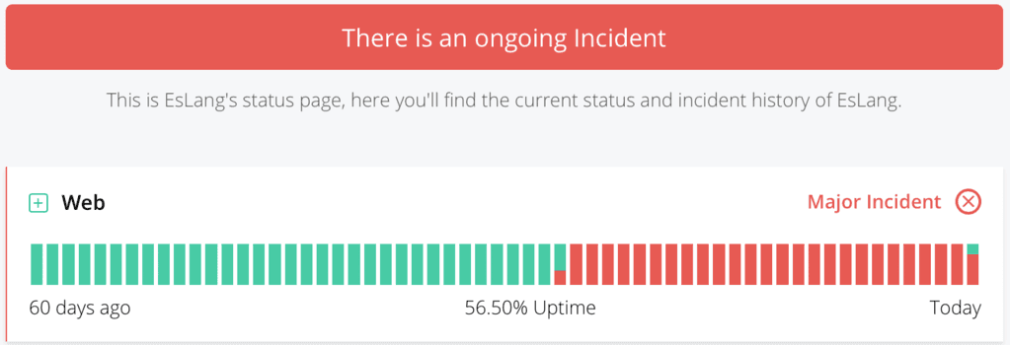
Simulate resizes & load
■ Load testing — does it work under the expected workload (e.g. month-end peak)?
■ Stress testing — where's the breaking point, and does it fail gracefully (queued / busy messages, data safe)?
■ Resize a component and measure the availability impact — vertical resizes often take a brief outage.
Kangan Institute
11

Slide 13
Monitor & measure availability
■ Watch uptime, errors and latency throughout the simulation — you can't prove availability you didn't measure.
■ Use CloudWatch metrics + alarms and the AWS Health Dashboard.
■ Record the numbers before, during and after each simulated failure.
Kangan Institute
9

Slide 14
ACTIVITY
Run the simulations
■ Per your simulation plan, with monitoring on:
– fail an instance / an AZ — confirm the service stays up (fault tolerant)
– trigger a database failover, then fail back
– resize under load and measure the availability impact
■ Record the availability impact of each, with evidence.
⏱ ~30 min
Kangan Institute
12

Slide 15
Key takeaways
Section 2 · Simulate
Untested HA isn't HA — simulate to prove it.
Measure availability (CloudWatch) throughout each simulation.
Simulate failures (disable assets / block a subnet) and confirm failover.
Load/stress test and measure the impact of a resize.
Kangan Institute
13

Slide 16
03
SECTION
Compare, improve & document
did it meet the design?
Kangan Institute

Slide 17
Compare findings to the design
your documented design
■ Measure what the simulations showed against your documented recovery objectives.
■ Did the build meet its RPO/RTO? Did each SPOF's fix actually hold under failure?
■ Note any gap between the design's intent and the simulated reality.
Kangan Institute
14

Slide 18
Improve availability if needed
■ If a simulation shows a prolonged outage or poor availability, adjust the design:
– more redundancy · Multi-AZ · managed services with built-in HA · monitoring with auto-triggered recovery
■ Consider making changes to your design:
Multi-AZ and Multi-Region Deployment: If workload fails due to outage, services elsewhere take over. e.g. Amazon RDS Multi-AZ.
Load Balancing: Distribute workload across resources. E.g. ALB Balancer for web traffic, or third-party LBs (e.g. F5 BIG-IP)
Extra Redundancy: key resources (servers, databases, network links) replicated so failure of one doesn’t cause downtime.
Managed Services with Built-In HA: Use services with built-in HA features. e.g. Amazon S3, DynamoDB.
Monitoring with auto-triggered actions: Utilise monitoring alarms that trigger automated recovery actions
■ Make the change, then re-test to confirm the improvement.
Kangan Institute
15

Slide 19
ACTIVITY
Compare, adjust & document
■ Finalise the implementation:
– compare your simulation findings against your documented design
– make any improvements the simulations call for, and re-test
■ Document the simulation findings against the design — this feeds the HA Deployment Report.
⏱ ~20 min
Kangan Institute
16

Slide 20
Key takeaways
Section 3 · Compare & improve
Compare simulation findings to the documented recovery objectives.
Improve where the simulations show gaps — then re-test.
Document the findings against the design.
What you record here becomes the HA Deployment Report.
Kangan Institute
17

Slide 21
Key takeaways
Topic 13 · Key takeaways
Implement incrementally — harden in place with no outage.
Demonstrate connectivity at all tiers, including failover.
Simulate failures and resizes to *prove* fault tolerance; measure availability.
Compare to the design, improve where needed, and document the findings.
You implemented and proved your own design.
Kangan Institute
18

Slide 22
Next: Topic 14 — Closure & documentation
Write the HA Deployment Report from your evidence and findings, seek and respond to feedback, and obtain final sign-off — closing the engagement.
Bring your simulation findings.

