Slide 1

Business Technology Management (BTM)
2024-01-10
Stéphane Gagnon, Ph.D.
admin@gagnontech.org
https://gagnontech.org
https://btmforum.org

Slide 2
Outline
Introduction
From Information to Business Technology Management
Digital Strategy
As-Practice Perspective
Rethinking IT Talent Management
Unified Digital Profession
Methodology
Results
Conclusion

Slide 3
Summary
Invitation to join the Business Technology Management (BTM) initiative
Digital transformation is accelerating causing an IS/IT leadership talent gap.
Digital leaders need more hybrid skillsets, and work across dozens of fragmented IS-IT professional specializations (e.g., Business Analysts, IT Architects, IT Services Management, etc.).
Must shift from an “information” to a broader “business” focus, co-creating digital organizations, processes, products, services, experiences, etc.
BTM and its applied research project for a BTM Body of Knowledge (BOK).
Launched in Canada and supported by 22 colleges and universities, BTM aims at rebranding IS and IT programs within a united framework, ensure collaboration between disciplines, and create more seamless career paths.

Slide 4
1. Introduction

Slide 5
Digital Project Leadership
Digital Transformation > multi-year programs of IT-enabled change
Regular IT vs. Digital Projects > beyond “IT-as-usual” - significantly new processes and infrastructures, products and services, business models, as well as behaviors and culture
Digital Leadership > more than leading an IT project - must lead a business unit and all its people in becoming digital, e.g., Chief Digital Officer (CDO)
evolving requirements imply greater agility
new approaches in recruiting and coaching IT and Digital Project teams and leaders
keeping organizational performance stable and avoiding “digital failure” (Ramesh and Delen 2021)
2024-01-21

Slide 6
Evolving IS-IT Profession
Acceleration of Digital Transformation, transdisciplinary IS-IT roles
Digital projects beyond just IT, require new tasks and new skillsets
Roles span technology and business units, co-development leaders
Senior digital leaders must promote IS-IT roles focused on:
developing an innovative mindset throughout the organization
gaining the necessary authority to negotiate with executives
developing a wide-ranging set of technical competencies
exercising influence through technical leadership
acquiring the necessary experience in the business
2024-01-21

Slide 7
Research Questions
How can IT executives best identify and position IT professionals and managers to fit digital leadership roles?
How to build upon recent studies of Chief Digital Officer (CDO), adapting to digital teams and leaders recruited at lower ranks?
How to link digital leadership competencies to IT and digital strategy outcomes, building upon IT strategy theories?
How to ground these competencies and explain their enactment using Strategy-as-Practice, along with its related concept in project management, Project-as-Practice?
2024-01-21

Slide 8
2. FROM INFORMATION TO BUSINESS TECHNOLOGY MANAGEMENT

Slide 9
BTM Initiative – Opening Door to AIDAF
New professional designation, with Registered Trademarks in Canada and the US:
Business Technology Management (BTM)
Gestion des technologies d’affaires (GTA)
Unifying Information Systems (IS) and Information Technology (IT) graduates within a stronger community of practice
Rebranding IS/ITM programs as BTM in Canadian Business Schools
Stakeholders moving from an information to a broader business focus
Emphasize distinctive professional abilities for digital leadership:
Renewed focus on innovation and digital value
Leaders of the digital lifecycle and transformation
Hybrid acumen as key to effective leadership
2024-01-21

Slide 10
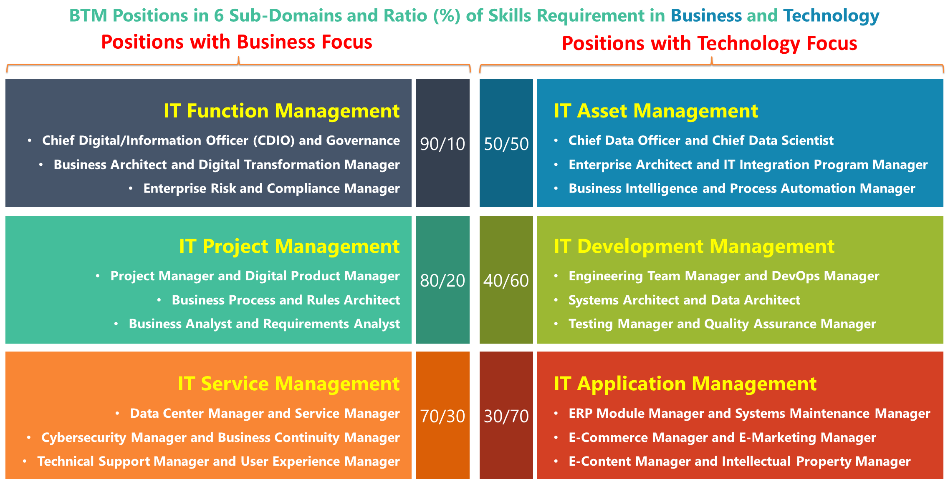
BTM Hybrid Professional Roles
2024-01-21

Slide 11
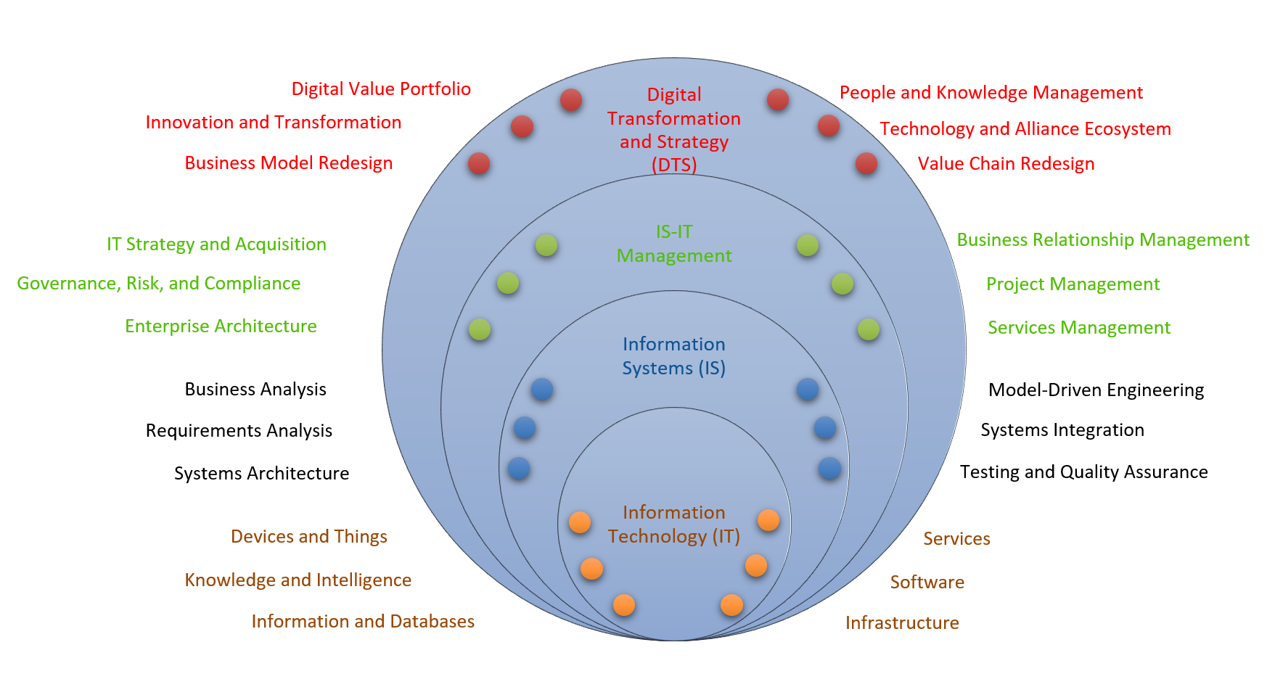
From Information to Business Technology Management

Slide 12
BTM Forum Mission
Prepare professionals to lead the digital transformation
Help organizations identify digital leaders with the best hybrid acumen
Broaden focus beyond “information” toward “business” technology management
1. Coach Digital Leaders
2. Develop Hybrid Acumen
3. Broaden Digital Vision
2024-01-21

Slide 13
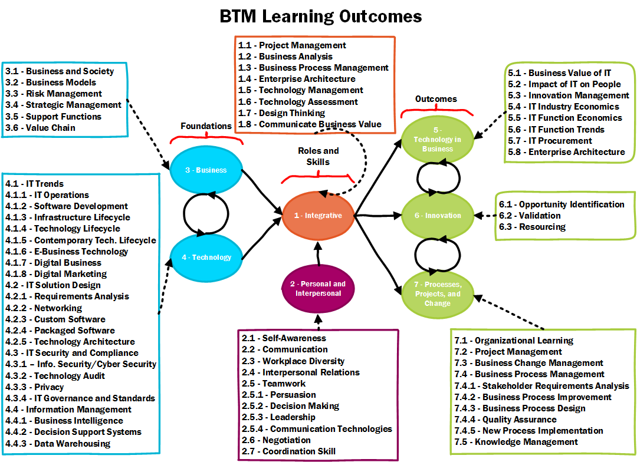
BTM Accreditation Standards

Slide 14
BTM Forum Timeline
2009: A team of faculty and industry leaders attend a meeting at the Toronto Metropolitan University (TMU) organized by the Canadian Coalition for Tomorrow’s ICT Skills (CCICT); they launch the Business Technology Management (BTM) initiative, with the BTM Advisory Council (BTMAC) as its steering committee; a set of 40 criteria are synthesized in the BTM Accreditation Criteria 1.0 administered by Canadian Information Processing Society (CIPS).
2010: Government of Canada Launches National Consultations on a Digital Economy Strategy; CCITC publishes the white paper entitled “Canada: The go-to country for brainpower resources in the global digital economy“.
2011: Based on the consultation, Government of Canada allocates CAN$ 720 million to a new digital economy strategy; CAN$ 60 million are dedicated to IT human resources development.
2013: Simon Fraser University (SFU) programs obtain the first BTM accreditation from CIPS.
2014: CCITC obtains a Government of Canada grant of CAN$ 1.6 million to develop and promote BTM programs; it merges with the IT Association of Canada (ITAC) to become ITAC Talent; first edition of BTM TalentMash is launched, which will develop into a Canada-wide annual job fair and competition, held every Fall until 2018 in 5-7 Canadian cities.
2015: The National Business Technology Management (BTM) Conference 2015 is organized in Halifax, NS, during the Administrative Sciences Association of Canada (ASAC) Conference.
2016: The BTM Accreditation Criteria 2.0 are published, growing to 70 criteria organized in 7 knowledge domains; a second edition of the BTM Conference is organized in Edmonton, AB, during the ASAC Conference; the BTM Forum is created with the BTM Governing Council (BTMGC) to run a professional networking organization, and the BTM Accreditation Council (BTMAC) to administer program reviews.
2017: The number of BTM accreditations and recognitions reaches 10 institutions among 20+ that offer BTM branded programs; a third edition of the BTM Conference is organized at Université du Québec à Montréal (UQAM), Montréal, QC; students of the TMU win the first Annual BTM Case Competition; ITAC Talent obtains CAN$ 160,000 MITACS Accelerate grant with Université du Québec en Outaouais (UQO), Gatineau, QC, to launch an applied research project and develop the BTM Body of Knowledge.
2019: The first edition of the BTM BOK (v.0.1) is published on GitHub; ITAC changes name to become TECHNATION Canada; ITAC Talent is disolved given the end of Government of Canada funding.
2020: The global pandemic stalls the development of BTM Forum activities.
2021: TECHNATION Canada signs an agreement to transfer all BTM initiative trademarks, assets, and operations to the Digital Innovation Foundation (DIF).
2022: CIPS signs an agreement with BTMGC members to reintegrate BTM accreditation operations.
2023: BTMGC votes to become the BTM Council for Canada; BTM Forum develops into a global initiative, with Canada chairing the first BTM Global Council.

Slide 15
Canadian BTM Programs
https://www.senecapolytechnic.ca/programs/fulltime/BTM.html
https://www.torontomu.ca/programs/undergraduate/business-technology-management/
https://www.yorku.ca/laps/sas/bcom/degree-options/business-technology-management/
https://academiccalendars.romcmaster.ca/preview_program.php?catoid=53&poid=27123
https://www.wlu.ca/programs/business-and-economics/undergraduate/business-technology-management-btm/index.html
https://telfer.uottawa.ca/en/bcom/your-program-of-study/program-options-and-minors/business-technology-management/
https://www.athabascau.ca/programs/summary/bachelor-of-commerce-in-business-technology-management.html
https://www.ualberta.ca/business/programs/bachelor-of-commerce/majors/business-technology-management.html
https://www.ucalgary.ca/future-students/undergraduate/explore-programs/business-technology-management
http://www.sfu.ca/students/calendar/2024/spring/programs/business-technology-management/certificate.html
https://mybcom.sauder.ubc.ca/courses-money-enrolment/options/business-technology-management
https://business.acadiau.ca/programs.php?id=btm
https://www.concordia.ca/academics/undergraduate/business-technology-management.html
https://www.fsa.ulaval.ca/etudier/programmes/baa/concentration-gestion-technologies-affaires/
https://etudier.uqam.ca/programme?code=4668
https://www.uqar.ca/etudes/etudier-a-l-uqar/programmes-d-etudes/4077
https://uqo.ca/mod/sciences-administration/certificat-gestion-technologies-daffaires
https://oraprdnt.uqtr.uquebec.ca/pls/public/gscw031?owa_no_site=2571&owa_no_fiche=194&owa_bottin=
6 in Ontario
5 in West
1 in East
6 in Québec

Slide 16
3. Digital Strategy

Slide 17
3.1. Business-Technology Alignment
Emergence of IT strategy from an organizational perspective, beyond the traditional functional viewpoint of IT, with a greater emphasis on its innovative potential (Chen et al. 2010)
Reconceptualizing IT beyond its artefact nature, and toward a broader value perspective integral to business (Gable 2010)
Complex adaptive system perspective conceptualizes digital as the vast network of relationships among business and technology concerns, wholly integrated, assessed, co-designed, and co-executed (Merali et al. 2012)
Explain how business and technology strategies are enacted, beyond alignment itself (Chan and Reich 2007)
Process amplified by the mediating interdependencies between the six relationships between four alignment components (Gerow et al. 2015)
2024-01-21

Slide 18
3.2. Digital Transformation
Digital Strategy creates a seamless integration of business and technology (Bharadwaj et al. 2013)
Requires a hybrid skillset of business technology leadership, that must be further adopted throughout the organization (Grover et al. 2018)
Develop the necessary abilities to manage a hybrid strategy process (Johnson and Lederer 2010)
Greater expectation on the business performance impact of IT (Peppard 2010; Varajão et al. 2016)
Greater freedom in contributing to business strategy (Ding et al. 2014)
2024-01-21

Slide 19
3.3. Leadership Competencies
Digital Strategy has emphasized hybrid leadership skills for digital project success (Kane et al. 2019)
Digital project leaders are required to help people learn and co-create both new technology applications and new organizational capabilities
Chief Digital Officer (CDO) role is a hybrid role with focus on business value from IT (Horlacher 2016; Locoro and Ravarini 2019)
Match and master the business strategies pursued by the organization (Li and Tan 2013; Shaughnessy 2018)
Acquiring the necessary understanding of the business and its industry through varied experience (Sobol and Klein 2009)
2024-01-21

Slide 20
Digital Leadership Competencies
Competency | Link to Digital Strategy | Example Authors
Business model redesign | Formulate digital strategies departing from established models for competitive advantages | (Berman 2012; Schallmo et al. 2017)
Value-driven and user-centric innovation | Focus IT-enabled change on actual value impact and end-user behaviors | (Kohli and Melville 2019; Vial 2019)
Data-centric transformation | Enhance strategies or formulate new ones based on data and intelligence capabilities | (Brock and von Wangenheim 2019; Raisinghani 2021)
2024-01-21

Slide 21
4. As-Practice Perspectives

Slide 22
As-Practice Perspective in IS-IT
Scopus: ( TITLE ( "as practice" ) AND SRCTITLE ( "information" OR "technology" OR "system" OR "software" ) )
Found 26, only 15 relevant, started in 2014 with Special Issue in Journal of Strategic Information Systems (JSIS)
After 2014, only 6 articles in journals, others all in proceedings and books.
2024-01-21

Slide 23
4.1. Strategy-as-Practice
Strategy-as-Practice is fundamentally a more dynamic and complex perspective of strategy making
Interplay of strategy making, strategy makers, strategy artefacts, and strategy processes are co-constructed through a dynamic, emergent, and learning-oriented praxis (Jarzabkowski 2008; Whittington 1996)
Still emerging in the IS literature, since 2014 with Special Issue in Journal of Strategic Information Systems (JSIS) (Arvidsson and Holmström 2017; Whittington 2014)
Extend the alignment literature and respond to calls for more dynamic and micro-focused research
2024-01-21

Slide 24
4.2. Project-as-Practice
Project-as-Practice poses to view project execution from the viewpoint of what actually happens in projects
Ensure that theories of project management are more accurately depicting the reality of project life (Blomquist et al. 2010; Hällgren and Söderholm 2011)
Integration of strategic and operational levels is also a challenge studied from the “as-practice” perspective in project and their governance, a key aspect as well of digital strategy enactment (Brunet 2019; Karanasios and Slavova 2019; Kwayu et al. 2018)
As digital strategies and projects are enacted and executed, the ongoing strategy process and emergence allows for a continuous learning and co-development or praxis in digital leadership competencies
2024-01-21

Slide 25
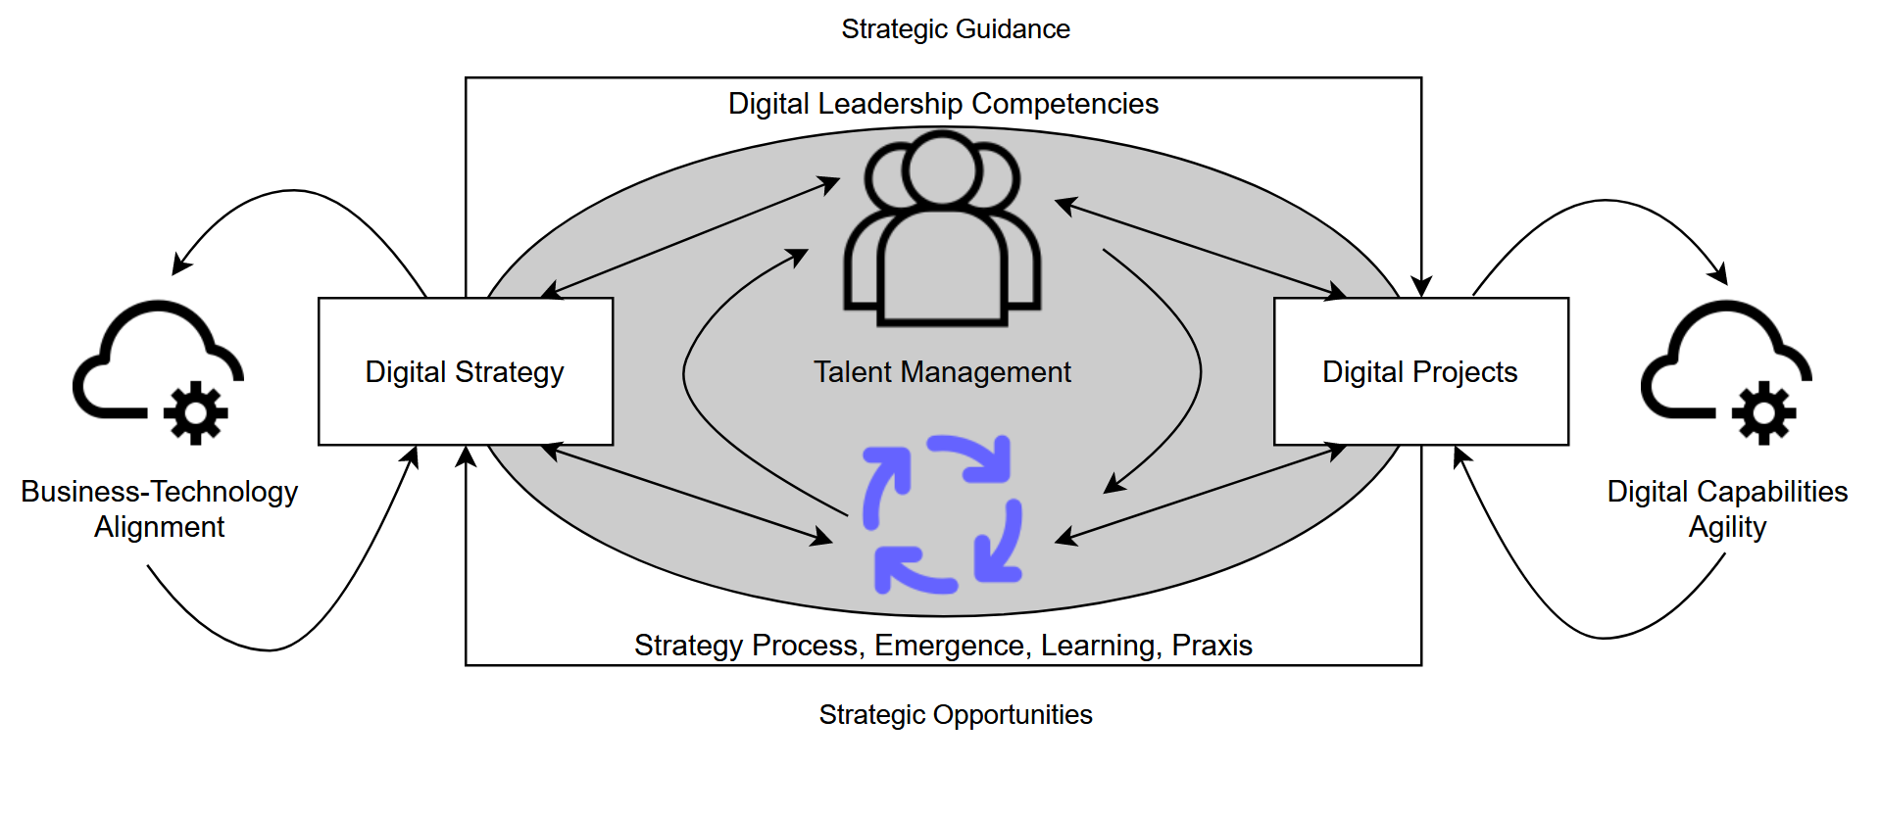
As-Practice Perspective on Digital Leadership
4
1
3
2
5
2024-01-21

Slide 26
5. Rethinking IT Talent Management

Slide 27
Talent Management (TM)
TM is one of the most strategic practices in Human Resources Management (HRM)
Focused on developing the “Competency Architecture” of an organization as the matching point between operations and people
Ontology of tasks, processes, roles, and outcomes, along with required knowledge, skills, and experience (Lewis and Heckman 2006)
Systematically plan and invest in the best people as strategic resources, enriching roles and allowing to influence strategy (McDonnell et al. 2017)
Requires renewed focus on people and culture (Ulrich and Dulebohn 2015)
Maintain career coherence using logical competency anchors for talent and job pools (Schein and Van Maanen 2016)
2024-01-21

Slide 28
BTM Specializations and BOK References

Slide 29
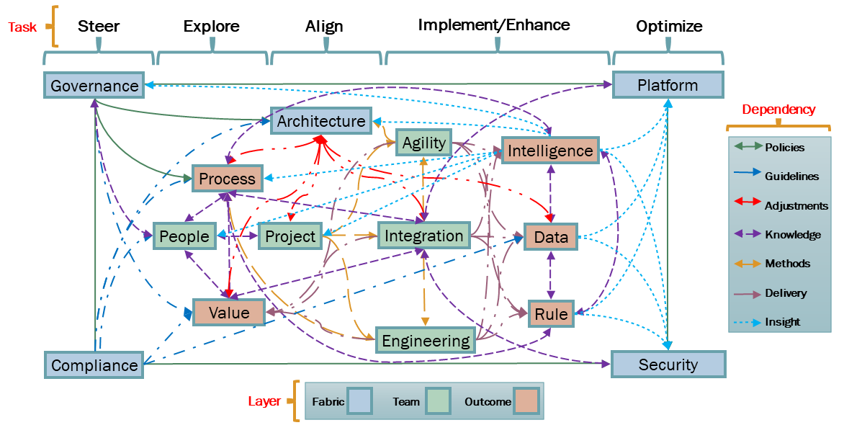
Transdisciplinary Competency Framework
2024-01-21

Slide 30
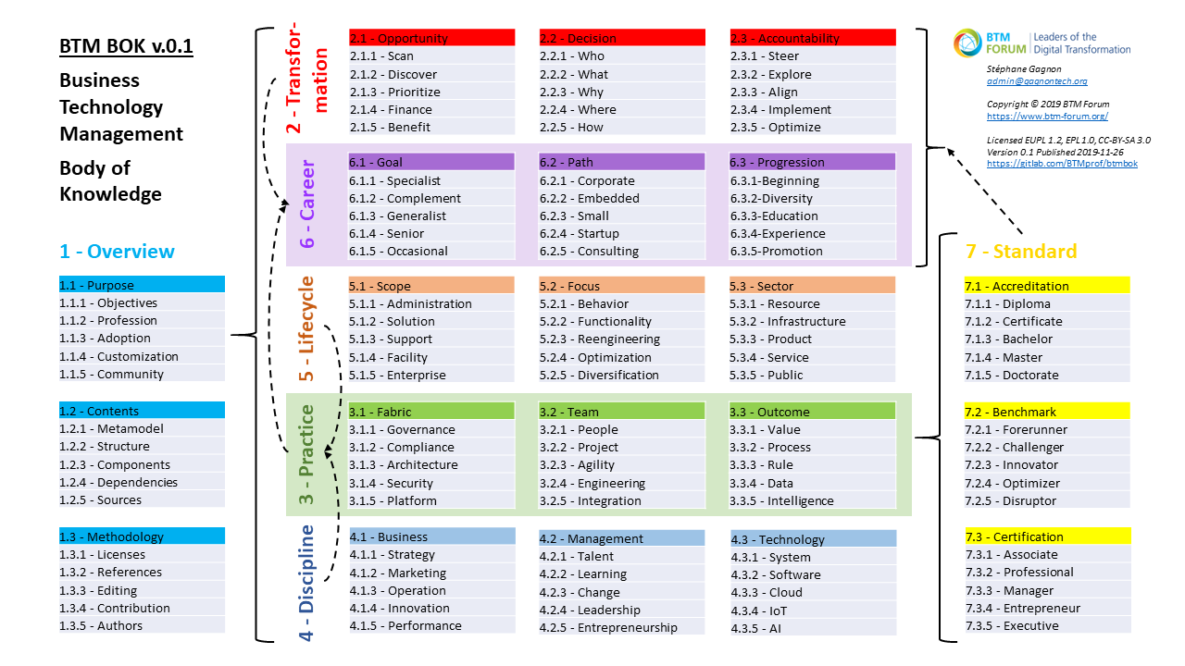
BTM BOK Outline v.0.1
https://gitlab.com/BTMprof/btmbok/-/tree/master/doc

Slide 31
Legend: Deconstructing BTM
Fields: Business, Computing, Design, Engineering, Mathematics
Disciplines: CS, EM, IS, SE, TIM
Domains: DITE, DL, DS, NPI, PM
Divides Transdisciplinary
Business Technology Management (BTM)
Cutting Across 5 Fields
Integrating 5 Disciplines
Encompassing 5 Domains
Information Systems (IS)
3
Engineering Management (EM)
2
Business
Digital Innovation, Transformation, and Entrepreneurship (DITE)
Digital Leadership (DL)
Business
Engineering
Design
Project
Management
(PM)
Business
Computer Science (CS)
Design
Data Science (DS)
Computing
1
New Product Innovation (NPI)
Technology
and Innovation Management (TIM) or Management of Technology (MOT)
5
Software Engineering (SE)
4
Maths
Engineering

Slide 32
BTM BOK Objectives
Develop a single Body of Knowledge (BOK), building upon existing practices, to guide upcoming digital leaders toward the common core competencies of their profession
Use the BOK for:
Design of seamless career paths across multiple specializations for more complete experience and knowledge
Define learning guidelines to develop new BTM expertise
Certification of digital leaders at Associate, Professional, Manager, and Executive competency levels
Accreditation of degree programs, helping them meet job requirements for digital leadership roles
2024-01-21

Slide 33
BTM BOK Contents
BTM BOK developed using the Eclipse Process Framework (EPF) platform
Supported by open community to help map the relationships between several BOKs
Integrating citations to academic and professional literature, build reading guides
Open and customizable, with API to reuse its contents in various Talent Management functions
Custom BTM-compliant job descriptions
Automated matching of CVs and job competencies
Learning path recommendations given prior experience for recognized BTM careers

Slide 34
6. UNIFIED DIGITAL PROFESSION

Slide 35
New Talent Management for Digital Projects
Designing a BTM BOK helped identify new TM methods for digital project leadership, focused on competency framework redesign
Iteration 1 results provide scaffolding of upcoming iterations
DevOps methods and infrastructure ready for community-led phase
Evolution from SPEM to Essence standards requires new tooling
Assets “uploading” is a first phase focusing on “harvesting” open-source contents, assets “alignment” should follow rapidly
Should link BTM BOK assets to IS-IT program accreditation
2024-01-21

Slide 36
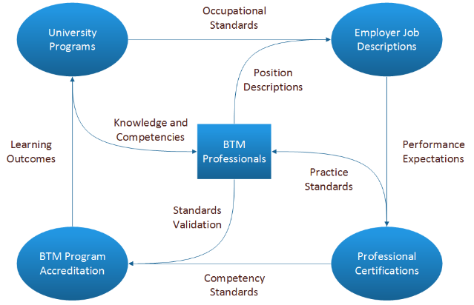
BTM Professionals at Core

Slide 37
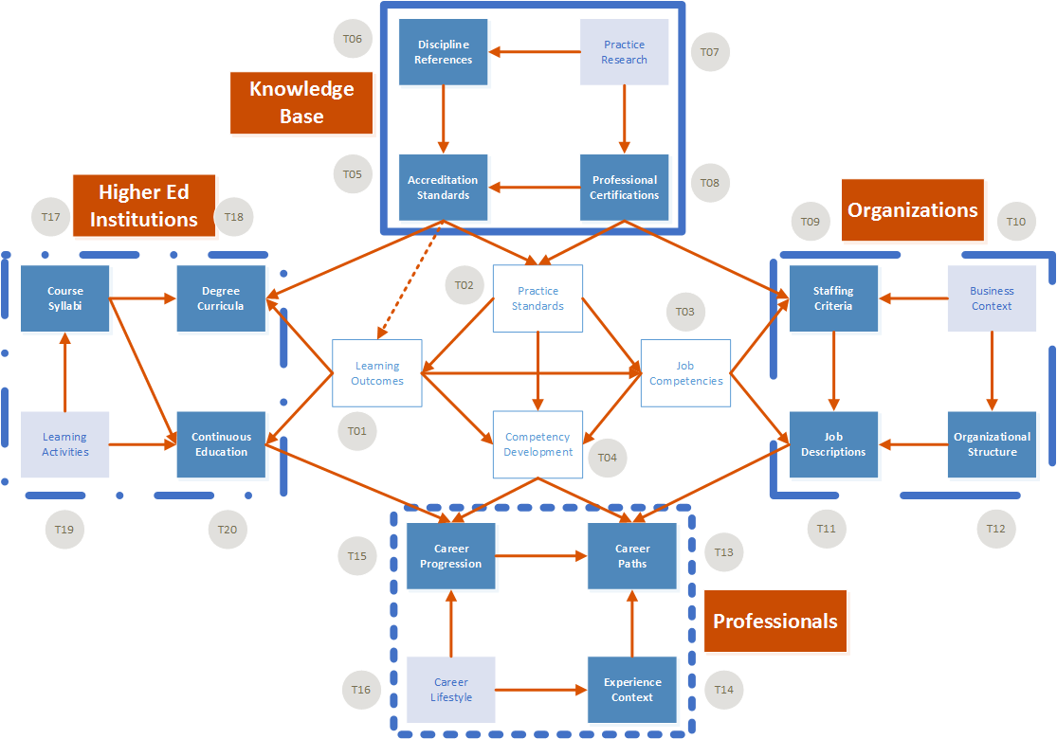
BTM BOK Customization Opportunities

Slide 38
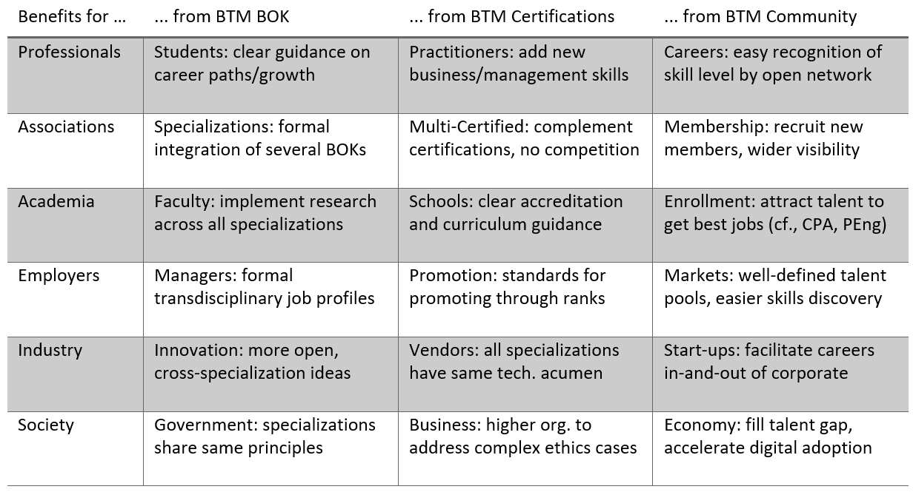
Benefits of BTM
2024-01-21

Slide 39
7. Methodology

Slide 40
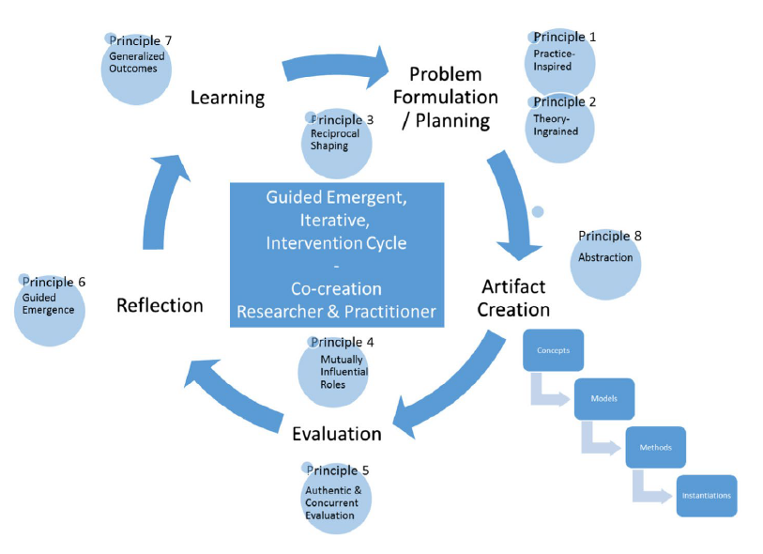
Action Design Research (ADR) Project Cycle
Objectives
1. Talent Management
2. Competency Framework
3. Agile Cycle
4. Core Language
Methodologies
Literature Review
Literature Review
Dev Methods Design
Results
BOK Structure
BTM Practices
EPF DevOps Infrastructure
BOK Editorial Process
Dev Methods Design
5. Community-Led Iterations
Dev Methods Design
Metamodel
Paper Sections
L
P
Literature
Methodology
Results
1
7
3
2
P
6
R
A
8
A
E
4
R
L
E
1
2
1
8
2
3
4
7
5
6
5
Deliverable 1
Deliverable 2
Deliverable 3
Deliverable 4
Deliverable 5
Source: Fig.1, p.3, Mullarkey, M. T., and Hevner, A. R. 2019. "An Elaborated Action Design Research Process Model," European Journal of Information Systems (28:1), pp. 6-20.
ADR Iteration 1
2024-01-21

Slide 41
DevOps Cycle
BTM BOK development relies on DevOps methods that emphasize continuous integration
Assets are co-developed at various stages by community that produce code published on a Git repo on a continuous basis
Eclipse Process Framework (EPF) serves to integrate 3 cycle steps:
EPF Composer to design the BTM BOK framework and integrate various external assets
EPF Wiki to maintain and add contents and citations to external BOKs and references
EPF Wiki and Git Application Programming Interfaces (API) to reuse BTM BOK assets into key TM tasks
2024-01-21

Slide 42
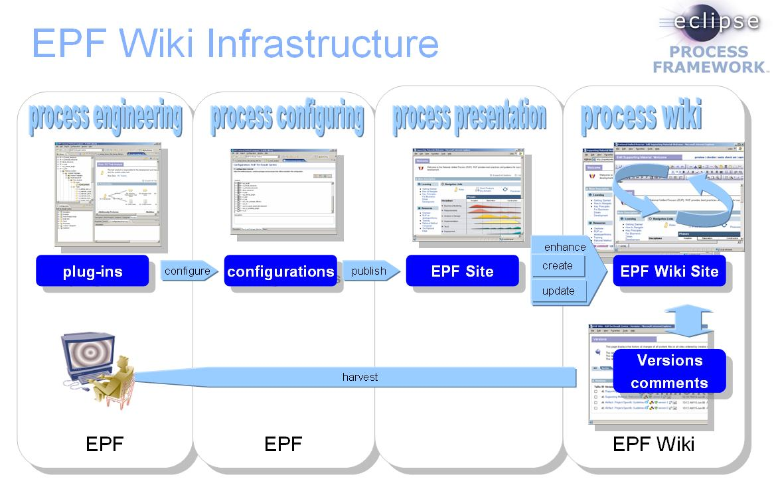
BTM BOK DevOps Lifecycle Based on EPF
Source: https://github.com/siguremon/epfwiki/blob/master/doc/infrastructure.jpg

Slide 43
8. results

Slide 44
Open-Source Knowledge Integration
Integrate contents to the 7 BTM BOK chapters, all Free Libre Open Source (FLOS) publications and projects in Creative Commons — Attribution-ShareAlike (CC BY-SA) and similar licenses
Focus on Ch. 3 Practice and Ch. 4 Discipline references, which are further edited to ensure continuous integration and harmonization
Find a common and converging language between specifications, both open and proprietary
e.g., harmonizing the Project Manager role as described in Architecture, Engineering, and Project practices
Future iterations, forking, and redistribution to occur more sporadically
Requiring formal releases of assets, with roadmap, do not evolve too fast
Target assets reuse in a variety of community activities, ranging from BTM community functions to value-added services
Ideally, Ch.3 Practice can be extensively reused by proprietary standards
2024-01-21

Slide 45
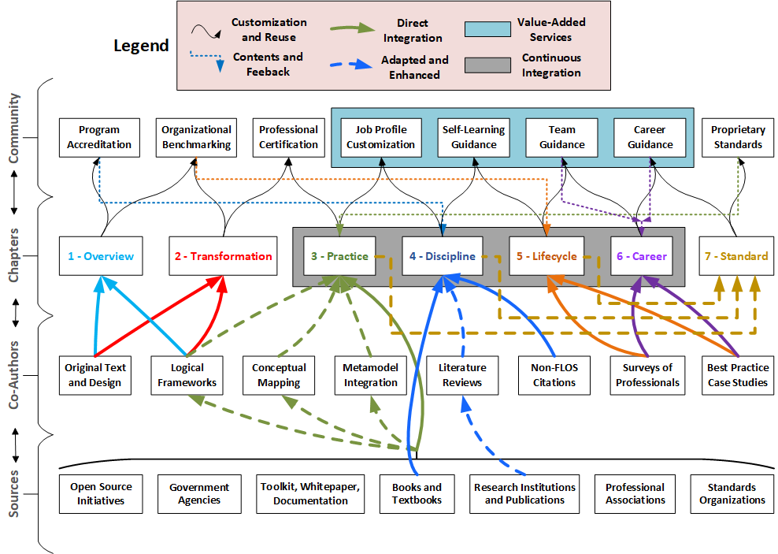
BTM BOK Sources, Integration, and Reuse
Source: https://gitlab.com/BTMprof/btmbok/-/tree/master/doc

Slide 46
Metamodel Components
Role: outline of job functions and qualifications, related to tasks and deliverables accountability.
Task: outline of role(s)-centered activities, with step-by-step, and deliverables as inputs-outputs.
Deliverable: artefacts delivering value for digital transformation, with templates and guidelines.
Guidance: glossaries, practices, and roadmaps to perform tasks, deliverables, and use tools.
Capability: combination of tasks as a short “way or work” or set of “states” to reach a milestone.
Workflow: combination of capabilities across iterations of varying scales to reach stage-gates.
Tool: documentation of techniques and *-wares used to perform tasks and support teamwork.
2024-01-21

Slide 47
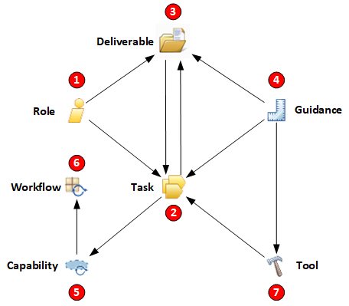
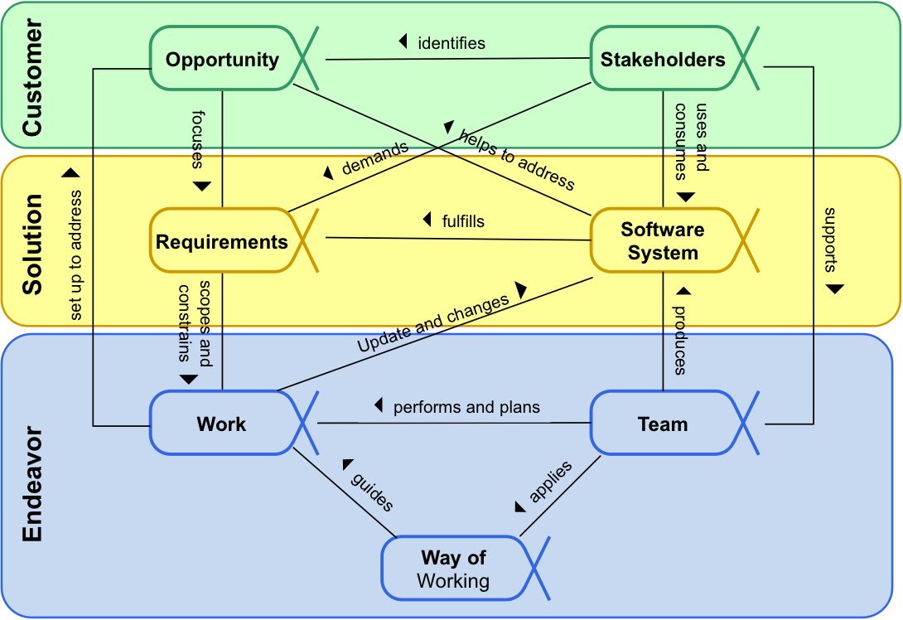
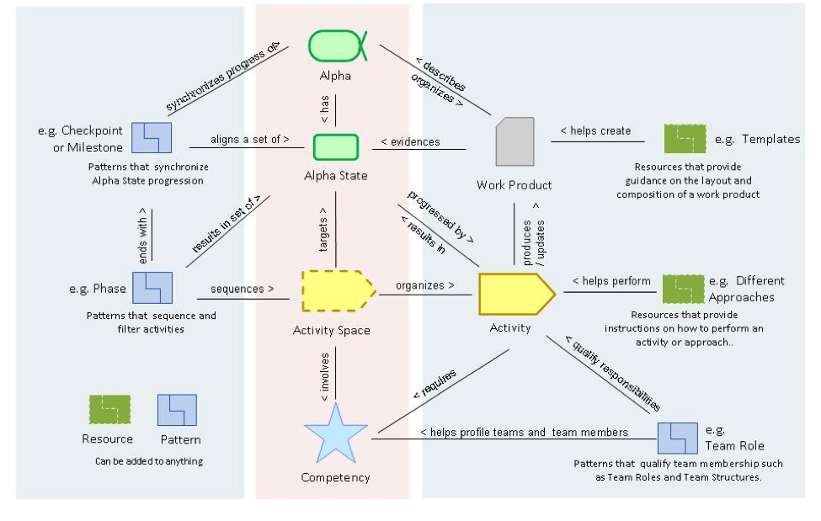
BTM BOK Metamodel – Present and Upcoming
Present Iteration 1
Upcoming Iterations 2 or 3
SEMAT Essence 1.8
https://www.omg.org/spec/Essence
Source: Fig.1, p.44, Jacobson, I., Ng, P. W., McMahon, P. E., Spence, I., Lidman, S. 2012. "The essence of software engineering: the SEMAT kernel," Communications of the ACM (55:12), pp. 42-49; and Essence Plus, SEMAT Guide, http://semat.org/view-3-essence-plus
Derived from SPEM 2.0
https://www.omg.org/spec/SPEM

Slide 48
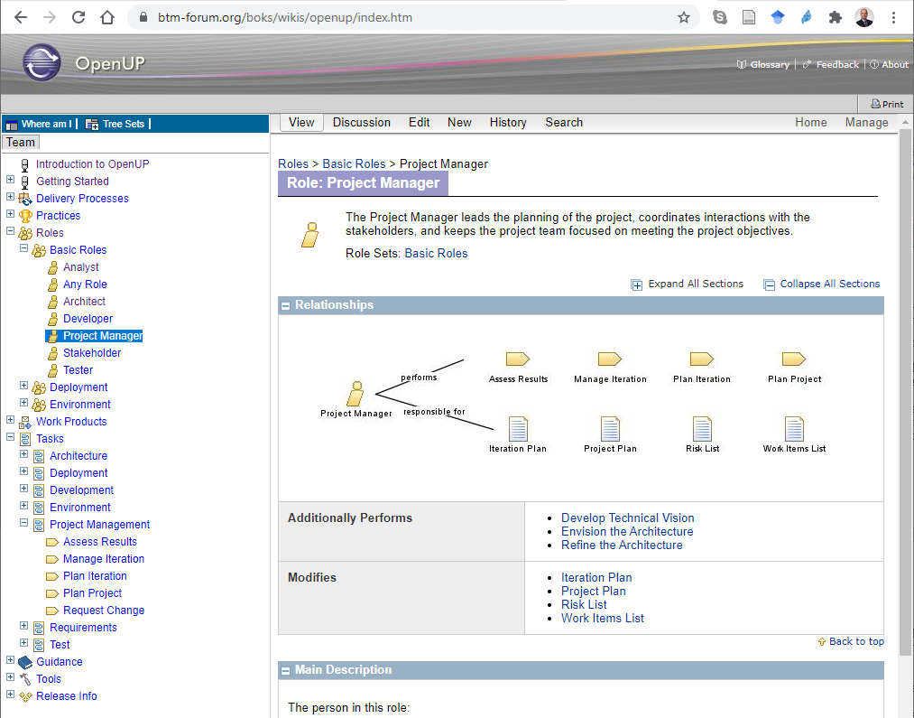
BTM BOK Wiki with Open Unified Process
Source: https://gitlab.com/BTMprof/btmbok/-/tree/master/doc

Slide 49
New Talent Management for Digital Projects
Designing a BTM BOK helped identify new TM methods for digital project leadership, focused on competency framework redesign
Iteration 1 results provide scaffolding of upcoming iterations
DevOps methods and infrastructure ready for community-led phase
Evolution from SPEM to Essence standards requires new tooling
Assets “uploading” is a first phase focusing on “harvesting” open-source contents, assets “alignment” should follow rapidly
Should link BTM BOK assets to IS-IT program accreditation
2024-01-21

Slide 50
Study Limitations
Validity can be limited and possibly disproven by further iterations
Reliability of digital project leadership practices cannot be ensured if there are too few crowdsourcing participants
Literature review focused on TM and broadly IS-IT practices, but must refocus on recent findings in leading Digital Transformation
BOK contents justified mostly by literature conceptual frameworks, but need a more a “BTM-as-Practice” perspective of digital leaders
Limiting their replication potential, unless TM-related incentives are developed, specific to application contexts
Assets to be converted to ontology standards for more reusability
2024-01-21

Slide 51
9. conclusion

Slide 52
Outcomes of BTM
IT Talent Management (TM) is evolving toward more integration
Research must focus on TM and broadly IS-IT practices, but must refocus on recent findings in leading Digital Transformation
BTM BOK contents justified by literature conceptual frameworks, but need a more a “BTM-as-Practice” perspective of digital leaders
Limiting their replication potential, unless TM-related incentives are developed, specific to application contexts
Assets to be converted to ontology standards for more reusability
2024-01-21

Slide 53
Implications for Practice
IS-IT professionals are called upon to take leadership of Digital Projects, they must learn new skills, more hybrid profiles
Use TM methods to guide IS-IT professionals and renew the ranks of digital leadership at various levels within organizations
Refocus on and better define leadership competencies around IT and Digital strategy outcomes
2024-01-21

Slide 54
Research Opportunities
Integrate theories: business-technology alignment, Digital Transformation, as well as Strategy-as-Practice, Project-as-Practice
Renewal of the alignment literature to become more coherent with practice, and research the enactment processes, micro-foundations, and performance impact of alignment practices
Develop new TM methods through an empirical research program in the “as-practice” perspective, integrate strategy and projects
Studying how digital leadership competencies are enacted by teams and their managers
Anticipate the ongoing changes throughout the IS-IT profession
2024-01-21

Slide 55
References

Slide 56
References Presented (1/7)
Sections 1. Introduction, and 5. Talent Management
Gagnon S., “Business Technology Management as Transdisciplinary IS-IT Competency Framework,” ICIS 2020 Proceedings, Hyderabad, India: https://aisel.aisnet.org/icis2020/digital_learning_env/digital_learning_env/8/
Lewis, R. E., and Heckman, R. J. 2006. "Talent Management: A Critical Review," Human Resource Management Review (16:2), pp. 139-154.
McDonnell, A., Collings, D. G., Mellahi, K., and Schuler, R. 2017. "Talent Management: A Systematic Review and Future Prospects," European Journal of International Management (11:1), pp. 86-128.
Ramesh, N., and Delen, D. 2021. “Digital Transformation: How to Beat the 90% Failure Rate?,” IEEE Engineering Management Review (49:3), pp. 22–25.
Schein, E. H., and Van Maanen, J. 2016. "Career Anchors and Job/Role Planning: Tools for Career and Talent Management," Organizational Dynamics (45:3), pp. 165-173.
Ulrich, D., and Dulebohn, J. H. 2015. "Are We There Yet? What's Next for HR?," Human Resource Management Review (25:2), pp. 188-204.
2024-01-21

Slide 57
References Presented (2/7)
Section 3.1. Business-Technology Alignment
Chan, Y. E., and Reich, B. H. 2007. "It Alignment: What Have We Learned?," Journal of Information Technology (22:4), pp. 297-315.
Chen, D. Q., Mocker, M., Preston, D. S., and Teubner, A. 2010. “Information Systems Strategy: Reconceptualization, Measurement, and Implications,” MIS Quarterly: Management Information Systems (34), pp. 233–259.
Gable, G. 2010. “Strategic Information Systems Research: An Archival Analysis,” Journal of Strategic Information Systems (19:1), pp. 3–16.
Gerow, J. E., Thatcher, J. B., and Grover, V. 2015. "Six Types of It-Business Strategic Alignment: An Investigation of the Constructs and Their Measurement," European Journal of Information Systems (24:5), pp. 465-491.
Merali, Y., Papadopoulos, T., and Nadkarni, T. 2012. “Information Systems Strategy: Past, Present, Future?,” Journal of Strategic Information Systems (21:2), Elsevier B.V., pp. 125–153.
2024-01-21

Slide 58
References Presented (3/7)
Section 3.2. Digital Transformation
Bharadwaj, A., El Sawy, O. A., Pavlou, P. A., and Venkatraman, N. 2013. "Digital Business Strategy: Toward a Next Generation of Insights," MIS Quarterly: Management Information Systems (37:2), pp. 471-482.
Ding, F., Li, D., and George, J. F. 2014. "Investigating the Effects of Is Strategic Leadership on Organizational Benefits from the Perspective of CIO Strategic Roles," Information and Management (51:7), pp. 865-879.
Grover, V., Kohli, R., and Ramanlal, P. 2018. "Being Mindful in Digital Initiatives," MIS Quarterly Executive (17:3), pp. 223-236.
Johnson, A. M., and Lederer, A. L. 2010. "CEO/CIO Mutual Understanding, Strategic Alignment, and the Contribution of Is to the Organization," Information & Management (47:3), pp. 138-149.
Peppard, J. 2010. "Unlocking the Performance of the Chief Information Officer (CIO)," California Management Review (52:4), pp. 73-99.
Varajão, J., Trigo, A., and Soto-Acosta, P. 2016. "An Exploratory Study on the Influencers of the Perceived Relevance of Cio's Activities," International Journal of Enterprise Information Systems (12:4), pp. 1-15.
2024-01-21

Slide 59
References Presented (4/7)
Section 3.3. Leadership Competencies
Kane, G. C., Phillips, A. N., Copulsky, J., and Andrus, G. 2019. "How Digital Leadership Is(n't) Different," MIT Sloan Management Review (60:3), pp. 34-39.
Horlacher, A. 2016. "Co-Creating Value - the Dyadic CDO-CIO Relationship During the Digital Transformation," 24th European Conference on Information Systems, ECIS 2016.
Li, Y., and Tan, C.-H. 2013. "Matching Business Strategy and CIO Characteristics: The Impact on Organizational Performance," Journal of Business Research (66:2), pp. 248-259.
Locoro, A., and Ravarini, A. 2019. "The Cio and Cdo Socio-Technical Roles in the Age of Digital Business Transformation: An Interpretive Study," Lecture Notes in Information Systems and Organisation (28), pp. 235-245.
Shaughnessy, H. 2018. "Creating Digital Transformation: Strategies and Steps," Strategy and Leadership (46:2), pp. 19-25.
Sobol, M. G., and Klein, G. 2009. "Relation of Cio Background, It Infrastructure, and Economic Performance," Information & Management (46:5), pp. 271-278.
2024-01-21

Slide 60
References Presented (5/7)
Section 3. Table
Berman, S. J. 2012. “Digital Transformation: Opportunities to Create New Business Models,” Strategy & Leadership (40), pp. 16–24.
Brock, J. K.-U., and von Wangenheim, F. 2019. “Demystifying Ai: What Digital Transformation Leaders Can Teach You about Realistic Artificial Intelligence,” California Management Review (61:4), pp. 110–134.
Kohli, R., and Melville, N. P. 2019. "Digital Innovation: A Review and Synthesis," Information Systems Journal (29:1), pp. 200-223.
Raisinghani, M. S. 2021. “Data Analytics for Business Value: An Interview with Andrew Davis, Co-Founder, and CEO, 3Dot Digital, Brisbane, Australia; and Samantha Garbutt, Chief Commercial Officer, 3Dot Digital, Brisbane, Australia,” Journal of Information Technology Case and Application Research (23:2), pp. 145–151.
Schallmo, D., Williams, C. A., and Boardman, L. 2017. “Digital Transformation of Business Models-Best Practice, Enablers, and Roadmap,” International Journal of Innovation Management (21:8), pp. 119-138.
Vial, G. 2019. "Understanding Digital Transformation: A Review and a Research Agenda," The Journal of Strategic Information Systems (28:3), pp. 118-144.
2024-01-21

Slide 61
References Presented (6/7)
Section 4.1. Strategy-As-Practice
Arvidsson, V., and Holmström, J. 2017. “Digitalization as a Strategy Practice: What Is There to Learn from Strategy as Practice Research?,” in The Routledge Companion to Management Inf. Systems, Taylor and Francis, pp. 218–231.
Jarzabkowski, P. 2008. "Strategy-as-Practice," in The Sage Handbook of New Approaches in Management and Organization. pp. 364-378.
Whittington, R. 1996. "Strategy as Practice," Long Range Planning (29:5), pp. 731-735.
Whittington, R. 2014. “Information Systems Strategy and Strategy-as-Practice: A Joint Agenda,” Journal of Strategic Information Systems (23:1), Elsevier B.V., pp. 87–91.
2024-01-21

Slide 62
References Presented (7/7)
Section 4.2. Project-As-Practice
Blomquist, T., Hällgren, M., Nilsson, A., and Söderholm, A. 2010. “Project-as-Practice: In Search of Project Management Research That Matters,” Project Management Journal (41:1), pp. 5–16.
Brunet, M. 2019. “Governance-as-Practice for Major Public Infrastructure Projects: A Case of Multilevel Project Governing,” International Journal of Project Management (37:2), pp. 283–297.
Hällgren, M., and Söderholm, A. 2011. “Projects-as-Practice: New Approach, New Insights,” in The Oxford Handbook of Project Management.
Karanasios, S., and Slavova, M. 2019. “How Do Development Actors Do ‘ICT for Development’? A Strategy-as-Practice Perspective on Emerging Practices in Ghanaian Agriculture,” Information Systems Journal (29:4), Blackwell Publishing Ltd, pp. 888–913.
Kwayu, S., Lal, B., and Abubakre, M. 2018. “Enhancing Organisational Competitiveness Via Social Media - a Strategy as Practice Perspective,” Information Systems Frontiers (20:3), Springer New York LLC, pp. 439–456.
2024-01-21

Slide 63
Additional Readings
BTM as a concept and initiative has not been extensively studied yet. A few papers exist with online presentations available in open access format. More will be published soon in BTM Journal by a more diverse array of authors from business, computing, and engineering disciplines.
Cabot, C., & Gagnon, S. (2021). Understanding the career dynamics of it professionals in digital transformation times: A systematic review of career anchors studies. International Journal of Information Systems and Project Management, 9(2), 44–60. https://doi.org/10.12821/ijispm090203
Gagnon, S. (2021). Talent Management of Transdisciplinary Roles in Digital Projects: Designing a Business Technology Management Body of Knowledge. AMCIS 2021 Proceedings. https://aisel.aisnet.org/amcis2021/is_leadership/sig_lead/1
Gagnon, S. (2022a). Digital Project Leadership and Talent Management in the As-Practice Perspective. AMCIS 2022 Proceedings. https://aisel.aisnet.org/amcis2022/conf_theme/conf_theme/2
Gagnon, S. (2022b). Rebranding IS/IT Management Programs: The Case of Business Technology Management (BTM) in Canada. Proceedings of the EDSIG Conference, ISSN 2473-4901, https://proc.iscap.info/2022/
Gagnon, S. (2020). Business Technology Management as Transdisciplinary IS-IT Competency Framework. ICIS 2020 Proceedings. International Conference on Information Systems (ICIS), Hyderabad, India. https://aisel.aisnet.org/icis2020/digital_learning_env/digital_learning_env/8/
Leger, M.-A., Valverde, R., & Gagnon, S. (2019). An Innovative Framework to Integrate CIO Competencies Within the Business Technology Management Body of Knowledge. International Journal of Organizational and Collective Intelligence, 9(3), 1–18. https://doi.org/10.4018/IJOCI.2019070101
Sidenko, S., Valverde, R., & Gagnon, S. (2019). Open Business Models for Business Technology Management Bodies of Knowledge. International Journal of Organizational and Collective Intelligence, 9(3), 19–44. https://doi.org/10.4018/IJOCI.2019070102
Van Dalen, G., Horner Reich, B., Babin, R., Chartier, A., Genoe McLaren, P., Valverde, R., & Drummond, C. (2014). Growing the Business Technology Management (BTM) Program: Ensuring BTM Supply is Meeting Industry Demand. Annual Conference of the Administrative Sciences Association of Canada, Muskoka, Canada. https://spectrum.library.concordia.ca/id/eprint/978663/
2024-01-21

Slide 64
Q&A ?

Slide 65
Thank You! Questions?
Stéphane Gagnon, Ph.D.
admin@gagnontech.org
https://gagnontech.org
BTM BOK Project Leader
https://github.com/Digital-Innovation-Foundation/btmbok
BTM Forum
https://btmforum.org
Digital Innovation Foundation
https://digitalinnovation.site

