Slide 1
Rebranding IS/IT Management Programs: The Case of Business Technology Management (BTM) in Canada
2024-01-05
Stéphane Gagnon, Ph.D.
admin@gagnontech.org
https://gagnontech.org

Slide 2
Outline
Introduction
From Information to Business Technology Management
Rethinking IT Talent Management
Unified Digital Profession
Conclusion

Slide 3
1. Introduction

Slide 4
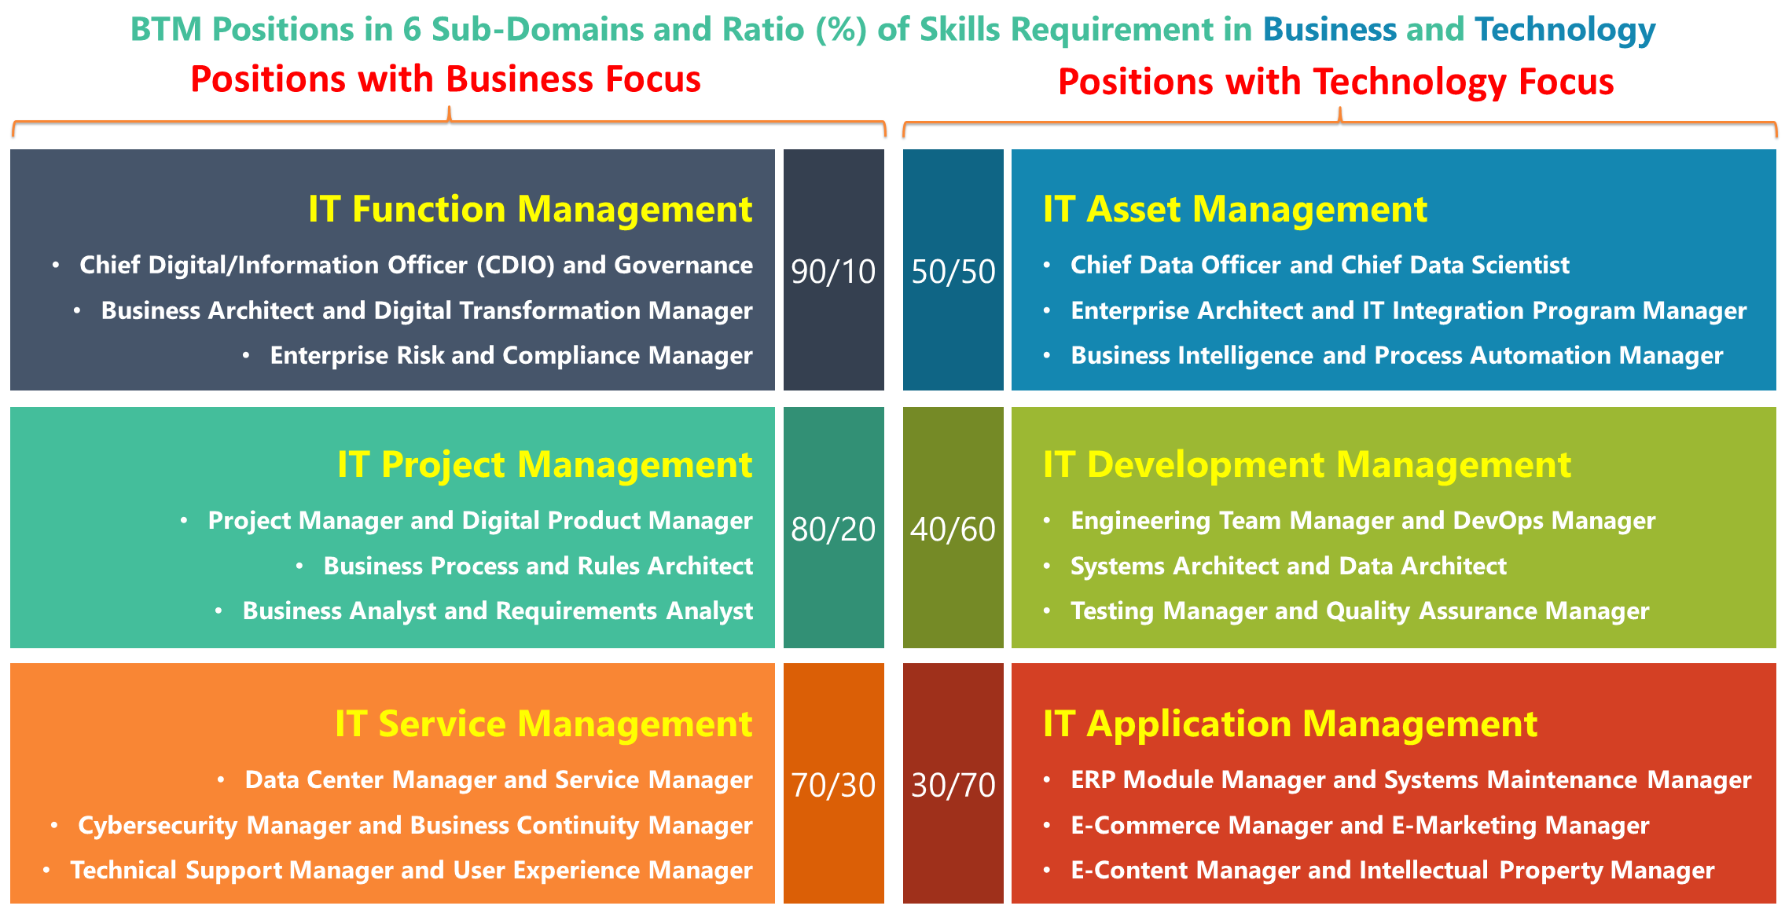
BTM Hybrid Professional Roles
2024-01-04

Slide 5
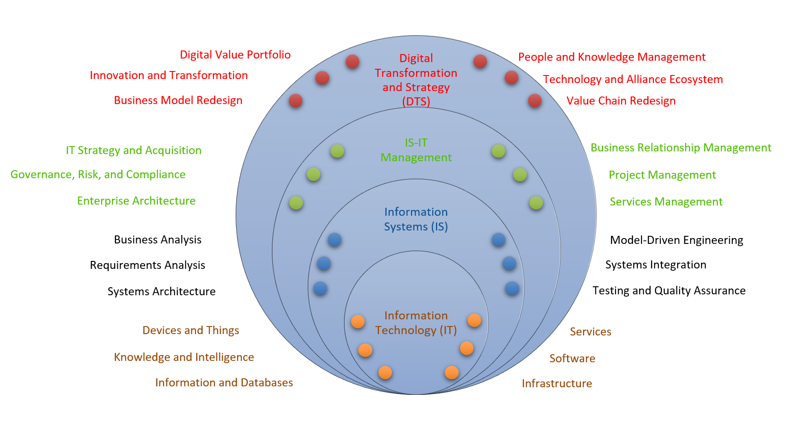
From Information to Business Technology Management

Slide 6
2. FROM INFORMATION TO BUSINESS TECHNOLOGY MANAGEMENT

Slide 7
BTM Community in Canada
New professional designation, with Registered Trademarks in Canada and the US:
Business Technology Management (BTM)
Gestion des technologies d’affaires (GTA)
Unifying Information Systems (IS) and Information Technology (IT) graduates within a stronger community of practice
Rebranding IS/ITM programs as BTM in Canadian Business Schools
Stakeholders moving from an information to a broader business focus
Emphasize distinctive professional abilities for digital leadership:
Renewed focus on innovation and digital value
Leaders of the digital lifecycle and transformation
Hybrid acumen as key to effective leadership
2024-01-04

Slide 8
BTM Forum Mission
Prepare professionals to lead the digital transformation
Help organizations identify digital leaders with the best hybrid acumen
Broaden focus beyond “information” toward “business” technology management
1. Coach Digital Leaders
2. Develop Hybrid Acumen
3. Broaden Digital Vision
2024-01-04

Slide 9
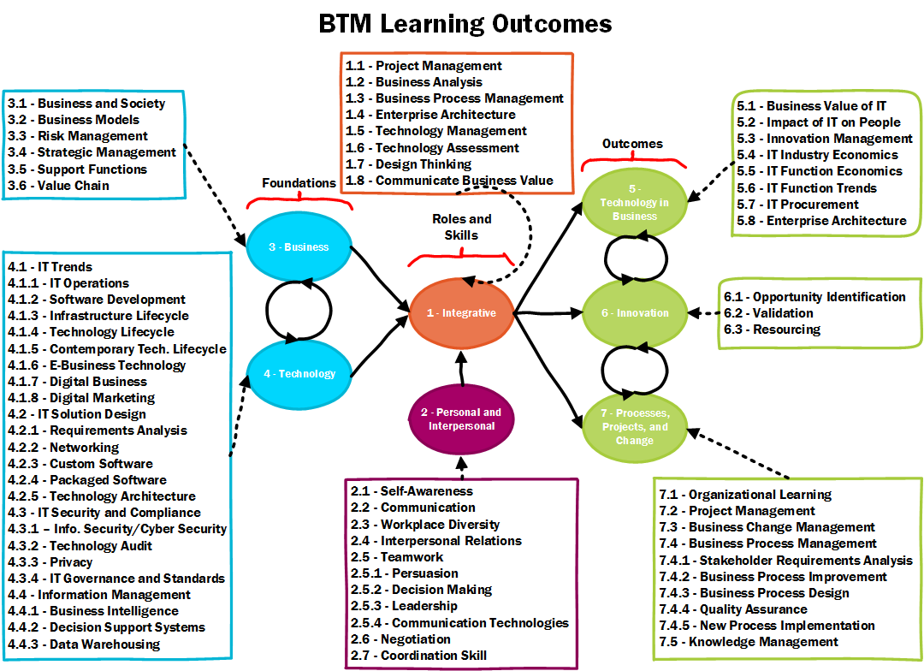
BTM Accreditation Standards

Slide 10
BTM Forum Timeline
2009: A team of faculty and industry leaders attend a meeting at the Toronto Metropolitan University (TMU) organized by the Canadian Coalition for Tomorrow’s ICT Skills (CCICT); they launch the Business Technology Management (BTM) initiative, with the BTM Advisory Council (BTMAC) as its steering committee; a set of 40 criteria are synthesized in the BTM Accreditation Criteria 1.0 administered by Canadian Information Processing Society (CIPS).
2010: Government of Canada Launches National Consultations on a Digital Economy Strategy; CCITC publishes the white paper entitled “Canada: The go-to country for brainpower resources in the global digital economy“.
2011: Based on the consultation, Government of Canada allocates CAN$ 720 million to a new digital economy strategy; CAN$ 60 million are dedicated to IT human resources development.
2013: Simon Fraser University (SFU) programs obtain the first BTM accreditation from CIPS.
2014: CCITC obtains a Government of Canada grant of CAN$ 1.6 million to develop and promote BTM programs; it merges with the IT Association of Canada (ITAC) to become ITAC Talent; first edition of BTM TalentMash is launched, which will develop into a Canada-wide annual job fair and competition, held every Fall until 2018 in 5-7 Canadian cities.
2015: The National Business Technology Management (BTM) Conference 2015 is organized in Halifax, NS, during the Administrative Sciences Association of Canada (ASAC) Conference.
2016: The BTM Accreditation Criteria 2.0 are published, growing to 70 criteria organized in 7 knowledge domains; a second edition of the BTM Conference is organized in Edmonton, AB, during the ASAC Conference; the BTM Forum is created with the BTM Governing Council (BTMGC) to run a professional networking organization, and the BTM Accreditation Council (BTMAC) to administer program reviews.
2017: The number of BTM accreditations and recognitions reaches 10 institutions among 20+ that offer BTM branded programs; a third edition of the BTM Conference is organized at Université du Québec à Montréal (UQAM), Montréal, QC; students of the TMU win the first Annual BTM Case Competition; ITAC Talent obtains CAN$ 160,000 MITACS Accelerate grant with Université du Québec en Outaouais (UQO), Gatineau, QC, to launch an applied research project and develop the BTM Body of Knowledge.
2019: The first edition of the BTM BOK (v.0.1) is published on GitHub; ITAC changes name to become TECHNATION Canada; ITAC Talent is disolved given the end of Government of Canada funding.
2020: The global pandemic stalls the development of BTM Forum activities.
2021: TECHNATION Canada signs an agreement to transfer all BTM initiative trademarks, assets, and operations to the Digital Innovation Foundation (DIF).
2022: CIPS signs an agreement with BTMGC members to reintegrate BTM accreditation operations.
2023: BTMGC votes to become the BTM Council for Canada; BTM Forum develops into a global initiative, with Canada chairing the first BTM Global Council.

Slide 11
Canadian BTM Programs
Ontario
https://www.senecapolytechnic.ca/programs/fulltime/BTM.html
https://www.torontomu.ca/programs/undergraduate/business-technology-management/
https://www.yorku.ca/laps/sas/bcom/degree-options/business-technology-management/
https://academiccalendars.romcmaster.ca/preview_program.php?catoid=53&poid=27123
https://www.wlu.ca/programs/business-and-economics/undergraduate/business-technology-management-btm/index.html
https://telfer.uottawa.ca/en/bcom/your-program-of-study/program-options-and-minors/business-technology-management/
https://www.concordia.ca/academics/undergraduate/business-technology-management.html
https://www.athabascau.ca/programs/summary/bachelor-of-commerce-in-business-technology-management.html
https://www.ualberta.ca/business/programs/bachelor-of-commerce/majors/business-technology-management.html
https://www.ucalgary.ca/future-students/undergraduate/explore-programs/business-technology-management
http://www.sfu.ca/students/calendar/2024/spring/programs/business-technology-management/certificate.html
https://mybcom.sauder.ubc.ca/courses-money-enrolment/options/business-technology-management
https://business.acadiau.ca/programs.php?id=btm
https://www.fsa.ulaval.ca/etudier/programmes/baa/concentration-gestion-technologies-affaires/
https://etudier.uqam.ca/programme?code=4668
https://www.uqar.ca/etudes/etudier-a-l-uqar/programmes-d-etudes/4077
https://uqo.ca/mod/sciences-administration/certificat-gestion-technologies-daffaires
https://oraprdnt.uqtr.uquebec.ca/pls/public/gscw031?owa_no_site=2571&owa_no_fiche=194&owa_bottin=
West
East
Québec

Slide 12
3. Rethinking IT Talent Management

Slide 13
BTM Specializations and BOK References

Slide 14
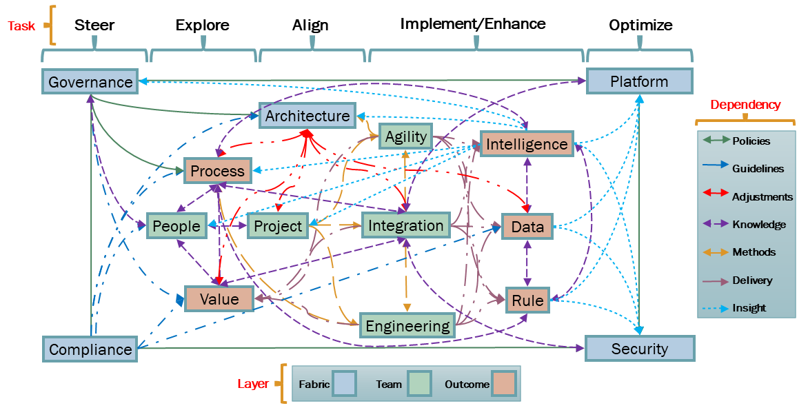
Transdisciplinary Competency Framework
2024-01-04

Slide 15
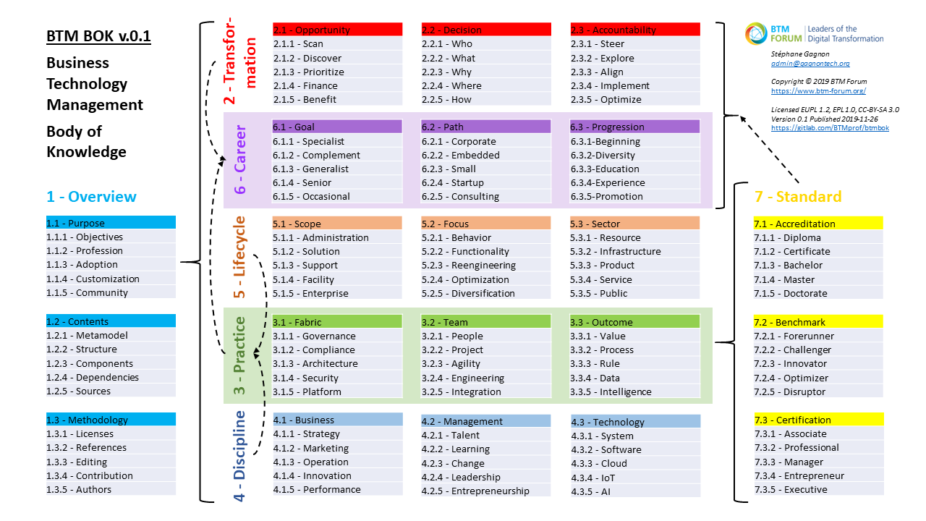
BTM BOK Outline v.0.1
https://gitlab.com/BTMprof/btmbok/-/tree/master/doc

Slide 16
Legend: Deconstructing BTM
Fields: Business, Computing, Design, Engineering, Mathematics
Disciplines: CS, EM, IS, SE, TIM
Domains: DITE, DL, DS, NPI, PM
Divides Transdisciplinary
Business Technology Management (BTM)
Cutting Across 5 Fields
Integrating 5 Disciplines
Encompassing 5 Domains
Information Systems (IS)
3
Engineering Management (EM)
2
Business
Digital Innovation, Transformation, and Entrepreneurship (DITE)
Digital Leadership (DL)
Business
Engineering
Design
Project
Management
(PM)
Business
Computer Science (CS)
Design
Data Science (DS)
Computing
1
New Product Innovation (NPI)
Technology
and Innovation Management (TIM) or Management of Technology (MOT)
5
Software Engineering (SE)
4
Maths
Engineering

Slide 17
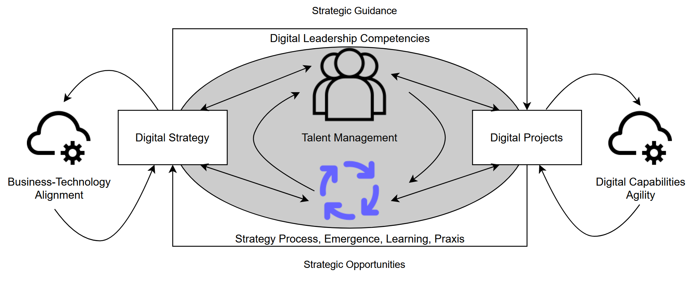
As-Practice Perspective on Digital Leadership
4
1
3
2
5
2024-01-04

Slide 18
BTM BOK Objectives
Develop a single Body of Knowledge (BOK), building upon existing practices, to guide upcoming digital leaders toward the common core competencies of their profession
Use the BOK for:
Design of seamless career paths across multiple specializations for more complete experience and knowledge
Define learning guidelines to develop new BTM expertise
Certification of digital leaders at Associate, Professional, Manager, and Executive competency levels
Accreditation of degree programs, helping them meet job requirements for digital leadership roles
2024-01-04

Slide 19
BTM BOK Contents
BTM BOK developed using the Eclipse Process Framework (EPF) platform
Supported by open community to help map the relationships between several BOKs
Integrating citations to academic and professional literature, build reading guides
Open and customizable, with API to reuse its contents in various Talent Management functions
Custom BTM-compliant job descriptions
Automated matching of CVs and job competencies
Learning path recommendations given prior experience for recognized BTM careers

Slide 20
4. UNIFIED DIGITAL PROFESSION

Slide 21
New Talent Management for Digital Projects
Designing a BTM BOK helped identify new TM methods for digital project leadership, focused on competency framework redesign
Iteration 1 results provide scaffolding of upcoming iterations
DevOps methods and infrastructure ready for community-led phase
Evolution from SPEM to Essence standards requires new tooling
Assets “uploading” is a first phase focusing on “harvesting” open-source contents, assets “alignment” should follow rapidly
Should link BTM BOK assets to IS-IT program accreditation
2024-01-04

Slide 22
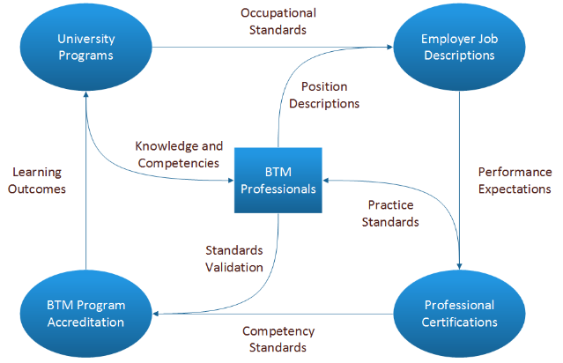
BTM Professionals at Core

Slide 23
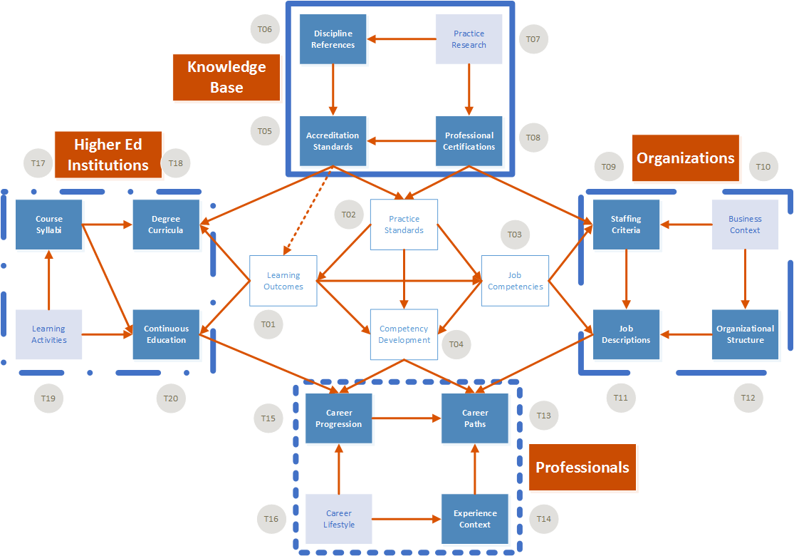
BTM BOK Customization Opportunities

Slide 24
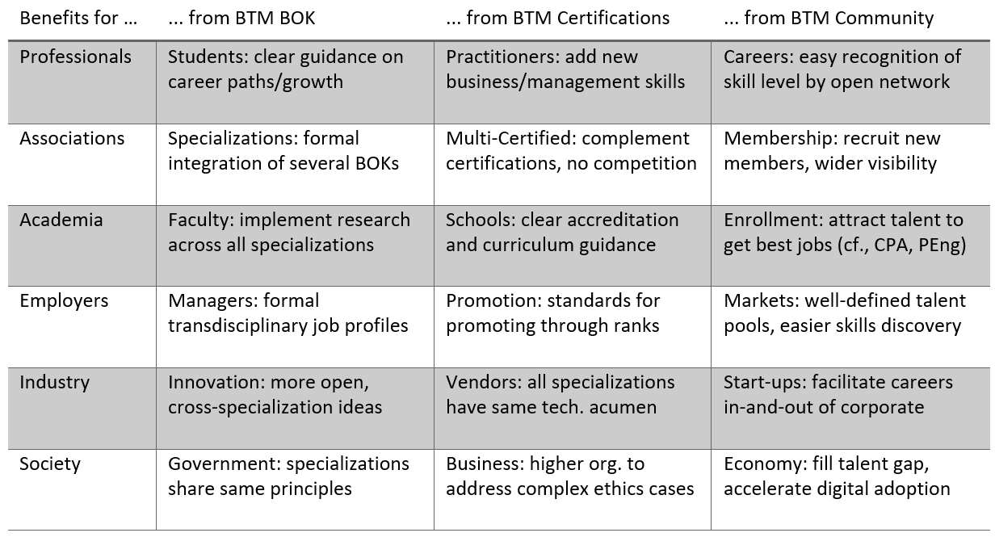
Benefits of BTM
2024-01-04

Slide 25
5. conclusion

Slide 26
Outcomes of BTM Initiative
BTM initiative in Canada has led to growth of IS/IT professional interest and enrollments (to be confirmed by 2023 survey)
IT Talent Management (TM) is evolving toward more integration
Research must focus on TM and broadly IS-IT practices, but must refocus on recent findings in leading Digital Transformation
BTM BOK contents justified by literature conceptual frameworks, but need a more a “BTM-as-Practice” perspective of digital leaders
Limiting their replication potential, unless TM-related incentives are developed, specific to application contexts
Assets to be converted to ontology standards for more reusability
2024-01-04

Slide 27

Thank You! Questions?
Stéphane Gagnon, Ph.D.
admin@gagnontech.org
https://gagnontech.org
BTM BOK Project Leader
MITACS Accelerate Fund
BTM Forum
https://github.com/Digital-Innovation-Foundation/btmbok

