Slide 1
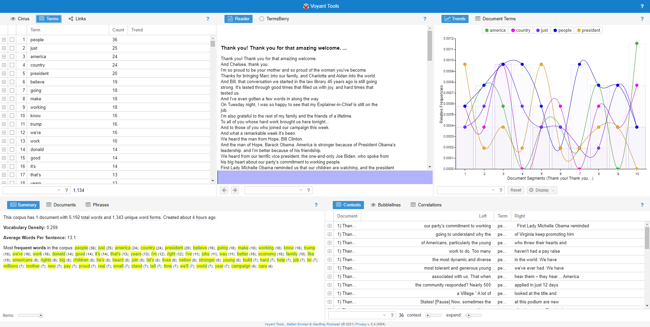
Hillary Clinton - DNC Speech

Slide 2
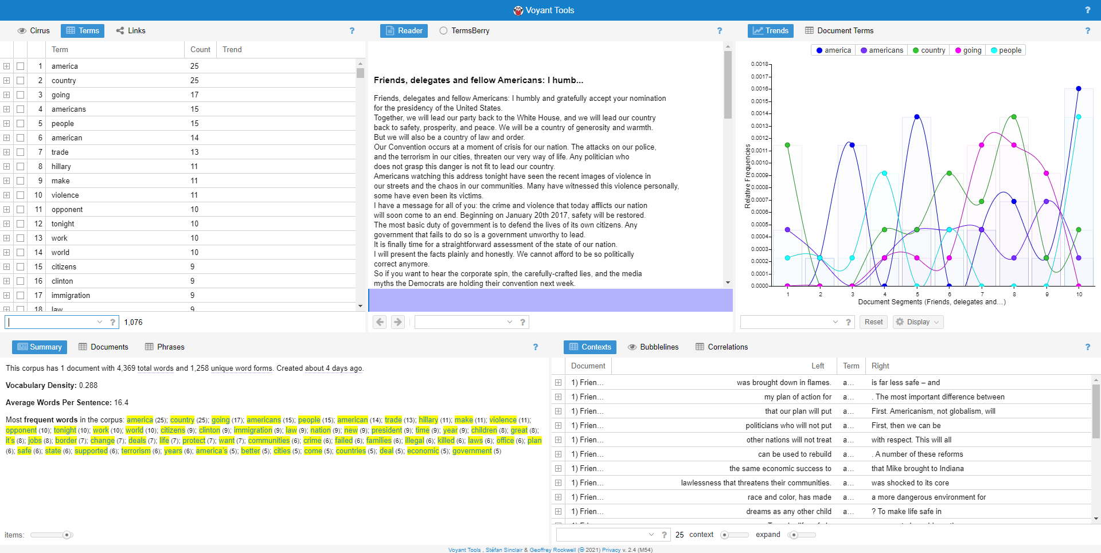
Donald Trump - RNC Speech

Slide 3
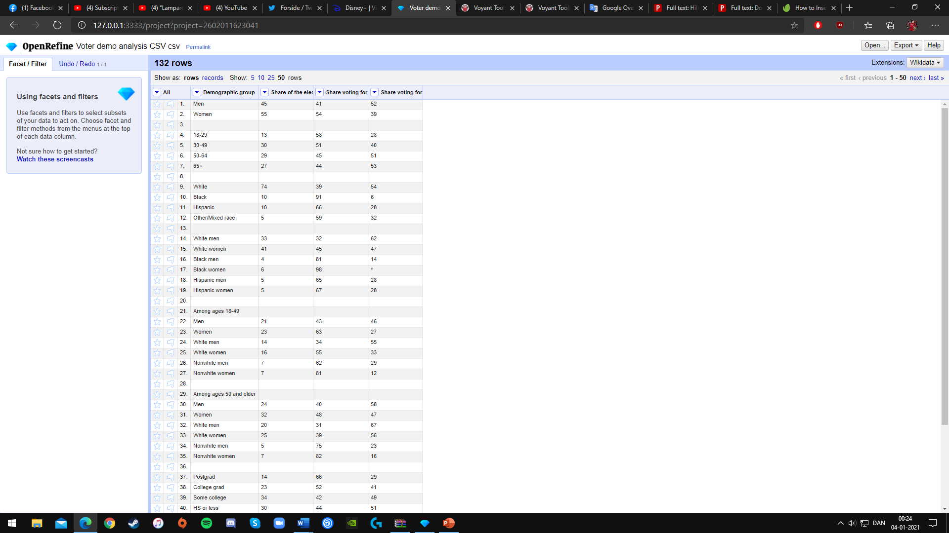
Pew Research Center - Detailed Tablets

