Slide 1

Legal Registry
Problem Exploration Workshop
Noah Fang, Zach Falsetto

Slide 2
Goals
Understand the problems
Put solutions in context
Build a case for action

Slide 3
Rules

Slide 4
Rules:
Timing over stretching
Everything is time-boxed.
Start on time. Stop on time.
Exceptions need to be justified.

Slide 5
Rules:
Rhyming over timing
Propose to extend time when keeping the rhyme of thoughts is critical.

Slide 6
Rules:
Writing over speaking
Write down your thoughts as much as you can. Only one person can speak at a time. We can all write at the same time.

Slide 7
Rules:
Opinion over complaint
Describing the symptoms of a problem only helps so much. Bringing up your opinion on the root causes is far better.

Slide 8
Rules:
Debate over opinion
Constructive debate yields more than the sum of different opinions.

Slide 9
Rules:
Idea over debate
There are no bad ideas. All ideas matter equally. Proposing ideas to solutions is the perfect outcome of debates.

Slide 10
Rules:
Suspend judgement
Result is the only judgement.

Slide 11
Rituals

Slide 12

Rituals:
Stop/Pause

Slide 13

Rituals:
I want to speak

Slide 14

Rituals:
5 more minutes

Slide 15

Rituals:
1 more minute

Slide 16
Rituals:
No more

Slide 17
Let’s begin

Slide 18
10 min
Warm-up activity:
A chain of words
hot
dog
food

Slide 19
10 min
Warm-up activity:
Visual connections
?

Slide 20
The frame creation process
Abstract
Themes
Frames
Field
Futures
Content
Transformation
Paradox
Archeology
Integration
Concrete
Understand
Empathize
Create new thinking
Test and iterate
Problem
Solution

Slide 21
Project phases
Abstract
Themes
Frames
Field
Futures
Content
Problem Exploration
Transformation
Paradox
Concept Case
Archeology
Business Case
Integration
Concrete
Understand
Empathize
Create new thinking
Test and iterate
Problem
Solution

Slide 22
60 min
Looking at the
current state
Stakeholder mapping
Process mapping

Slide 23

15 min
Morning break

Slide 24
Identifying problems and needs:
Mapping decision flow

Slide 25
Identifying problems and needs:
Writing job stories

Slide 26
Identifying problems and needs:
Writing problem statements

Slide 27
Identifying problems and needs:
Prioritizing jobs
and problems

Slide 28
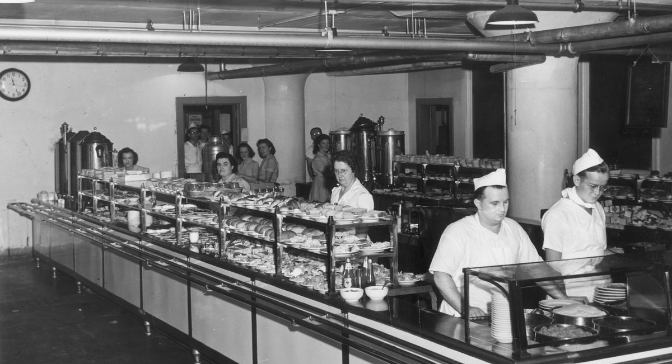
60 min
Lunch break

Slide 29
Understanding
the scope
30 min
Evaluate the impact of each problem on each job priority

Slide 30
15 min
Scoping the change:
Writing SMART goals
Specific
Measurable
Achievable
Realistic
Timebound

Slide 31
15 min
Scoping the change:
Building a risk matrix
 | Negligible | Marginal | Critical | Catastrophic
Certain
Likely
Possible
Unlikely
Rare

Slide 32
Envisioning the
future state
30 min
Journey maps, process maps
Job stories
Which risk is addressed by what

Slide 33

15 min
Afternoon break

Slide 34
Next steps
15 min

Slide 35
Mapping solutions
60 min
Identify gaps between current and future state
How to act upon identified priorities and goals

