Slide 1
Sprint 3
Austin Bray Champtaloup
Start date – 23rd May
End date – 3^{rd June}
Git hash - 9b34a0a175c90505ef652486acf890aad30d71cc
Work hard rating – 3/5

Slide 2
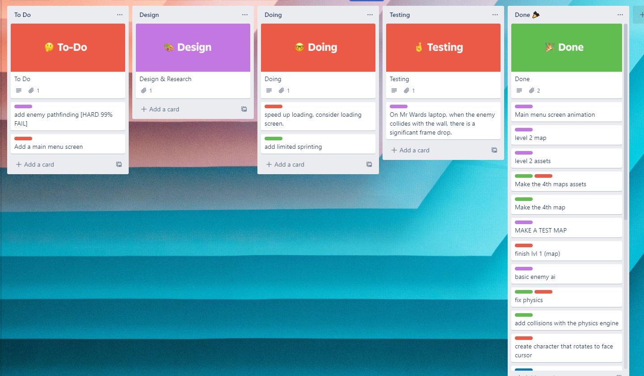
Trello board at the start of the sprint

Slide 3
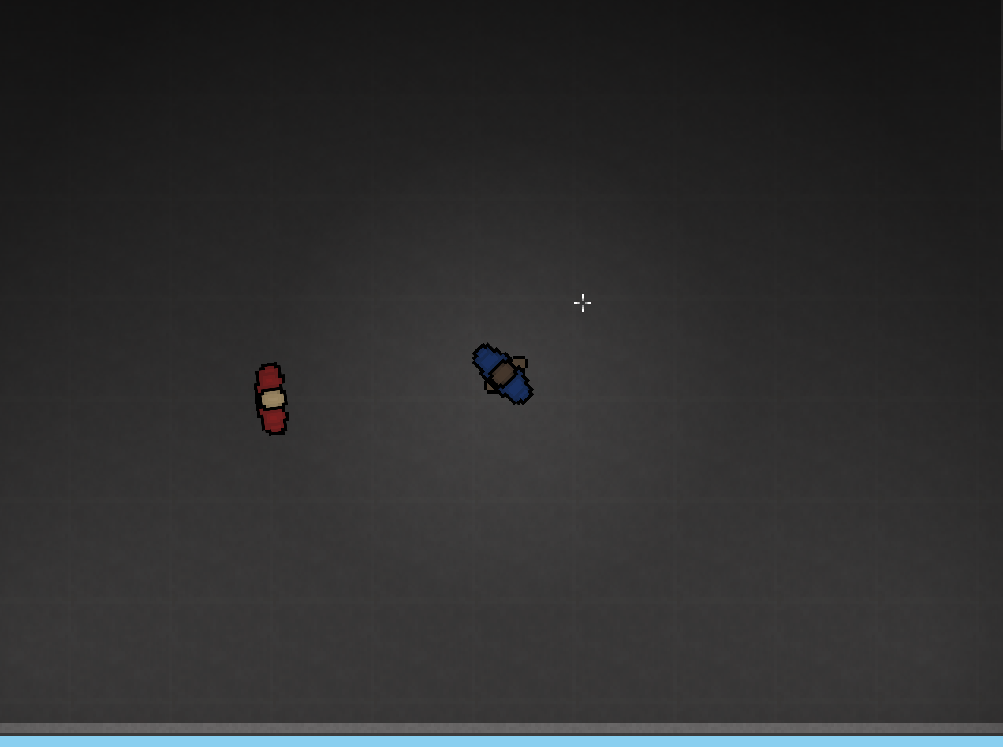
Screenshot of game at beginning of sprint

Slide 4
Sprint reflection and summary/Achievements/Testing.
Unfortunately, I could not work for the most of sprint 3, as I had COVID-19 and was self isolating, so, I will be skipping sprint 3 and moving straight onto sprint 4. During this sprint, the team has been hard at work developing gameplay mechanics to make our game more fun.
Achievements:
I was able to get a wander state for the enemy to work, making them feel more alive. To do this, i had them constantly walking forward at a slow pace, but their This is a HUGE update from the last system where the enemy would constantly follow you no matter where you are. Nick got the enemies to stop following you when they lost LOS (line of sight) on the player.
We had a few options to trial when working on the random look behaviour, LERP, look at point and Open Simplex noise randomisation, for now, we chose LERP, as it looks relatively natural and isn’t snappy, we might choose to implement Open Simplex later on to make the movement even more smooth.
Since its been a while since we got Alek to play our game to experience the new enemy ai and wander state. He told us it was a major improvement over the last system, where the enemy would follow the player at all times, now it would only chase the player when it had direct line of sight, and will wander in random directions when it does not have LOS.

Slide 5
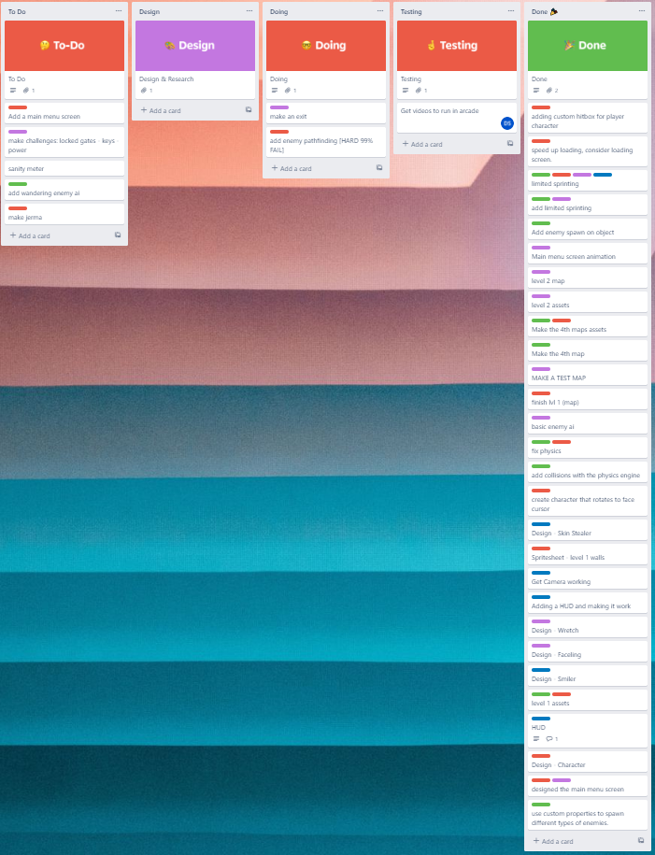
Trello board at end of sprint

Slide 6
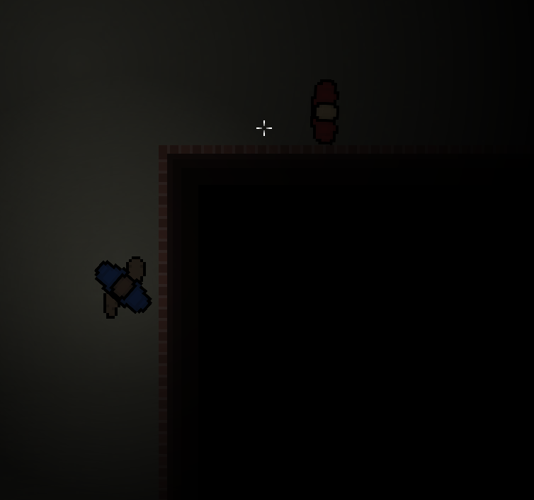
Screenshot of current game

Slide 7
Video of game as of now refer to Video Powerpoint

Slide 8
Notes for Next Sprint
My main priority is getting multiple levels loaded and the ability to switch between them, this will allow for multi-level gameplay and smooth transitioning between them. We need to have multiple levels because of the way our game is designed, if we put everything onto one level, the performance will be awful.
We want to add a main menu screen (and possible settings screen?) I will have to dive into Dylans branch and find the code for his working videos.

