Slide 1
Sprint 8
Austin Bray Champtaloup
Start date – 26th July
End date – 5^{th august}
Git hash – 894a6bda680b4c9612f2ea8368200f1356d66d5a
Work hard rating – 5/5

Slide 2
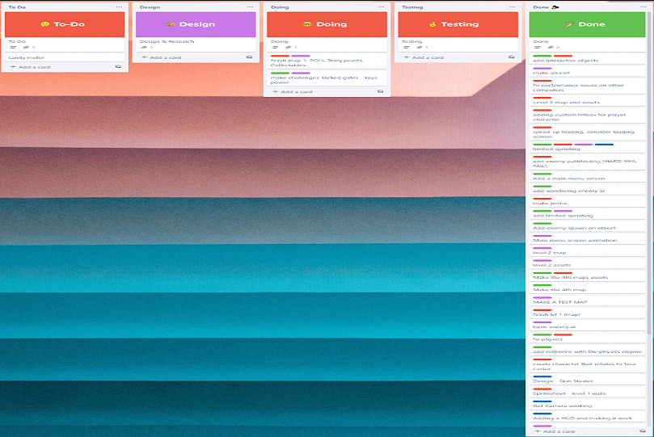
Trello board at the start of the sprint

Slide 3
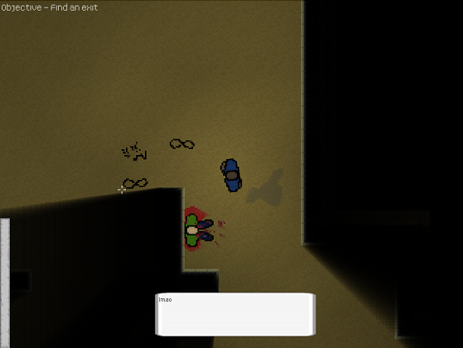
Screenshot of game at beginning of sprint

Slide 4
Sprint reflection and summary/Achievements/Testing.
Sprint 8 was spent finishing the game up. Hundreds of lines got commented, all the code tidied to comply with PEP8 standards, and getting the final level made and in the game.
Nick was able to fix the footstep audio to an acceptable standard, before, the footstep sounds would constantly repeat every frame, sounding awful, but now the footsteps have a pause interval between each one, so they sound much more natural.
The game now runs independently, without having to be in a specific directory folder.
Level 5 was added, a thin strip of sand with an ocean on each side that goes on infinitely in each direction, this functions as the ending to our game, the final level.
We had our classmate Cam do a playtest of our "finished" game, to see how a player would play from start to finish. There were a few things that he liked; the enemy ai, the ray casting shadows that give the game a feeling of "confinement" and increase the fear of the unknown, and the level design, it felt like a maze, but was fair. Only setting the player back a few seconds if they run into a dead end. He managed to finish the first level in under 20 mins, which is a lot faster than what we expected.

Slide 5
Trello board at end of sprint

Slide 6
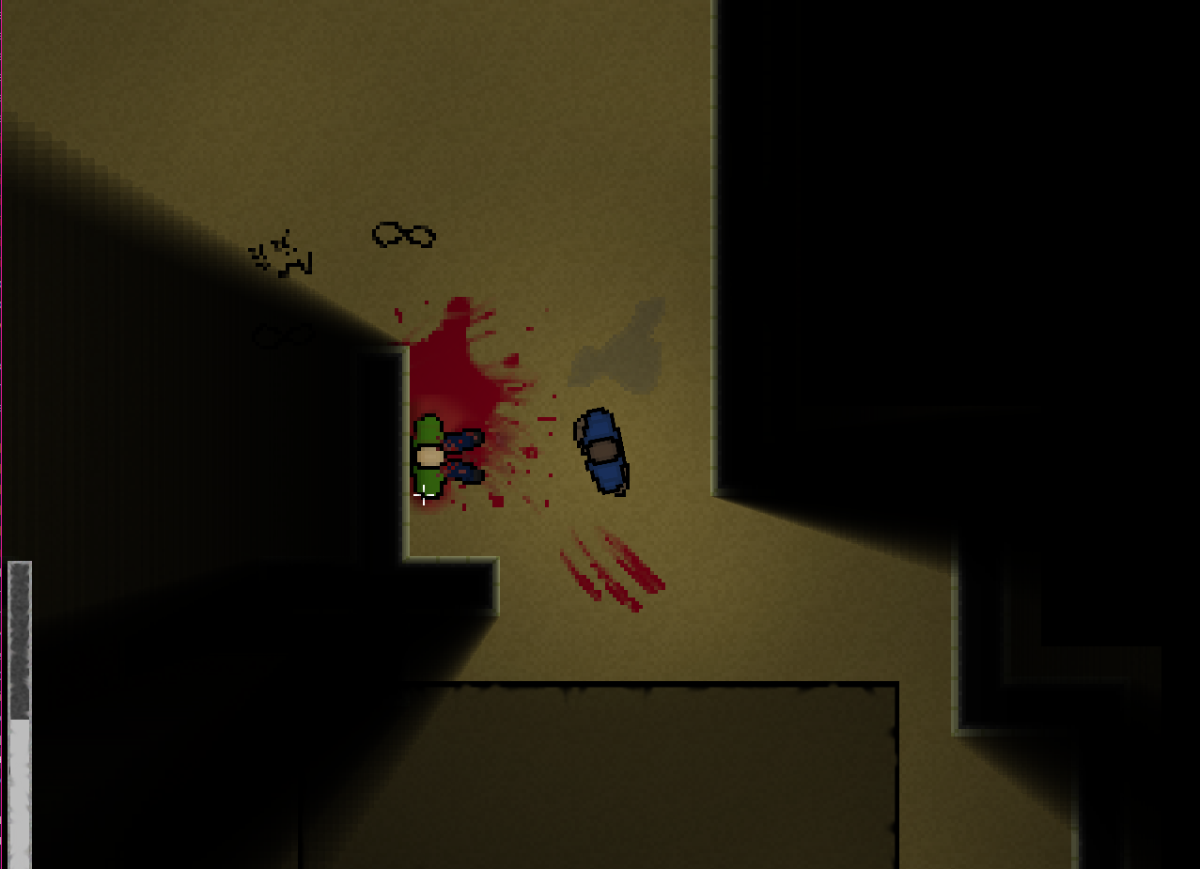
Screenshot of current game

Slide 7
Video of game as of now refer to Video Powerpoint

Slide 8
Notes for Next Sprint
This is the final sprint

