Slide 1
Sprint 2
Austin Bray Champtaloup
Start date – 31st March
End date – 14th April
Git hash - 1f1ea1c07e76f7cb8a617b3496ceea77cb844baa
Work hard rating – 4/5

Slide 2
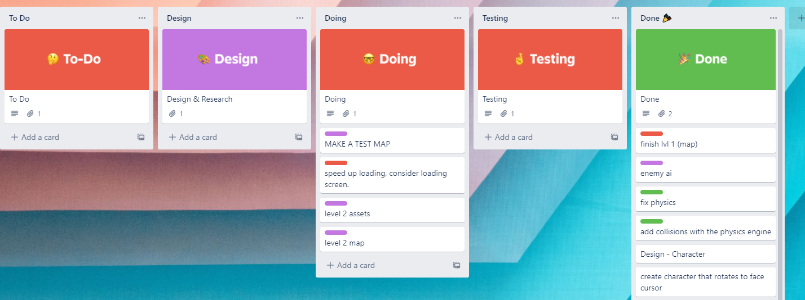
Trello board at the start of the sprint

Slide 3
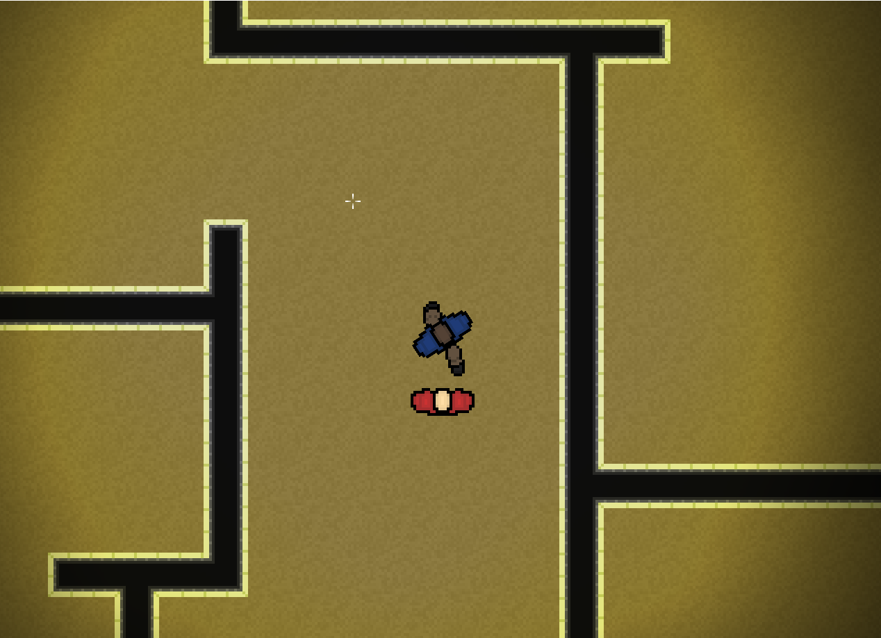
Screenshot of game at beginning of sprint

Slide 4
Sprint reflection and summary/Achievements/Testing.
During this sprint, me team has split up to work on separate things to speed up the process of development, however, our hard work rating has suffered as a few factors have slowed us down this sprint, two of our team members have been isolating due to COVID-19, deterring and even preventing them for working on the game, we have also had a day rostered off and lost a day to good Friday.
Sprint 2 achievements:
This sprint I have finalised level 2’s map, created art assets for our upcoming main menu and beginning cutscene, cleaned up and fixed some Janky and messy code that was really making the code hard to read and creating our test level.
During sprint 2, we decided it would be a good idea to create a test level to help with quickly testing any issues that occurred during development
Testing:
We found a weird bug that would cause the framerate to drop when the enemy collided with a wall, however this bug only occurred on our teachers laptop. We will have to look into it.
Performance overall has been an issue for us, with adding more things comes lower framerates. Spacial hashing and optimisation may be necesary in the future.

Slide 5
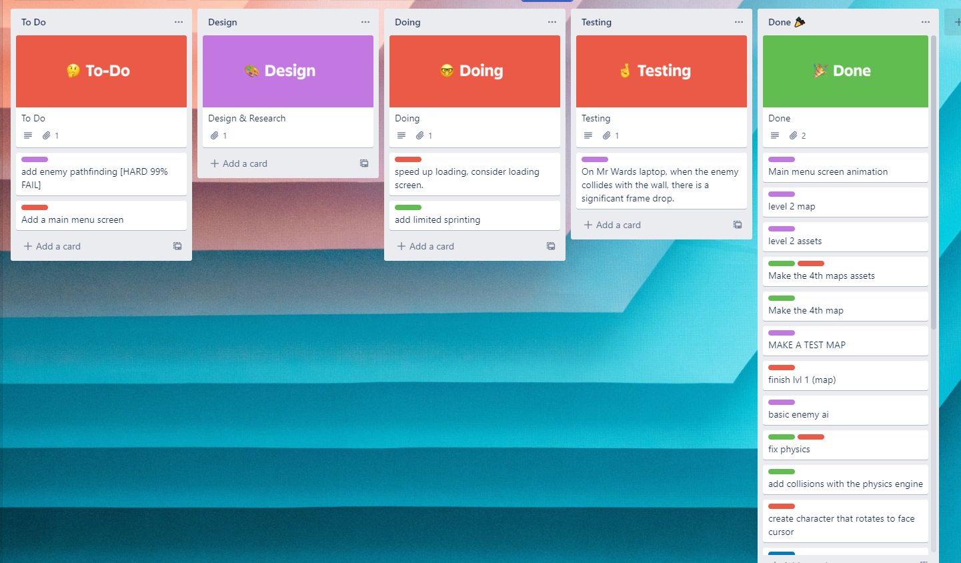
Trello board at end of sprint

Slide 6
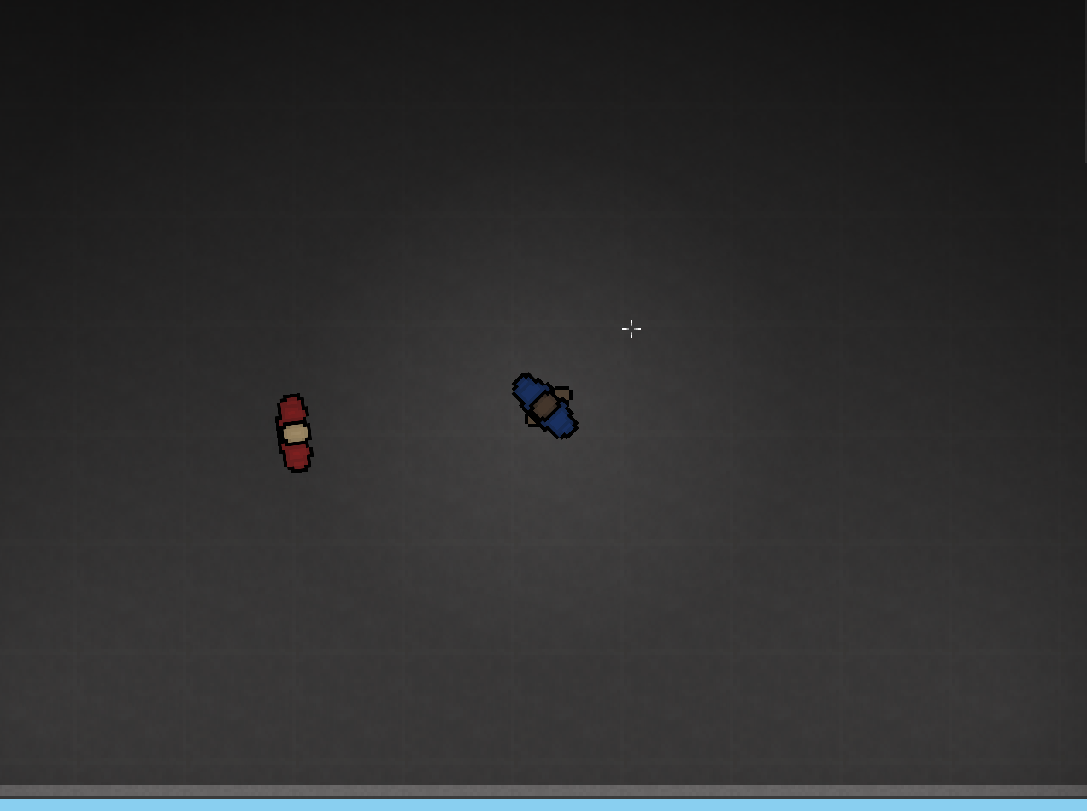
Screenshot of current game

Slide 7
Video of game as of now refer to Video Powerpoint

Slide 8
Notes for Next Sprint
Number one priority for me next sprint is collaborating with Hayden on getting limited sprinting working. This is quite an ambitious project for us as we aren’t as experienced at programming than Nick, hopefully together we can figure it out, we also need to help Dylan with his work as he is a total beginner to the python language and especially python arcade

