Slide 1
Sprint 5
Austin Bray Champtaloup
Start date – 23rd April
End date – 3^{rd June}
Git hash – a7c32775fc3b58e3a6dedf6566267f9827671265
Work hard rating – 4/5

Slide 2
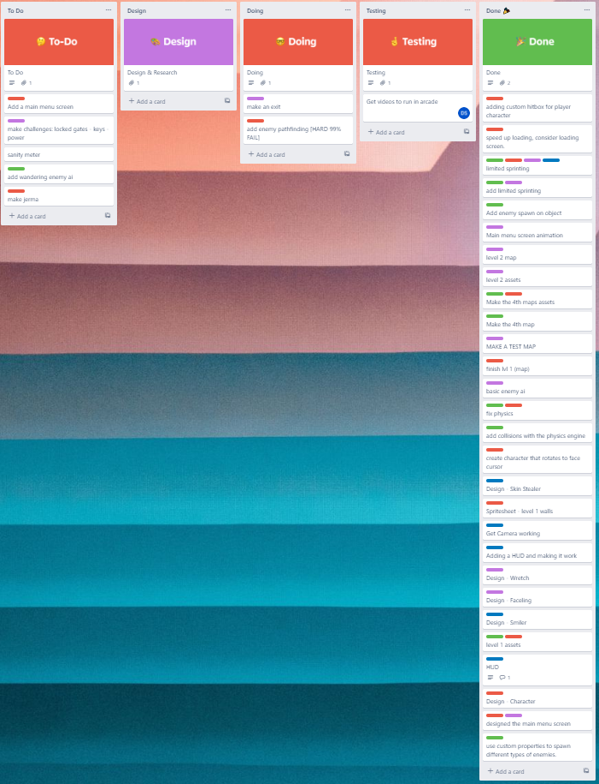
Trello board at the start of the sprint

Slide 3
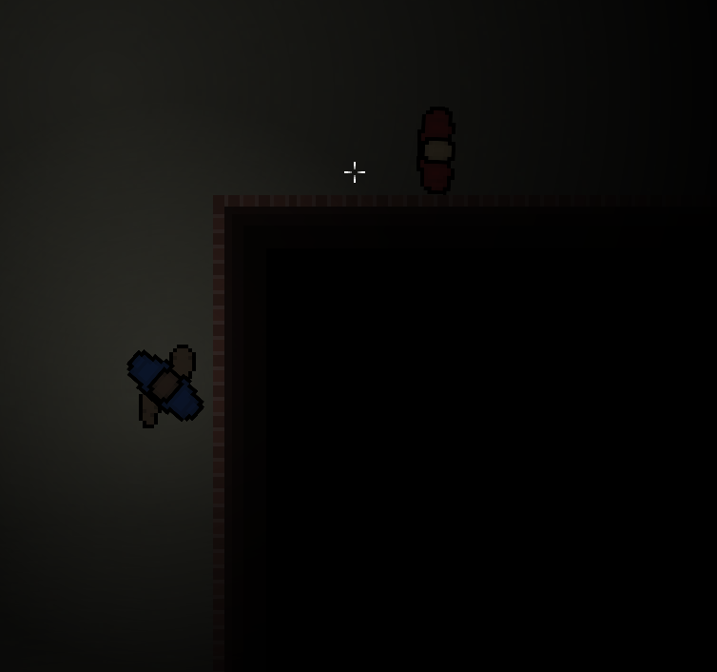
Screenshot of game at beginning of sprint

Slide 4
Sprint reflection and summary/Achievements/Testing.
Sprint 5 was spent well, getting many QOL changes and features added, my additions included a loss condition/screen, when the enemy collides with the player, the view switches to a game over screen, then if the player clicks the mouse, the game restarts.
Enemy wandering behaviour, the enemy is constantly moving forwards slowly but points in a random direction every few seconds or so, also to make the turning of the enemy look natural, i used LERP to interpolate the movement, making it look less snappy.
Text to show the current level + the current objective, the text dynamically changes depending on the level, it shows a level specific subtitle and the level number upon entering the area. I also added a main menu screen along with GUI to navigate the main menu, when the game starts, the menuview starts instead of the gameview, then the player can press the start button which then sends them to the gameview.
My teammates contributions included better UI, an additional map and some more QOL changes.

Slide 5
Trello board at end of sprint

Slide 6
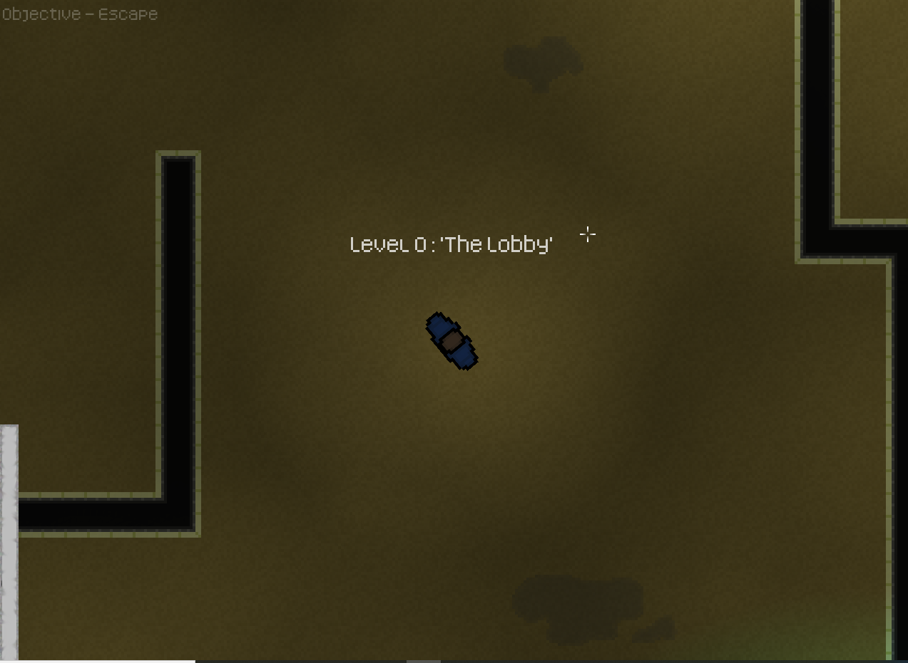
Screenshot of current game

Slide 7
Video of game as of now refer to Video Powerpoint

Slide 8
Notes for Next Sprint
Number one priority for next sprint is to finally bite the bullet and add interactable objects, I attempted to add them this sprint but didn’t get very far, I suspect a rework of the system will be necessary. Interactable objects will be paramount for us to design gameplay puzzles / story elements.

