Slide 1
Sprint 7
Austin Bray Champtaloup
Start date – 26th July
End date – 5^{th august}
Git hash – b798d36998d3051f834c478462a3ac08fa00d892
Work hard rating – 5/5

Slide 2
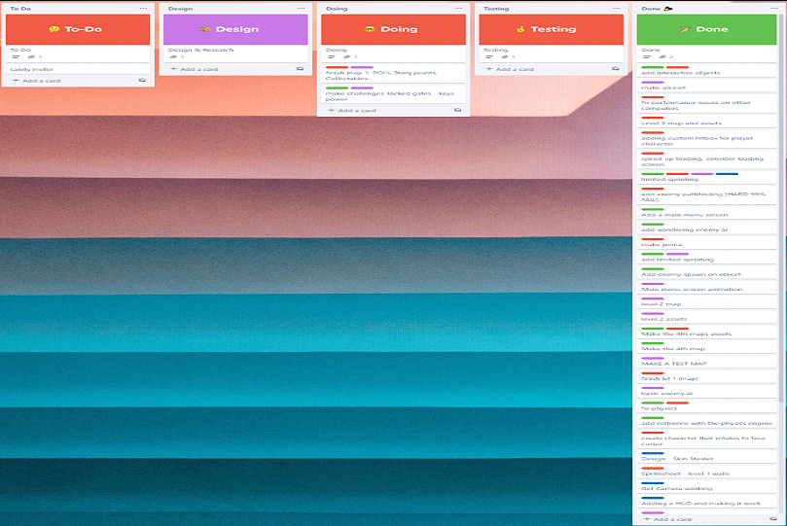
Trello board at the start of the sprint

Slide 3
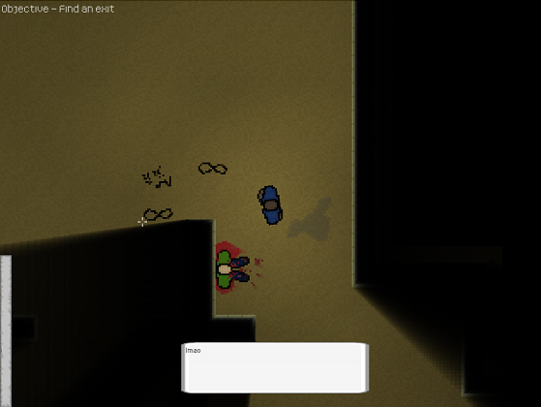
Screenshot of game at beginning of sprint

Slide 4
Sprint reflection and summary/Achievements/Testing.
My focus during sprint 7 was to continue working on the maps to make them interesting and fun to play. Unfortunately, this sprint i fell very ill and was unable to do very much, but still did as much as I could. I ended up adding more props to our assets and placing them on the maps, i made many edits to mostly the first level, as i didn't want the player to get too lost while playing, of course, there had to be the occasional dead end where they would have to loop back around in order to continue, but it felt unfair having them go in the complete wrong direction for 5 mins only for them to find nothing and to be completely lost. My challenge was making the maps follow a linear path while also feeling like a bunch of randomly interconnected rooms.
Hayden added a static vignette that gets applied to the camera when an enemy has line of sight with the player, this is a small change that makes the game just a bit scarier.
The rest of the team finalised the interactable system, after a lot of grief for all of us, we finally developed a simple system; when the player is touching an interactable object and presses the MB1, text will appear in the text box, or something will happen, like the lights turning on from a switch.
Hayden also made the doors on levels 2 and 4 open when the switch is activated, by giving them a custom property that can be toggled by the switch, since the exit is locked behind these doors, the player must find the switch first if they want to progress, this change adds another layer of gameplay to the exploration aspect.

Slide 5
Trello board at end of sprint

Slide 6
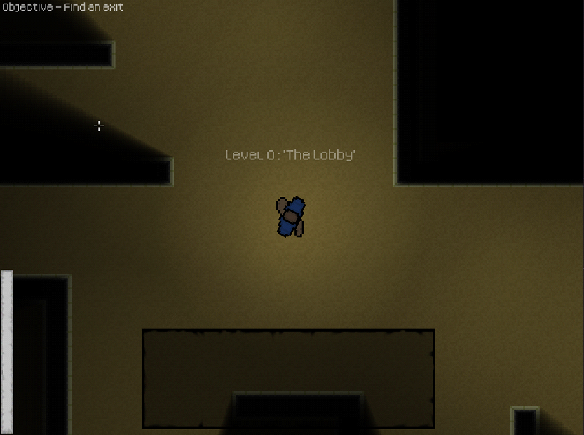
Screenshot of current game

Slide 7
Video of game as of now refer to Video Powerpoint

Slide 8
Notes for Next Sprint
We are in the final stretch for our game, the last things that need to be done are code commenting, making sure the code is up to PEP8 standards and making an ending, we already have an idea for what the ending is going to be.
Unfortunately, the process of commenting the code is not a fun one, but it is paramount for us to do for our code to be readable to an external source, and it needs to be tidy to make it easier to read.

