Slide 1
Sprint 5
Austin Bray Champtaloup
Start date – 23rd April
End date – 3^{rd June}
Git hash – a7c32775fc3b58e3a6dedf6566267f9827671265
Work hard rating – 4/5

Slide 2
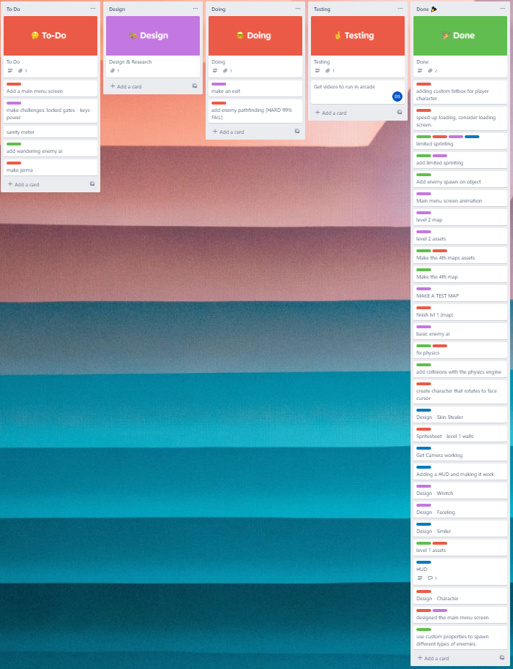
Trello board at the start of the sprint

Slide 3
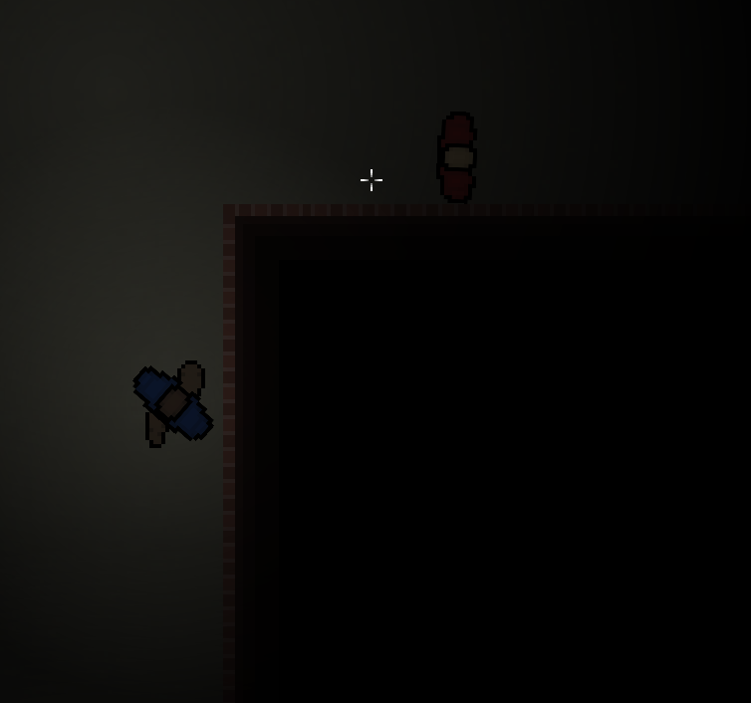
Screenshot of game at beginning of sprint

Slide 4
Sprint reflection and summary/Achievements/Testing.
Sprint 5 was spent well, getting many QOL changes and features added, my additions included a lose condition/screen, enemy wandering behaviour, text to show the current level + the current objective, I also added a main menu screen along with GUI to navigate the main menu.
My teammates contributions included better UI, an additional map and some more QOL changes.

Slide 5
Trello board at end of sprint

Slide 6
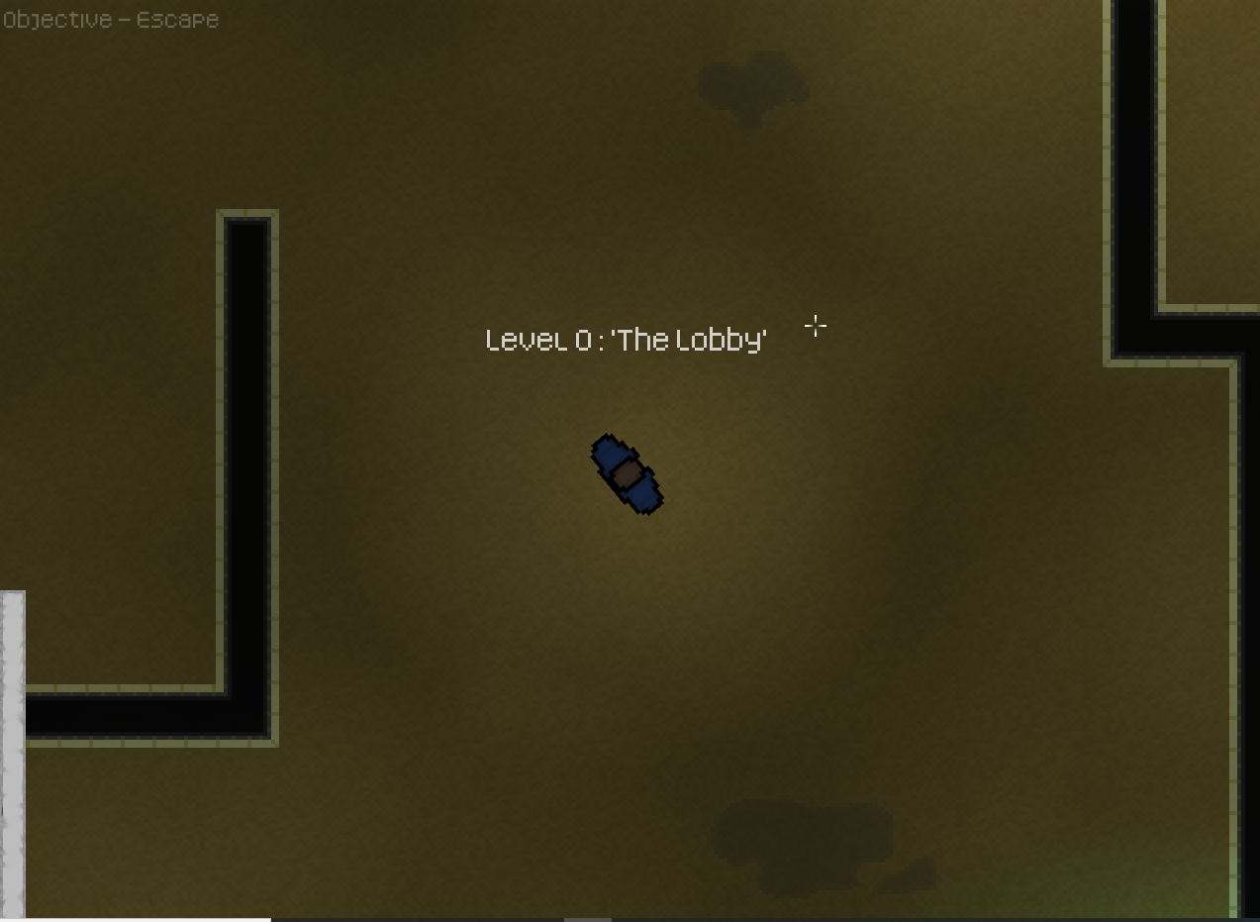
Screenshot of current game

Slide 7
Video of game as of now refer to Video Powerpoint

Slide 8
Notes for Next Sprint
Number one priority for next sprint is to finally bite the bullet and add interactable objects, I attempted to add them this sprint but didn’t get very far, I suspect a rework of the system will be necessary. Interactable objects will be paramount for us to design gameplay puzzles / story elements.

