Slide 1
Sprint 1
Austin Bray Champtaloup
Start date – 21st March
End date – 31st March
Git hash - 1f1ea1c07e76f7cb8a617b3496ceea77cb844baa
Work hard rating – 5/5

Slide 2
Trello board at the start of the sprint
N/A

Slide 3
Screenshot of game at beginning of sprint
N/A

Slide 4
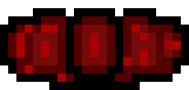

Sprint reflection and summary/Achievements/Testing.
During the sprint I have worked collaboratively with the other team members to get out the best MVP possible, at the beginning my focus was to create something that was playable but not complex, unfortunately, since I had issues on my system at home, this became nicks job, and he did amazing, in 24 hours we had a player that could move around with animations.
My job for the most part of the first sprint was mostly getting some of the core gameplay mechanics in and working, things like player sprinting, and the enemy were made by me, these are very important features that will lay the foundation for more mechanics to be built onto, more enemies, lose condition, limited sprinting/stamina etc.
While moving, if the player holds the shift key, the character will increase in speed. We call this sprinting. This is done by replacing the player speed with a sprint speed when the shift key is held down. As of now, there is nothing limiting the player from sprinting indefinitely
The enemy is now constantly following the player, by finding the location of the player and following the shortest path there, it often runs into walls, continues to follow the player when they are behind walls, and upon reaching the player, nothing happens.
Some art I made consists of the “wretch”, the “faceling”, the tile set for “level1” and the very early version for the main menu screen, we had a big discussion about what our tileset should look like and my suggestion was what was chosen.
There were many many bugs and issues along the way, but the worst was getting the enemy to look towards, and follow the player, we had to test the enemy to make sure it was working properly after I made any significant changes, when I tried to run the game to test following the player, it at first wouldn’t look towards the player like it was supposed to, our use of testing was very important for getting the enemy to work properly
During this sprint, I decided we needed to test how a player would react to the enemy's ai, since if it wasn't scary or wasn't intuitive the game wouldn't be very fun. we had Alek Wagner, a fellow DTC student playtest our game with the enemy active, unfortunately since it only walked towards the player constantly and through walls, the enemy felt very unnatural to alek, it didn't seem fair that the enemy constantly knew where the player was. A line of sight feature that made it so the enemy could not spot the player through walls could improve the players experience, only having the enemy chase the player when they have direct LOS.

Slide 5
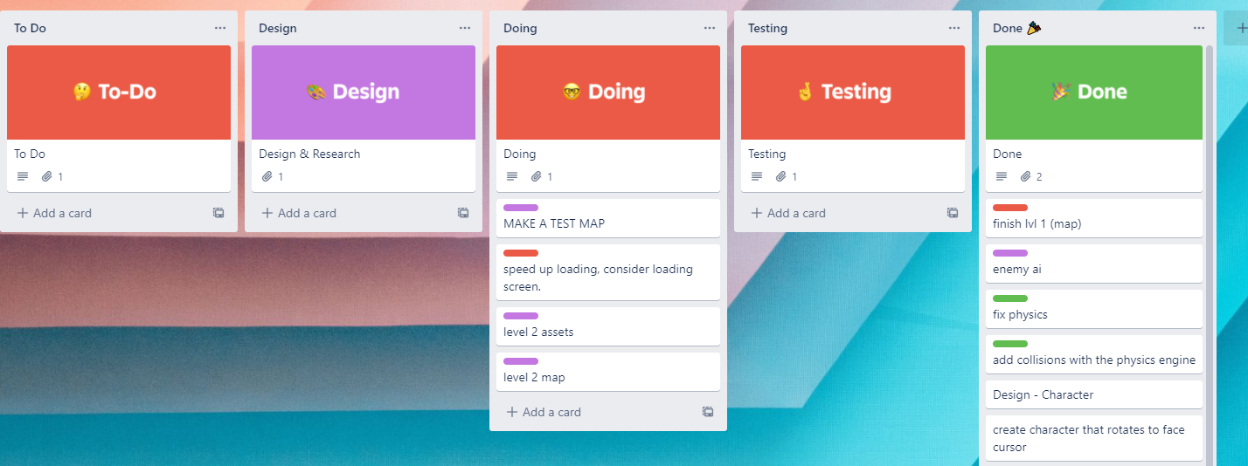
Trello board at end of sprint

Slide 6
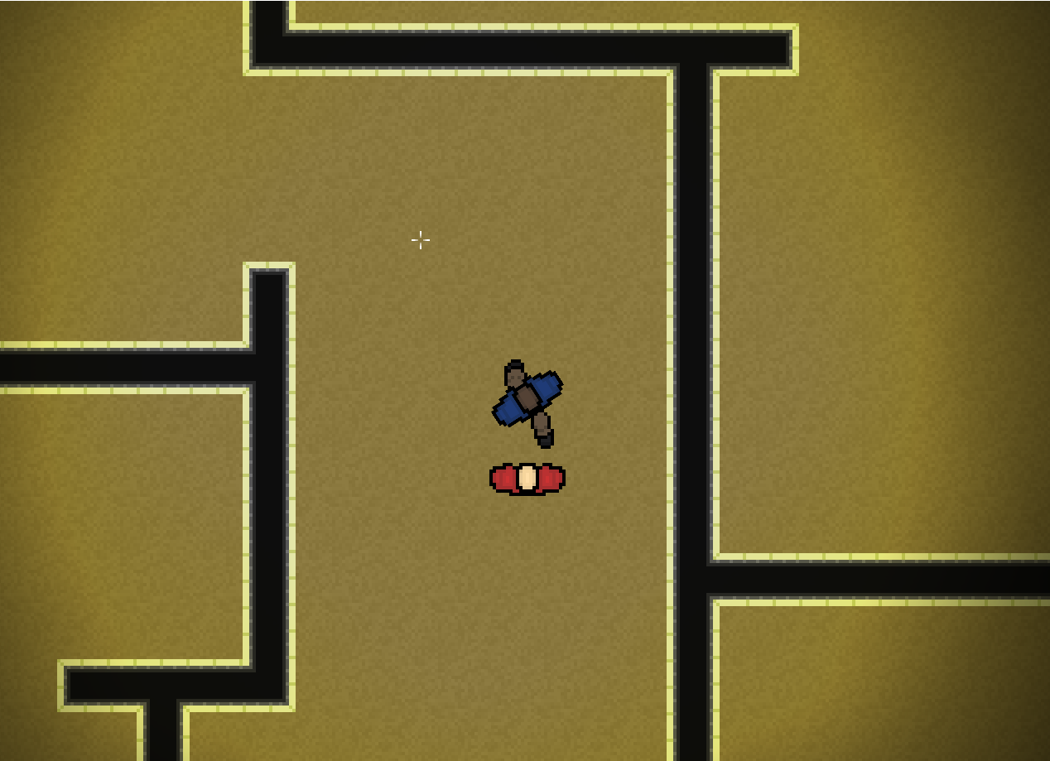
Screenshot of current game

Slide 7
Video of game as of now refer to Video Powerpoint

Slide 8
Notes for Next Sprint
I really need to clean up our code, now, the team has rushed so quickly to get something working out that we have neglected our code and its become quite sloppy and messy, I will work on keeping our code tidy as well as cleaning up our current code, keeping the documents clean and organised with proper comments will be paramount to the future development of the game, failure to do so will affect our efficiency with adding new features, changing existing ones, and overall source control.
Some interesting gameplay features we have discussed to possibly add next sprint are limited sprinting and a lose condition.

