Slide 1
Sprint 6
Austin Bray Champtaloup
Start date – 6th June
End date – 8^{th July}
Git hash – fc4ab3f381a70663fa76f78ffe32153f3f4bc86e
Work hard rating – 5/5

Slide 2
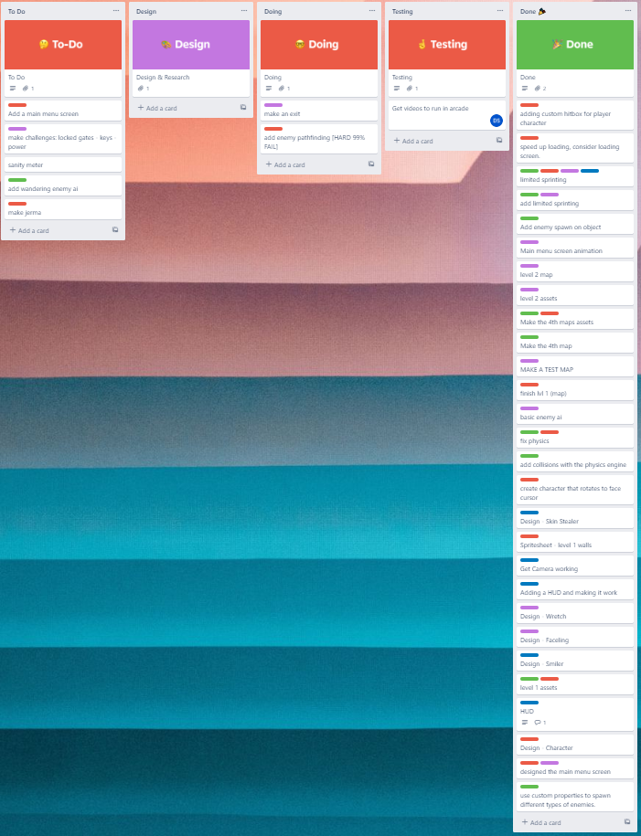
Trello board at the start of the sprint

Slide 3
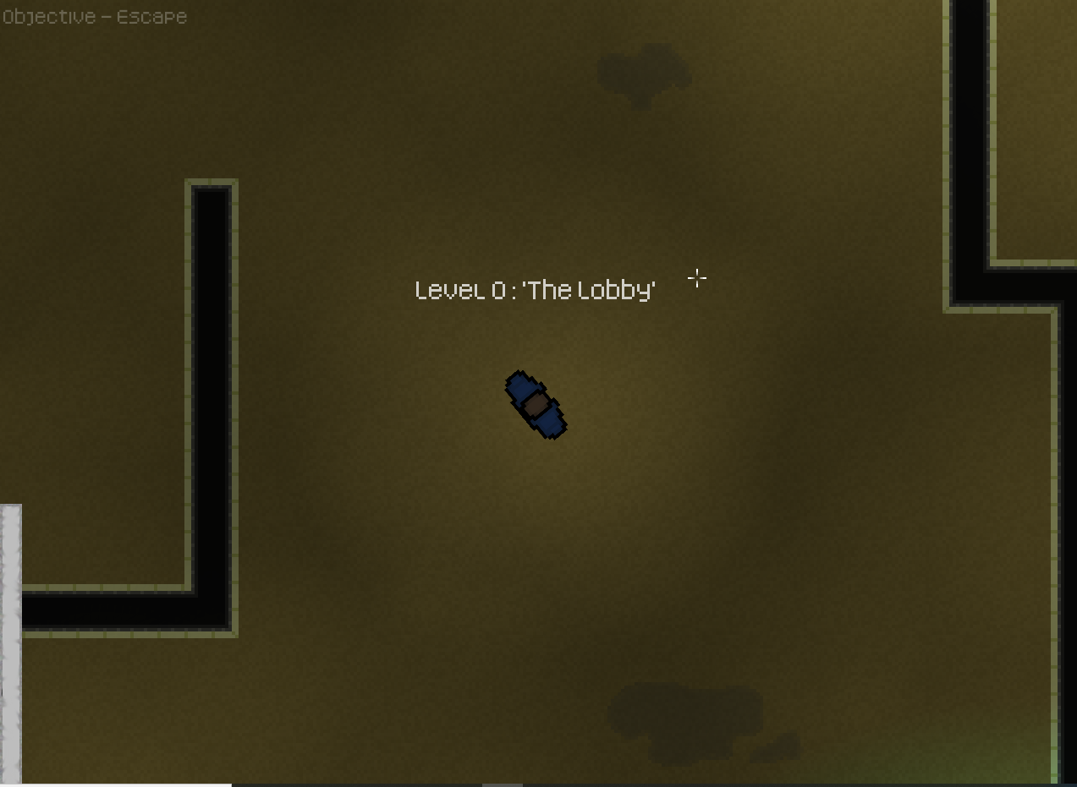
Screenshot of game at beginning of sprint

Slide 4
Sprint reflection and summary/Achievements/Testing.
I spent most of Sprint 6 coming up with story elements for the game and altering the map to fit the story, I decided to take a break from the technical side and focus more on the creative aspects, while my teammates tackled the largest fish so far: Interactable objects, for some ungodly reason, this was insanely difficult for the team to pull off, and is STILL in the making.
Achievements
Nick managed to get a ray casting shadow system in the game working, it basically works by rendering black rectangles behind objects the player has direct line of sight with.
We are still having issues with performance but unfortunately other than making our maps smaller, there's not a whole lot we can do about it. The game runs horribly on school systems, but runs fine on our home personal computers, so we aren’t too stressed about it, still though, I added an FPS counter to help with debugging/testing

Slide 5
Trello board at end of sprint

Slide 6
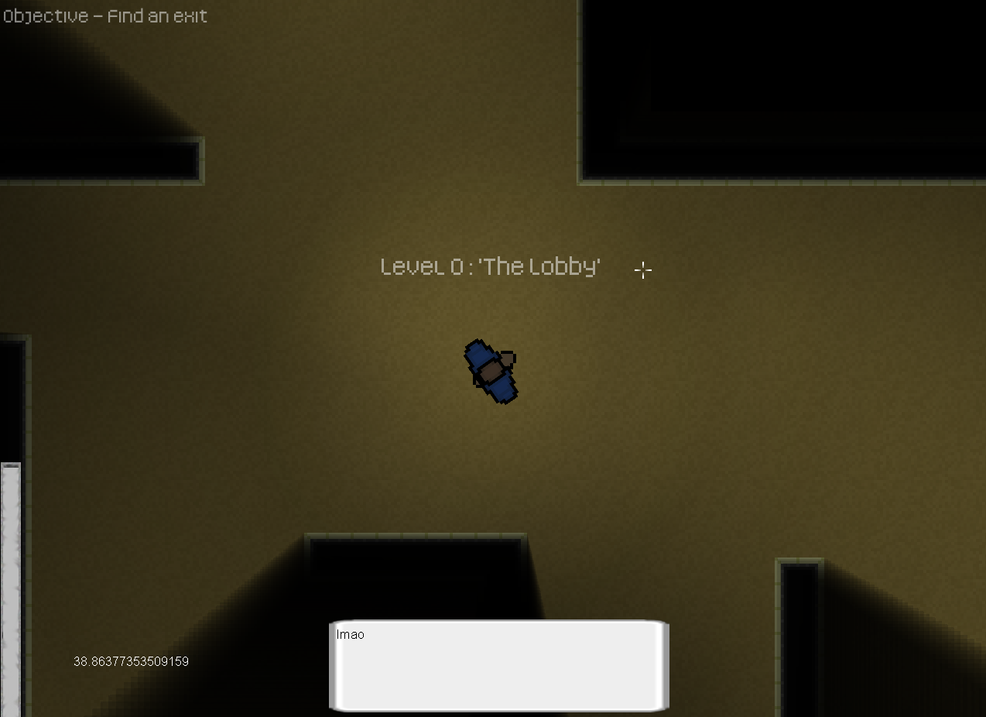
Screenshot of current game

Slide 7
Video of game as of now refer to Video Powerpoint

Slide 8
Notes for Next Sprint
Priority for next sprint is to tie the game together adding the final required features like checkpoints, a win condition, finishing interactable and more, so we can finalise our game ready for play.

