Slide 1
Name | Cameron
Git Hash | 414a4c29b40e505e68a63cd4912131eb806027b3
Sprint number | Start date | end date | Work hard rating
1 | 14/3 | 31/3 | 4/5

Slide 2
KANBAN board at the start of the sprint
NA

Slide 3
Screenshot of the game at the start of the sprint
NA

Slide 4
Sprint Reflection and summary
James and I created a moving player and moving asteroids from scratch
I created 3 assets (2 for player, 1 for enemy) I had a slight problem with the enemies design but I researched similar games and managed find a design that I liked
I created a camera which will centre on the player but it does sometimes look like the player isn’t moving
I helped James work on the acceleration system we want to use and it has become a very smooth system of movement

Slide 5
Briefly describe other team members contributions
James handled merging
James finalized the acceleration system which feels very good
James has been doing lots of research on pymunk physics engine which we plan on using
James created first view which he ran into some problems but it was easy to fix once he found the problem

Slide 6
Major Changes and Achievements Described
Create 3 sprites
Create game view
Player acceleration
Player rotation
Camera follows player
Moving asteroids

Slide 7
Brief Description of your testing
For testing we generally would run the game and use/observe a specific part of the game
Both testing the camera and movement included running around the map and seeing if any problems show up
Everything else was done by letting the game run and observing what happens

Slide 8
Link to testing results/tables

Slide 9
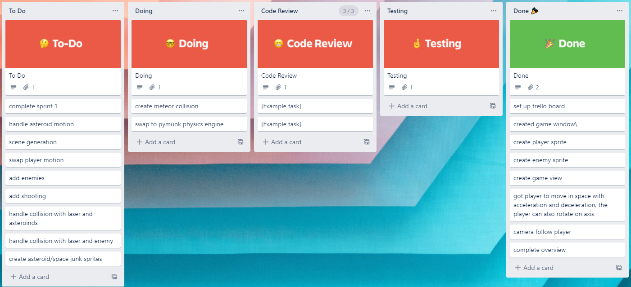
KANBAN board at the end of the sprint

Slide 10
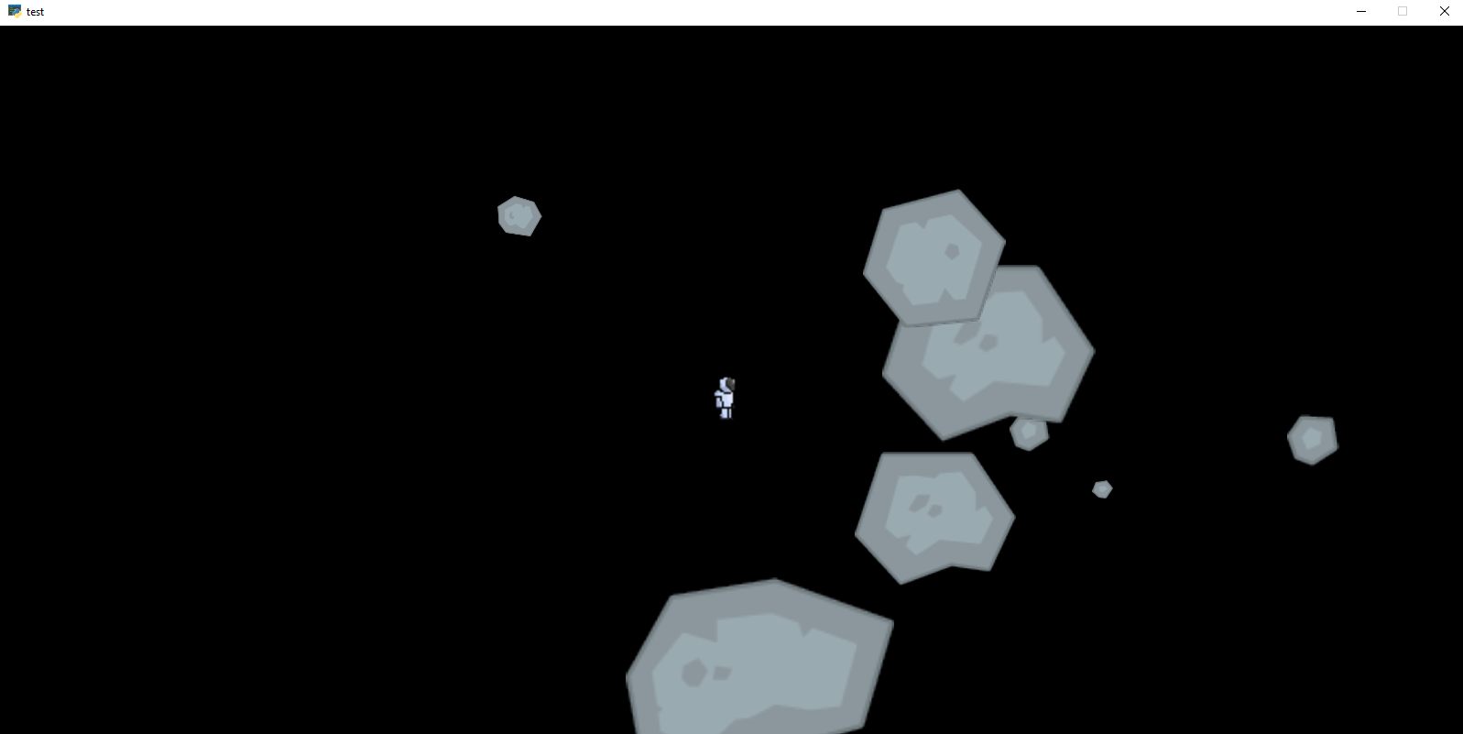
Screenshot of the game at the end of the sprint

Slide 11
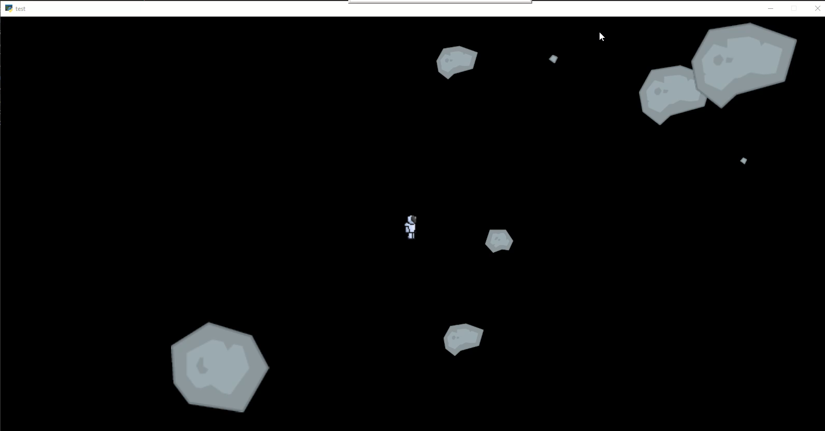
Video of the game at the end of the sprint

Slide 12
Notes for next time, future improvements
I need to add enemy spawning into the game
I need to add player shooting to destroy meteors and enemies
I need to remove the barrier stopping meteors from moving out of an area
I want to get a base game done by the end of next sprint

