Slide 1
Name | Cameron
Git Hash | b02f5a313f43e511992a9f2618782f5ab49d2391
Sprint number | Start date | end date | Work hard rating
2 | 4/04 | 15/04 | 3/5

Slide 2
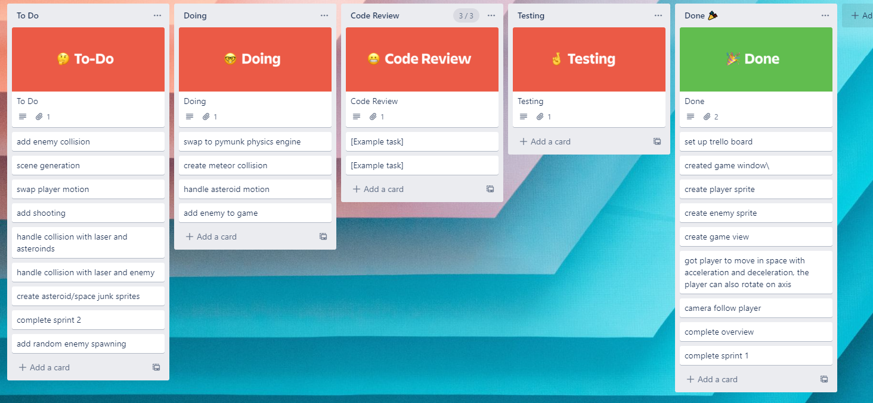
KANBAN board at the start of the sprint

Slide 3
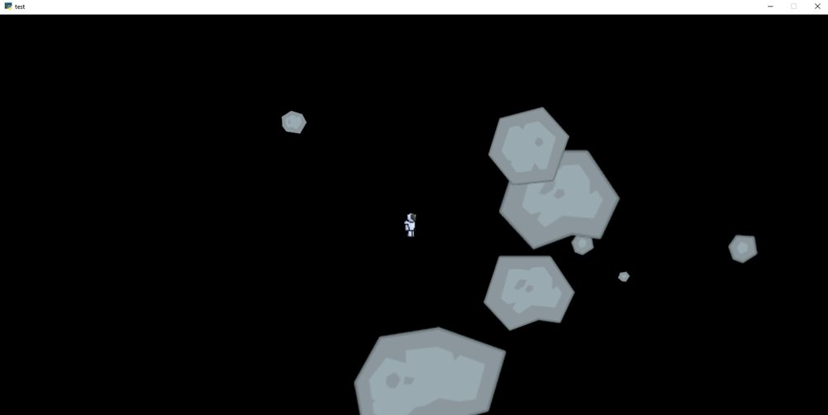
Screenshot of the game at the start of the sprint

Slide 4
Sprint Reflection and summary
The entire sprint i was working on spawning the enemies
I managed to get them to spawn in random locations but not off screen
I feel like i could have done it faster and finished spawning and started learning about ai

Slide 5
Briefly describe other team members contributions
James got covid during this sprint so couldnt do a lot of work but he still learnt a lot about the physics engine

Slide 6
Major Changes and Achievements Described
Enemies spawn in random locations within a range
Learnt about the physics engine so that we could use it next sprint

Slide 7
Brief Description of your testing
For testing i would run the game and move around to see where enemies are spawning

Slide 8
Link to testing results/tables
By the end of the sprint the enemies were randomly placed near the player

Slide 9
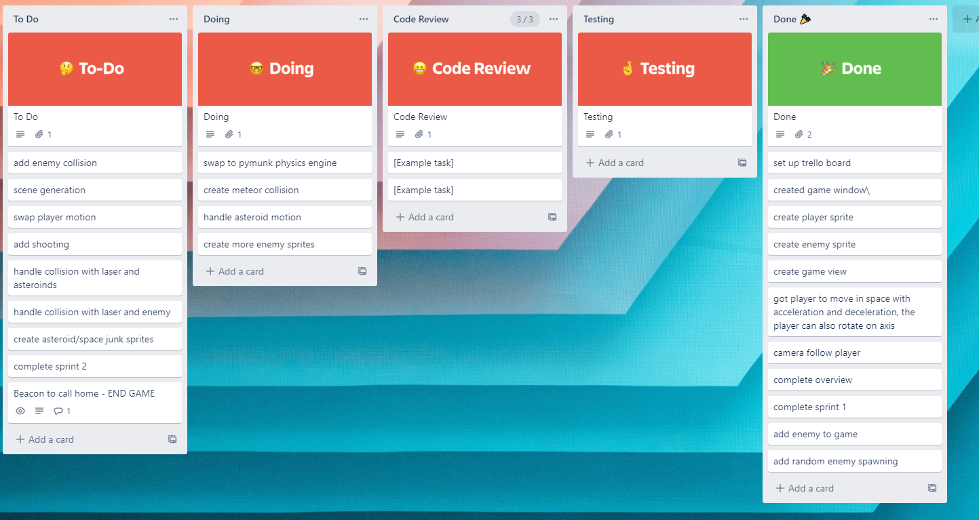
KANBAN board at the end of the sprint

Slide 10
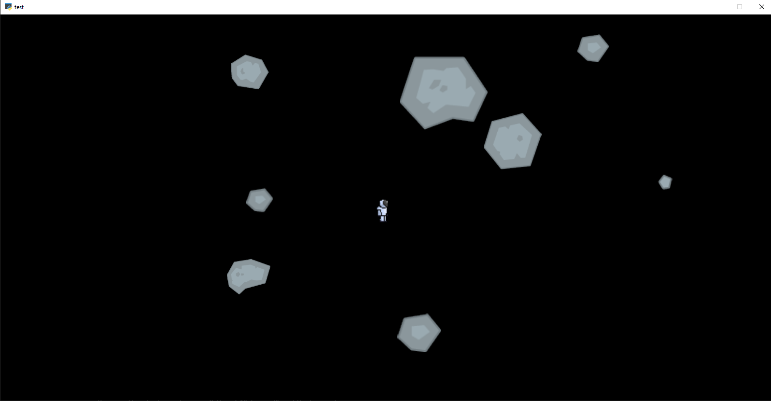
Screenshot of the game at the end of the sprint

Slide 11
Video of the game at the end of the sprint

Slide 12
Notes for next time, future improvements
Finish spawning
I need to learn how the seek ai works
James should have learnt enough to start the physics engine

