Slide 1




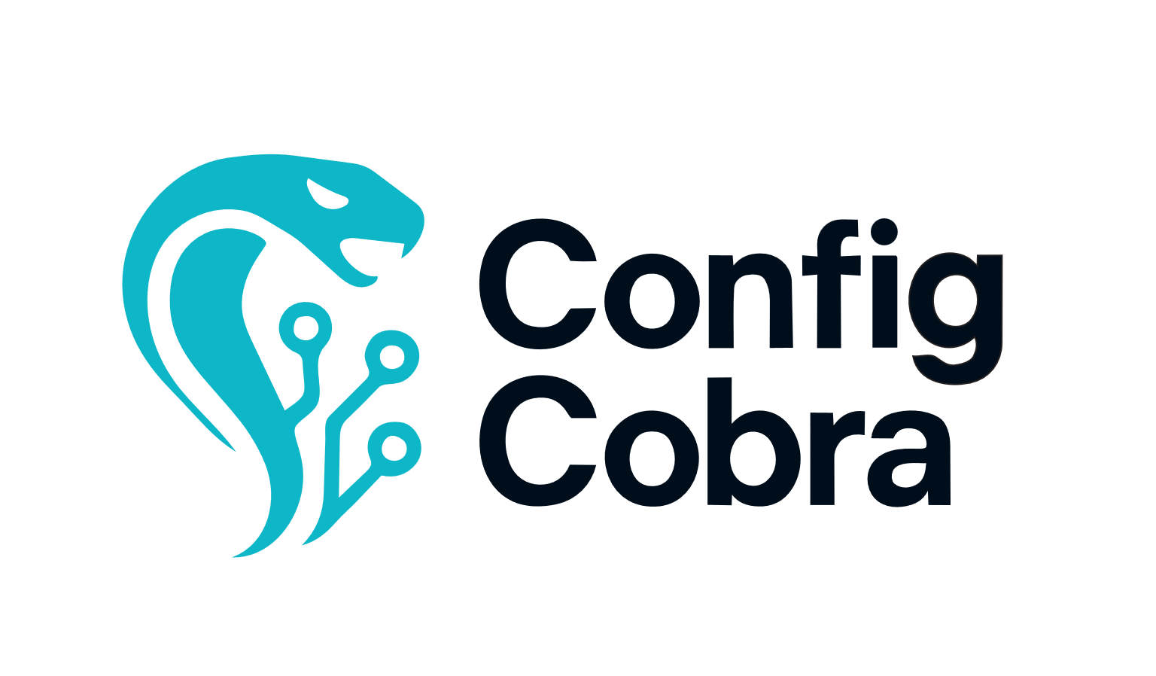





ConfigCobra automated CIS assessments in M365, boosting security and saving time.
A mid-sized organization running Microsoft 365 needed a reliable way to keep security configurations consistent as the environment evolved. Manual compliance reviews were slow, hard to repeat, and often missed changes that introduced risk. They chose ConfigCobra to continuously assess their tenant against the CIS Microsoft 365 Foundations Benchmark, gain clear visibility into their security posture, and generate trusted, audit-ready evidence while improving day-to-day security.
At a glance
Customer: Digital Technologies Holding GmbH.
Website: https://digitechold.com
Customer size: 10-50
Country: Germany
Industry: Data Center Design
Products and services: Microsoft Azure, Microsoft 365, Windows 10​
ConfigCobra configcobra.com | info@configcobra.com
See our offer on the Microsoft Commercial Marketplace

Slide 2





Digital Technologies & ConfigCobra
Customer challenges A fast-growing team delivering scalable data center solutions relies heavily on Microsoft Azure and Microsoft 365 to collaborate and operate securely. As their environment expanded, manual security and compliance reviews became too slow and inconsistent, and configuration drift increased risk over time. They needed a repeatable way to continuously validate Microsoft 365 settings against recognized security best practices, quickly identify gaps, and remediate issues without slowing delivery. Their goals were improved day-to-day security, continuous CIS-aligned compliance visibility, and audit-ready reporting backed by clear evidence.
Automated CIS M365 Foundations assessments (Level 1/2), with clear remediation guidance for every failed control.
Scheduled scans (daily/weekly/monthly) plus notifications, so teams stay continuously informed.
CIS-certified, audit-ready PDF reports with evidence, and rule sets to focus on what matters most
Partner solution We deployed ConfigCobra by connecting to the customer’s Microsoft 365 tenant via Entra admin consent and Microsoft APIs, then automated CIS M365 Foundations assessments on a schedule. The platform detects configuration drift, flags misconfigurations with clear remediation steps, and generates CIS-certified PDF evidence. Using Microsoft identity and tenant configuration data keeps onboarding simple, access controlled, and results aligned to the live environment.
Customer benefits With ConfigCobra + Microsoft 365 (Entra ID and Microsoft Graph), the team cut compliance review time from days to ~25 minutes per run and automated weekly checks. They now spot configuration drift early, remediate faster, and generate CIS-certified PDF evidence on demand. “We moved from manual spot-checks to continuous visibility in Microsoft 365,” the partner said.
ConfigCobra configcobra.com | info@configcobra.com
See our offer on the Microsoft Commercial Marketplace

