Slide 1


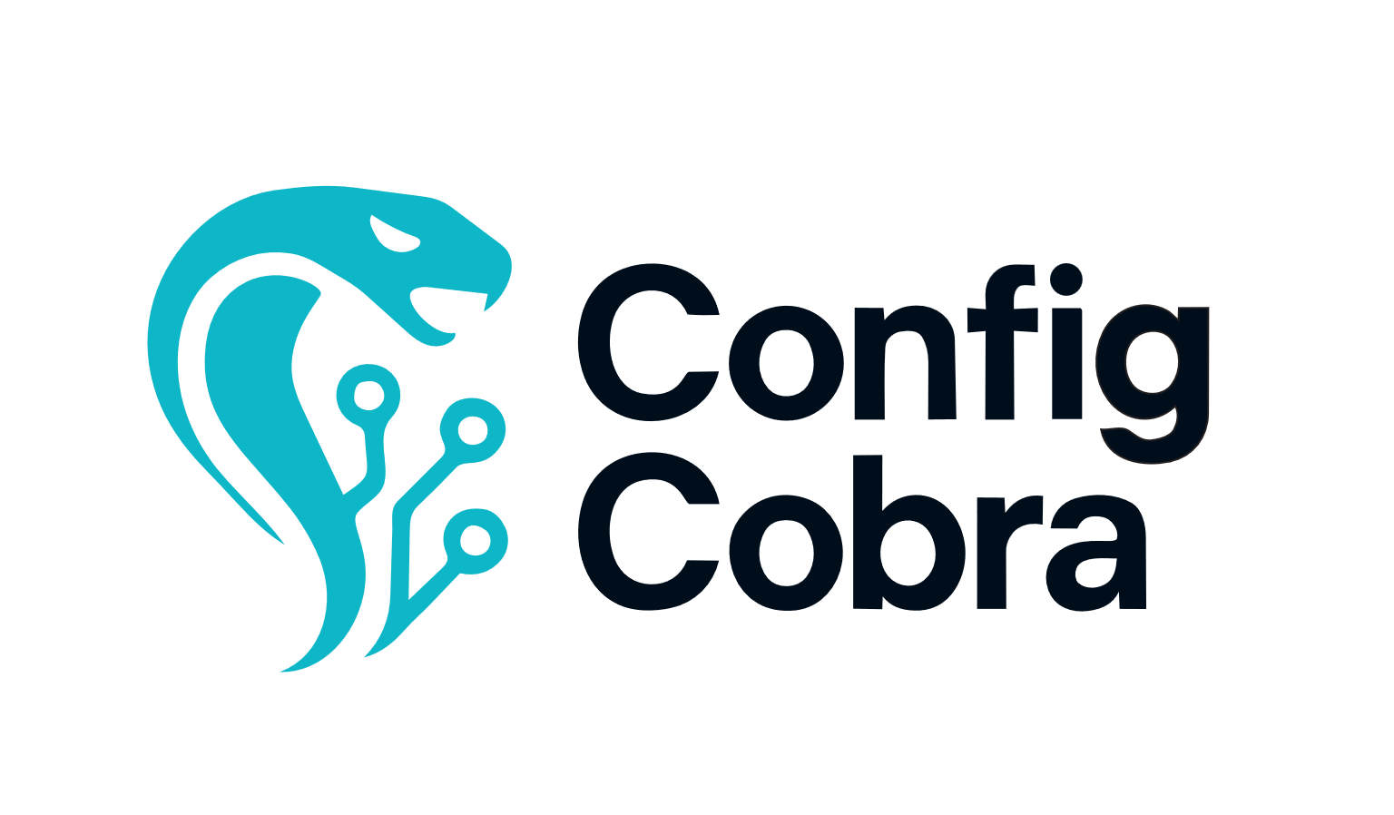

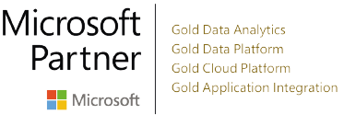




Automate CIS compliance for Microsoft 365 in 20 minutes, not days
About ConfigCobra:
ConfigCobra is a SaaS company delivering CIS-certified compliance assessments for Microsoft 365. Our approach replaces manual audits with automated checks, drift monitoring, and audit-ready evidence. We stand out with CIS-certified reporting and a self-service experience. We serve enterprises, healthcare, finance, and government contractors.
What we offer
ConfigCobra is a SaaS solution that automates CIS-certified compliance assessments for Microsoft 365, replacing days of manual checking with fast, consistent, audit-ready results.
It automates more than 90% of benchmark checks, detects configuration drift in near real time, and supports scheduled, continuous assessments to keep your compliance posture up to date.
Customers can generate CIS-certified PDF reports with evidence for audits and use clear remediation guidance to fix findings quickly.
With custom rule sets, assessments can be tailored to specific teams or priorities, while mapping to 24+ standards and frameworks (such as HIPAA, SOC 2, PCI DSS, ISO 27001, NIST, and CMMC) helps support multi-standard compliance programs.
ConfigCobra is differentiated by its CIS-certified approach (not just “aligned”), continuous drift monitoring, and a self-service experience designed for ongoing compliance.
What our customers are saying
ConfigCobra turned our Microsoft 365 CIS compliance from days of manual work into a repeatable, automated process. The CIS-certified reports and drift detection give us confidence we’re always audit-ready—and the remediation guidance is clear
– Sofia, CEO, Digital Technologies Holding
ConfigCobra configcobra.com | info@configcobra.com
See our offer on the Microsoft Commercial Marketplace

Slide 2





Why
ConfigCobra?
Be future-ready Microsoft 365 changes constantly — ConfigCobra helps you stay ahead with CIS-certified assessments designed for continuous compliance, not point-in-time audits.
By automating the vast majority of benchmark checks, highlighting gaps instantly, and providing clear remediation guidance, teams can keep pace with evolving security requirements without adding manual workload.
Assessments (CIS for Microsoft 365) ConfigCobra runs CIS-certified assessments for Microsoft 365 to give you a clear, repeatable view of your compliance posture.
You can run assessments on-demand or automate them with scheduled, continuous scans to keep compliance up to date without manual effort.
Findings are presented with pass/fail/partial outcomes, the reason behind each result, and clear remediation guidance — so teams can move from discovery to fix quickly and confidently.
Drift detection Compliance can break between checks when configurations change. ConfigCobra detects configuration drift so you can catch deviations early, understand what changed, and prioritize remediation before issues become audit blockers or security risks.
CIS-certified reporting Generate audit-ready, CIS-certified PDF reports with evidence that auditors can review quickly and confidently, helping you document compliance status and improvements over time.
ConfigCobra is a SaaS solution that automates CIS-certified compliance assessments for Microsoft 365, helping organizations replace time-consuming manual checks with fast, repeatable, audit-ready results. With on-demand and scheduled continuous assessments, drift detection, and clear remediation guidance, teams can maintain a strong security posture and stay compliant as configurations evolve. Learn more at configcobra.com
ConfigCobra configcobra.com | info@configcobra.com
See our offer on the Microsoft Commercial Marketplace

