Slide 1
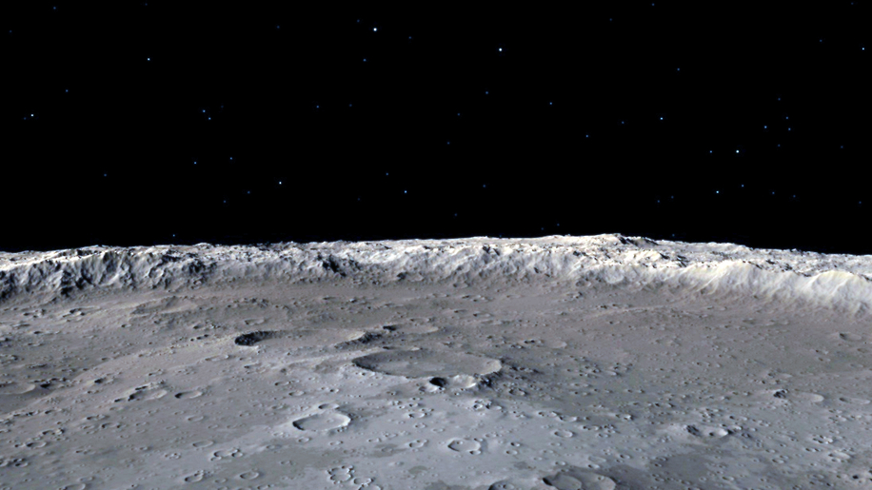

HSML Schema
How to create our own private schema using schema.org
Alicia Sanjurjo Barrio (349B – Affiliate)
12/06/2024

Slide 2
HSML Schema
Create schema with the HSML ontology types
Use existing properties from Schema.org
Create our own custom properties for each type
Use the same identifier as defined in the standard (SWID)
Create examples that follow this schema extension

Slide 3
Spatial Web Ontology Entries
ENTITIES are the base items used across the Spatial Web in HSML
The Spatial Web ontology defines several classes. All classes are types of the Entity base class:
ACTIVITY
AGENT
CONTRACT
CHANNEL
CREDENTIAL
DOMAIN
HYPERSPACE/SPACE
TIME
HSML encodes ENTITIES in a format, e.g., JSON-LD

Slide 4
Agent has goals, senses, and responds, i.e. Lunar Rover
AGENT
Agent is a type of Domain. Agents can also sense other Domains
Activity is an action performed by an Agent
Agent can send messages through
the Channel
i.e. Lander, Rover, Moon surface
A Domain info can be sent through the Channel
CHANNEL
Channel contains messages related to an Activity
i.e. Leave the Lander
DOMAIN
ACTIVITY
A Domain can perform an Activity.
An Activity can be performed on a Domain
Domain references a Hyperspace
A Credential is made by a Domain (domain authority)
A Contract is done for an Activity
Activities take Time to be carried out
A Credential parties to a Contract
CREDENTIAL
CONTRACT
HYPERSPACE
TIME
Notes:
HYPERSPACE: A set of ‘points’ such that, for every ordered pair of points, there is a possibly empty set of ‘paths’ from the first point to the second, and such that there is an ‘identity’ path from every point to itself. Syn: SPACE.

Slide 5
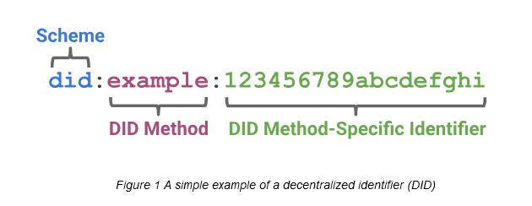
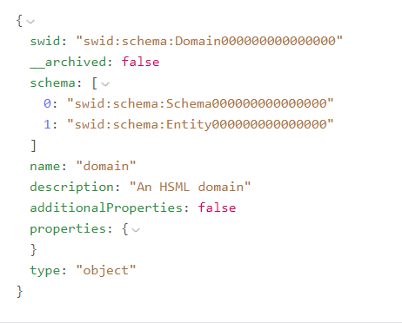
Attributes of HSML ENTITY
Identifiers – SWIDs¹ that conform to W3C did-core, https://www.w3.org/TR/did-core/.
Name
Description
Links to other ENTITIES
Properties
Type: either “ENTITY” or one of the eight semantic entities in the Spatial Web ontology
All HSML objects derive from the Entity class.
¹SWID ≡ Spatial Web Identifier

Slide 6
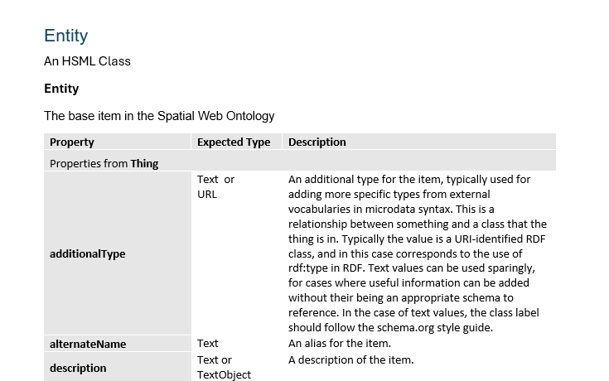
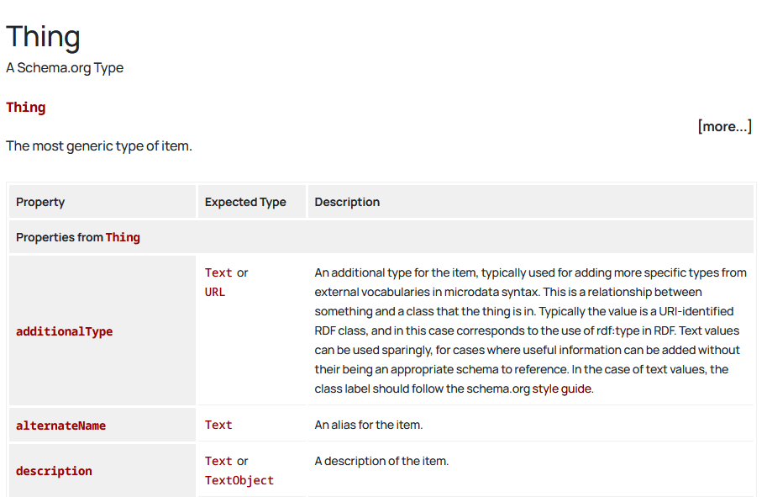
HSML Types Structure
Document currently under construction
Schema.org webpage

Slide 7
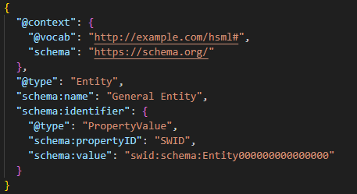
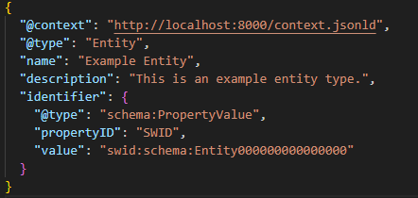
HSML Schema Examples
Entity
Agent (using modified Jared’s 3DModel)
Credential (that could be used for access)

Slide 8
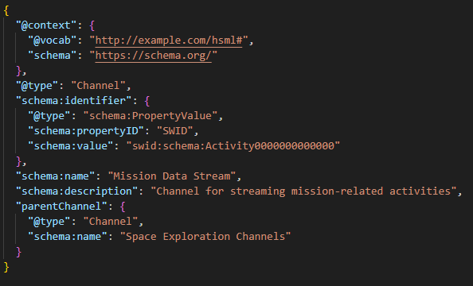
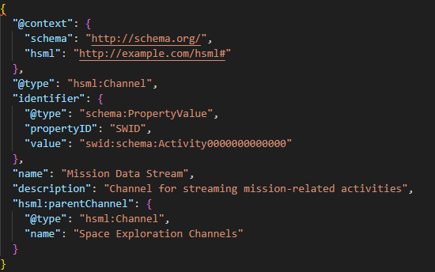
HSML Schema Context (1/2)
2 options:
1. Typing schema for Schema.org properties & types
2. Typing hsml for our properties & types
  Placeholder for public namespace: http://example.com/hsml#

Slide 9
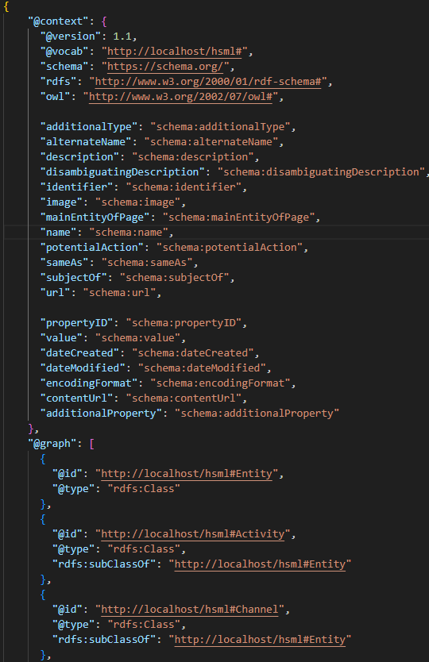
HSML Schema Context (2/2)
HSML schema context.jsonld file stored in a local server for now
The schema.org properties are mapped inside context.jsonld to an equally named HSML property for simplicity
Entity Example
[…]

Slide 10
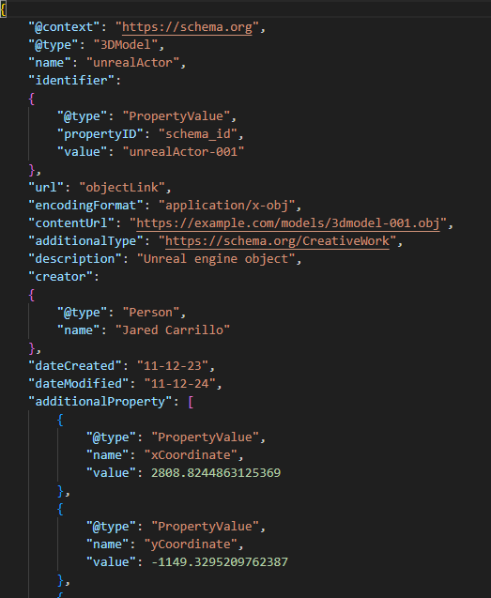
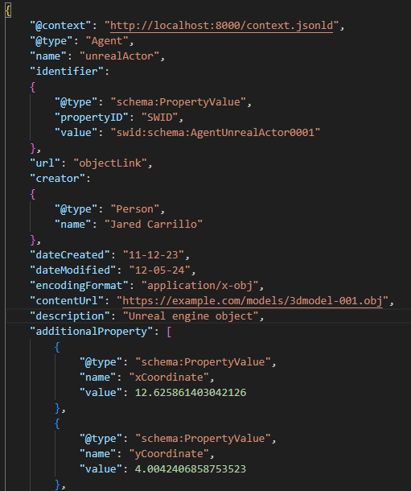
Agent Example: kafkaUnrealProducer from Jared:
Before: Using only schema.org
Now: Using new schema

Slide 11
Agent Example: kafkaUnrealProducer from Jared:
Before: Using only schema.org
Now: Using new schema

Slide 12
Questions & Concerns
In the future, to store our HSML schema, we need to purchase a domain, e.g. https://schema.jpl.hsml.org. What is the Procedure to do this within JPL?
In the meantime, we have a few options:
More Private:
  Option A: Use a local namespace or an arbitrary URL in the context of the JSON files. Each user needs to have the context stored locally or accessible through Google Drive.
  Option B: Store the schema context JSON-LD file in AWS S3 or Google Cloud Storage. They can provide URLs that are either public or accessible only to users with the proper permission
More Public:
  Option C: Use GitHub pages or a web server to have publicly accessible JSON-LD file.

Slide 13
ADDITIONAL SLIDES

Slide 14
HSML in Simple Words
HSML ≡ Hyperspace Modeling Language
A modeling language that can be read by both humas and machines
A detailed schema/map that explains how all the different data is related to each other in the system
It describes objects, relations, actions, activities and their permissions
  HSML does for the Spatial Web as HTML does for the WWW

Slide 15



Spatial Web Protocols
HSML ≡ Hyperspace Modeling Language
  A multi-dimensional ontology for encoding fundamental elements and the relationships between them.
HSTP ≡ Hyperspace Transaction Protocol
  A multi-dimensional range query for governing the interactions between actors and assets
HSQL ≡ Hyperspace Query Language
  Syntax for performing predictive (probabilistic) queries on a vector graph document database which combines comparative, relational, and similarity searching

Slide 16
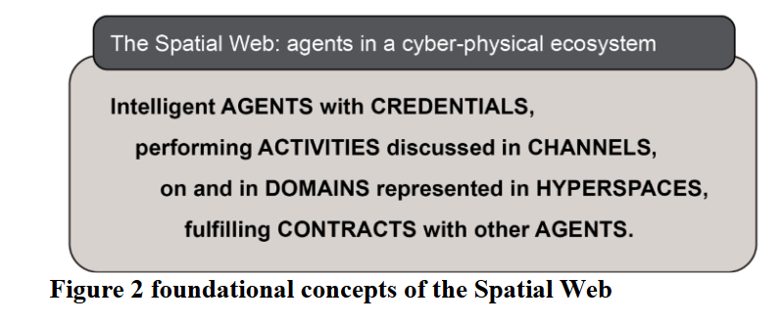
In summary,
From 979-8-3503-5597-0/25/$31.00 ©2025 IEEE,
Enabling Interoperable Digital Twins for Collaborative Lunar Exploration

Slide 17
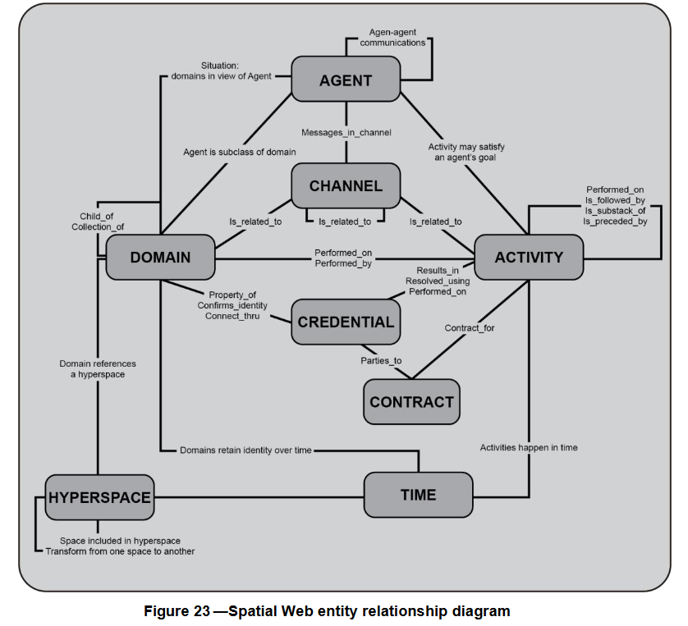
From P2874/D3.1, June 2024 Draft Standard for Spatial Web Protocol, Architecture and Governance:

Slide 18
CHANNEL
  CHANNEL: A stream of HSML Entities that are related to an Activity of a specific context that does not itself warrant a Domain or hierarchy. A Channel contains HSML messages that relate to an HSML Activity.
  A CHANNEL may be a collection of CHANNELs, where the wider CHANNEL will contain all information from all lower CHANNELs.
    Kafka: Can we do topics contained in other topics?
  CHANNEL be specific to a specific ACTIVITY or ACTIVITIES.
    Kafka: have a topic destined for each Activity or collection of related Activities, where the corresponding Activities and Contracts are talked about, granted access to other Agents…
  CHANNEL be specific to a specific AGENTS based on CREDENTIALS
    Kafka: For each 3D Model, we have a topic. The access to subscribe to this topic will be done through a credential

Slide 19
DOMAIN Types
There are 6 types of Domains:
Geographic — ex: Moon surface
Concept — ex: Planetary Protection
Organization — ex: a JPL team workplace
Agent — ex: a physical rover, a digital twin, a lander
Person — ex: a human person, astronaut
Thing — ex: lunar rocks, the lander’s platform

Slide 20
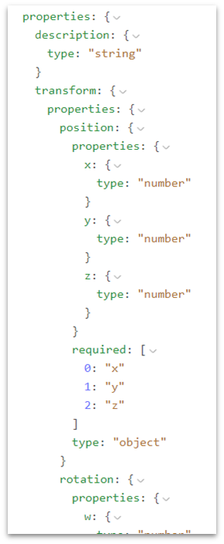
SPACE Properties
There are different properties that can define a SPACE:
description
transform
position (xyz)
rotation (xyz)
volume (xyz)

Slide 21
Channel 1
User 1
User 2
Channel 2
User 3
User 4
Channel 3
User 5
User 6

