Slide 1


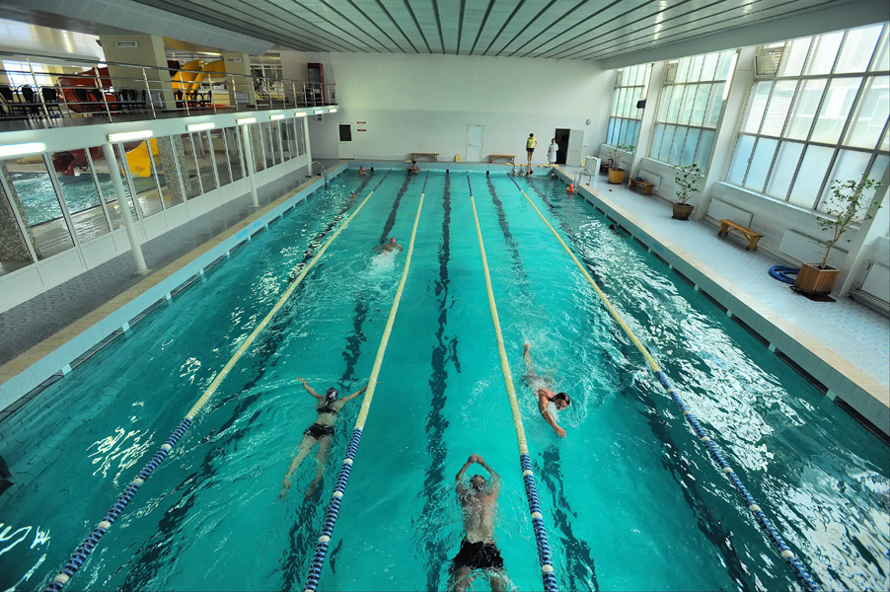
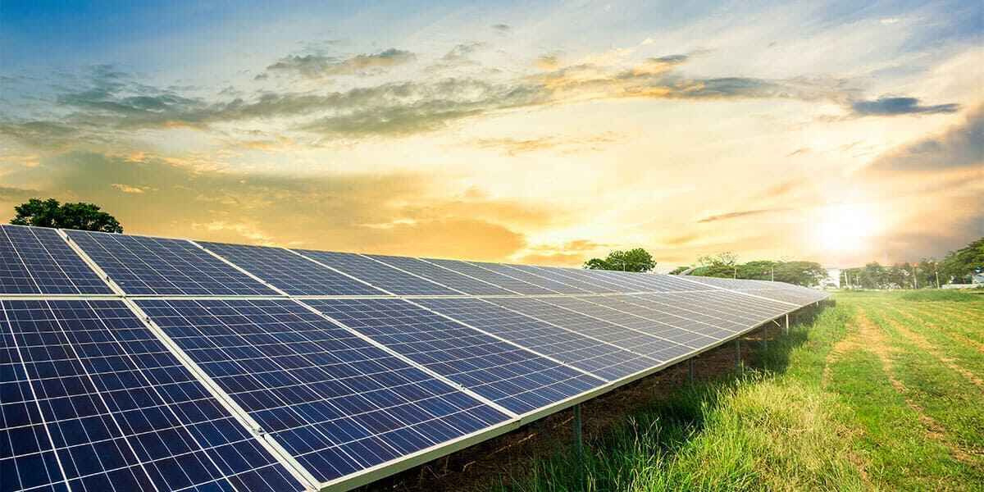


Alternative energy supply for the facilities of Municipal Enterprise "Cherkasyvodokanal"
Modular solar power plant of 300 kW at a pumping station of the III-stage

Slide 2

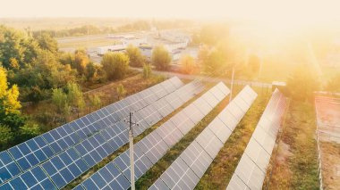






Alternative energy supply for the facilities of Municipal Enterprise "Cherkasyvodokanal"
Purchase of a modular
solar power plant of 300 kW at a pumping station of the III-stage
The total cost of the project is
≈ 562 418 EUR

Slide 3







Construction of a solar power plant (SPP)
The projects include the
following works:
Social significance of projects:
provision of 24-hour water supply and drainage for the residents of Cherkasy,
in conditions of war and blackouts
reducing the risks of environmental pollution
269 000 residents of the city will receive high-quality centralized water supply services
purchase of equipment
installation of equipment
commissioning of SPP
electric capacity of SPP: 1 MW, 300 kW

Slide 4






Implementation of the project will allow:
to reduce the effects of climate change, to save 1061 trees, 11228 liters of fuel annually
to reduce the level of carbon emissions, to reduce CO2 emissions - 8 tons/year, SOx NOx - 78 kg/year
100% 100% provision of the station's electrical energy needs
to give excess electricity to the power grid

