Slide 1


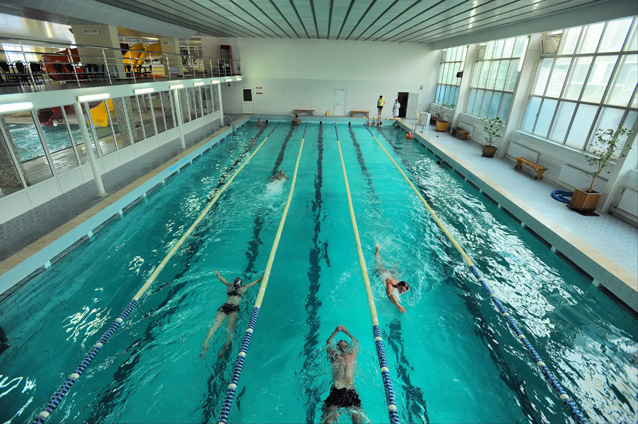
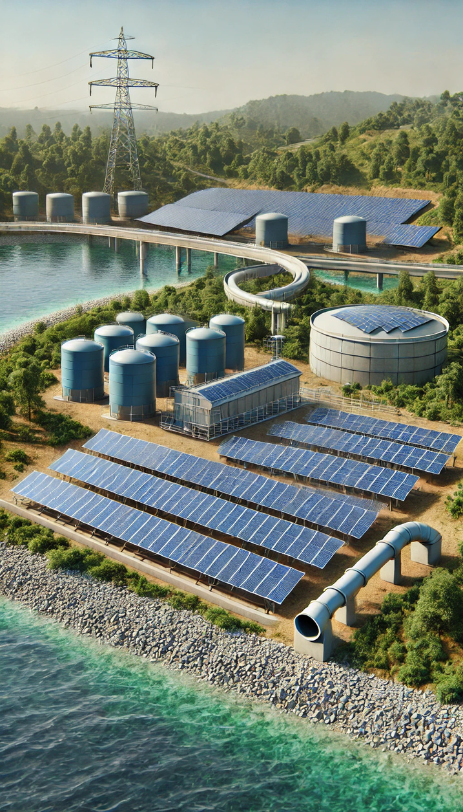


Alternative energy supply for the facilities of Municipal Enterprise "Cherkasyvodokanal"
Modular solar power plant at the reserve water intake "Vilshanka"

Slide 2

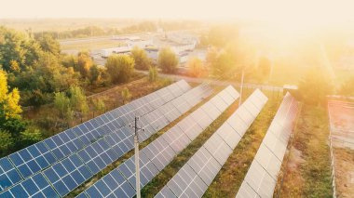







Alternative energy supply for the facilities of Municipal Enterprise "Cherkasyvodokanal"
Purchase of a 1MW
modular solar power plant at the reserve water intake "Vilshanka"
The total cost of the project is
≈ 932 398 EUR

Slide 3







Construction of a solar power plant (SPP)
The projects include the
following works:
Social significance of projects:
provision of 24-hour water supply and drainage for the residents of Cherkasy,
in conditions of war and blackouts
reducing the risks of environmental pollution
269 000 residents of the city will receive high-quality centralized water supply services
purchase of equipment
installation of equipment
commissioning of SPP
electric capacity of SPP: 1 MW, 300 kW

Slide 4






Implementation of the project will allow:
to reduce the effects of climate change, to save 3502 trees, 37053 liters of fuel annually
to reduce the level of carbon emissions, to reduce CO2 emissions - 27 tons/year, SOx NOx - 257 kg/year
100% provision of electricity needs of the Vilshanka reserve water intake
to give surplus electricity to the power grid of the village of Sokyrno, where 199 residents live

