Slide 1


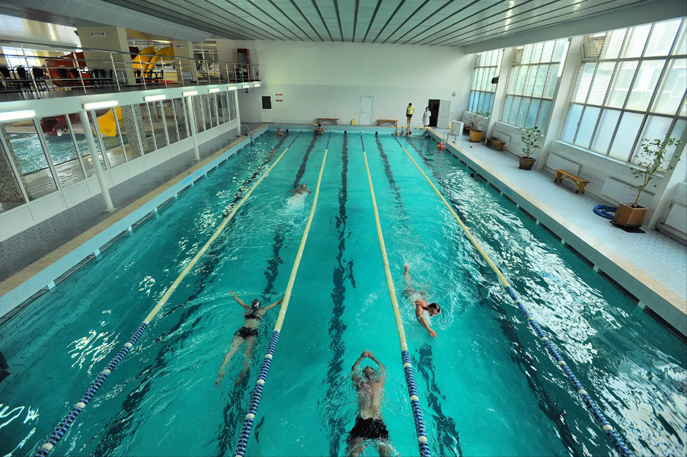
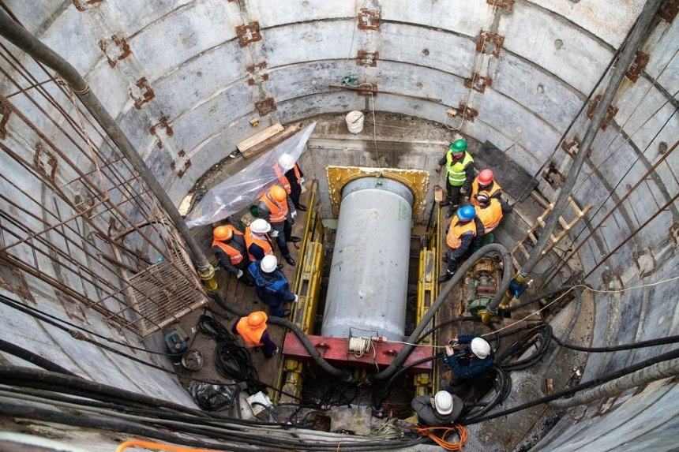
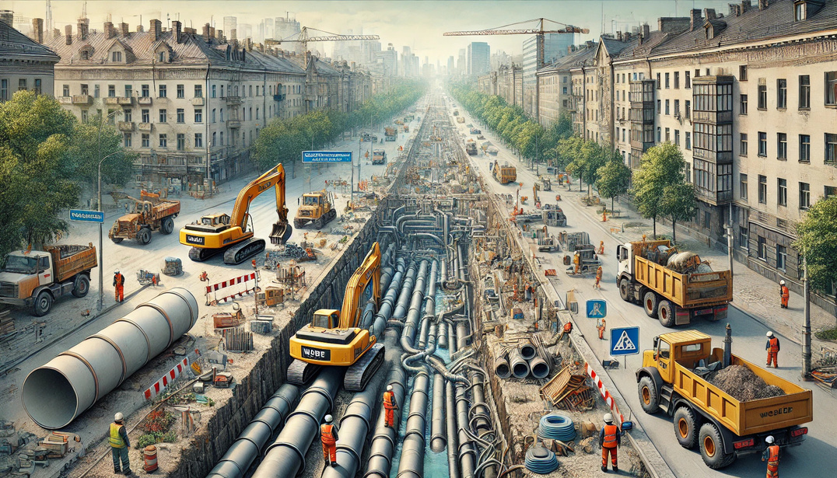


The project of reconstruction of the section of the main sewage collector on Khimikiv Avenue in the city of Cherkasy

Slide 2

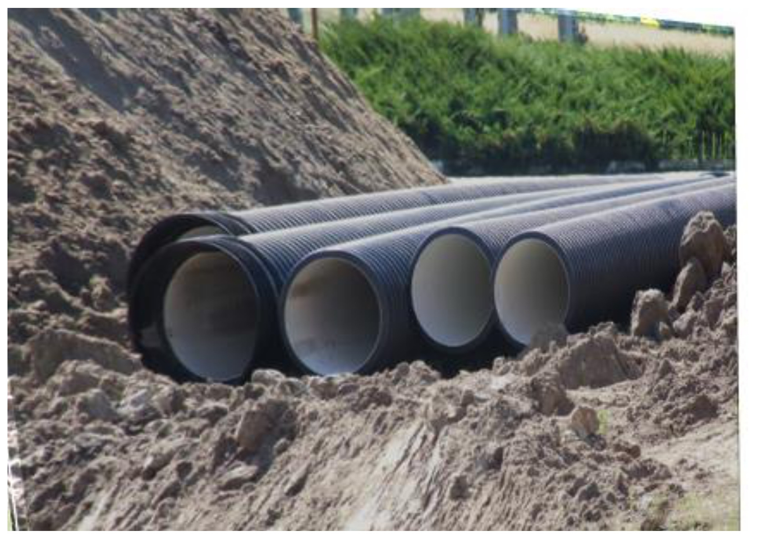





The project of reconstruction of the section of the main sewage collector on Khimikiv Avenue in the city of Cherkasy
The total cost of the project is
≈ 1 064 275 EUR

Slide 3





The projects include the following works:
Social significance of the projects:
reduction risks of pollution of land cover, groundwater of the surrounding natural environment
stable and continuous provision of high-quality centralized water drainage services
269 000 residents of the city will receive high-quality centralized water drainage services
rehabilitation of reinforced concrete pipelines Ø 800, which have exhausted their operational life, with pipelines made of new corrosion-resistant materials
modern equipment
total length of the collector: along Khimikiv Ave. 784.4 running meters

