Slide 1


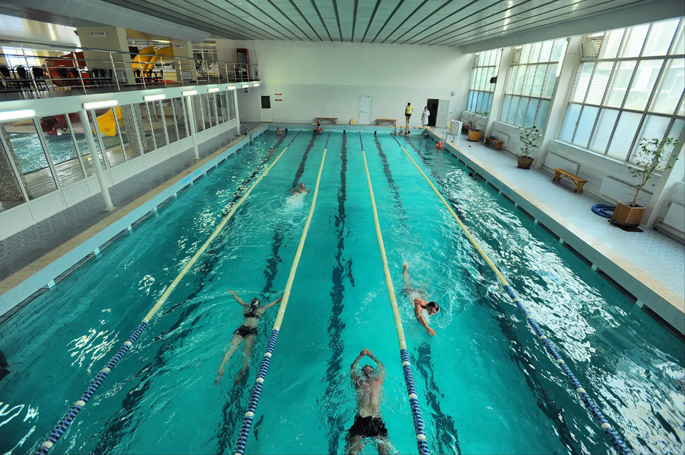
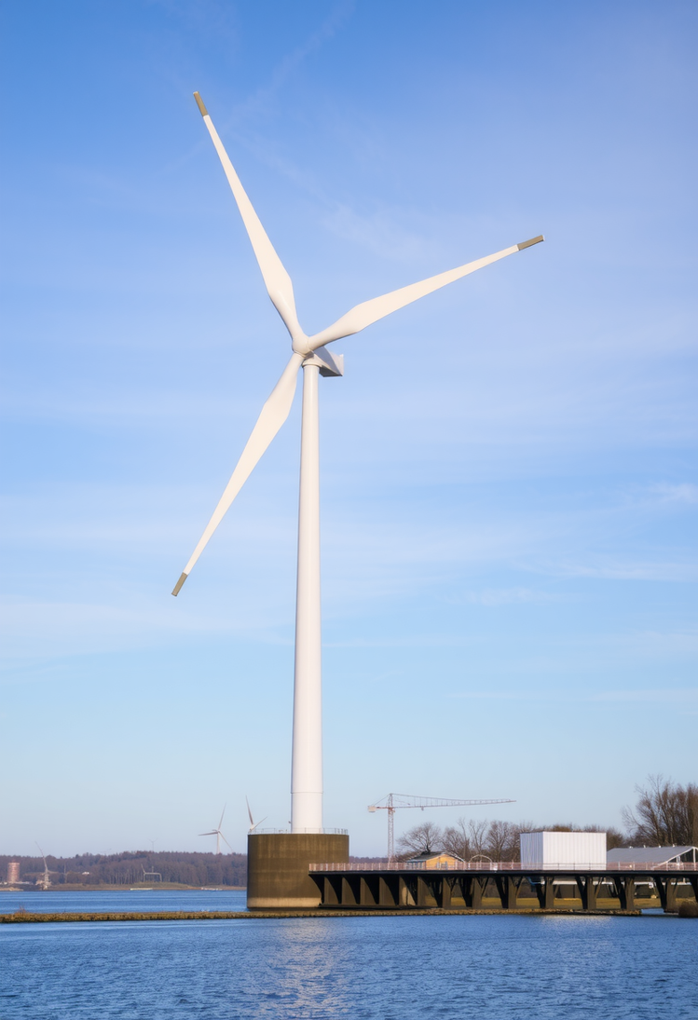


Alternative energy supply for the facilities of Municipal Enterprise "Cherkasyvodokanal"
Wind power plant (WPP) at the Dnipro water treatment plant

Slide 2

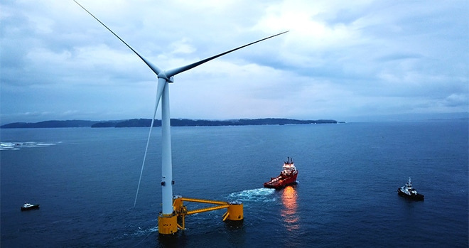
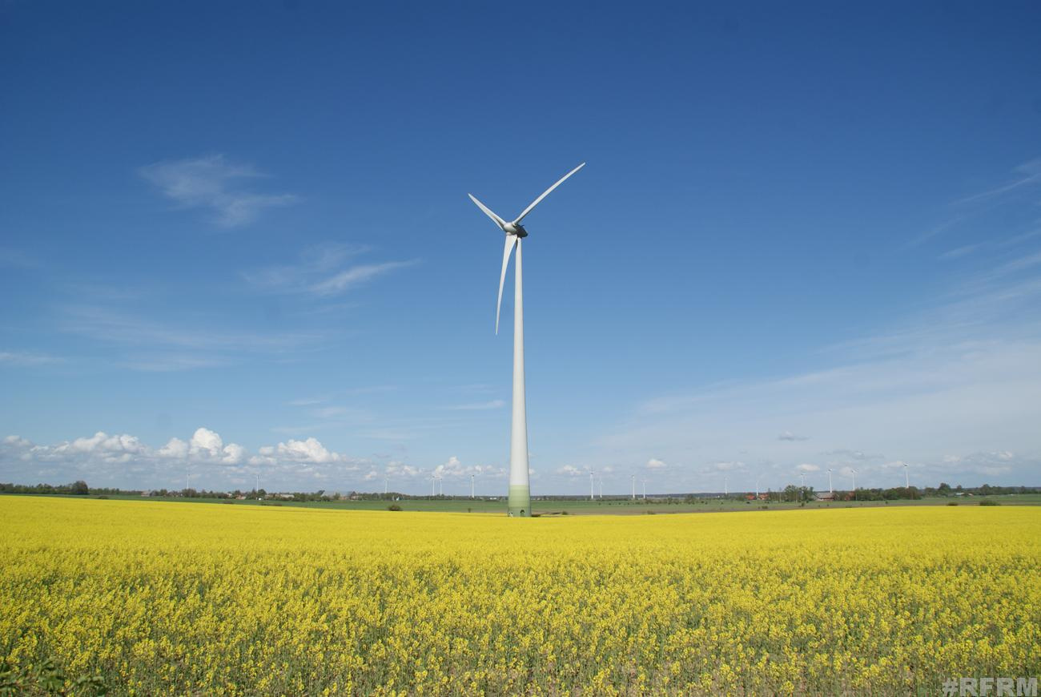




Alternative energy supply for the facilities of Municipal Enterprise "Cherkasyvodokanal"
Construction of a 1MW
wind power plant (WPP) at the Dnipro water treatment plant
The total cost of the project
≈ 2 000 000 EUR

Slide 3







Purchase of a wind power plant and a 1MW container-type cogeneration gas-piston unit for the Dnipro water treatment plant
The projects include the
following works:
Social significance of the projects:
purchase of equipment
installation of equipment
commissioning works of the
wind power plant;
electric capacity of 1MW
provision of 24-hour water supply and drainage for the residents of Cherkasy,
in conditions of war and blackouts
reducing the risks of environmental pollution
269 000 residents of the city will receive high-quality centralized water supply services

