Slide 1


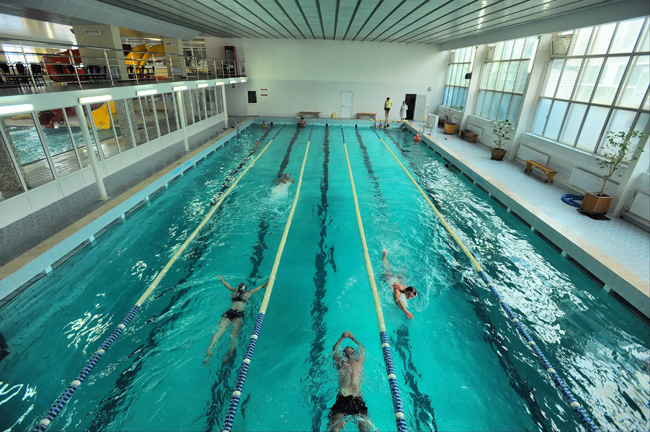
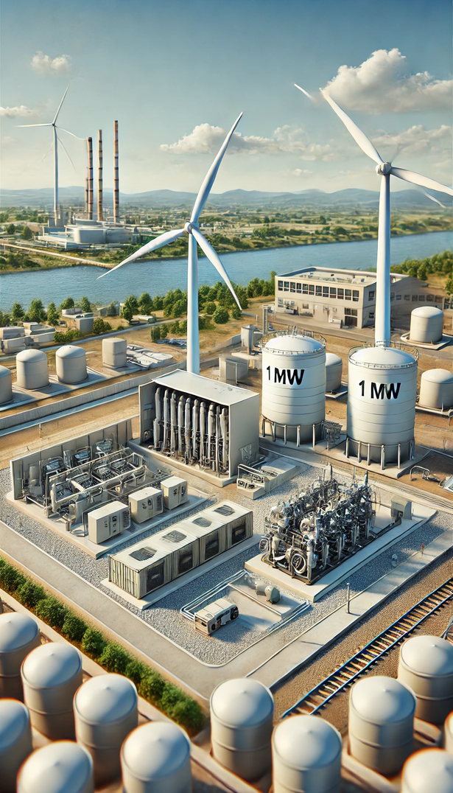


Alternative energy supply for the facilities of Municipal Enterprise "Cherkasyvodokanal"
Container-type cogeneration gas-piston unit for the Dnipro water treatment plant

Slide 2

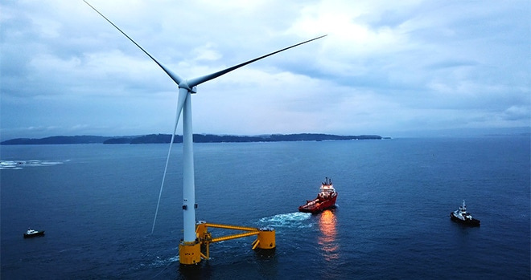
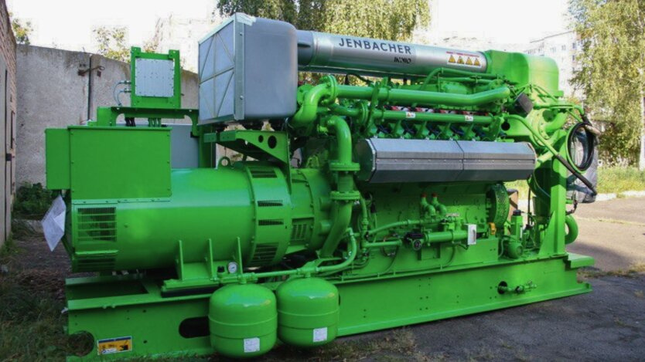




Alternative energy supply for the facilities of Municipal Enterprise "Cherkasyvodokanal"
Purchase of a 1MW
container-type cogeneration gas-piston unit
for the Dnipro water treatment plant
The total cost of the project
≈ 578 894 EUR

Slide 3








Purchase of a wind power plant and a 1MW container-type cogeneration gas-piston unit for the Dnipro water treatment plant
The projects include the
following works:
Social significance of the projects:
provision of 24-hour water supply and drainage to the residents of Cherkasy, in conditions of war and blackouts
reducing the risks of environmental pollution
providing electrical and thermal energy to the facilities of the Dnipro water treatment plant, including during blackouts
269 000 city residents will receive
high-quality centralized water supply
services
purchase of equipment
installation of equipment
commissioning works of the
wind power plant;
electric capacity of 1MW

